Slide 1
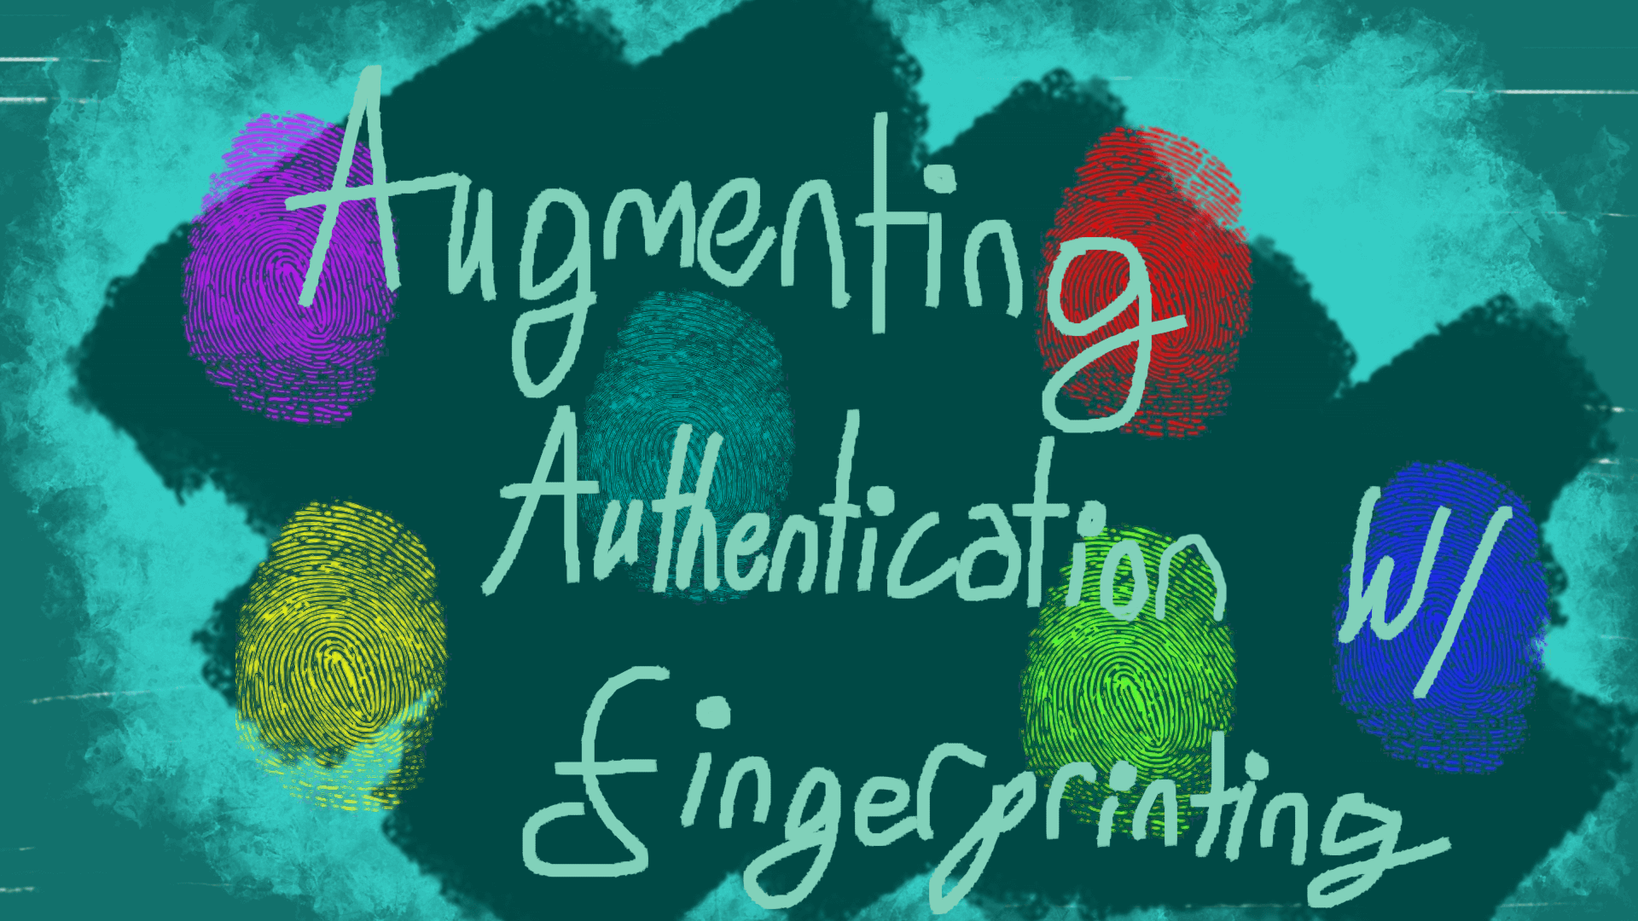

Slide 2
Features Future Plans
Authentication using fingerprints
Email Tokens for login failures
Device creation for valid logins using a token
Device listing and deleting
API endpoints, implementable for any client
More work on our authenticator
More fingerprints
Strong and weak fingerprints
Sets of fingerprints

