Slide 1
Cyber Security in Healthcare and Pharma
Alon Ben-Ari , MD MSc.
CMIO, VA Northern California Healthcare system.

Slide 3
Overview
Review of HHS healthcare tracker
Review IBM’s Cost of Data Breach Report.
Cybersecurity and the main clinical journals.
Change Healthcare cyber attack
Digital transformation by the numbers and what this means.

Slide 4
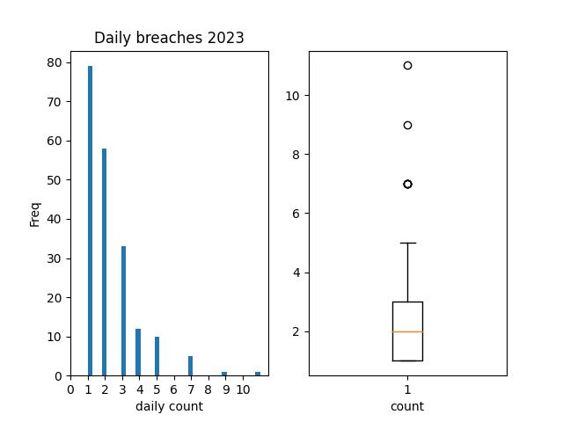
HHS- office of civil right breach tracker (https://ocrportal.hhs.gov/ocr/breach/breach_report.jsf)

Slide 5
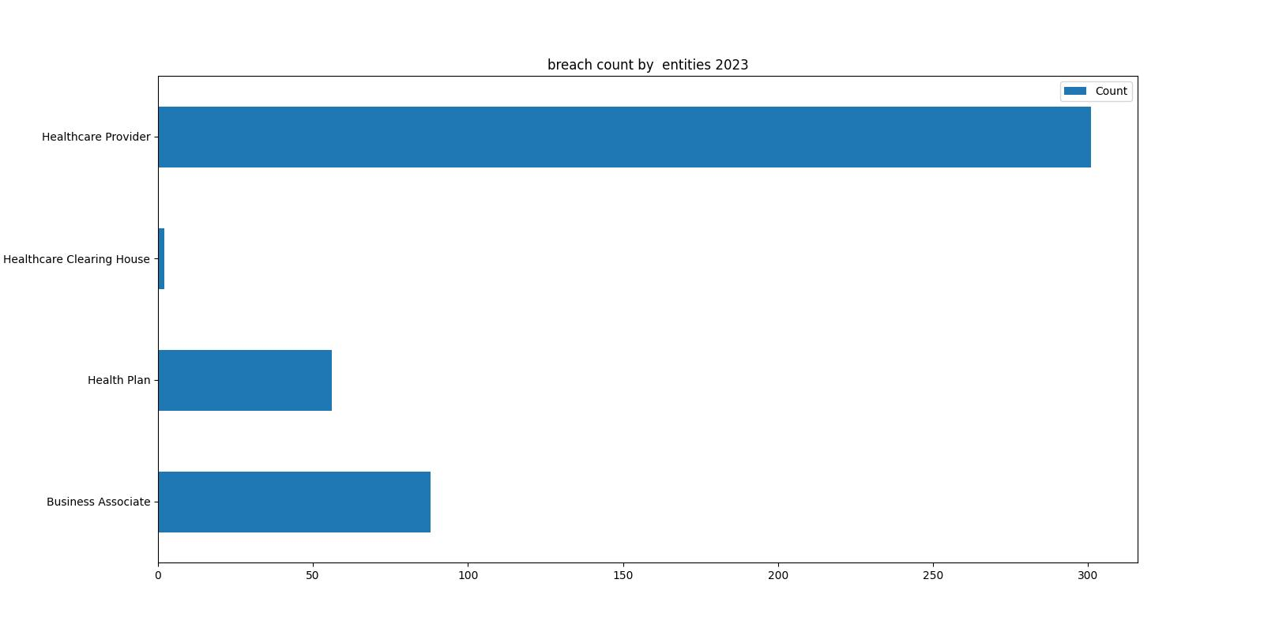
Entities Being Hacked

Slide 6
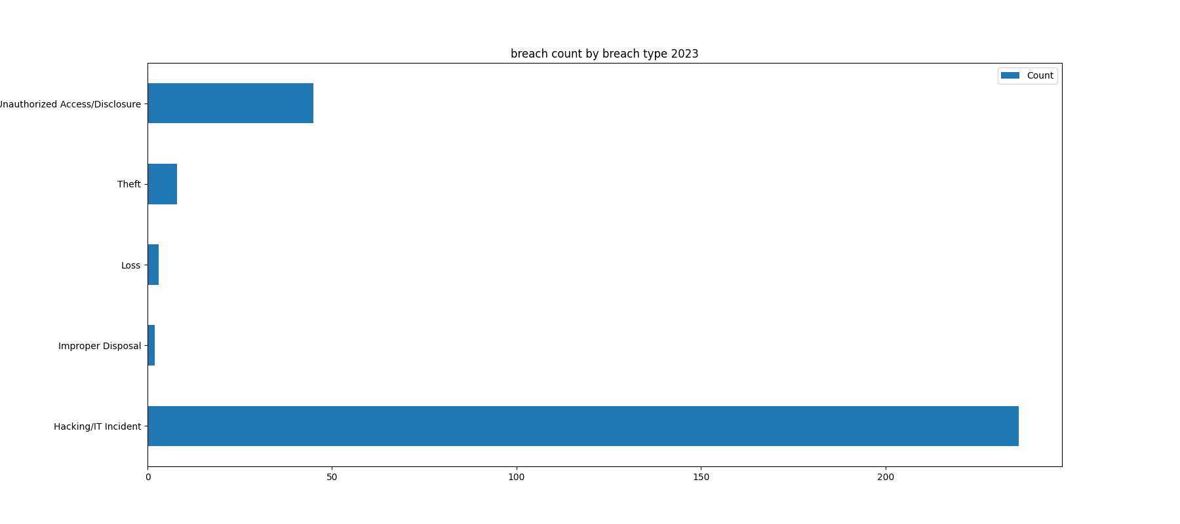
Breach type

Slide 7
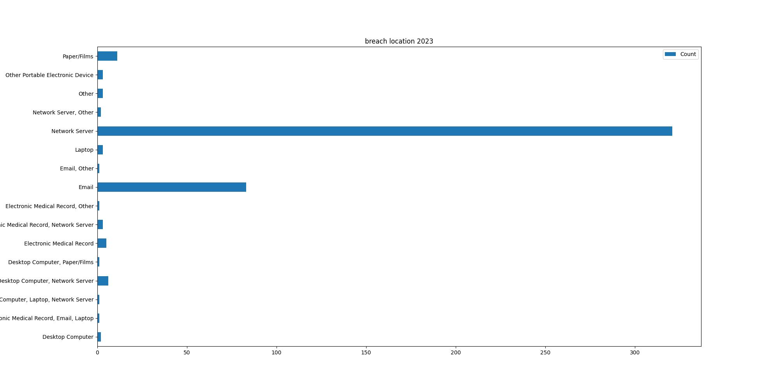
Breach location

Slide 8
IBM’s 2023 cost of data breach report
Average total cost $4.45 million in 2023 – an all-time high for the report and a 15% increase over the last 3 years.
AI and automation had the biggest impact on speed of breach identification and containment for studied organizations
Silence - Ransomware victims in the study that involved law enforcement saved $470,000 in average costs of a breach, shorter by 33 days of expected life cycle.
Costs of Healthcare Breaches Continue to Soar – The average costs of a studied breach in healthcare reached nearly $11 million in 2023 – a 53% price increase since 2020.
51% of organizations are planning to increase security investments

Slide 9
IBM’s DBCR (cont.)
6/10 organization have not implemented Multi-Factor Authentication.
1/3 breaches are discovered by internal teams

Slide 10
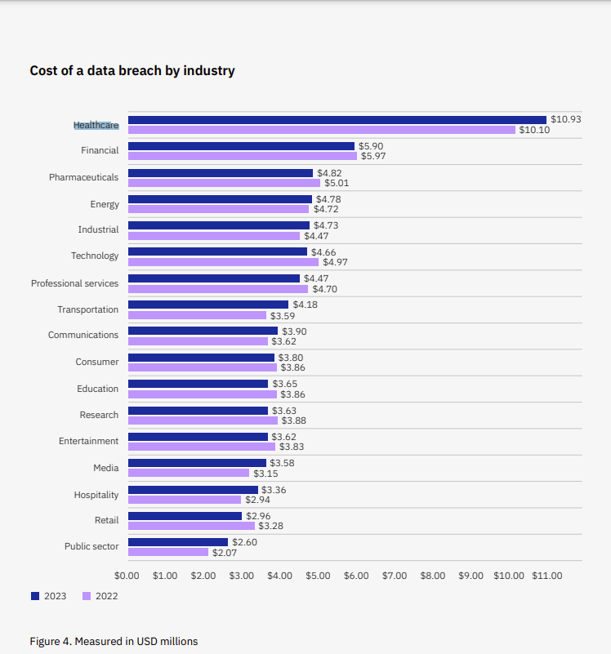
Healthcare is the most expensive breach 13 years in a row.

Slide 11
Cyber in clinical medicine’s publications.
Rates of Cybersecurity on Pubmed. National Library of Medicine
Computer Security MeSh term browser results: 2021:45, 2022:6, 2023:2
Pubmed search “Ransomware”:2024:17, 2023:35,2022:28.
JAMA Netw Open. 2023;6(5):e2312270. “Ransomware Attack Associated With Disruptions at Adjacent Emergency Departments in the US”.

Slide 12
Change Healthcare cyber attack
Feb 21, 2024
Non secure application on a Network server that did not have MFA.

Slide 13
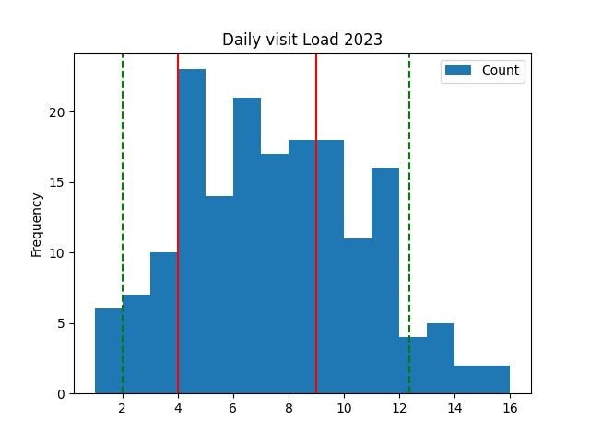
Digital Transformation - by the numbers. VA’s perspective MyHealtheVet (MHV).

Slide 14
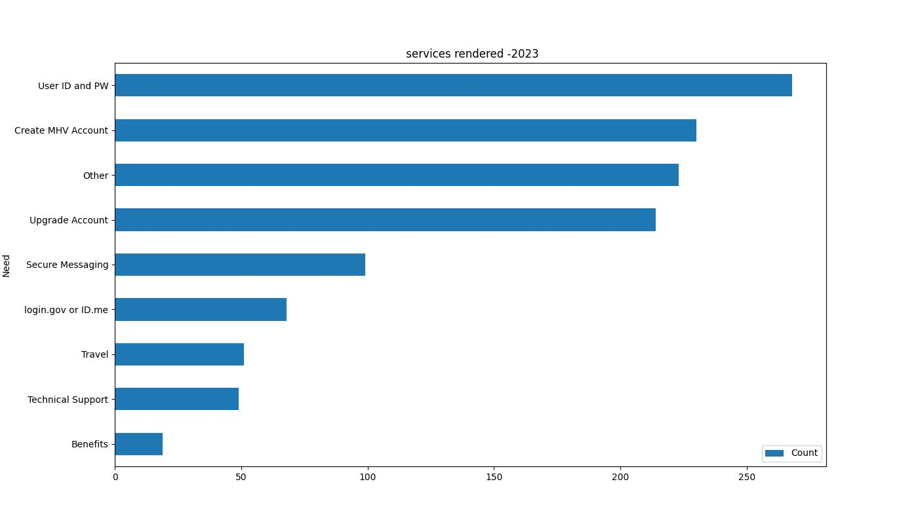
Services Rendered for Veterans by MHV staff.

Slide 15

Cont.

Slide 16
Summary
Human Factor
Under appreciated by the medical community

