Slide 1















Starhub POC Logical Topo
VIO-API
VLAN 300
VCD-API
VLAN 200
VMware Integrated
OpenStack (VIO)
vCloud Director
(vCD)
NFVO/VNFM
Brocade SDN
Controller
vROPS
Log-Insight
EMC VIPR
3rd party VNFM
3rd party Mgmt VMs
SQL
(10.0.5.21)
vCenter Server
10.0.1.50
NSX Manager
10.0.1.60
vCenter Server
10.0.1.51
NSX Manager
10.0.1.61
AD/DNS/NTP
(10.0.1.20)
Mgmt-5 Vlan 105
10.0.5.0/24
192.168.102.0/24
(For mgmt. & VIO)
(For VCD)
External network
Jump box
Mgmt-1 Vlan 101
10.0.1.0/24
Management Cluster
VIO Compute Cluster
VIO Edge Cluster
VCD Resource Cluster
VCS
Fabric
vMotion: VLAN 102 (10.0.2.0/24)
ScaleIO-transport VLAN 103 (10.0.3.0/24)
vxlan-transport VLAN 104 (10.0.4.0/24)
VIO-External-01_VLAN301
External VLAN 3xxx
(Existing VLANs)
VCD-External-01_VLAN201
Leaf Switches
(Hardware VTEP enabled)
Legacy hardware appliance
which cannot be virtualized
Tenant-A
Tenant-B
Tenant-Y

Slide 2
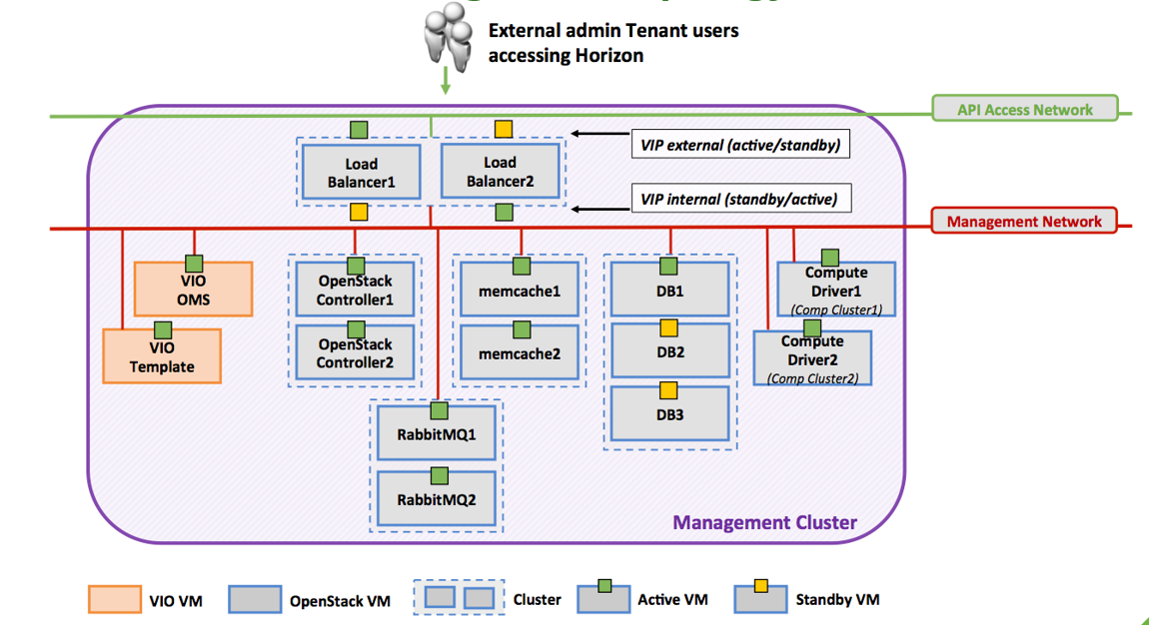
VIO Setup
Other Info:
Nova vCenter: 10.0.1.50
Neutron NSX mgr: 10.0.1.60
LDAP/DNS/NTP: 10.0.1.20
External network: VIO-External-01_VLAN301 (10.1.101.0/24)
VIO-External-01_VLAN302 (10.1.102.0/24)
API Entry Point:
Vio.shdemo.local
10.2.0.10
Username: nfv-admin@shdemo.local
Password: VMware1!
VIOAPI_VLAN 300
10.2.0.0/24
.11
.12
Mgmt-02_VLAN 105
10.0.5.0/24
.83
.84
.70
.77
.81
.74
.78
.82
.75
.76
.86
.79
.80

Slide 3
Modification and assignment of Service Template
Create Network Service Template consisting of Network Functions - Create Network Service A – 1 x Server, 1 x FW - Create Network Service B – 2 x Servers, 2 x FW - Create Network Service C – 2 x Servers, 2 x FW, 1 x LB - Create Network Service D - 1 x Server, 1 x FW
Modify Network Service Template to add or remove Network Functions - Modify Network Service A – Add 1 x Server, 1 x FW - Modify Network Service B – Remove 1 x FW - Modify Network Service D – Add 1 x LB
Delete Network Service Template to add or remove Network Functions - Delete Network Service D
Assignment of service to 1 or more tenants - Assign Network Service A – Tenant A,B &C - Assign Network Service B – Tenant A&B - Assign Network Service C – Tenant C
Add 1 x Server,
1 x FW
Remove 1 x FW
Service Template A:
Service Template B:
Remove 1 x FW
Service Template C:
Service Template D:
 | Tenant A | Tenant B | Tenant C
Service Template | A | A, B | A, C
IP range (mgmt.) | 172.1.1.0/24 | 172.1.2.0/24 | 172.1.3.0/24 172.1.4.0/24
IP range (VNF) | 10.1.1.0/24 | 10.2.2.0/24 | 10.3.3.0/24

Slide 4
Service Deployment & Modification
Service
VCS
Fabric
Cloudify-private-Net
10.60.0.0/16
VIO-External-01_VLAN301
10.2.101.0/24
VIO-Provider-02_VLAN302
Service Creation for Tenants. - Tenant A – Network Service A ( Chain Server 1 – FW 1 – External Network ) ( Chain Server 2 – FW 2 – External Network ) - Tenant B – Network Service B ( Chain Server 1 – FW 1 – Server 2 ) - Tenant C – Network Service C ( Chain Server 1 – FW 1 – LB1 – External Network) ( Chain Server 2 – FW 2 – LB1 – External Network)
Modify the VNF configuration using the management IP Assigned - Tenant A – Access the FW1 & 2 to add rules - Tenant C – Access FW 1 & FW 2 to add rules Access LB1
Service modification for Tenants - Tenant A – Add LB ( Chain Server 1 – FW 1 – LB1 - External Network ) - Tenant B – Add FW 2 ( Chain Server 1 – FW 1 ) ( Chain Server 2 – FW2 )
10.2.102.0/24
113
vyatta-vio-tenantb-r01
1
vyatta-vio-tenantc-r01
Tenant-a-network01
172.1.1.0/24
Tenant-b-network01
172.1.2.0/24
Tenant-c-network01
172.1.3.0/24
Tenant-c-network02
172.1.4.0/24
Michael-test-VM
172.1.3.103/24
Tenant-a:
Tenant-b:
Tenant-c:
Notes:
Vyatta vrouter does not support OOB interface. All management are through in-line

Slide 5
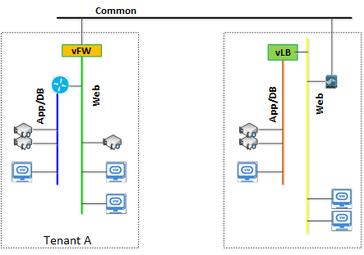
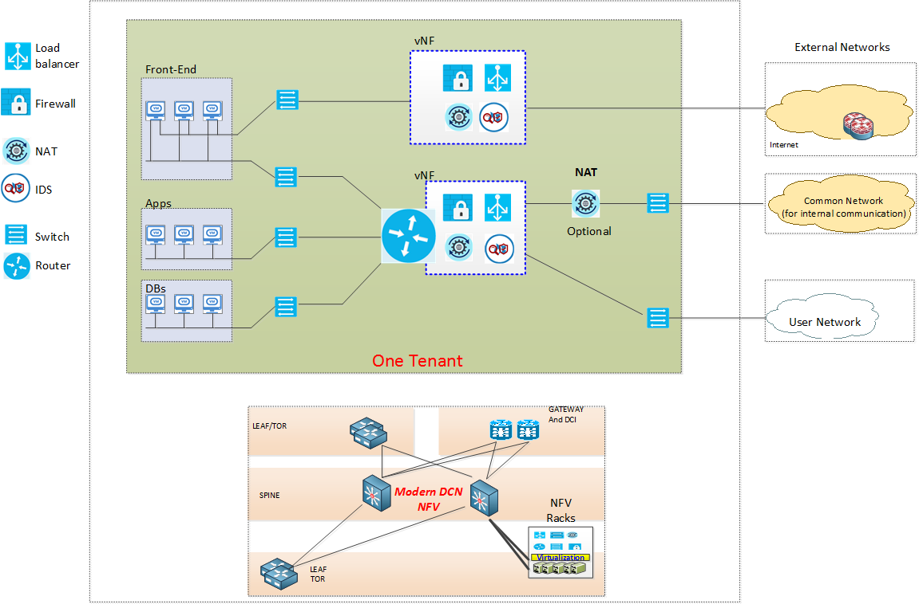
Targeted Setup (Starhub Tech. Spec.)
Inter-Tenant
Intra-Tenant

Slide 6
Modification and assignment of Service Template
Create Network Service Template consisting of Network Functions - Create Network Service A – 1 x Server, 1 x FW - Create Network Service B – 2 x Servers, 2 x FW - Create Network Service C – 2 x Servers, 2 x FW, 1 x LB - Create Network Service D - 1 x Server, 1 x FW
Modify Network Service Template to add or remove Network Functions - Modify Network Service A – Add 1 x Server, 1 x FW - Modify Network Service B – Remove 1 x FW - Modify Network Service D – Add 1 x LB
Delete Network Service Template to add or remove Network Functions - Delete Network Service D
Assignment of service to 1 or more tenants - Assign Network Service A – Tenant A,B &C - Assign Network Service B – Tenant A&B - Assign Network Service C – Tenant C
Add 1 x Server,
1 x FW
Remove 1 x FW
Service Template A:
Service Template B:
Back up slides
Add 1 x SLB
Service Template C:
Service Template D:
 | Tenant A | Tenant B | Tenant C
Service Template | A | A, B | A, C
IP range (mgmt.) | 172.1.1.0/24 | 172.1.2.0/24 | 172.1.3.0/24 172.1.4.0/24
IP range (VNF) | 10.1.1.0/24 | 10.2.2.0/24 | 10.3.3.0/24

