Slide 1


Slide 2
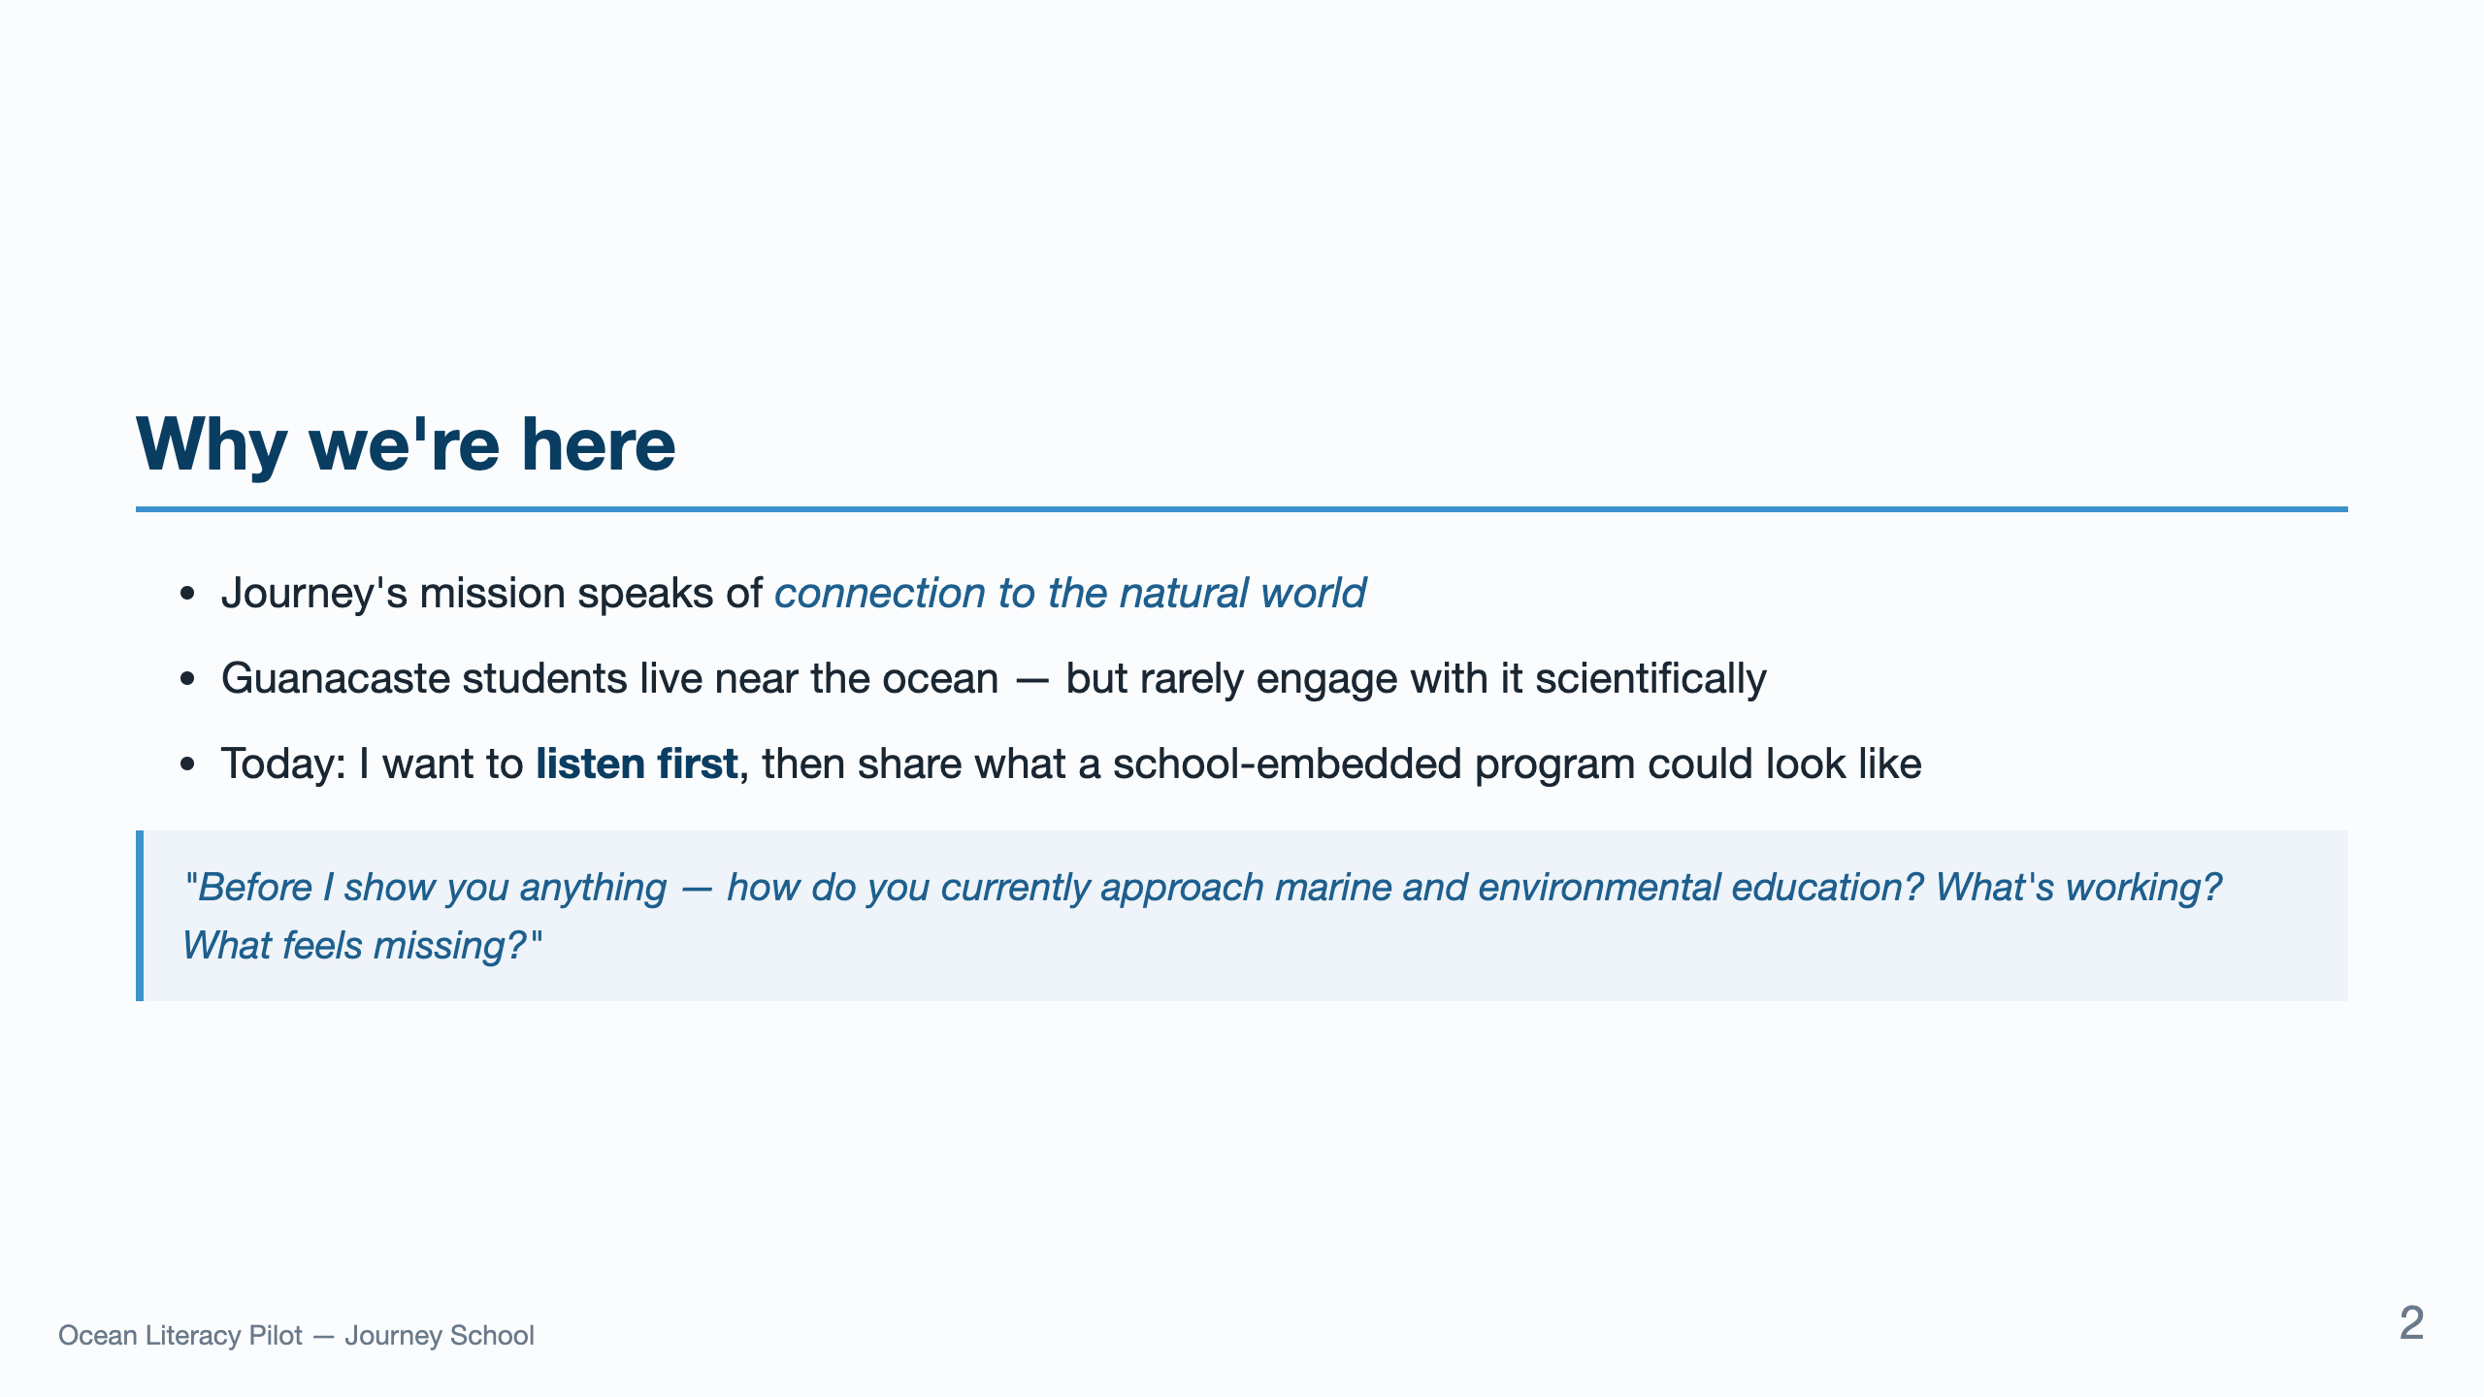
Notes:
Open by listening. Don't present until they answer. The deck is a frame for the conversation, not a script. Section 4 of the prep doc has 5 opening questions in Spanish.

Slide 3
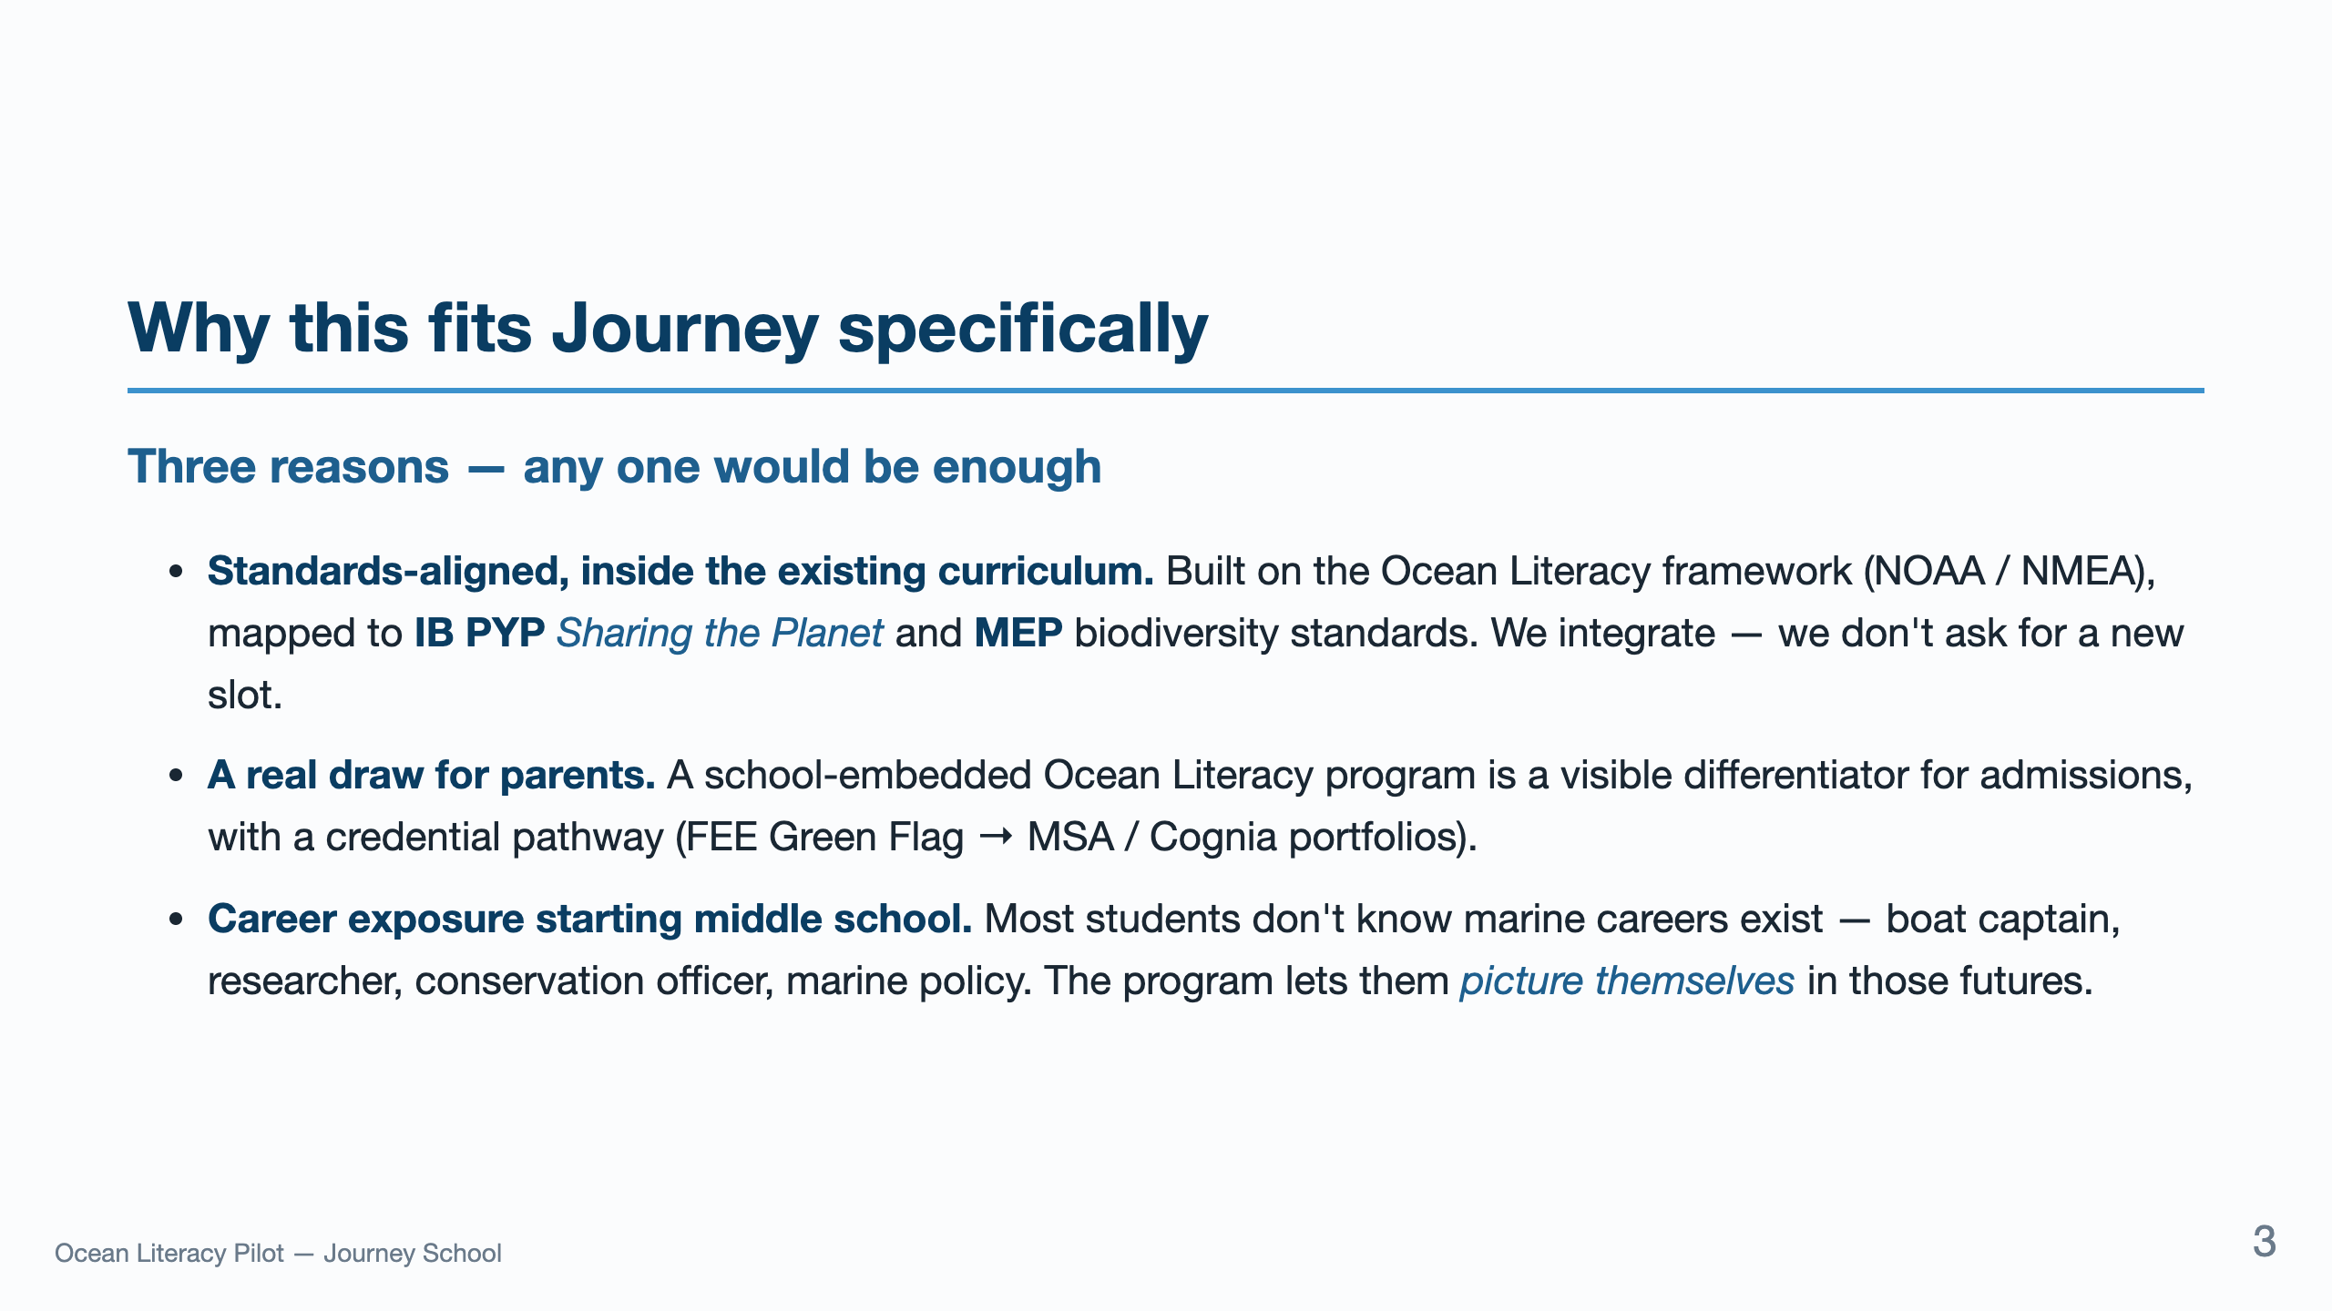
Notes:
This is the heart of the pitch. Don't rush it. Each bullet stands alone — pause between them. The third one is what parents respond to most: it's about the kids' future, not the school's brand.

Slide 4
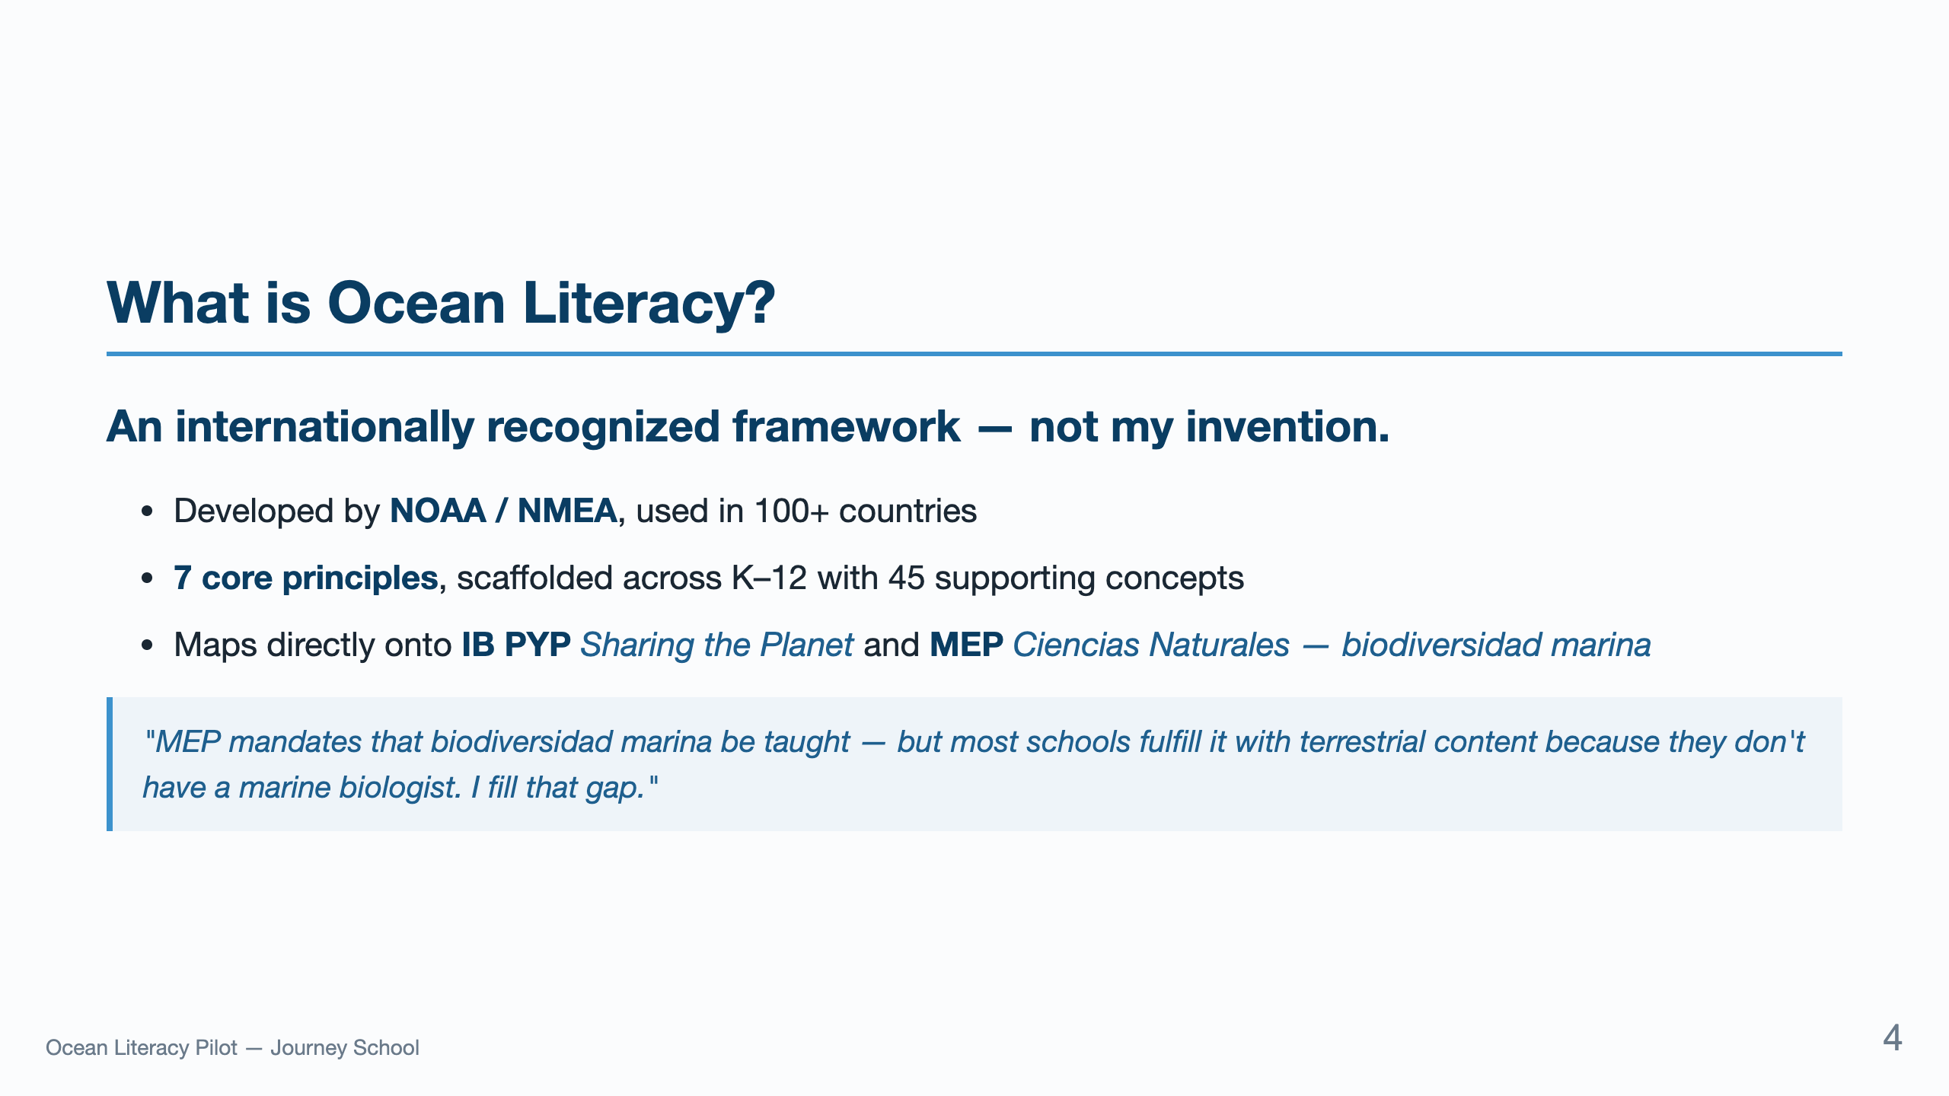
Notes:
Drop this if accreditation comes up. The MEP angle is your strongest credibility move with the pedagogical managers — they know the gap exists.

Slide 5
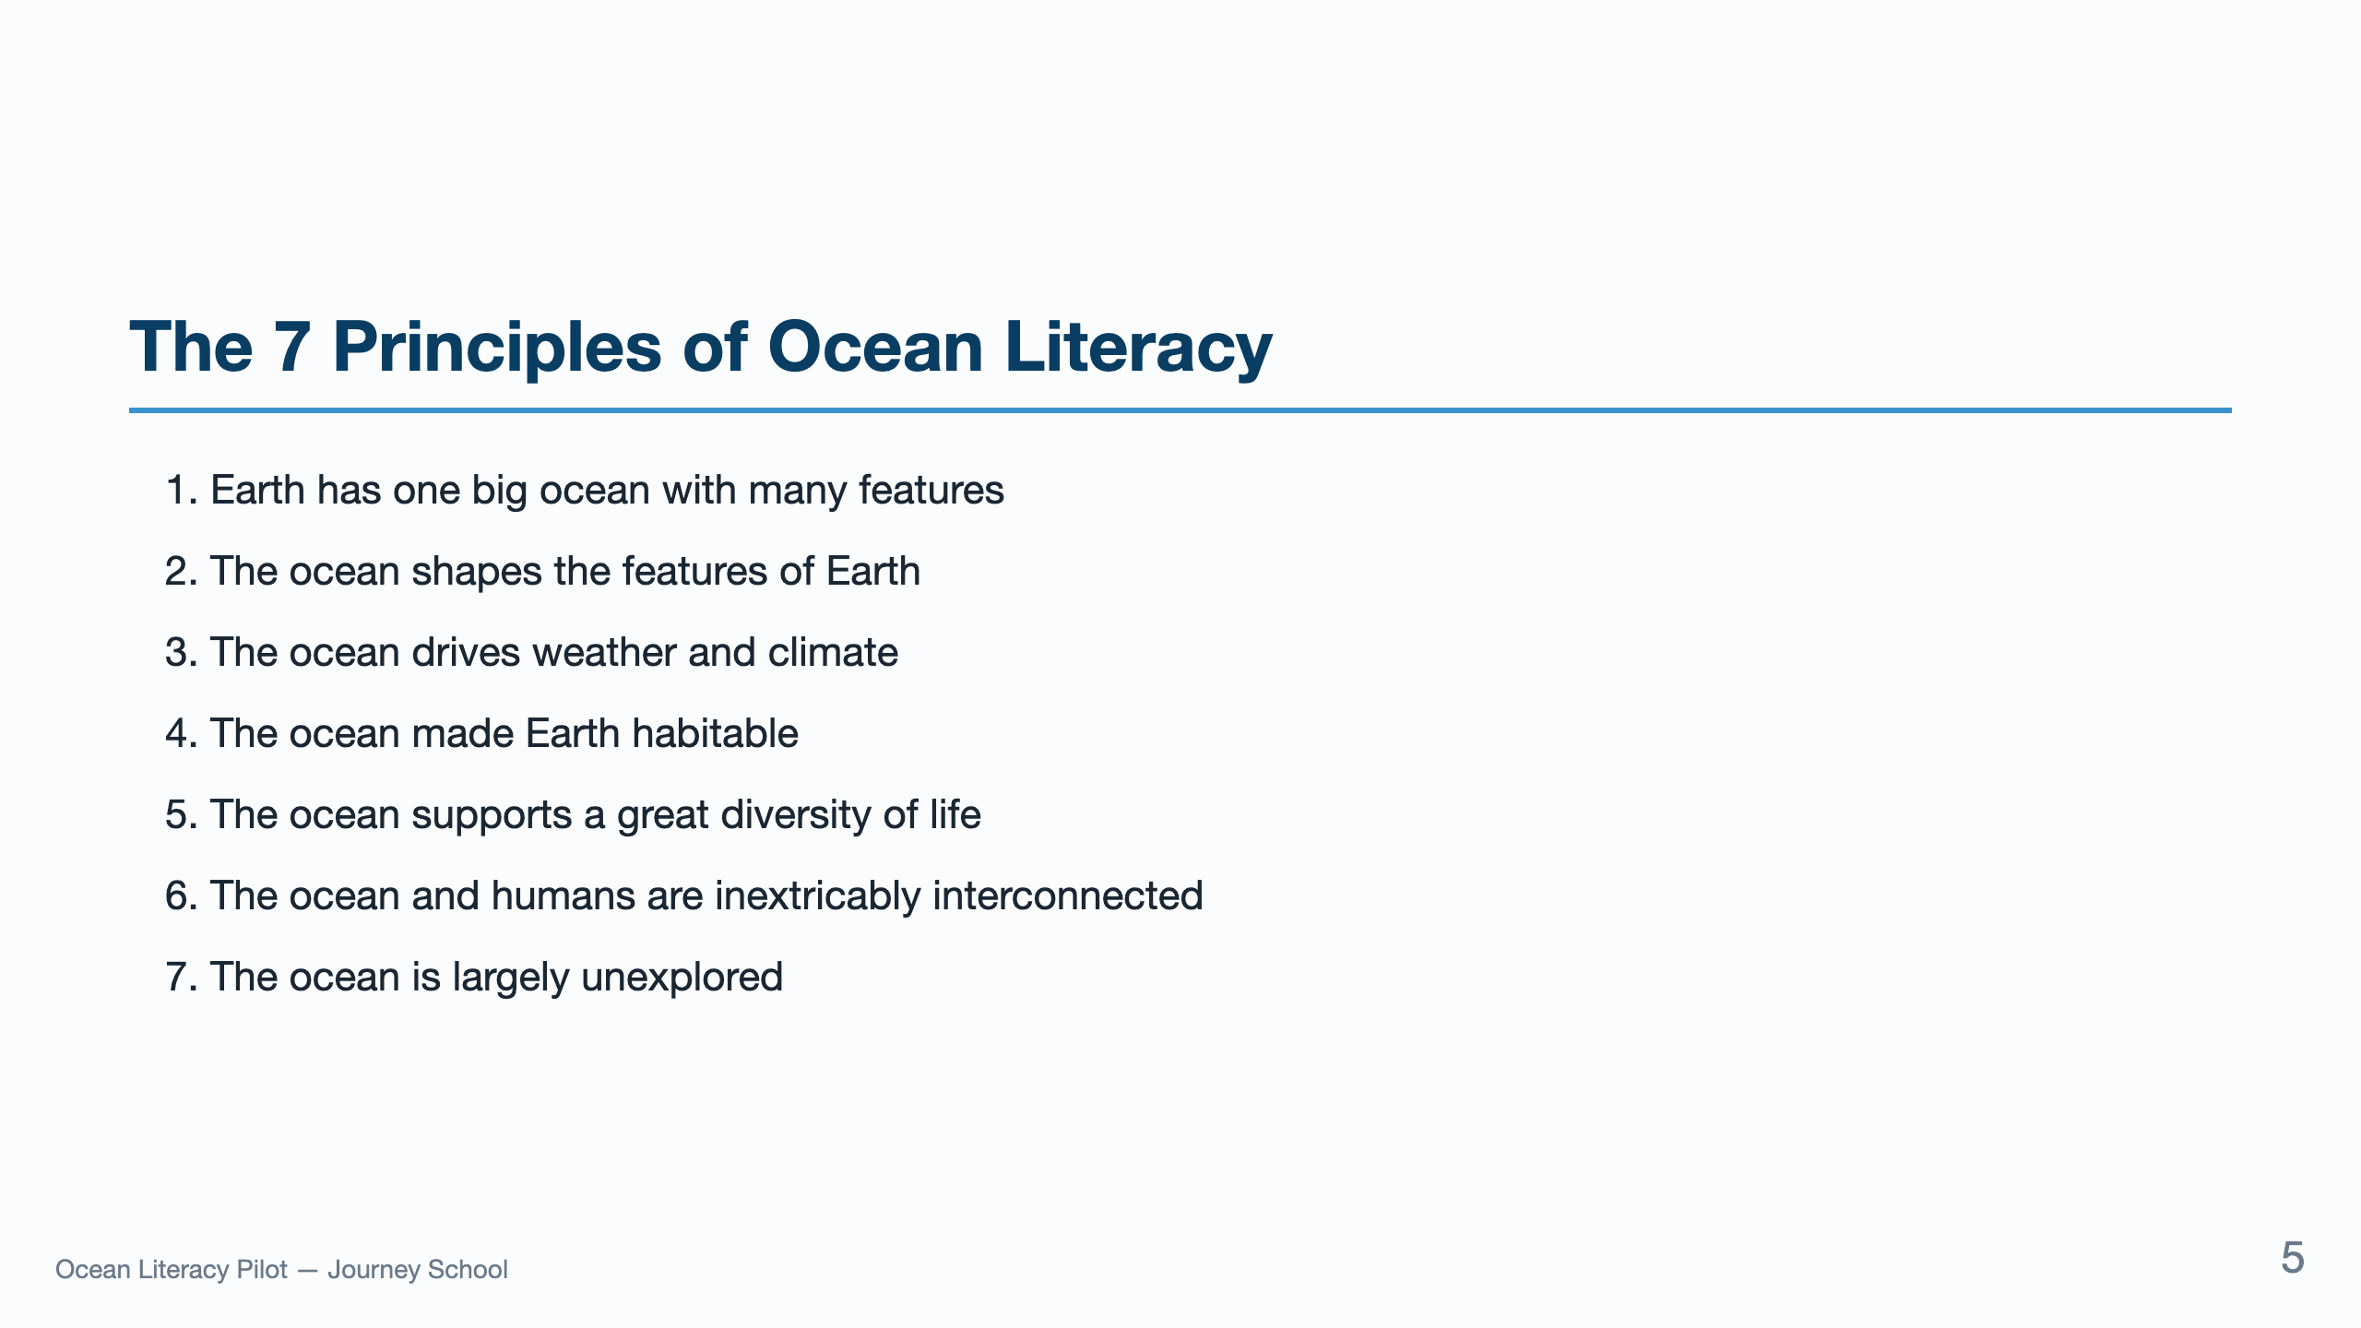
Notes:
Don't read all seven aloud. Point to the slide and say: "These are the seven principles. The framework gives us 45 supporting concepts and a K-12 scope and sequence — we don't have to build that from scratch." Move on.

Slide 6
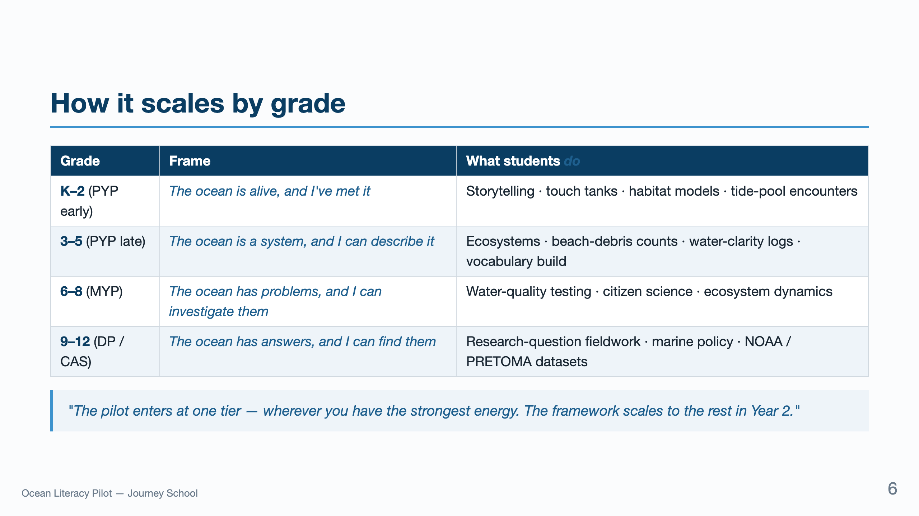
Notes:
The italic phrases are what each child walks away with. Read those out loud, slowly, when you walk through the table — they land emotionally with the principal.

Slide 7
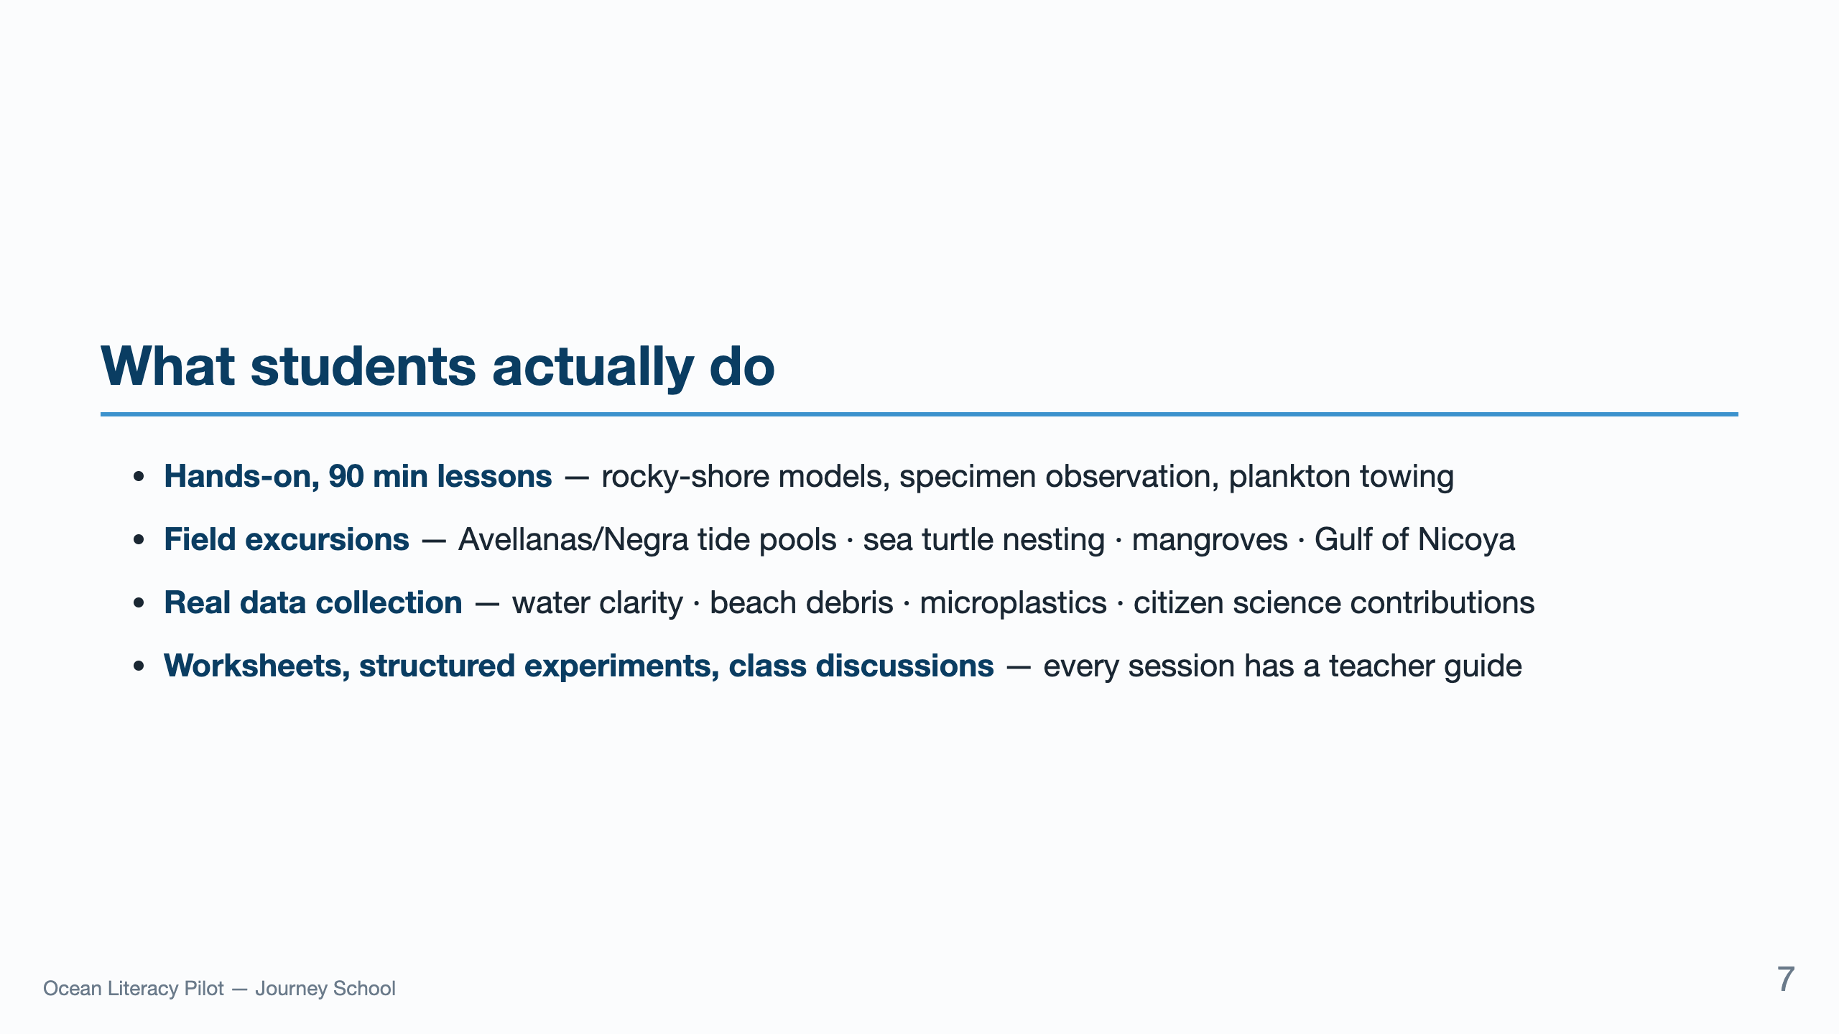
Notes:
Lead with hands-on. The field excursions slide is where the principal leans forward. Don't undersell: students contribute to actual NOAA-monitored datasets.

Slide 8
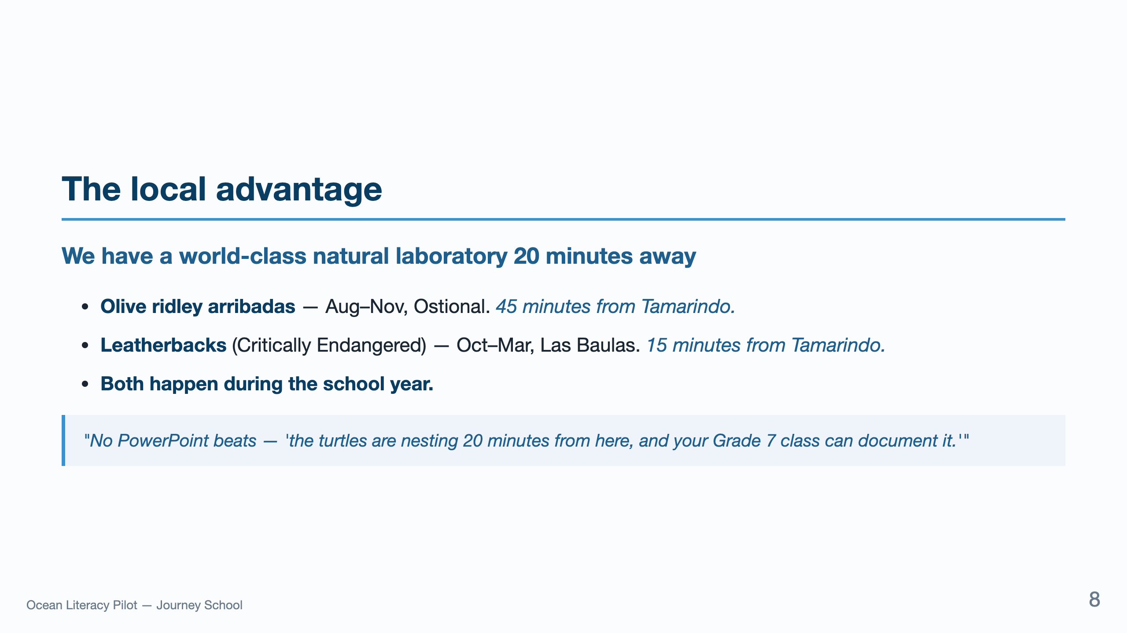
Notes:
Drop this image when the conversation lulls. It's the single strongest concrete asset you have. Don't use a slide for it — say it.

Slide 9
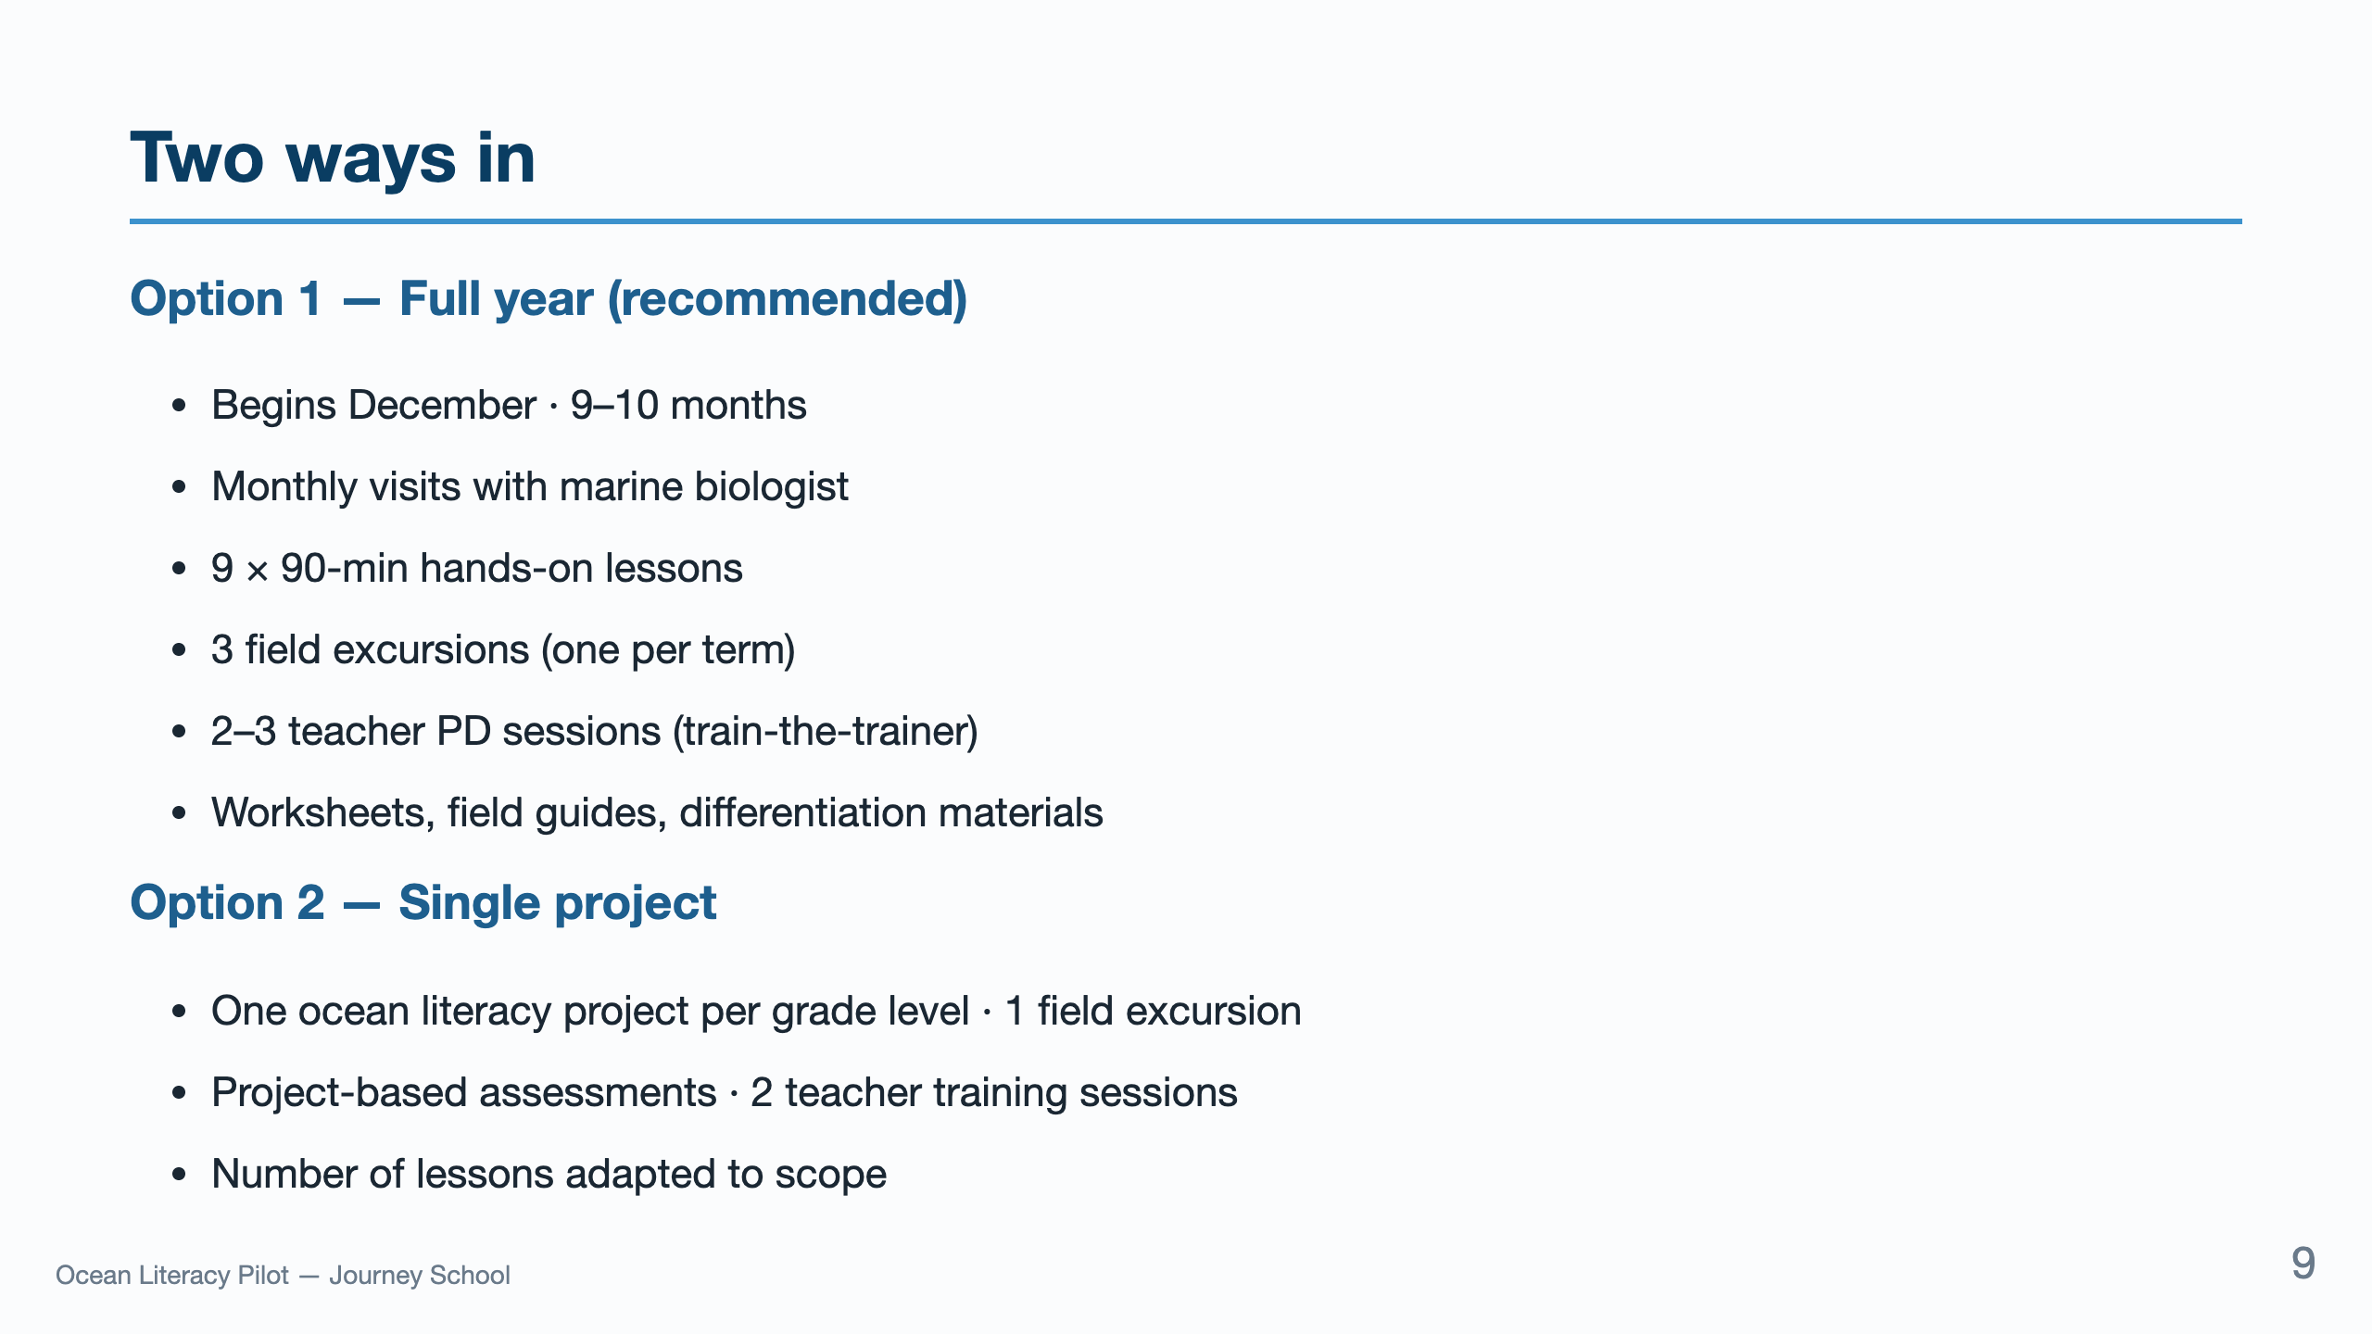
Notes:
Don't ask them to choose in the room. Frame it as: "Both come with curriculum, materials, and a measured outcome. Option 2 can also be a pilot that graduates to Option 1 in Year 2."

Slide 10
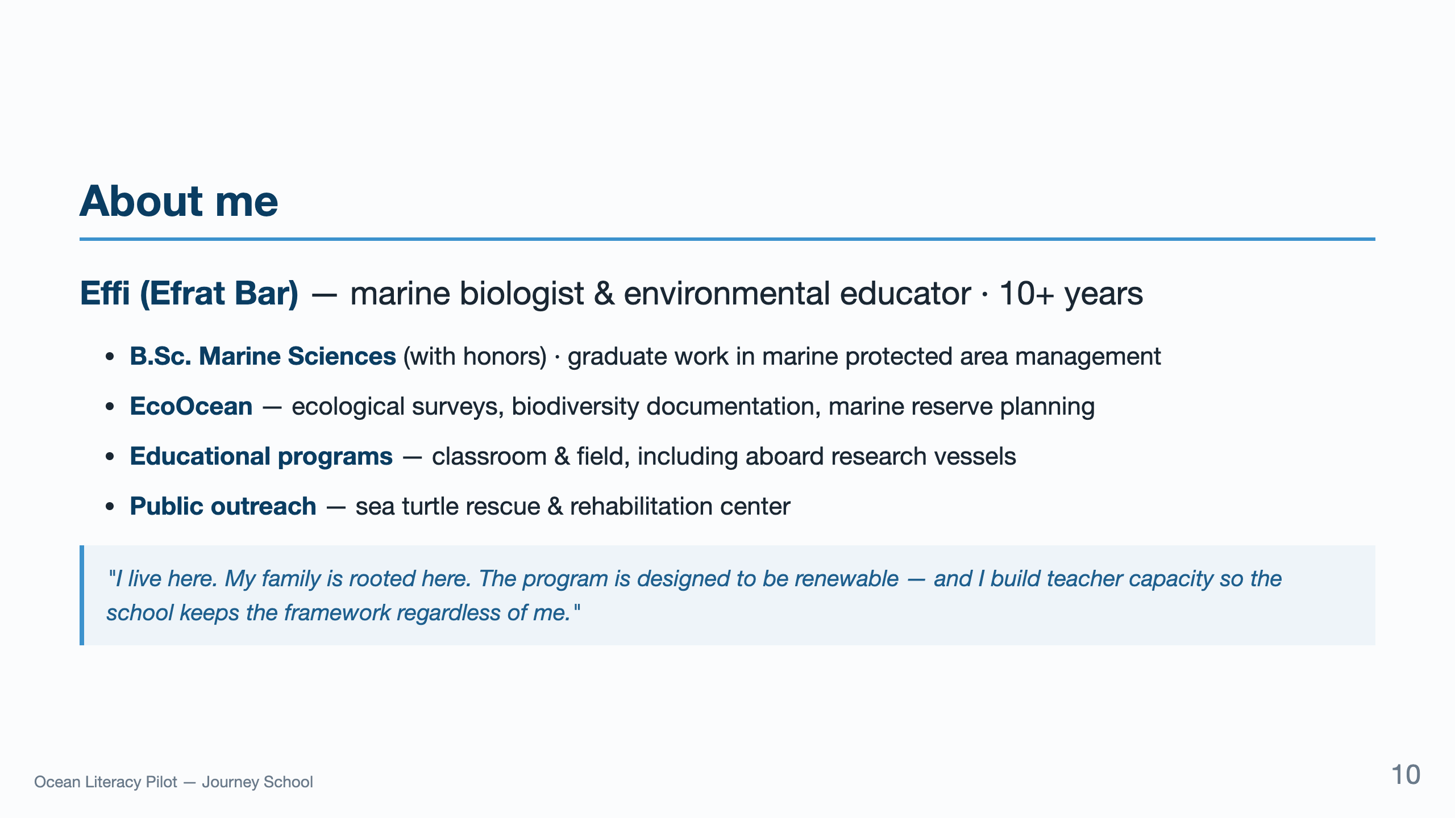
Notes:
The last quote is the preempt for "how do we know you'll be here Year 2?" Drop it before they ask.

Slide 11
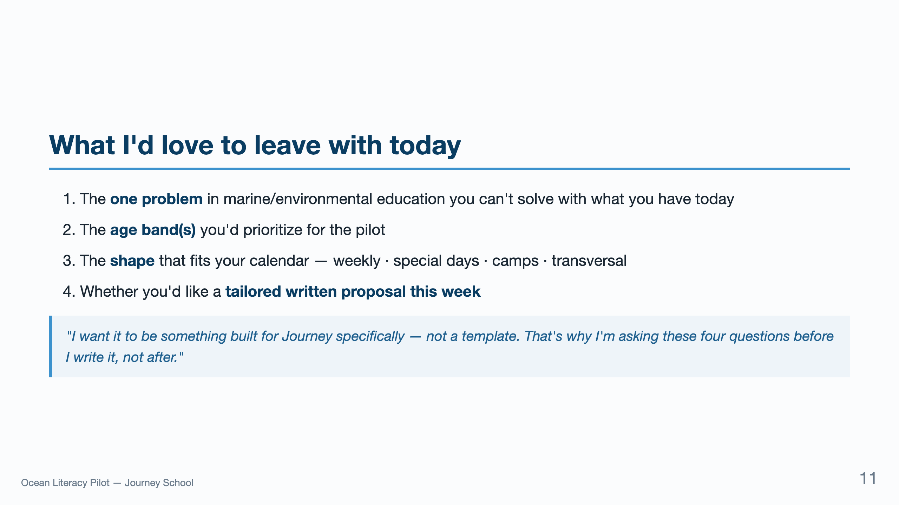
Notes:
This is the close. Don't ask for the sale. Ask for the four pieces of information that let you build the proposal that wins it.

Slide 12
