Slide 1
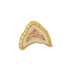
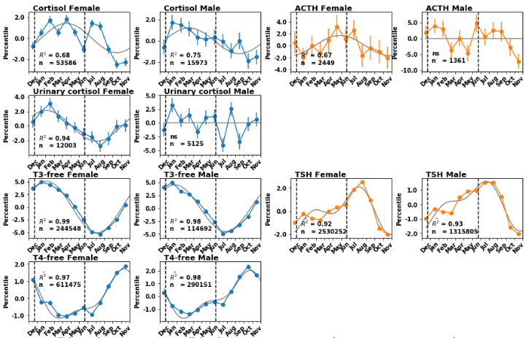
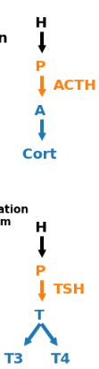
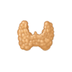
A
Stress adaptation
Adrenal cortex
B
Thermoregulation
& Metabolism
Thyroid

Slide 2
A
Adrenal cortex
Cortisol
Stress adaptation
B
Thyroid
T3/T4
Thermoregulation
Metabolism

