Slide 1
Intricate Developers APPLICATIONS DEVELOPMENT- TRAVEL EXPERTS
Alonso Suarez
MB Camacho
Mehmet Demirci
Kaseem Farayola

Slide 2
Aims and Objectives
User friendly desktop and website applications
Present developed applications
Easy to navigate Graphical User Interface
Add value to Travel Experts Business
Align with Travel Experts Policies and Requirements

Slide 3
Scope
Build applications components using Oracle Technologies:
Packages Maintenance
Agents Maintenance
Customers Details
Suppliers Maintenance
Product Maintenance
Customer Login

Slide 4

Our Focus
To manage relationships with our client for
sustainability
To apply our expertise in order to support customers retention efforts of our client

Slide 5
Applications Development
Java for Desktop Applications Development
Java/JSP for Website Development
Both Desktop Applications and Websites provide User friendly GUI
Employees can view and modify data
Customers can register and log in

Slide 6
Oracle Technology using Java
Java Development Eclipse Environment
Forms Application. Console Application.
.NET has one platform and many languages
Java has one language and many platforms
Java and JSP using Eclipse, NetBeans and Intellij IDEA
Java use class library in reusable components

Slide 7
Oracle Technology using Java
Eclipse Java EE
Designer and Palette
Code Window
Properties Window
Project/Package Explorer
Database Development and Connectivity

Slide 8
Implementations- Object Oriented Programming
Classes, Interfaces, Abstract
Encapsulation, Inheritance and Polymorphism
Junit Testing
Model View Controller

Slide 9
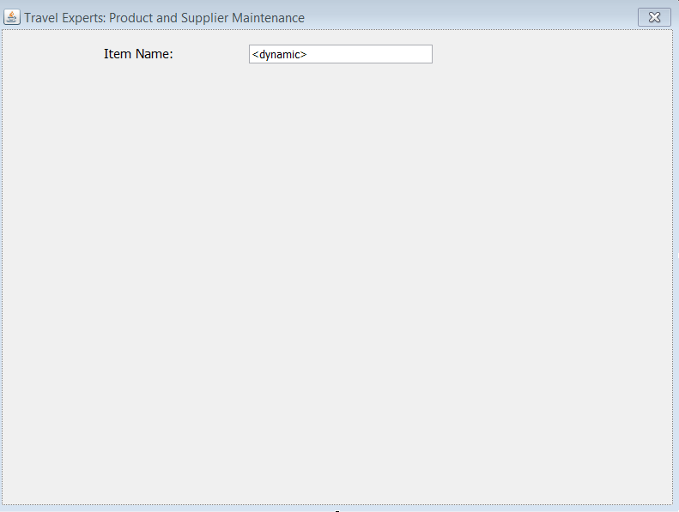
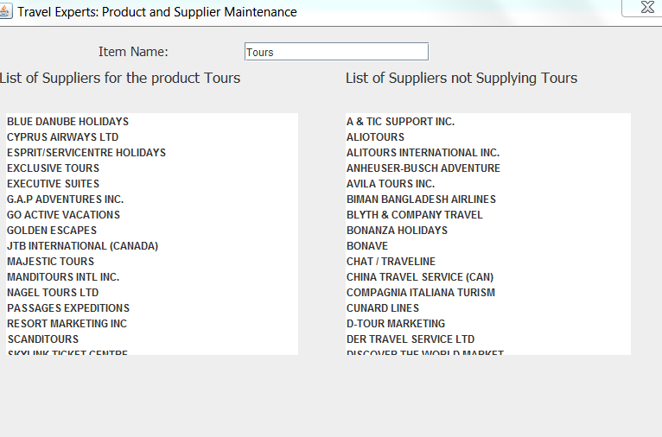
VIEW

Slide 10
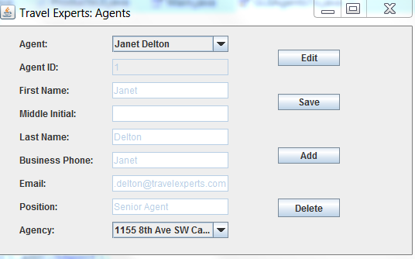
Agents Form
Employee can search using Agent Name
Application pull search results from DB
Agent details can be modified as appropriate

Slide 11
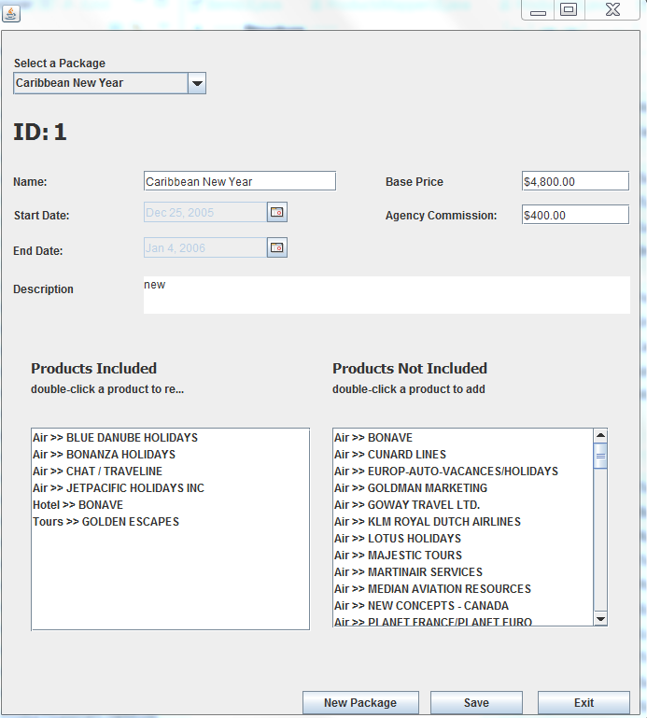
Java and Eclipse – Package Manager
Employee can search using Package ID
Application pull search results from DB
Employee can add, edit and delete package

Slide 12
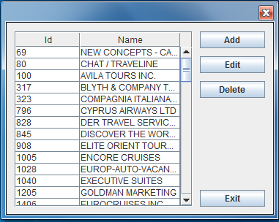
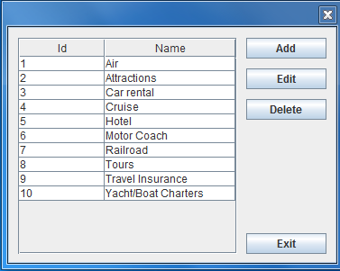
Supplier and Product Records
Employee modifies data
Select Product or Supplier
Link to the Supplier Product View page

Slide 13

Applications Demo

Slide 14
Travel Experts- Website
Customer can display/update Account Information
JSP- Java Server Pages used with MySQL Database
Dynamic Web Pages using AJAX and JQuery
Customer Authentication

Slide 15
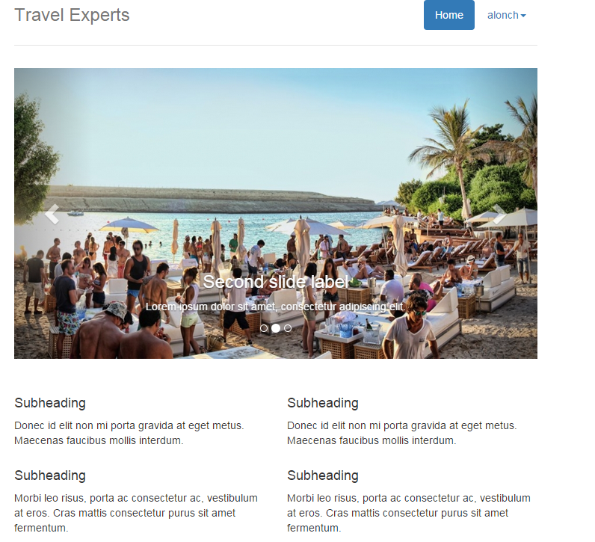
Travel Experts Website

Slide 16
Travel Experts Website Demo

Slide 17
Conclusions
The Java and Eclipse Platform Framework have successfully been used to build functional applications
Eclipse as a software development tool has been employed to build powerful, high-performance applications
Our group will continue to add value to Travel Expert business through functional applications and support

Slide 18
Thank you so much! Questions

