Slide 1

Advanced data analysis on research publications
Gonzalo Romeral, Alonso García, Shengxing Lu, Santiago Sueiras

Slide 2

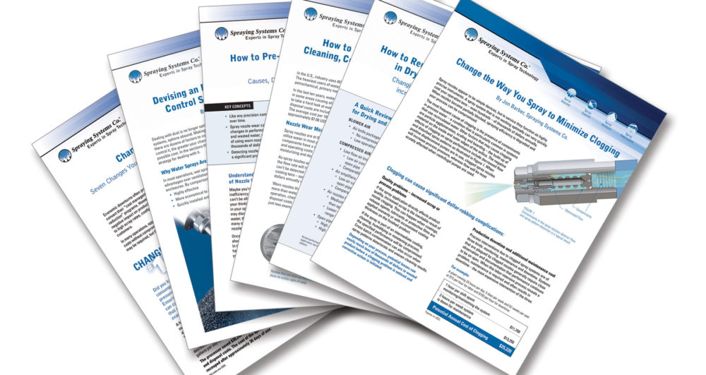
Introduction

Slide 3


DATA SOURCES
30 papers
https://arxiv.org/list/cs.AI/recent
Grobid_Client_Python

Slide 4

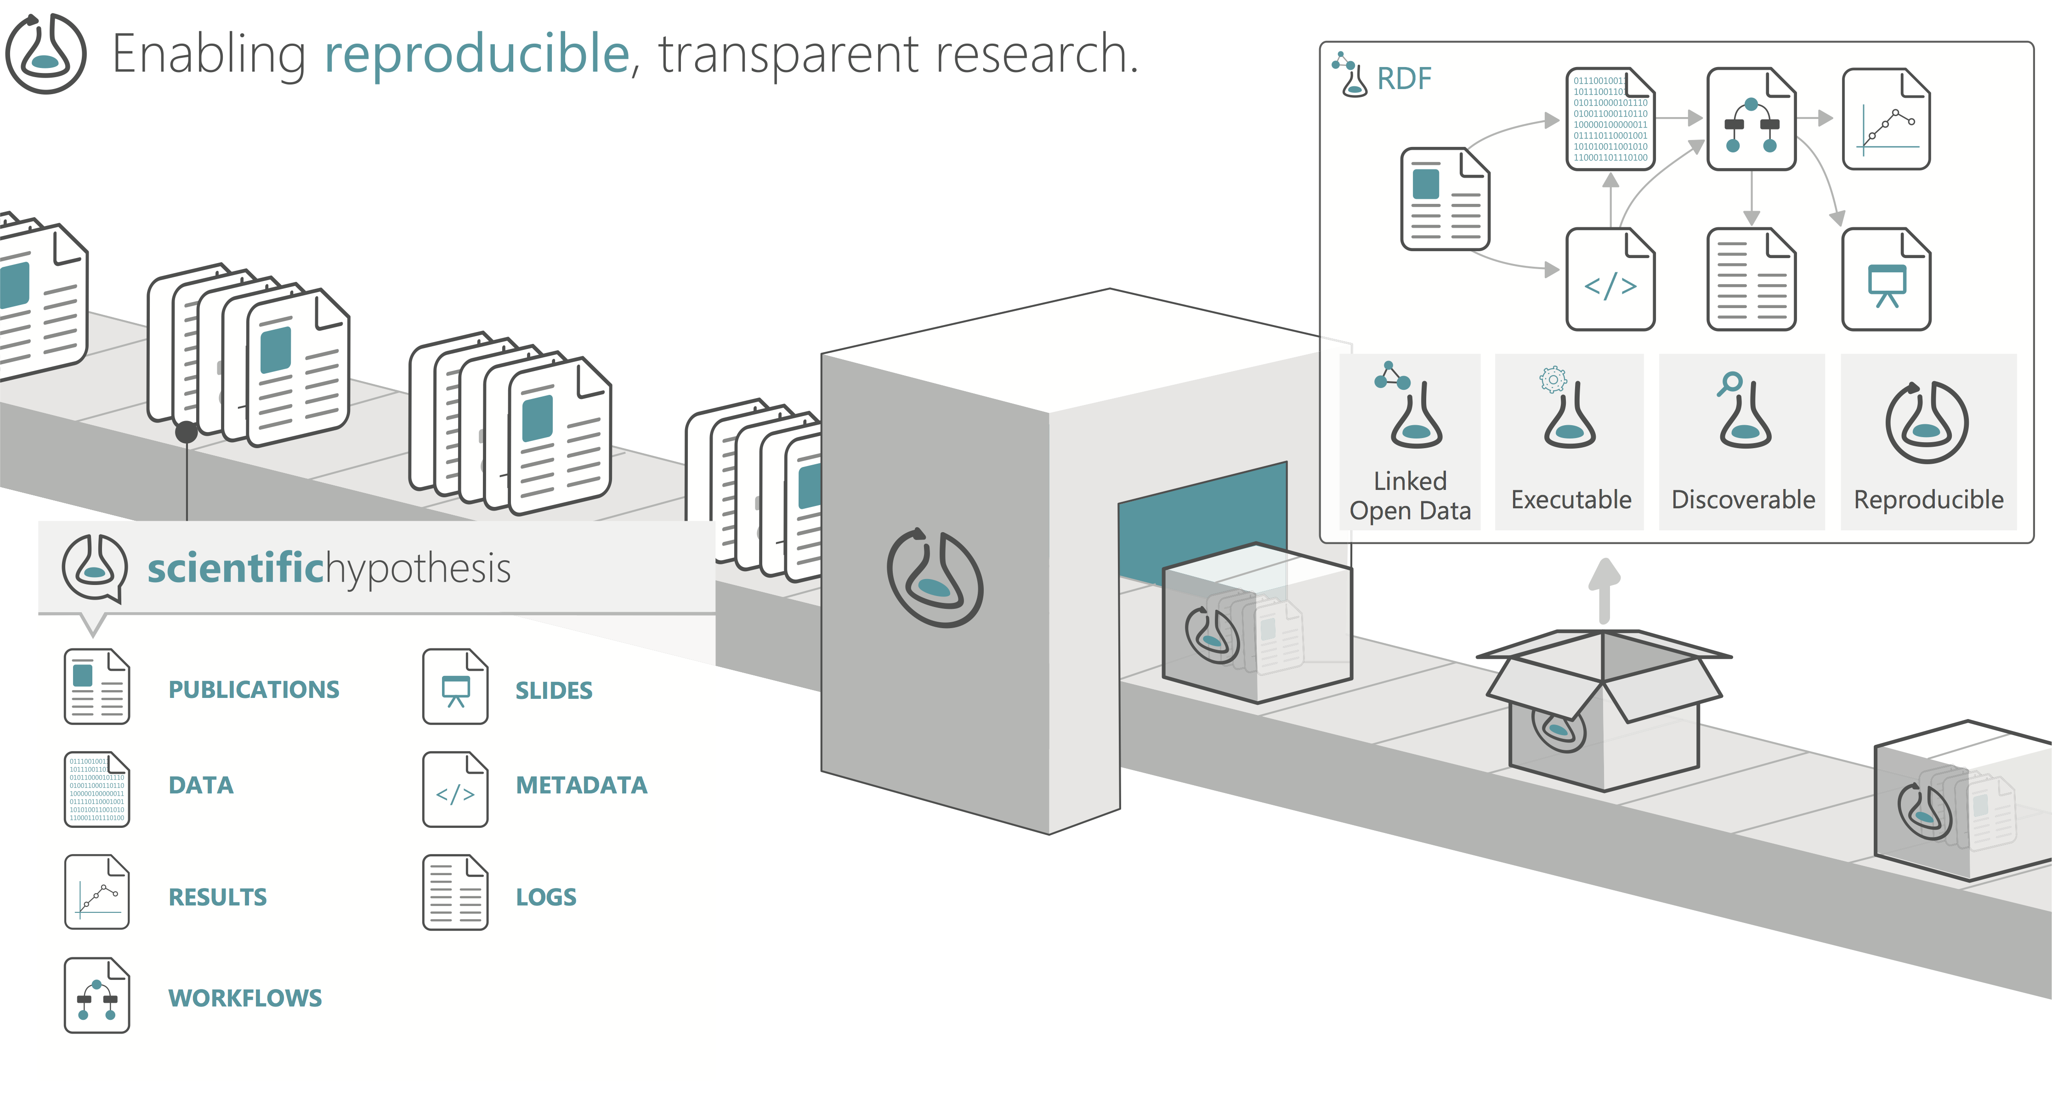

OVERVIEW OF THE STEPS

Slide 5
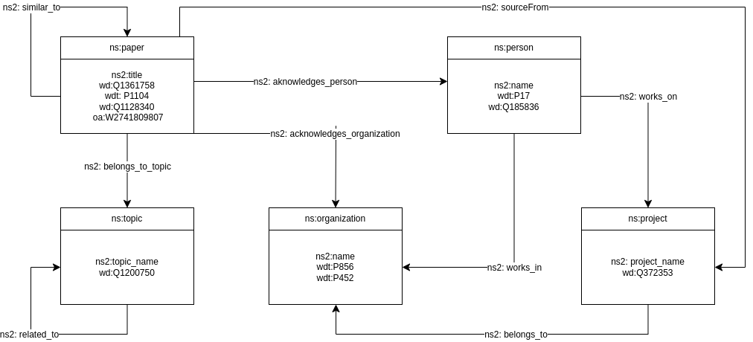
KNOWLEDGE GRAPH

Slide 6
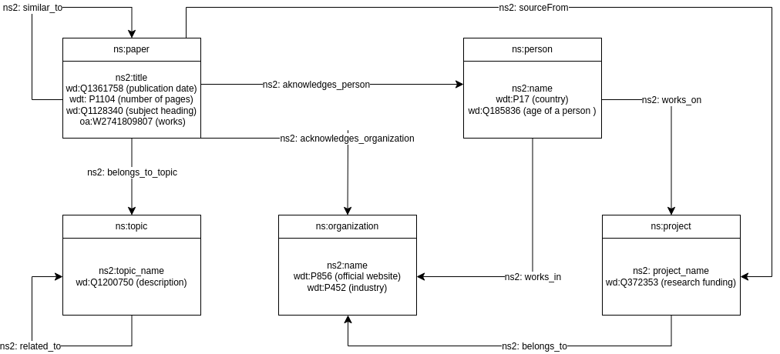
KNOWLEDGE GRAPH

Slide 7
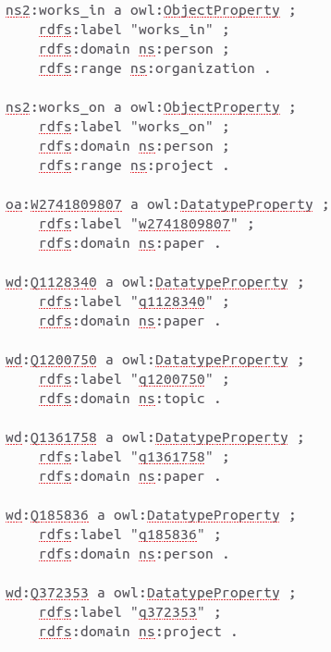
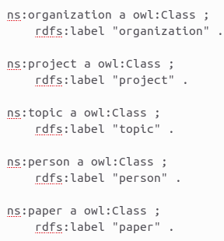
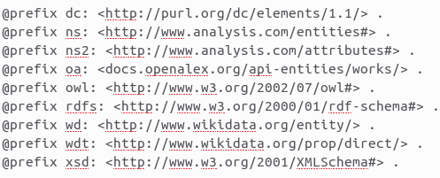
ONTOLOGY

Slide 8


EnRICH THE INFORMATION

Slide 9
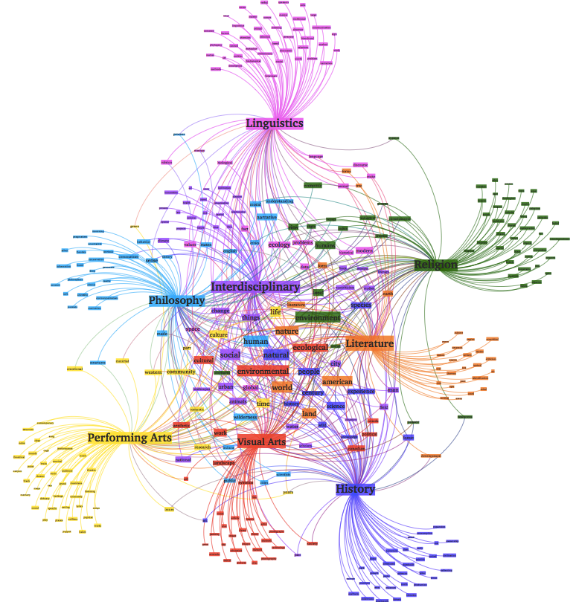
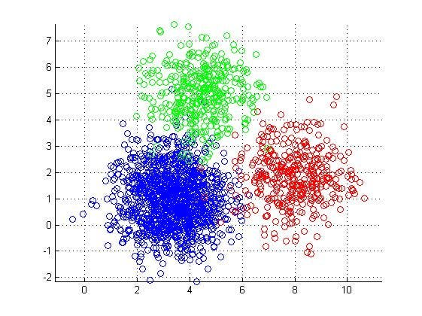

VALIDATED THE APPROACH

Slide 10


BEST PRACTICES

Slide 11


Slide 12

THANK YOU

