Slide 1
Lesson 1: Greeting and Introducing

Slide 2
Greeting expressions
Formal | Neutral | Informal

Slide 3
Greeting expressions
Formal | Neutral | Informal
Good morning
Good afternoon
Good evening

Slide 4
Greeting expressions
Formal | Neutral | Informal
Good morning | Morning
Good afternoon | Afternoon
Good evening | Evening
 | Hi
 | Hello

Slide 5
Greeting expressions
Formal | Neutral | Informal
Good morning | Morning | Hi
Good afternoon | Afternoon | Hey
Good evening | Evening
 | Hi
 | Hello

Slide 6
Introducing yourself
Formal | Neutral | Informal

Slide 7
Introducing yourself
Formal | Neutral | Informal
My name is … | I am …. | …….

Slide 8
Introducing others
Formal | Neutral | Informal

Slide 9
Introducing others
Formal | Neutral | Informal
Let me introduce …. | This is ….. | …..

Slide 10
What’s next?
Formal | Neutral | Informal
It is very nice to meet you.
It is a pleasure to meet you.

Slide 11
What’s next?
Formal | Neutral | Informal
It is very nice to meet you. | Very nice to meet you.
It is a pleasure to meet you. | Very glad to meet you.

Slide 12
What’s next?
Formal | Neutral | Informal
It is very nice to meet you. | Very nice to meet you. | Nice to meet you.
It is a pleasure to meet you. | Very glad to meet you. | Glad to meet you.

Slide 13
Small talk
 | Questions | Responses
Ask for names
Ask for spelling of name
Ask for where from

Slide 14
Small talk
 | Questions | Responses
Ask for names
Ask for spelling of name
Ask for where from

Slide 15
Listening practice, p. 2
Read the questions and write down the answers.
1. What is his name?
2. What is her name?
3. Where is he from?
4. Where is she from?
5. Who is Sun-hee?
6. Where is Sun-hee from?

Slide 16
Listening practice, p. 2
Read the questions and write down the answers.
1. What is his name?
2. What is her name?
3. Where is she from?
4. Where is he from?
5. Who is Sun-Hee?
6. Where is Sun-Hee from?
David Garza
Elizabeth Silva
Brazil
Mexico
Beth’s classmate
South Korea

Slide 17
Listening practice, p. 3
Listen to the conversation and fill in the blanks.
Beth: Sun-hee, this is David Garza. He is a new ______ ______ from Mexico.
Sun-hee: ______ to _____ you, David. I’m Sun-hee Park.
David: Hi. So you’re from South Korea?
Sun-hee: That’s right. I’m from _______.
David: That’s cool. What’s _______ like?
Sun-hee: It’s really _____. It is a very ______ city.

Slide 18
Listening practice, p. 3
Listen to the conversation and fill in the blanks.
Beth: Sun-hee, this is David Garza. He is a new _____________ _____________ from Mexico.
Sun-hee: _________ to __________ you, David. I’m Sun-hee Park.
David: Hi. So you’re from South Korea?
Sun-hee: That’s right. I’m from _______.
David: That’s cool. What’s _______ like?
Sun-hee: It’s really ________. It is a very __________ city.
club
member
Nice
meet
Seoul
Seoul
nice
exciting

Slide 19
Listening practice, p. 5
Listen to the conversation and fill in the blanks.
Sun-hee: Hey, David. How is it _______?
David: Fine, thanks. How are you?
Sun-hee: _______ good. So are your classes ______ this semester?
David: Yes, _______ are. I ______ love chemistry.
Sun-hee: ________? Are you and _______ in the same class?
David: No, we ________. My class is in the _____. Her class is
in the ___________.
Sun-hee: Listen. I’m on my way to the ____________ now. Are you ________?

Slide 20
Listening practice, p. 5
Listen to the conversation and fill in the blanks.
Sun-hee: Hey, David. How is it _______?
David: Fine, thanks. How are you?
Sun-hee: _______ good. So are your classes ______
this semester?
David: Yes, _______ are. I ______ love ____________.
Sun-hee: ___________? Are you and _______ in the same class?
David: No, we ________. My class is in the ____________.
Her class is in the ______________.
Sun-hee: Listen. I’m on my way to the ____________ now. Are you ________?
going
Pretty
interesting
they
really
chemistry
Chemistry
Beth
aren’t
morning
afternoon
cafeteria
free

Slide 21
Forming questions
Yes-No questions: Be
Q: _______________________________?
A: Yes, he is. He is a student.
Q: _______________________________?
A: No, she isn’t. She is from UK.
Q: _______________________________?
A: Yes, I am. I am very tired.
Is he a student
Is she from the US
Are you tired

Slide 22
Forming questions
WH-questions: Be
Q: _______________________________?
A: He is at the library now.
Q: _______________________________?
A: She is my sister.
Q: _______________________________?
A: She is late because she took the wrong bus.
Where is he now
Who is she
Why is she late

Slide 23
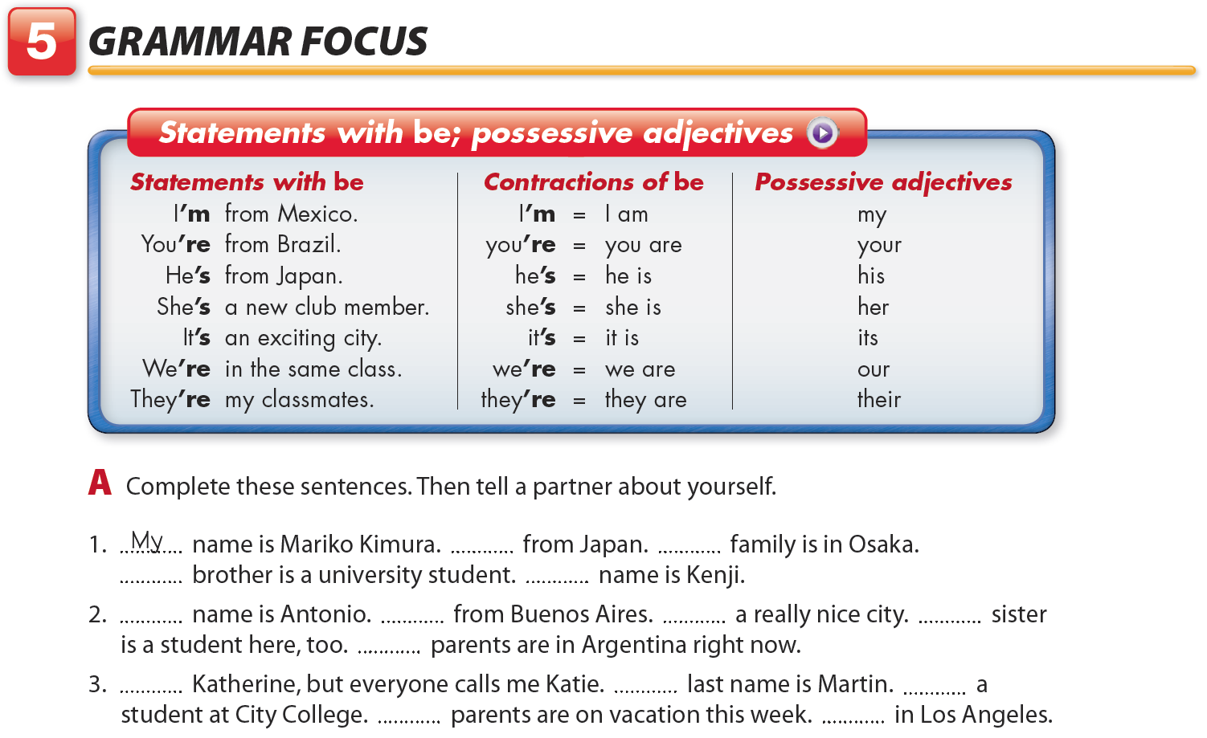
Student’s Book 1, unit 1, page 3
Please call me Beth.
I’m
My
My
His
My
I’m
It’s
My
Our
I’m
My
I’m
My
They’re
Notes:
Answers
1. My name is Mariko Kimura. I’m from Japan. My family is in Osaka.
My brother is a university student. His name is Kenji.
2. My name is Antonio. I’m from Buenos Aires. It’s a really nice city. My sister
is a student here, too. Our parents are in Argentina right now.
3. I’m Katherine, but everyone calls me Katie. My last name is Martin. I’m a
student at City College. My parents are on vacation this week. They’re in Los Angeles.

Slide 24
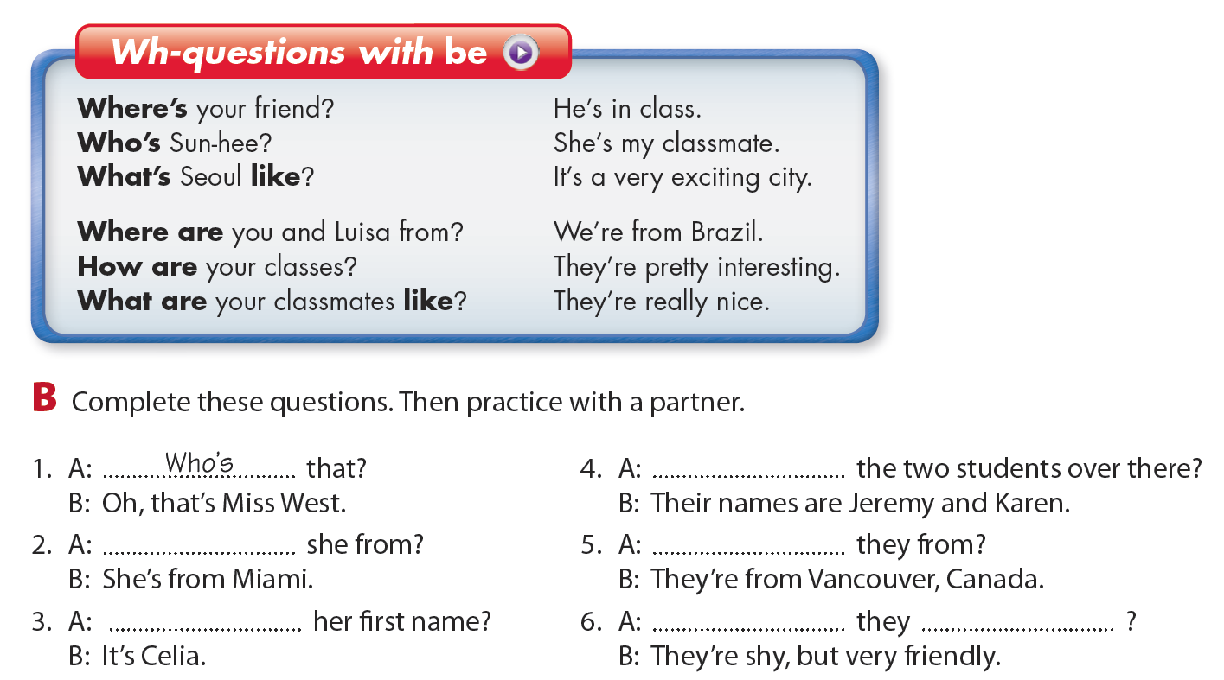
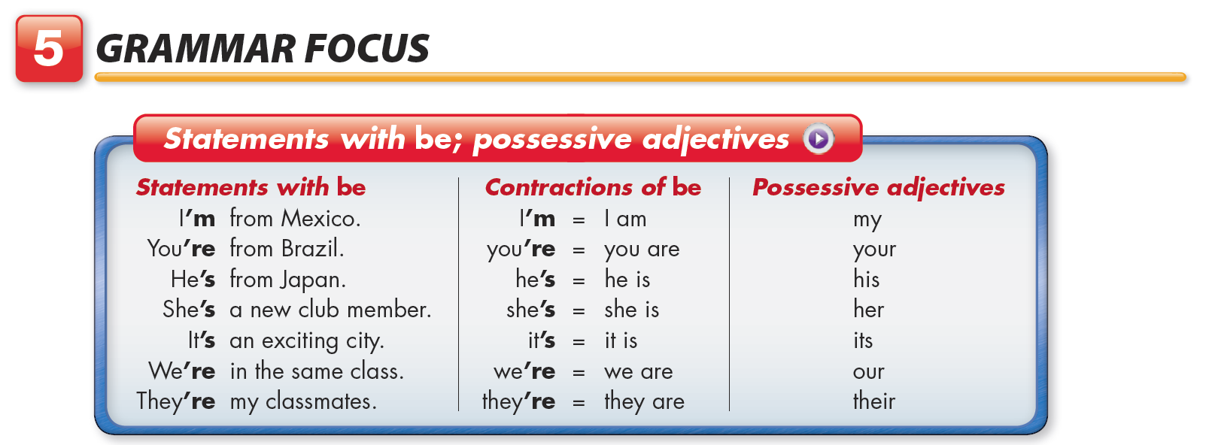
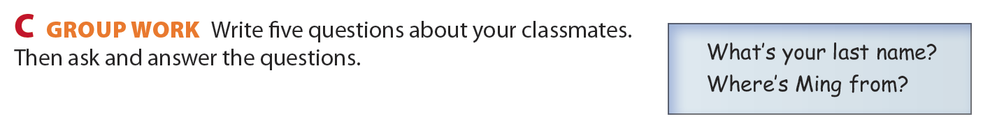
Student’s Book 1, unit 1, page 4
Please call me Beth.
Who are
Where is / Where’s
Where are
What is / What’s
What are
like
Notes:
Answers
1. Who is/Who’s that?
2. Where is/Where’s she from?
3. What is/What’s her first name?
4. Who are the two students over there?
5. Where are they from?
6. What are they like?

Slide 25
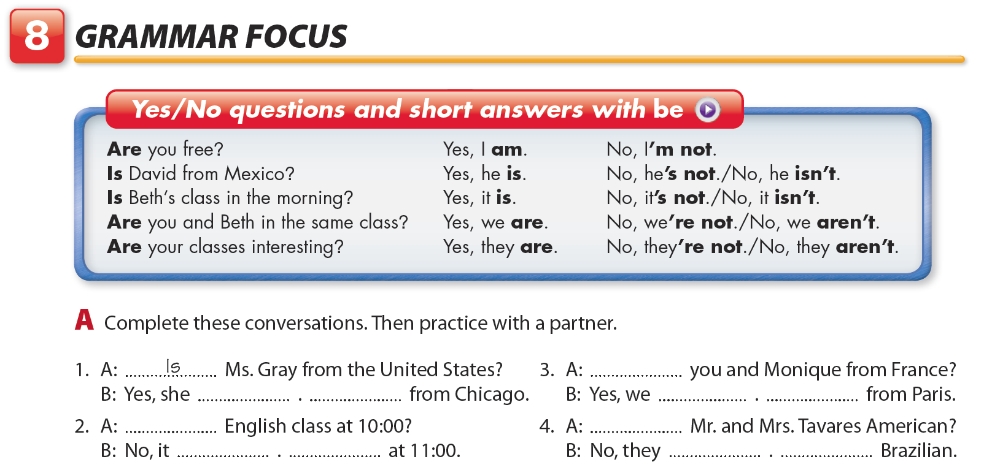
Student’s Book 1, unit 1, page 5
Please call me Beth.
Are
is
She’s
are
We’re
Is
Are
it isn’t
It’s
aren’t
They’re
Click to jump to Parts B and C.
Notes:
Answers
1. A: Is Ms. Gray from the United States?
B: Yes, she is. She’s from Chicago.
2. A: Is English class at 10:00?
B: No, it isn’t. It’s at 11:00.
3. A: Are you and Monique from France?
B: Yes, we are. We’re from Paris.
4. A: Are Mr. and Mrs. Tavares American?
B: No, they aren’t. They’re Brazilian.

Slide 26
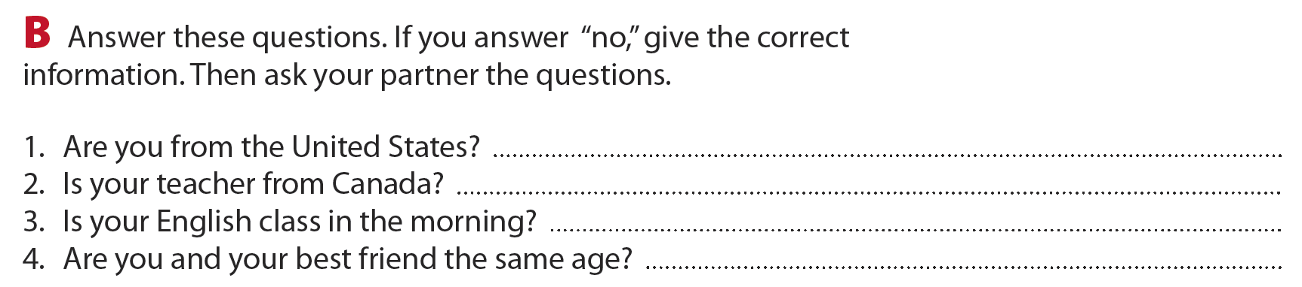
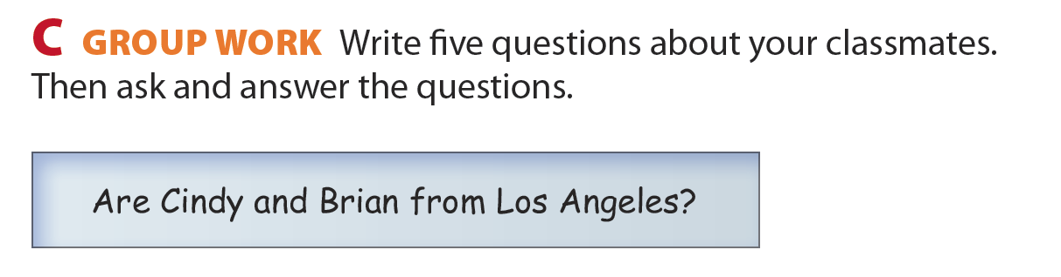
Student’s Book 1, unit 1, page 5
Please call me Beth.
Click to jump to Grammar Focus.

Slide 27
Speaking practice:
In pairs, talk to your partner including the following topics
- Greeting
- Introducing yourself
- Exchangoing the information including 3 yes-no questions and 4 wh-questions
- Ending the conversation

