Slide 1
00. INTRODUCTION
Predicting Professional CS2 Match Outcomes
A Comparative Study of Logistic Regression, Random Forest, and Gradient Boosting.
Seisenbek Dias · Mergen Temirzhan · Onashov Aidos
Mining signal from noise in 7,033 elite competitive matches.
Seisenbek Dias
Mergen Temirzhan
Onashov Aidos
Problem · Data · Variables
Models · Setup · Results
Insights · Discussion · Conclusion

Slide 2
01. THE PROBLEM
Top-tier teams look identical on paper.
At the highest levels of Counter-Strike 2, aggregate statistics lose their discriminatory power. Predicting a winner before the match starts is a problem of stochastic variation, not just historical data.
Seisenbek Dias

Slide 3
02. THE EVIDENCE
7,033
648
18
Professional Matches
Global Tournaments
Months of Data (May 2024 – Oct 2025)
Post-Transition Architecture: Most prior studies rely on CS:GO data. The 2023 engine transition and the HLTV 2.0 rating system effectively reset the field. This study processes only native CS2 data from the current competitive landscape.
Seisenbek Dias

Slide 4
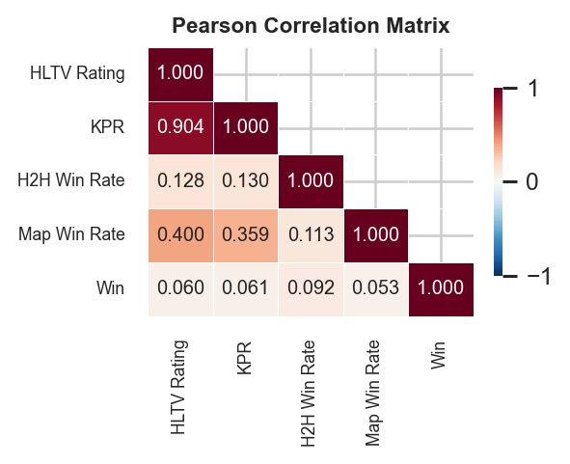
03. THE VARIABLES
Mean HLTV 2.0 Rating
X1
The team's average aggregate performance score
Mean Kills Per Round
X2
The aggregate historical combat lethality
Head-to-Head Win Rate
X3
Specific historical matchup dominance between the two teams
Map-Specific Win Rate
X4
The team's historical success rate on the decided map
* Pearson correlations: all feature-target |r| < 0.15 — weak individual signal
Seisenbek Dias

Slide 5
04. THE MODELS
Logistic Regression
Random Forest
Gradient Boosting
Linear Baseline
Bagging Ensemble
Additive Ensemble
P(Y=1|X) = 1 / (1 + e^(-b0 - b1X1 - b2X2 - b3X3 - b4X4))
P(Y=1|X) = (1 / 200) x SUM [Pb(Y=1|X)]
Fm(x) = Fm-1(x) + n * hm(x) [n = 0.05, M = 200]
Maximum likelihood with L2 regularisation. Evaluates standardised log-odds per standard deviation.
200 decision trees aggregating predictions by majority vote. Robust to overfitting.
Sequential shallow trees fitting pseudo-residuals. Prioritises hold-out accuracy.
Mergen Temirzhan

Slide 6
05. THE VERDICT
Logistic Regression
Random Forest
Gradient Boosting
56.1%
57.2%
56.4%
Accuracy
Accuracy
Accuracy
F1: 0.484
F1: 0.536
F1: 0.528
AUC: 0.574
AUC: 0.571
AUC: 0.573
Paired t-tests (5-fold CV) confirm: differences between classifiers are not statistically significant (p > 0.05)
Mergen Temirzhan

Slide 7
06. THE BASELINE
57.2%
The Bound of Stochastic Variation
A naïve baseline — simply predicting the majority class (always predict 'Win') — yields an automatic 54.6% accuracy. Applying a 200-tree Random Forest model lifts that accuracy by just 2.6%. The models are not failing; they have reached the limits of pre-match data.
Random Forest Maximum Accuracy
54.6%
Naïve Baseline
Mergen Temirzhan

Slide 8
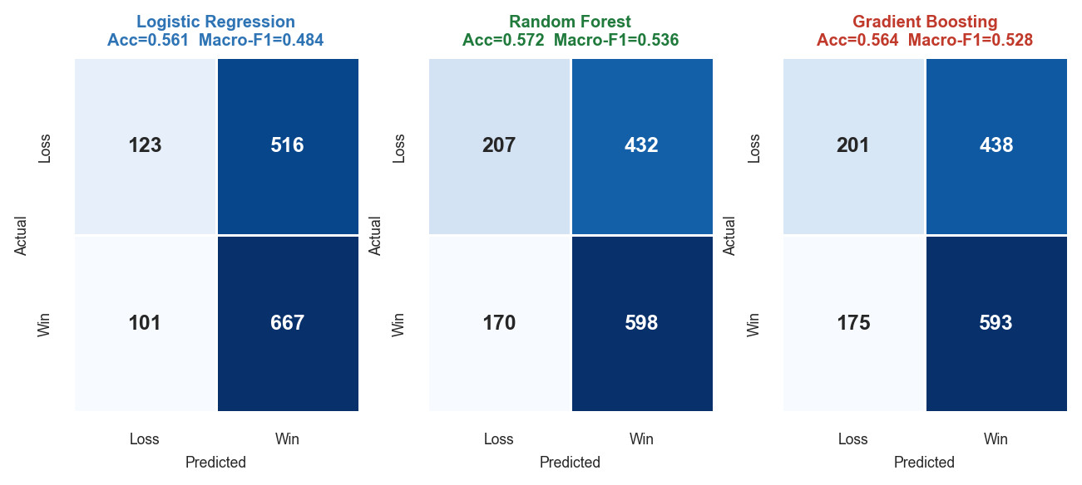
07. CONFUSION MATRICES
All models over-predict Win — false positive rate is the dominant error, as expected from weak feature-target correlations
Mergen Temirzhan

Slide 9
08. THE SIGNAL
01
02
03
Map Win Rate
Head-to-Head
Aggregate Skill
Importance: 0.403 (RF) · 0.399 (GB)
Importance: 0.269 (RF) · 0.292 (GB)
Importance: 0.191 HLTV · 0.138 KPR
The dominant predictor. At the elite tier, being pulled into an unfamiliar structural environment — a weak map — creates a measurable, objective disadvantage that raw skill cannot overcome.
The secondary signal. Stylistic matchups and historical dominance persist over time, creating psychological and tactical friction between opponents.
The weakest signal. When both teams are elite, historical combat lethality and overall ratings cancel each other out.
Onashov Aidos

Slide 10
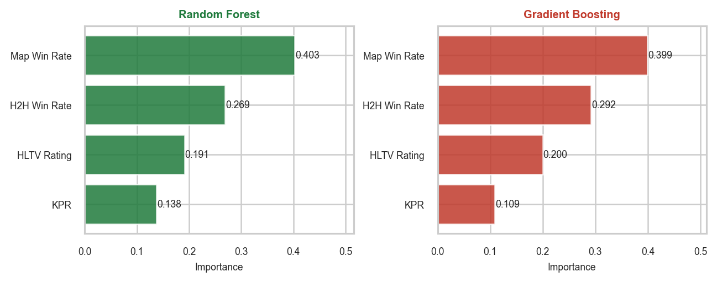
09. FEATURE IMPORTANCE — BOTH ENSEMBLE MODELS
Map Win Rate ranks first in both RF and GB with ~40% importance. KPR is consistently the weakest contributor.
Onashov Aidos

Slide 11
10. THE FEATURE CEILING
Pre-Match Horizon
In-Game Reality
Historical Aggregates
Real-Time Economy
Temporal Noise
Alive-Player State
Map Veto
Round Score
Roster Shifts
Clutch Variance
Max Accuracy: ~56%
Max Accuracy: 80%+
Onashov Aidos

Slide 12
11. CONCLUSION
The algorithms do not lack capacity.
The data lacks certainty.
At the highest tier of competition, pre-match outcomes are bound by a structural ceiling of stochastic variance. To break the 56% barrier, we must look past aggregate history and measure the game in motion.
H3
confirmed
Map Win Rate is the dominant predictor
H2
partial
H2H Win Rate is the secondary signal
H1
weakly supported
HLTV Rating / KPR — least discriminating
github.com/aloneen/cs2-match-outcome-prediction
Thank you · Questions?

