Slide 1
NARXOZ UNIVERSITY - RESEARCH METHODS 2026
Predicting Professional CS2 Match Outcomes
A Comparative Study of Logistic
Regression, Random Forest, and
Gradient Boosting.
Mining signal from noise in 7,033 elite competitive matches.
Authors: Seisenbek Dias, Mergen Temirzhan, Onashov Aidos

Slide 2
. THE PROBLEM
Top-tier teams look
identical on paper

Slide 3
THE HYPOTHESES
01
H1: Skill Predicts Wins
"TEAMS WITH HIGHER HLTV RATING
AND KPR ARE MORE LIKELY TO WIN.
H2: History Predicts Rematches
02
"TEAMS WITH A STRONGER HEAD-TO-HEAD
RECORD ARE MORE LIKELY TO WIN AGAIN.
03
H3: Map Mastery Decides Maps
"TEAMS WITH A HIGHER WIN RATE ON
THE SPECIFIC MAP PLAYED WILL WIN IT.

Slide 4
THE EVIDENCE
7,033
648
18
Professional
Matches
Global Tournaments
Months of Data
(May 2024 – Oct 2025)

Slide 5
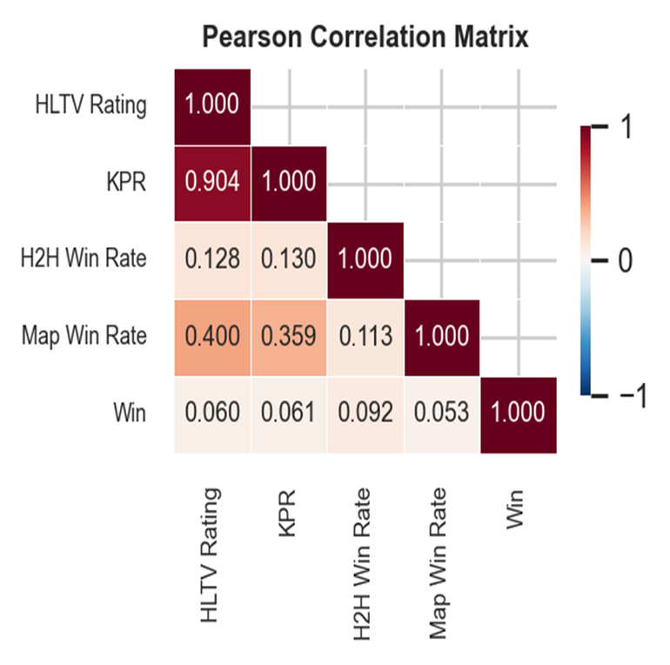
THE VARIABLES
Mean HLTV 2.0 Rating
The team's average aggregate performance score
Mean Kills Per Round
The aggregate historical combat lethality
Head-to-Head Win Rate
Specific historical matchup dominance between the two teams
Map-Specific Win Rate
The team's historical success rate on the decided map

Slide 6



THE MODELS
Logistic
Regression
Gradient
Boosting
Random
Forest

Slide 7
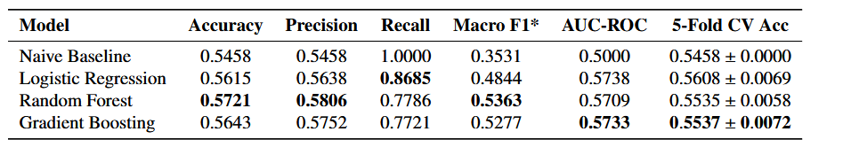
THE VERDICT

Slide 8
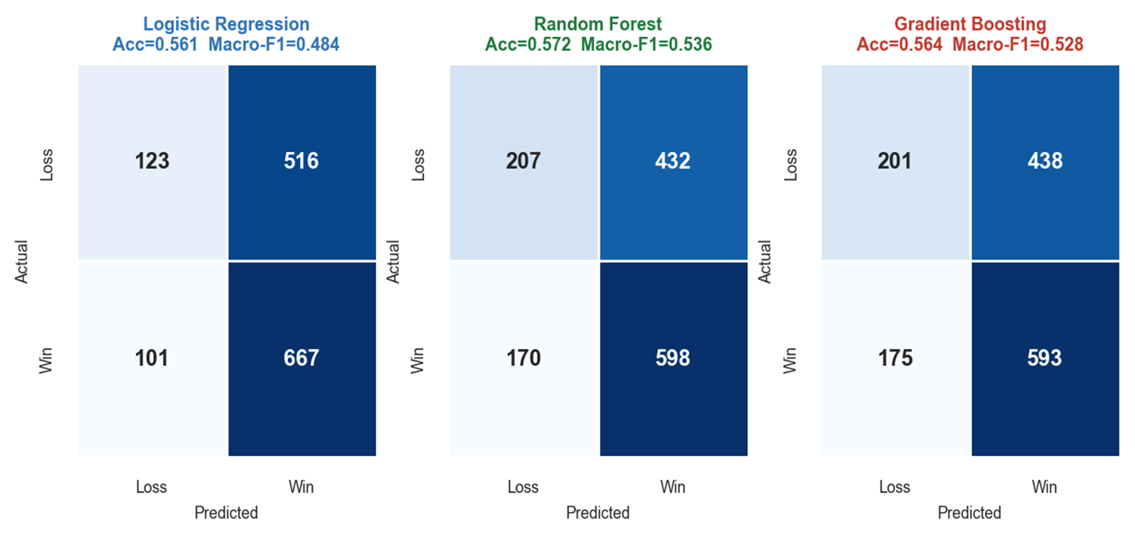
CONFUSION MATRICES

Slide 9
THE SIGNAL
01
02
03
Map Win Rate
Head-to-Head
Aggregate Skill
IMPORTANCE: 0.403 (RF) 0.399 (GB)
IMPORTANCE: 0.269 (RF) 0.292 (GB)
IMPORTANCE: 0.191 HLTV ·0.138 KPR

Slide 10
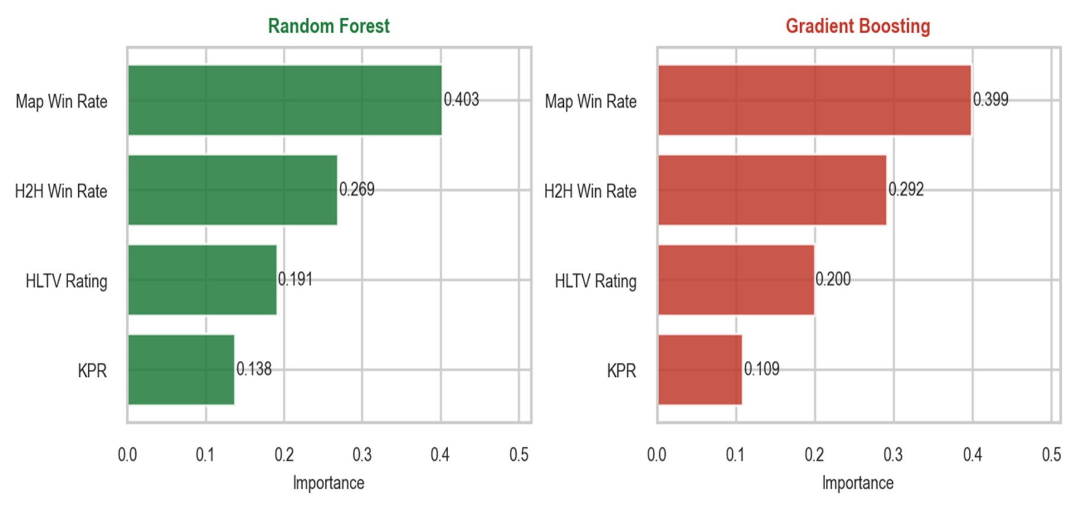
FEATURE IMPORTANCE — BOTH ENSEMBLE MODELS

Slide 11
LIMITATIONS
Pre-Match Horizon
In-Game Reality
Historical Aggregates
Real-Time Economy
Temporal Noise
Alive-Player State
Map Veto
Round Score
Roster Shifts
Clutch Variance
Max Accuracy: ~56%
Max Accuracy: 80%+

Slide 12
CONCLUSION
The algorithms do not
lack capacity.
THE DATA DOES.

Slide 13
thank you so much!
Questions

