Slide 1
AgentCoder
Multi-Agent Code Generation with
Iterative Testing and Optimisation
Huang et al. — arXiv:2312.13010
Presented by: Alon Engel, Anas Khoury, Othman Khleel

Slide 2

The Problem
When the same model writes code AND tests, it cheats on itself
Single-Agent Approach
Existing Multi-Agent Frameworks
Same LLM writes code and tests
Tests inherit bugs from the code
No objectivity — like a student grading their own exam
Edge cases get missed
MetaGPT: 5 agents, ChatDev: 7 agents
High token cost from agent coordination
Test accuracy only ~80%
Tests not based on real execution
Developer flow:
Developer flow:
Prompt
LLM
Code+Tests
Self-check
Project Manager
Architect
Project Manager
Engineer
QA

Slide 3



The Solution: 3 Specialized Agents
Each agent has one job — and does it well
Programmer Agent
1
Test Designer Agent
2
Test Executor Agent
3
כותב את הקוד
מעצב בדיקות
מריץ ובודק
LLM
LLM
Script
Uses Chain-of-Thought:
• Understand task
• Choose algorithm
• Write pseudocode
• Generate code
Independent of code:
• Basic test cases
• Edge cases
• Large-scale tests
• No bias!
Python script (not LLM!):
• Runs code in terminal
• Captures real errors
• Sends feedback
• 0 tokens cost!
Key Insight: Test Designer never sees the code → objective tests, no inherited bias

Slide 4

The Iterative Feedback Loop
The heart of AgentCoder — like TDD (Test Driven Development) for AI
1
2
3
4
Generate
▶
Execute
▶
Decide
▶
Refine
Programmer writes code
Test Designer creates tests
Executor runs code
in real terminal
All tests pass?
Programmer Agent rewrites
code from the error message
If a test failed → loop back to Execute (up to 5 iterations, then stop)
Why is this powerful?
Concrete feedback — actual errors from terminal, not LLM guesses
Programmer Agent fixes itself — LLM rewrites the code from the error; no human in the loop
Tests stay fixed — Programmer Agent can't 'convince' the Test Designer to change its mind
Bounded budget — paper caps the loop at 5 iterations; most fixes happen in the first 1–2 (74% → 80% over 5 rounds)

Slide 5
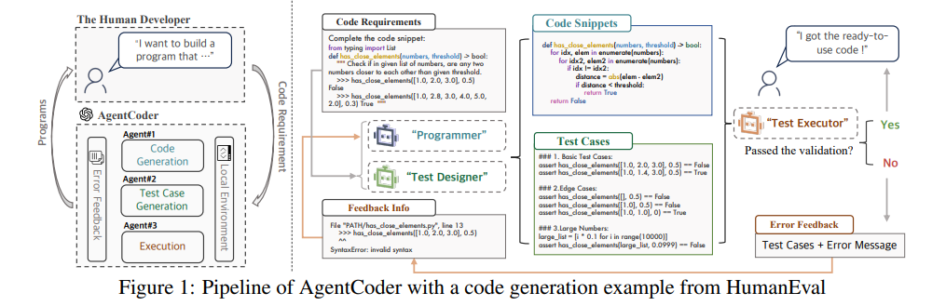
The Original AgentCoder Pipeline
Figure 1 — the full pipeline with a HumanEval code-generation example
Key idea: tests are written independently of the code, so the executor's feedback is objective — driving each refinement loop.
Source: Huang et al. (2023), "AgentCoder," arXiv:2312.13010

Slide 6
Task Demonstration: has_close_elements
Check if any two numbers in a list are closer than a given threshold
📝 Programmer's first attempt
🧪 Test Designer (independent python code!)
if numbers[i] - numbers[j] <= threshold:
return True
# Basic
assert has_close_elements([1.0, 2.5], 1.0) == True
# Edge case
assert has_close_elements([], 1.0) == False
# Large scale
list_100k = [i * 0.1 for i in range(100000)]
❌ Bug: missing abs() — fails on negative differences
⚙️ Test Executor runs the code → AssertionError on negative numbers
Concrete error message sent back to Programmer (not a guess — actual runtime output)
→ Programmer fixes: abs(numbers[i] - numbers[j]) ≤ threshold ✓
Why this works:
Single-agent approaches (like CodeCoT) wrote both the buggy code AND biased tests that didn't catch the bug. AgentCoder's independent test designer caught it because it was based on the requirement, not the code.

Slide 7
Results: Better AND Cheaper
Counter-intuitive finding: more agents does NOT mean better results
96.3%
91.8%
Accuracy across both benchmarks
pass@1
HumanEval — vs 90.2% state-of-the-art
MBPP — vs 78.9% state-of-the-art
57K
66K
tokens vs MetaGPT
HumanEval — vs 138K (~59% less)
MBPP — vs 207K (~68% less)
3
agents only (vs 7 in ChatDev)
less coordination overhead
🎯 Beats every multi-agent baseline on both HumanEval AND MBPP
💰 Up to ~70% fewer tokens than other multi-agent frameworks — better AND cheaper

Slide 8
Why Separate the Agents?
RQ6 — specialized agents beat one agent doing both, on every metric (shown as HumanEval / MBPP)
Metric | Single Agent | AgentCoder (Multi-Agent)
Test-case accuracy | 61.0 / 51.8 | 87.8 / 89.9
pass@1 (code) | 71.3 / 79.4 | 79.9 / 89.9
Test line coverage | 72.5 / 75.9 | 87.5 / 89.5
Why it works: a separate test designer can't be biased by code it never wrote, and each agent stays focused on a single job — so the tests are tougher, more objective, and catch the edge cases a single agent would rationalize away.
Source: Huang et al. (2023), "AgentCoder," arXiv:2312.13010 (RQ6, Tables 6–8)

Slide 9
Token Overhead — AgentCoder vs Multi-Agent Frameworks
Total token cost per problem (GPT-4) — lower is better
Framework | HumanEval tokens | MBPP tokens
AgentCoder | 56.9K | 66.3K
MetaGPT | 138.2K | 206.5K
AgentVerse | 149.2K | 193.6K
ChatDev | 183.7K | 259.3K
HumanEval: function completion · MBPP: entry-level Python tasks
💡 2–4× fewer tokens — at higher accuracy
Source: AgentCoder paper (Huang et al., 2024) — Table 9, GPT-4

Slide 10
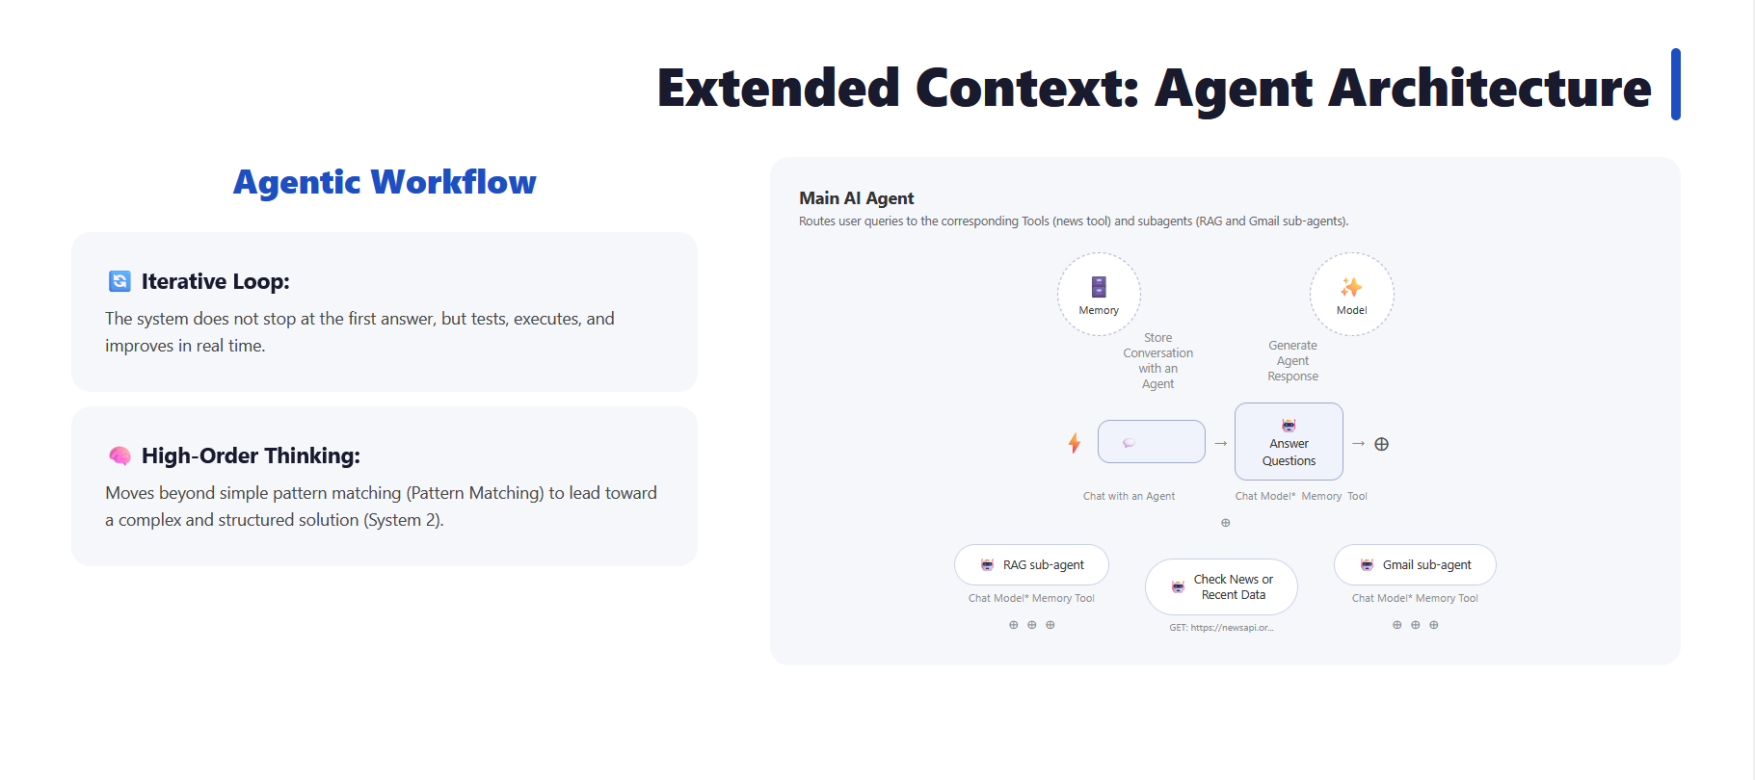

Slide 11
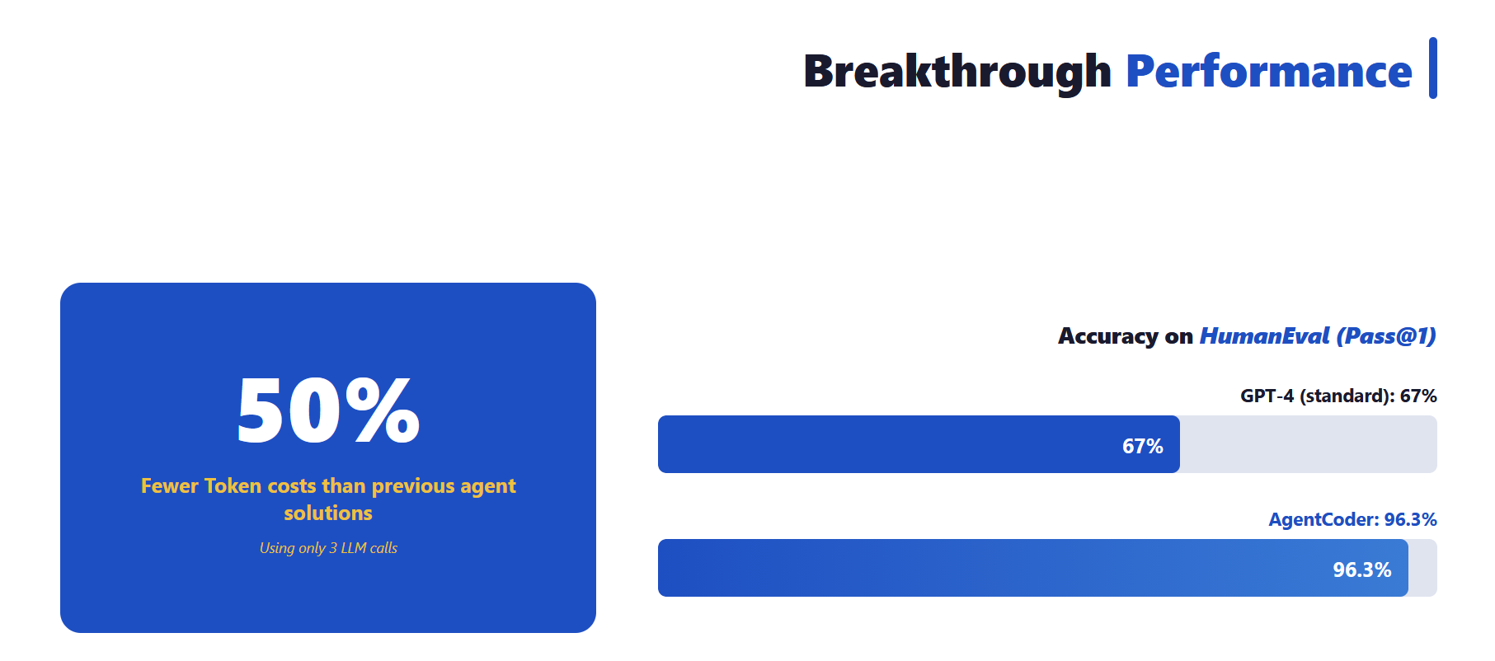

Slide 12
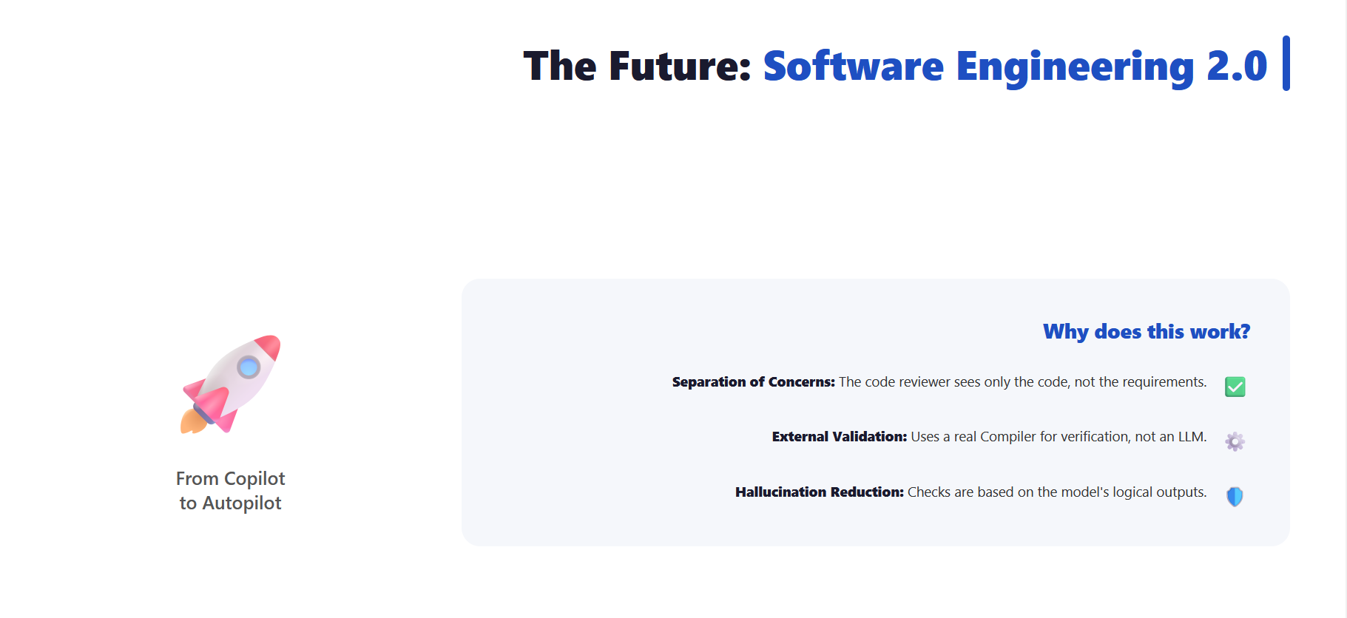

Slide 13
Critical Lens: Where AgentCoder Falls Short
Strong on toy benchmarks — but the design has real blind spots
Objective ≠ correct
The test designer is the same kind of LLM reading the same ambiguous prompt. Misread the spec and it writes wrong tests — then the executor's “objective” feedback steers the code confidently the wrong way.
Proven only on toy problems
HumanEval & MBPP are short, single-function Python tasks likely seen in pre-training. 96.3% says little about multi-file, stateful, or under-specified real-world code.
Self-written tests aren't ground truth
Production has no hidden tests. The loop only guarantees “passes the tests it wrote itself,” which can miss whole edge cases — high pass@1 ≠ correctness.
Narrow comfort zone
Needs a clear, auto-testable spec with deterministic I/O. Weak fit for UI, ML, or performance tasks — and iterating costs more tokens and latency than a single call.
Critical analysis — based on Huang et al. (2023), arXiv:2312.13010, and the code-benchmark contamination literature.

Slide 14
The Field Moved On: Dec 2023 → 2026
AgentCoder's core idea survived — its benchmark didn't
HumanEval is solved
AgentCoder's 96.3% (2023) was already near the ceiling — today's best models sit around ~99%, so HumanEval no longer separates methods. The real bar moved to far harder, repo-level benchmarks.
From functions to repositories
Evaluation shifted to real GitHub issues: SWE-bench and its Verified, Multilingual & Pro variants. Agents like SWE-agent and OpenHands edit whole codebases — a regime AgentCoder wasn't built for.
The idea endures
Role specialization + execution feedback became standard (AlphaCodium, AgileCoder, CodeAct). Even 2026 frontier models do best when they get feedback as they work — AgentCoder's thesis.
Through 2026 — HumanEval saturated; SWE-bench Pro the new bar; Claude Fable 5 / Mythos (Jun 2026).

Slide 15
Key Takeaways
3 things to remember about AgentCoder
1
Separation of agents
Each agent focuses on one task. Tests stay objective because the test designer never sees the code.
📚 Like not letting a student grade their own exam
2
Iterative feedback loop
If tests fail → real error message → programmer refines → re-run tests → repeat until success.
🔄 Like Test-Driven Development (TDD) for AI
3
Up to ~70% fewer tokens, higher accuracy
3 focused agents beat 5-7 chatty ones. Test Executor is a Python script — costs 0 tokens.
💰 Smart architecture > brute force
Smart architecture beat brute force in 2023 — but HumanEval is now solved; the real test has moved to repo-level SWE-bench.

Slide 16

Scan to Play: AgentCoder Escape Room

