Slide 1

Clinical Lab Analysis System
MIMIC-III Based Automated Clinical Laboratory Analysis
Research Question:
"How can laboratory test results during hospital admission be used to automatically answer a limited set of clinical analysis questions about hospitalized patients?
Hala Hillou • Dana Nmarny • Anas Khoury • Alon Engel
Notes:
Welcome. Introduce the system and the research question.

Slide 2
Presentation Agenda
What we will cover today
01
The Problem
Why manual MIMIC-III analysis fails
11
Advanced AI Mode
AgentCoder-style guarded code-gen
02
Our Solution
Modular, automated clinical lab system
12
User Interface
Streamlit dark-theme app
03
Dataset & Preparation
MIMIC-III: cleaning and merging
13
Live Demo: Trend Chart
Q3 hematocrit walkthrough
04
System Architecture
Registry-driven pipeline overview
14
Live Demo: NL Query
Same result via natural language
05
Example Workflow
End-to-end request walkthrough
15
Live Demo: Correction
Typo injection demo
06
12 Supported Questions
Full question registry
16
Evaluation Results
159 tests, 94% coverage
07
Code Generation
Template-based code builder
17
Sample Results
Real numbers from MIMIC-III
08
Execution & Validation
Safe exec + per-question rules
18
Engineering Quality
Design decisions & quality
09
Correction Loop
Bounded rule-based retry
19
Limitations & Future
Honest scope and roadmap
10
Natural Language Input
Controlled NL routing
20
Conclusion
Key takeaways
Notes:
Quick roadmap of the presentation.

Slide 3

1. The Problem
Why manual MIMIC-III analysis is not enough
Massive Dataset
MIMIC-III at a Glance
LABEVENTS alone is ~2 GB with millions of records — impossible to query manually at scale
~2 GB
LABEVENTS file size
Error-Prone Queries
1M+
Writing SQL/Python per question is time-consuming, repetitive, and easy to get wrong
Lab event rows (cleaned)
2,839
No Reproducibility
Unique admissions
Ad-hoc queries can't be reliably repeated or audited by others
2,234
Unique patients
376
Clinical Urgency
Clinicians need answers quickly during hospital admissions — not hours of scripting
Lab test types
Notes:
Describe the scale of the problem. Manual querying just doesn't work at this size.

Slide 4




2. Our Solution
A modular, automated clinical lab analysis system
For every predefined clinical question: generate executable Python code → run it → validate → auto-correct if needed → present the result with the code
Code Generation
Safe Execution
Template-based Python code is generated from the selected question + parameters. Never free-text, always typed.
Generated code runs in a controlled environment. Output is validated against expected columns and question-specific rules.
Auto-Correction
Transparent Results
If the first run fails, a rule-based corrector fixes common errors and retries — with a hard attempt limit.
Every answer ships with the exact generated code that produced it. Full traceability for clinical/research use.
Notes:
Introduce the core idea: generate → execute → validate → correct → present.

Slide 5



3. Dataset & Data Preparation
MIMIC-III: ADMISSIONS, LABEVENTS, D_LABITEMS
ADMISSIONS
LABEVENTS
D_LABITEMS
Patient admission records
HADM_ID, SUBJECT_ID
ADMITTIME, DISCHTIME, DIAGNOSIS
→
~2 GB of lab measurements
HADM_ID, ITEMID, CHARTTIME
VALUENUM, VALUEUOM, FLAG
→
Lab item dictionary
ITEMID → LABEL
(376 readable test names)
Cleaning & Merging Steps
Result Dataset
1
Schema inspection: confirmed required fields exist (HADM_ID, ITEMID, CHARTTIME, VALUENUM, VALUEUOM, FLAG, LABEL)
1,003,949
2
Filter: drop LABEVENTS rows with missing HADM_ID (required for the join)
3
Filter: keep only rows with valid VALUENUM for numeric analysis
rows
12 columns · cleaned merged CSV
used by every analysis module
4
Join: LABEVENTS ⟶ ADMISSIONS on HADM_ID to add admission context
5
Enrich: join D_LABITEMS (ITEMID → LABEL) to add readable test names
Notes:
The data prep was a significant effort — show the schema and pipeline steps.

Slide 6





4. System Architecture
Registry-driven, layered pipeline
›
›
›
›
›
Question
Selection
Data
Preparation
Code
Generation
Execution
Validation &
Correction
Result
Presentation
Single Source of Truth: all questions defined once in questions.py — UI, code generation, validation, and pipeline all read from it. Adding a question is a one-place change.
questions.py
Question registry – single source of truth
correction.py
Rule-based fixes + bounded retry loop
data_prep.py
Load dataset; one function per question
question_router.py
Controlled NL routing to template + params
code_generation.py
Build runnable code string from spec + params
app.py
Streamlit UI (dark theme)
execution.py
Safe exec(); capture result/error/status
sandbox.py
AST allowlist + restricted exec
validation.py
Columns, shape, per-question rule checks
agent_pipeline.py
Guarded LLM code-gen loop (experimental)
Notes:
Walk through the pipeline stages top to bottom, then the module table. Emphasize the registry.

Slide 7

5. Example Workflow
End-to-end request: "Show the latest Glucose value for admission 145834"
User Request:
"Show the latest Glucose value for admission 145834"
1
Selects matching question template
Q2: 'Latest value of a lab test' → inputs: HADM_ID=145834, ITEMID=Glucose
2
Generates Python analysis code
result = get_latest_lab_value(145834, 50931)
3
Filters & processes the dataset
Filters ~1M rows → admission 145834 → Glucose → most recent CHARTTIME
4
Executes the code
exec() in controlled environment; captures result DataFrame + status
5
Validates the result
Checks: 1 row, expected columns, VALUENUM not null → Validation: Passed
6
Presents the clinical answer
Metric card: 'Latest value: 102 mg/dL' + Generated Code tab
Notes:
Walk through step by step. The poster shows the same 6-step workflow.

Slide 8
6. The 12 Supported Questions
Base questions (Part 1: Q1–Q5) and new additions (Q6–Q12)
1
Abnormal lab results for an admission
Admission
7
Count abnormal vs normal results
Admission
2
Latest value of a selected lab test
Admission + Lab Test
8
Abnormal results for a specific lab test
Admission + Lab Test
3
Trend of a lab test over time
Admission + Lab Test
9
List all distinct abnormal lab tests
Admission
4
All lab tests during an admission
Admission
10
Lab values within a date range
Admission + Lab Test + Dates
5
Compare first vs last value of a lab test
Admission + Lab Test
11
All admissions for a patient
Patient ID
6
Summary statistics (min / max / mean)
Admission + Lab Test
12
Abnormal vs normal across ALL admissions
None (dataset-wide)
dataset-wide
Notes:
12 questions total. Q1–Q5 are from Part 1; Q6–Q12 are new additions including the dataset-wide aggregate.

Slide 9

7. Code Generation
Template-based: QuestionSpec → runnable Python
QuestionSpec
(registry)
User
Parameters
generate_code()
Runnable
Code String
→
→
→
Generated Code — Q3: Lab Trend
Only known functions
Generated code only ever calls a data function declared in data_prep.py — no free-text exec risk
# Generated by generate_code(spec, params) result = get_lab_trend(hadm_id=107521, itemid=51221)
# data function in data_prep.py:
def get_lab_trend(hadm_id, itemid):
df = merged_df.copy()
df = df[df['HADM_ID'] == hadm_id]
df = df[df['ITEMID'] == itemid]
return df.sort_values('CHARTTIME')
Typed parameters
Admission IDs, ITEMIDs, and dates are validated before being injected into the code string
Every question → one template
Each QuestionSpec declares its function name; code generation is a one-line call per question
Full transparency
The generated code string is shown to the user in the 'Generated Code' tab
Notes:
Template generation is the key safety feature. No free-form code is ever executed.

Slide 10
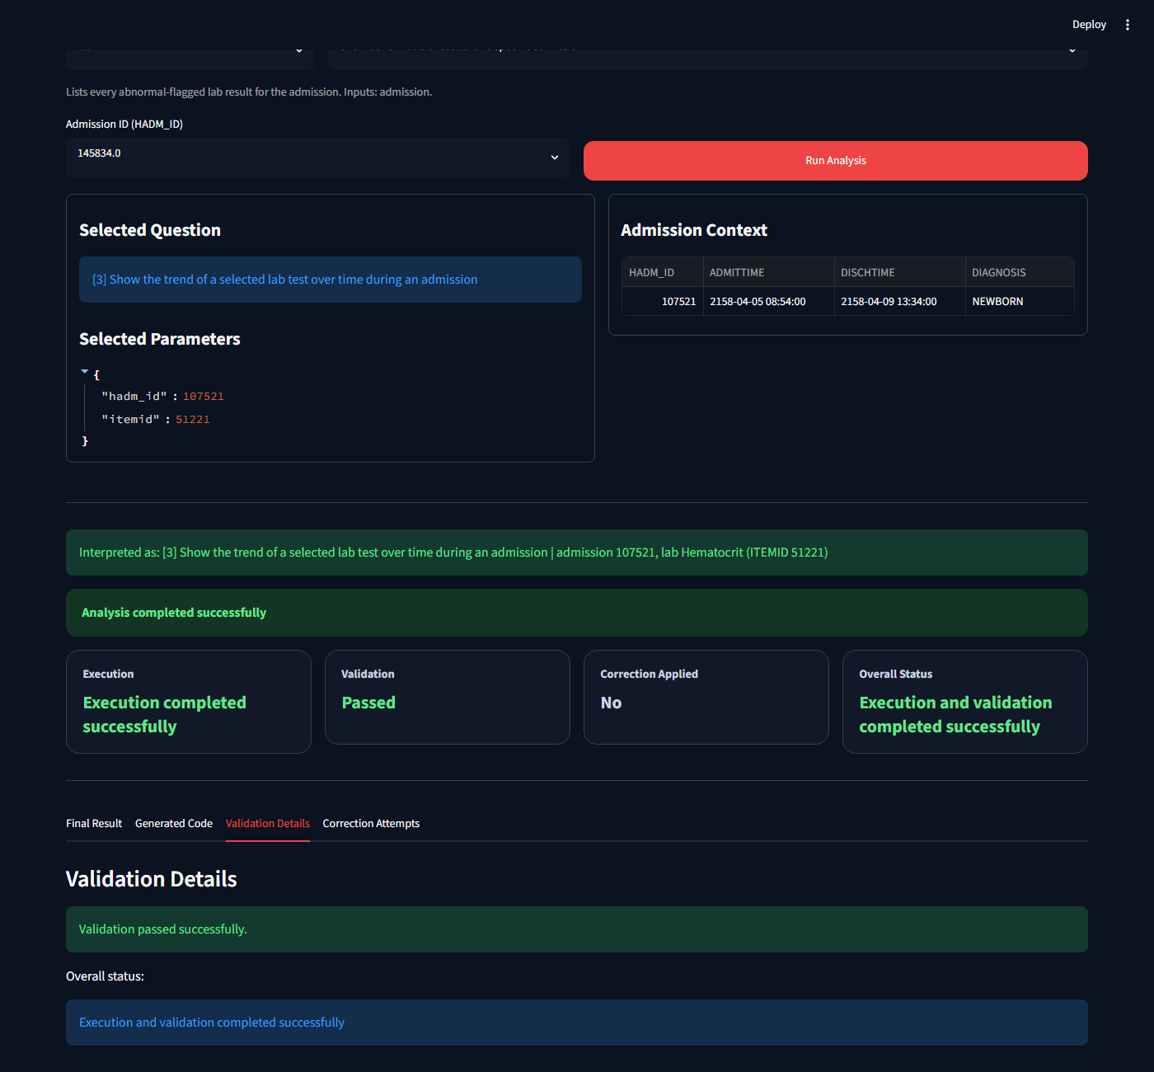
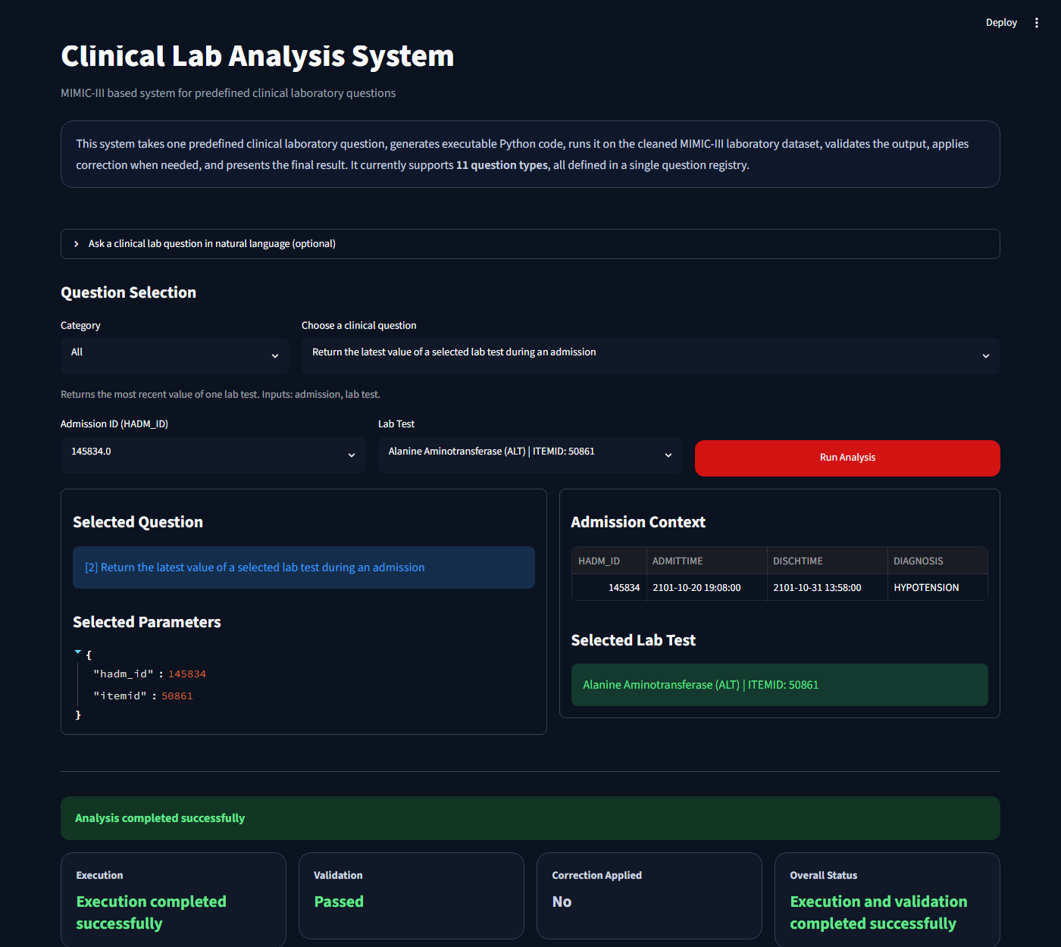
8. Execution & Validation
Safe exec() and per-question output checks
Execution (execution.py)
Validation (validation.py)
Calls exec() on the generated code string
Result is a non-empty DataFrame
Provides only the data functions namespace — no file/network access
Expected columns are all present
Captures: result DataFrame, error message, success status
Shape check (e.g. exactly 1 row for Q2 latest value)
Returns structured ExecutionResult to the pipeline
Per-question rules: time-ascending for trends, only FLAG=abnormal for Q1/Q8, counts add up for Q7/Q12
Validation Details tab
Q2: Latest lab value — 1-row result
Notes:
Execution is safe — only known functions are available. Validation is per-question, not generic.

Slide 11
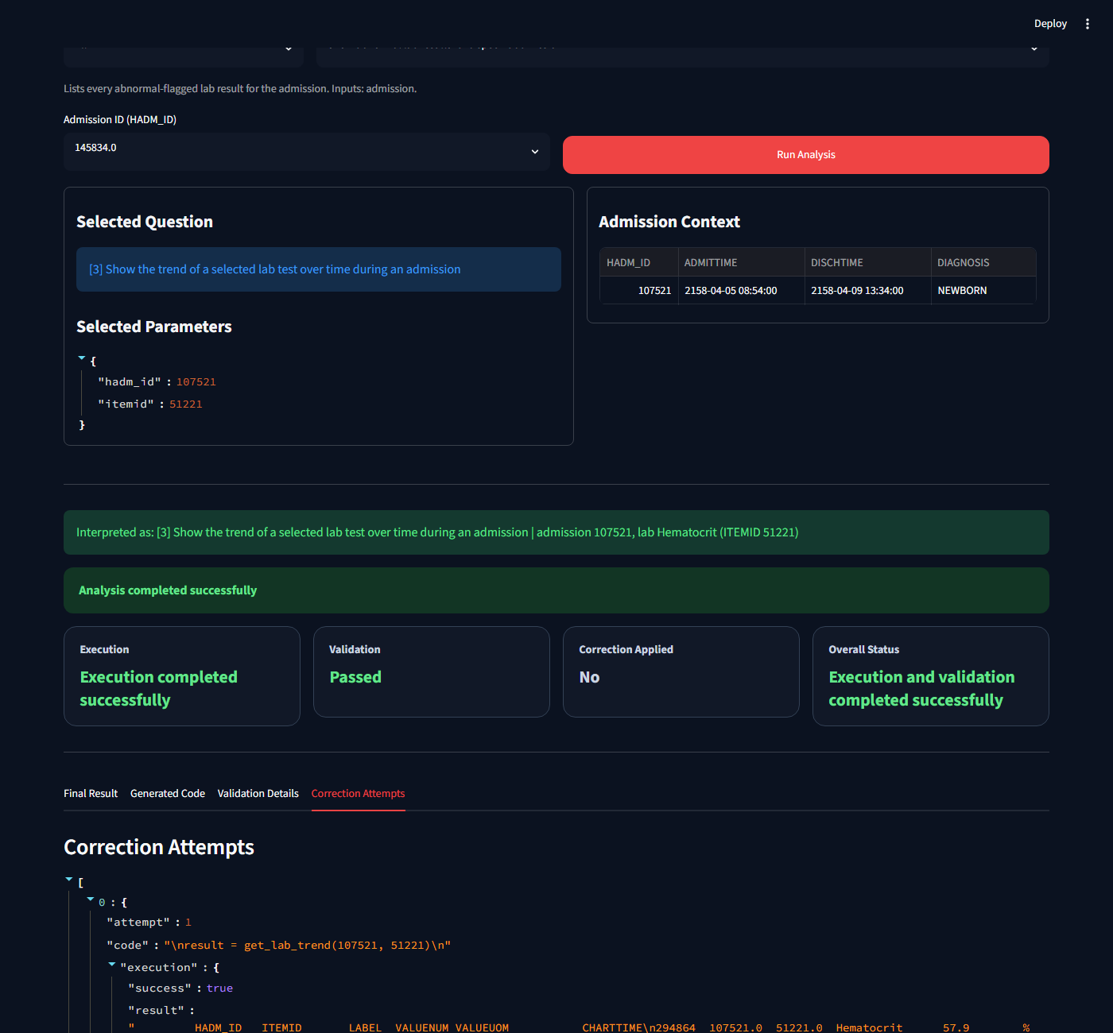
9. The Correction Loop
Rule-based retry when generated code fails
Generate Code
→
Execute
→
Validate
→
✓ Done
✗ Correct & Retry
↺ bounded retry (max N attempts)
How Correction Works
Whole-identifier matching
Regex matches only full function names (word boundaries) — won't corrupt a valid similar name like get_abnormal_results_for_lab
Known typo map (TYPO_FIXES)
A fixed map in correction.py covers the most common generated-code errors; REVERSE_TYPOS allows inverse repair
Bounded retry loop
Maximum attempt limit prevents infinite loops; if correction still fails, the error is surfaced cleanly to the user
Transparent attempts
Every attempt (code tried, error received, fix applied) is saved and shown in the 'Correction Attempts' tab
Correction Attempts tab — two attempts
Notes:
The correction loop only fires in normal use when the generator emits a typo. The demo checkbox forces it.

Slide 12
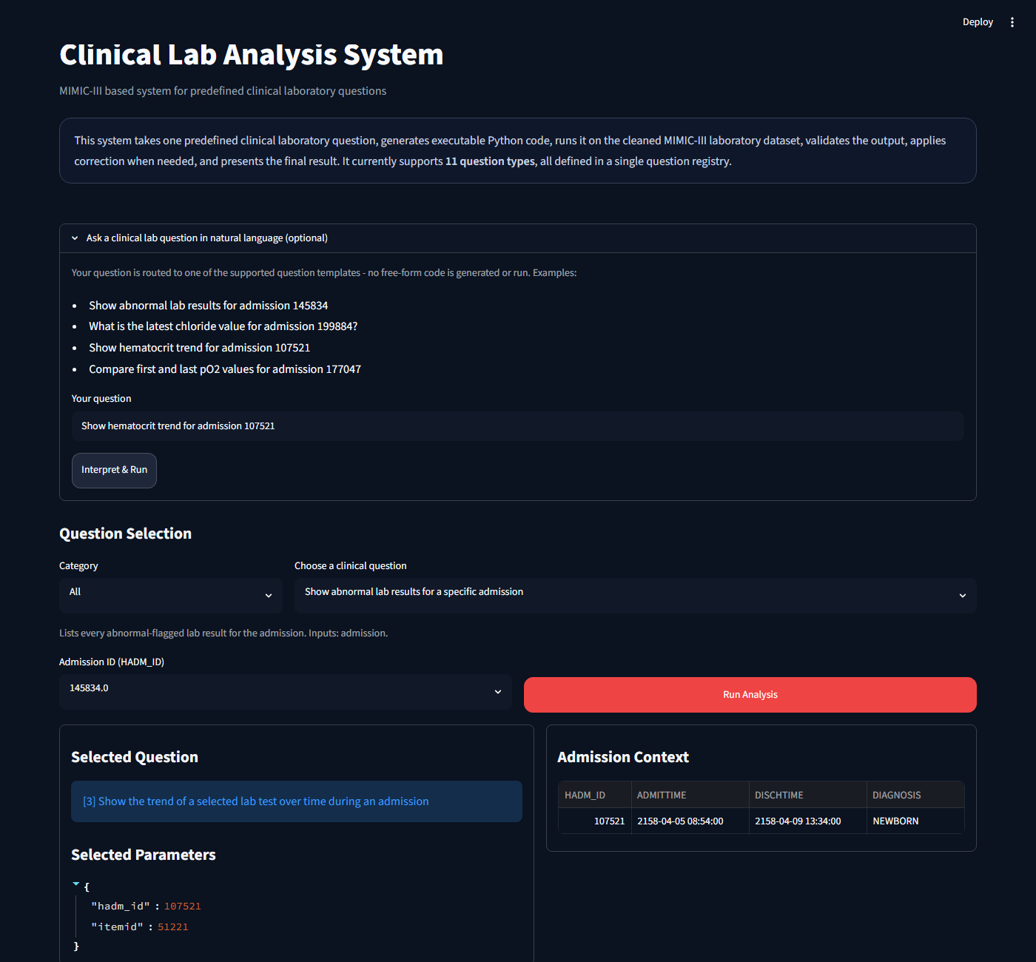


10. Natural Language Input
Type a question in plain English — controlled routing to predefined templates
Rules Only (default)
Regex / keyword matching maps free text to a template ID + params. Fast, offline, deterministic. Always available.
Rules → AI Fallback
If no rule matches and an LLM key is set (Anthropic / OpenAI / Gemini), the LLM selects the best template + params. Still never generates code.
Advanced: AI Writes Code
Optional, off by default. LLM programmer agent writes a pandas snippet for free-form questions. Sandboxed + validated. See next slide.
Examples: "Show hematocrit trend for admission 107521" → Q3 | "What is the latest chloride for admission 199884?" → Q2 | "Show abnormal results for all admissions" → Q12
Notes:
The NL router never generates code — it only selects a template. LLM routing is opt-in.

Slide 13
11. Advanced: AI Writes Code (Experimental)
AgentCoder-style guarded LLM code generation — off by default
Free-text
Question
LLM Programmer
Agent
Sandbox
(AST check)
exec()
+ Validator
Result or
Refine
→
→
→
→
Inspired by: AgentCoder (arXiv 2312.13010) — programmer agent + validator + executor, in a generate→test→refine loop. Orchestration is kept lightweight and in-repo (no CrewAI/AutoGen/LangGraph).
Sandbox Guardrails (sandbox.py)
When Does It Activate?
AST allowlist: no imports, no dunder/underscore attributes
Off by default
No LLM key set → Rules Only mode, always
No file / network / eval / exec methods allowed
Explicit selection
No loops (for/while) in generated code
User chooses 'Advanced: AI writes code' mode in the UI
Restricted __builtins__: only pd and a read-only df exposed
Escalation dialog
If template mode cannot match, a popup offers one-click switch to Advanced
Worker thread with soft timeout and row cap
Free-form questions
Result must pass validate_freeform_result() before display
Questions outside the 12-template registry (e.g. 'last 10 abnormal across the dataset')
Notes:
Off by default. The sandbox is the key safety feature. The 12-question registry remains the trusted core.

Slide 14

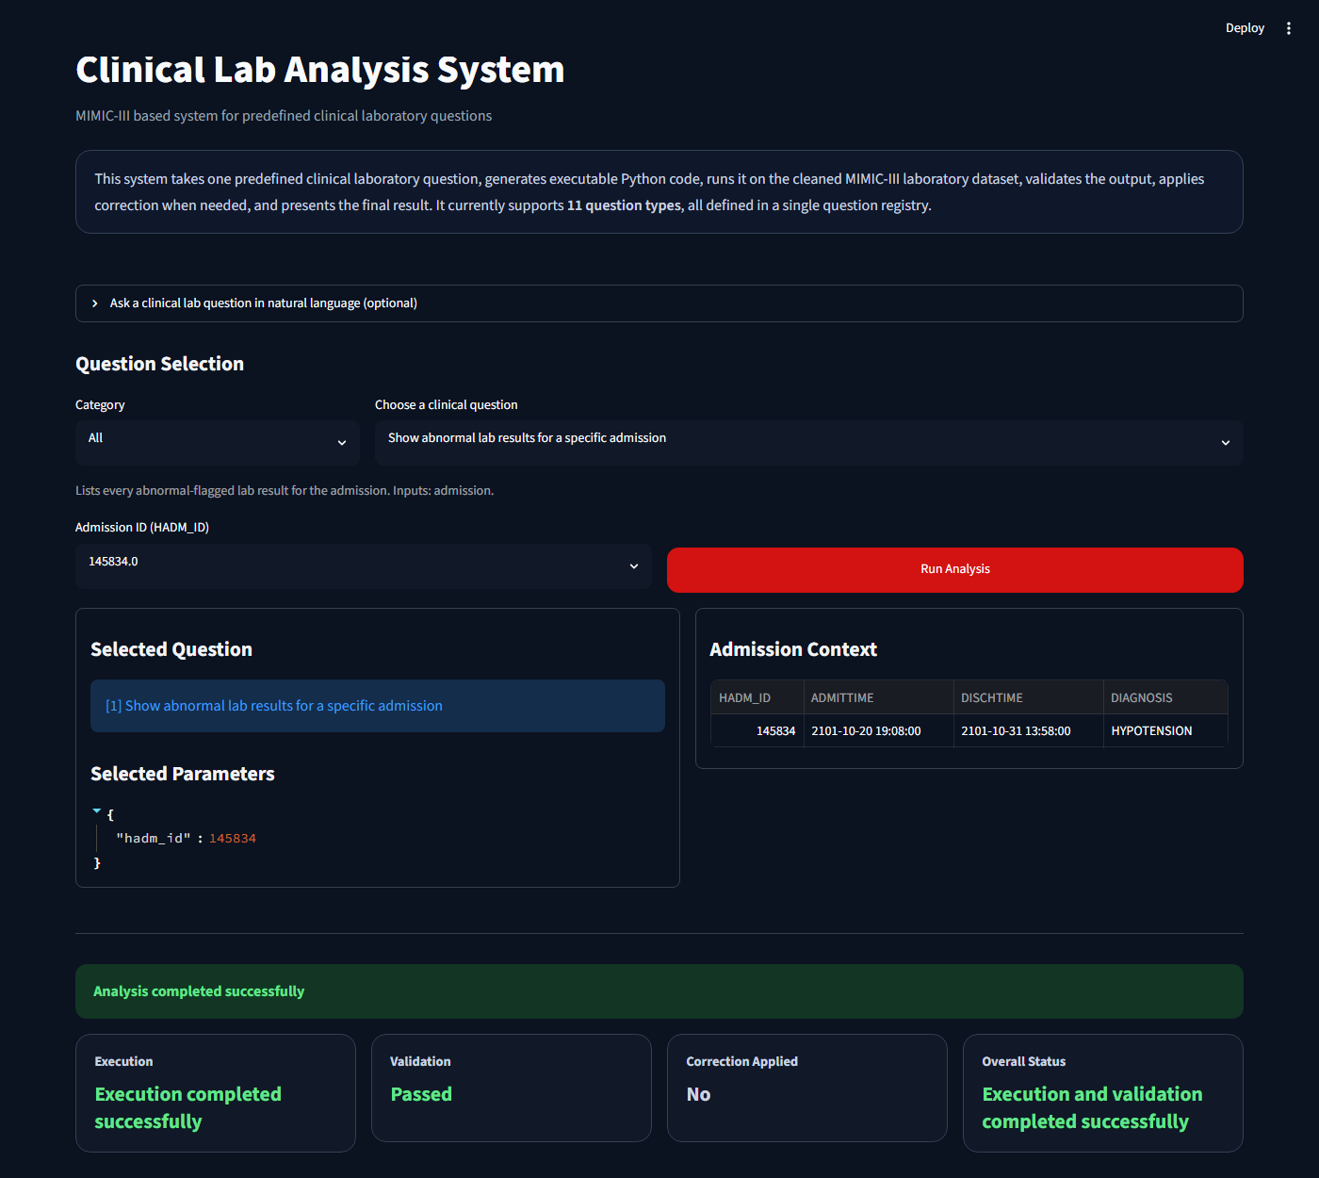

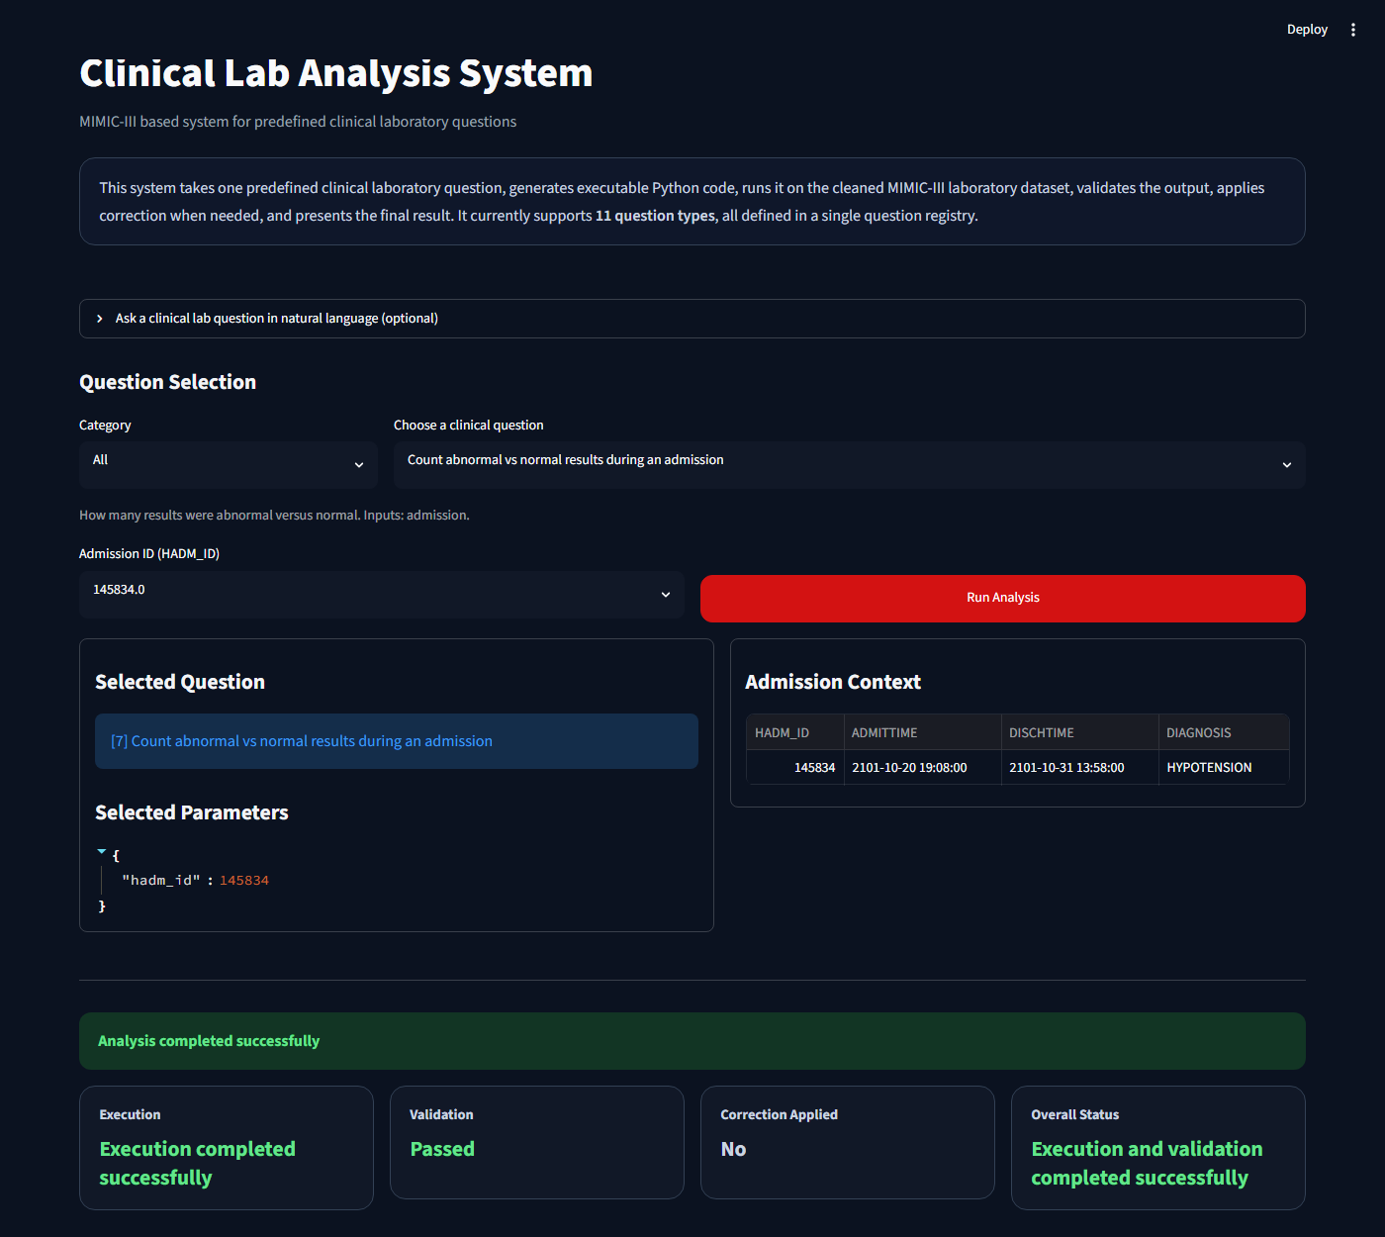
12. User Interface (Streamlit)
Dark-themed app with dynamic inputs and rich result display
UI Features
Question selector with category filter
Per-question help caption (what it returns)
Parameter inputs rendered dynamically from the registry
Optional natural-language question box
Summary metric cards (latest value, min/max/mean, counts)
Altair trend line chart with axis labels + units
Color-coded status: ✓ green / ✗ red / — blue no-records
Generated Code tab: exact code that ran
Validation Details tab
Correction Attempts tab
CSV download of results
Pinned dark theme (config.toml)
Q3: Trend + chart Q6: Summary stats
Q1: Abnormal results Q7: Counts
Notes:
Show the four screenshots. Emphasize the dark theme, metric cards, and generated-code tab.

Slide 15
13. Live Demo: Lab Trend Chart (Q3)
Hematocrit trend for admission 107521
What We Do
Select Question: 'Show the trend of a selected lab test over time during an admission'
Set Admission ID: 107521
Set Lab Test: Hematocrit (ITEMID 51221)
Click: Run Analysis
Expected: line chart showing decreasing trend ~57.9% → 44.4%
Generated Code tab: result = get_lab_trend(107521, 51221)
Status: Execution ✓ Validation ✓ Correction: No
Result:
Hematocrit trend for admission 107521: decreasing from 57.9% → 44.4% over admission period. Line chart + data table + generated code shown.
Notes:
Run this live if demo environment is available. Otherwise walk through screenshot.

Slide 16
14. Live Demo: Natural Language Query
Same result via plain English — no code needed from the user
User types: "Show hematocrit trend for admission 107521"
What the Router Does
Keyword match: 'trend' → Q3 template
Extract HADM_ID: 107521 from the sentence
Match lab: 'hematocrit' → ITEMID 51221
Build route result: question_id=3, params={...}
Pass to pipeline — same path as dropdown
Show: 'Interpreted as: [3] ... admission 107521, Hematocrit'
The router maps the sentence to a predefined template + parameters — it NEVER generates or executes free-form code. The result is identical to the dropdown path.
Notes:
Emphasize that both paths (dropdown and NL) hit the same pipeline.

Slide 17
15. Live Demo: Correction Loop
Injecting a typo to show auto-repair in action
How to Demo It
Select any of Q1–Q5
Check: 'Demo: inject a typo to force a correction'
Click: Run Analysis
Attempt 1 fails — function name is misspelled
Corrector repairs the name → Attempt 2 succeeds
Status row shows: Correction Applied = Yes
Correction Attempts tab shows both attempts
Why This Matters
The template generator always emits correct code in normal use — the demo checkbox is the only reliable way to show the corrector firing live.
The corrector uses whole-identifier matching (word boundaries) to avoid corrupting valid names like get_abnormal_results_for_lab.
The bounded retry limit (N attempts) ensures the system never loops forever — if all attempts fail, the error is surfaced cleanly.
Notes:
The typo checkbox is the only reliable demo trigger. Emphasize the whole-identifier fix.

Slide 18
16. Evaluation Results
All 12 questions pass execution and validation
12 / 12
159
94%
85%
Questions Pass
Automated Tests
Line Coverage
Coverage Gate
End-to-End Results (all from MIMIC-III dataset)
Q1
HADM 145834
Abnormal results returned (FLAG = abnormal)
Q2
HADM 199884, Chloride
Latest value: 103 mEq/L
Q3
HADM 107521, Hematocrit
Decreasing trend: 57.9% → 44.4%
Q4
HADM 158675
All lab tests listed
Q5
HADM 177047, pO2
First 82, Last 103, Diff +21 mm Hg
Q12
Dataset-wide
One row per admission, most abnormal first
Notes:
All 12 questions pass. 159 tests, 94% line coverage, well above the 85% gate.

Slide 19



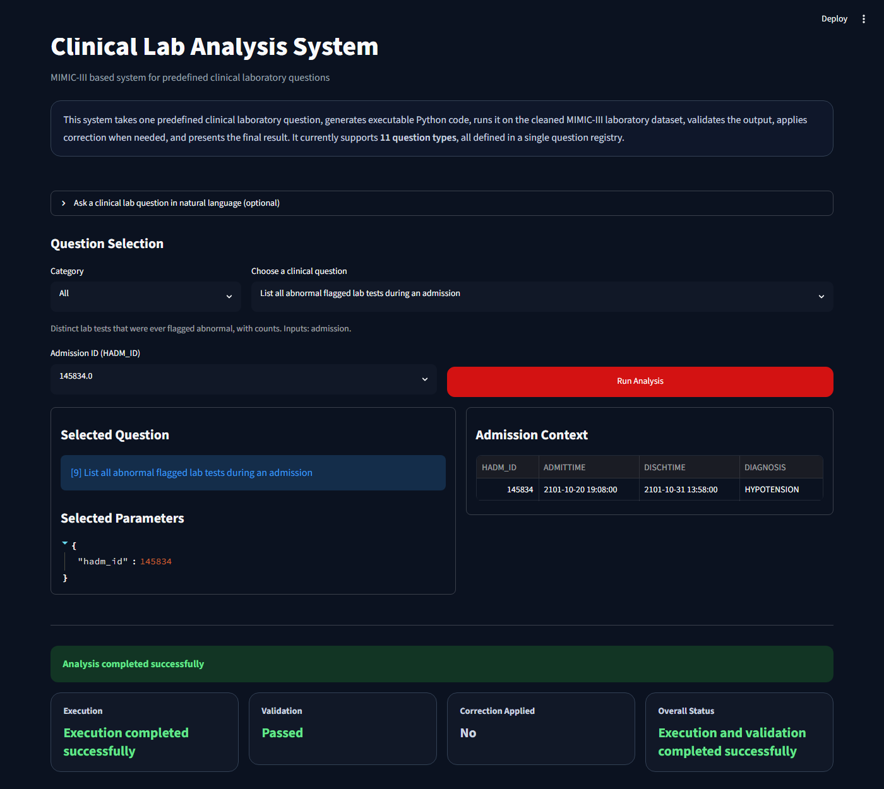
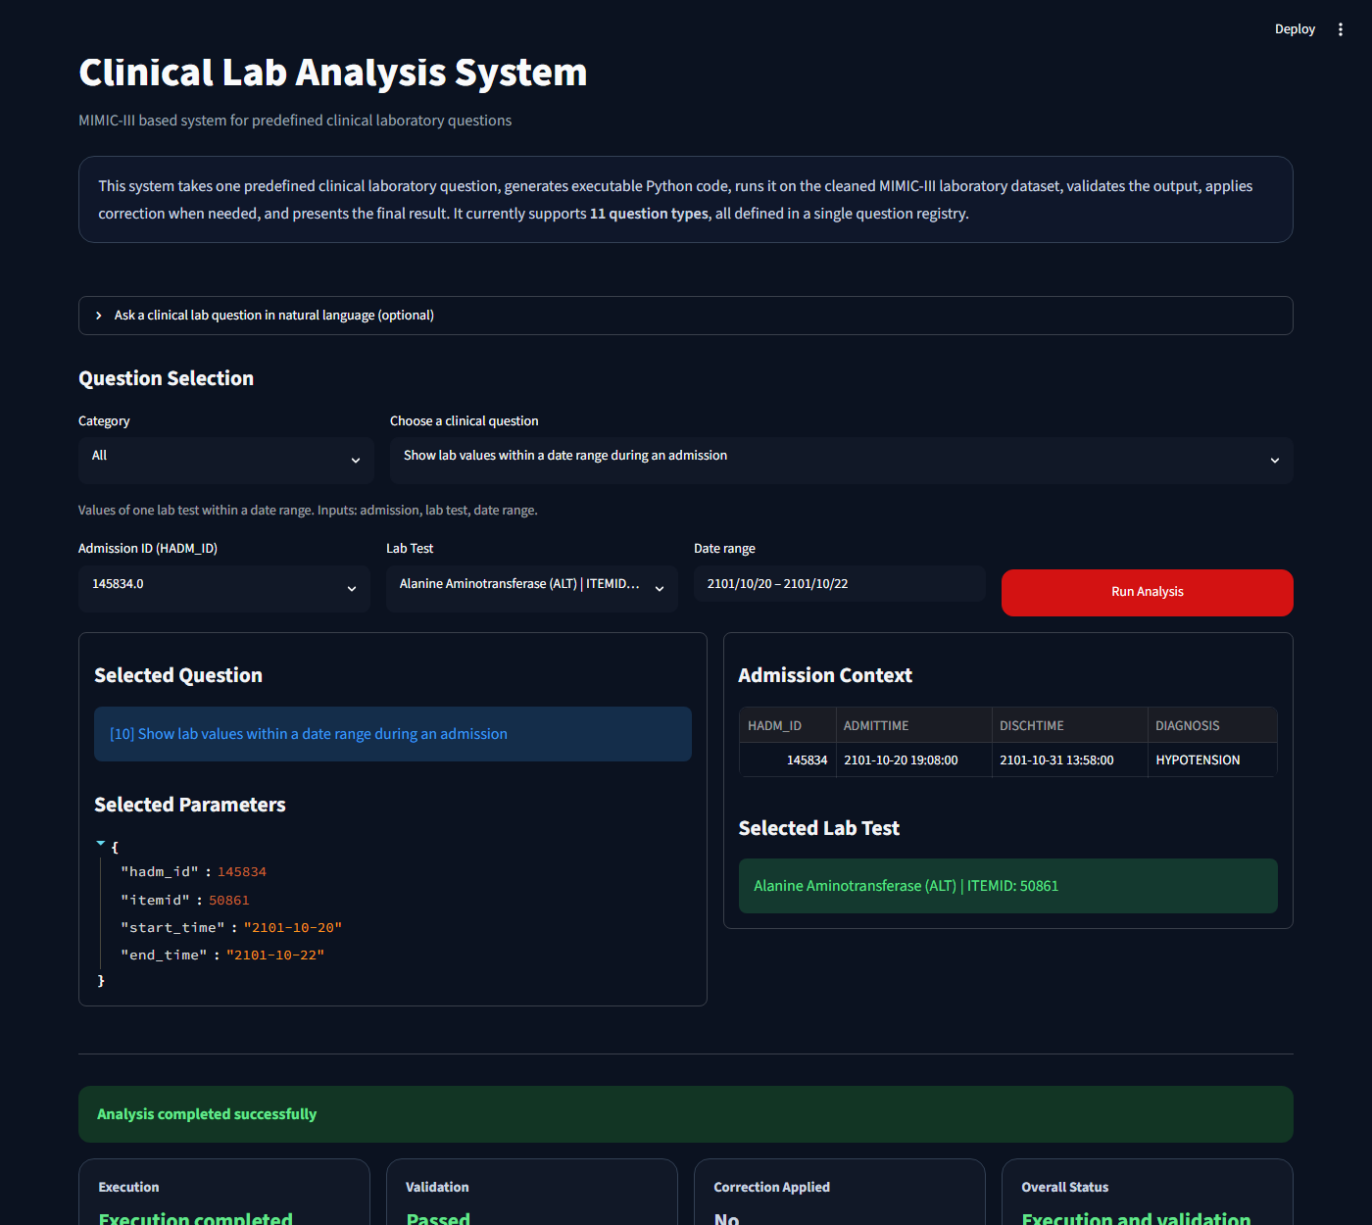
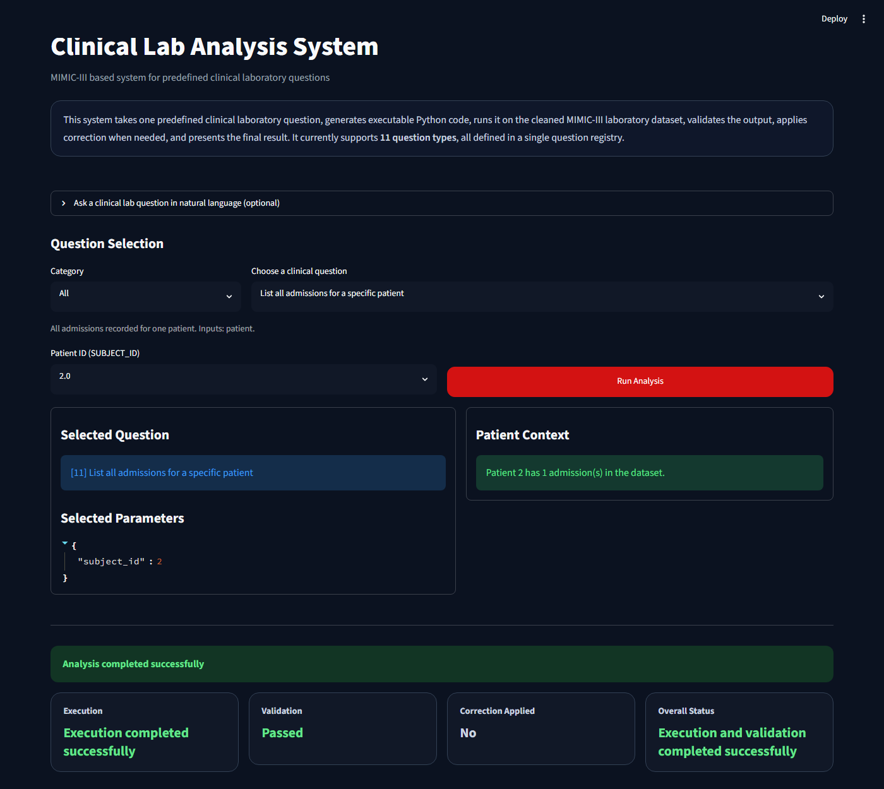
17. Sample Results from MIMIC-III
Real output across multiple questions and admissions
Q2
Chloride Latest
Q3
Hematocrit Trend
103 mEq/L
57.9% → 44.4%
HADM 199884
HADM 107521 (decreasing)
Q5
pO2 First vs Last
Q12
Dataset-Wide
+21 mm Hg
2,839 admissions
HADM 177047: 82 → 103
Abnormal / Normal counted per admission
Q5: First vs Last (pO2)
Q9: Distinct abnormal tests
Q10: Date range values
Q11: Patient admissions
Notes:
Real numbers from the MIMIC-III dataset. Q12 is the dataset-wide aggregate with no admission input needed.

Slide 20



18. Engineering Quality & Design
Modular, tested, and maintainable
Single Source of Truth
Sandboxed Execution
All 12 questions in one registry (questions.py). Adding a question is a one-place change — no edits to app, pipeline, or validation.
AST allowlist + restricted builtins: no imports, no file/network, no loops. Worker thread timeout and row cap.
159 Tests, 94% Coverage
Optional AI, Controlled
Unit tests for every module + end-to-end Streamlit AppTest for all 12 questions. 85% minimum coverage gate in pyproject.toml.
LLM features are off by default. Both routing and code-gen use deterministic validators before any result is shown.
Template Safety
Secrets & Dependency Mgmt
Generated code only calls declared data functions with typed parameters — never executes free-text or user-supplied code.
API keys only in .env (gitignored). Dependencies managed with uv + pyproject.toml + committed uv.lock.
Notes:
Quality is not just test numbers — it's the registry design and sandbox that make this trustworthy.

Slide 21


19. Limitations & Future Work
Honest scope and what comes next
Current Limitations
Future Work
—
Questions are predefined — free-form code-gen is experimental and off by default
Broaden the guarded code-gen catalog with more safe question types
—
Single local CSV dataset — no live SQL backend or real-time hospital connection
Live SQL backend for real-time hospital data integration
—
No authentication or multi-user state isolation
Richer visualizations: heatmaps, multi-lab comparisons, distribution charts
—
UI and chart presentation polish deferred (future iteration)
Support for broader MIMIC-III tables: vital signs, clinical notes, medications
—
Empty results for valid-but-unmatched filters reported as 'no records' (not an error)
LLM-assisted question suggestion and parameter auto-fill
Notes:
Be honest about limitations. The scope is intentionally narrow — reliability over breadth.

Slide 22
20. Conclusion & Key Takeaways
What we built and why it works
Automated Clinical Analysis
Generated + Transparent Code
12 predefined questions answered reliably from MIMIC-III without manual scripting
Every result ships with the exact Python code that produced it — full traceability
One Registry to Rule Them All
Safe & Validated
Single question registry drives UI, code gen, validation, and pipeline — zero duplication
Sandboxed execution, per-question validation, bounded correction, deterministic results
Rich User Experience
Production-Quality Engineering
Metric cards, trend charts, NL input, dark theme, CSV export, generated-code tab
159 tests, 94% coverage, secrets in .env, managed with uv, clean git history
Goal: Provide an automated, reliable, and user-friendly system for clinical laboratory data analysis.
Notes:
Summarize all key points. End with the goal statement from the poster.

Slide 23
Thank You
Clinical Lab Analysis System — MIMIC-III
Hala Hillou • Dana Nmarny • Anas Khoury • Alon Engel
12
159
94%
1M+
Questions
Tests
Tested Code Coverage
Lab Rows
Notes:
Open for questions. Quick stat summary in the bottom row.

