Slide 1
SEMINAR PRESENTATION
Self-Edit:
Fault-Aware Code Editor for Code Generation
Dana Nmarny, Hala Hillou
PRESENTED BY :

Slide 2
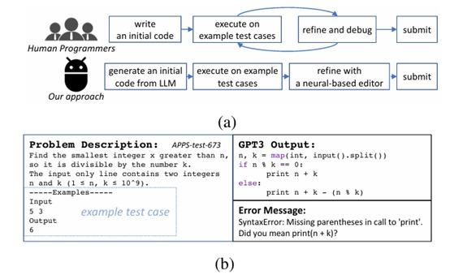
The Problem
02 / 12
Why do LLMs struggle with code generation?
7%
⚠ Syntax Errors
LLMs produce Python 2-style print,
wrong brackets, missing colons
⚡ Runtime Errors
GPT-3 pass@1
on APPS-test
NameError, IndexError, TypeError
crash the program at runtime
✗ Wrong Answers
Logical errors — code runs but
outputs incorrect results
Can we fix AI-generated code using its own execution results
— instead of generating from scratch?
Figure 1 — GPT3 output with SyntaxError on APPS-test

Slide 3
Core Idea
03 / 12
Inspired by how human programmers actually work
👨‍💻 Human Programmers
Write
Execute
Debug
Submit
→
→
→
🤖 Self-Edit (Our Approach)
Generate
Execute
Edit
Submit
→
→
→
◈ Black-box LLM
◉ First Editing Approach
◆ Constant Sample Budget
No retraining of the base model.
Works with any LLM via API.
Novel editing-based method
for competitive programming.
No large-scale sampling.
Fixed number of LLM calls.

Slide 4
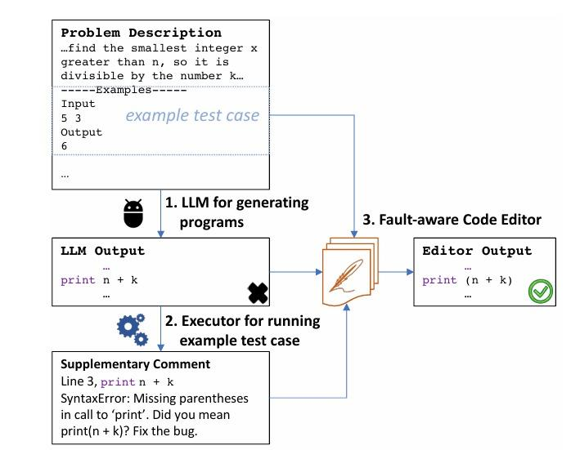
Self-Edit Pipeline
04 / 12
Three-stage generate-and-edit workflow
Generate
01
LLM produces initial code
from problem description
& example test cases
Execute
02
Run code on example test case
Capture: Pass / Wrong Answer
or Error with message
Edit
03
Fault-aware editor receives
description + code + feedback
Outputs corrected code
Figure 2 — Self-Edit pipeline diagram

Slide 5
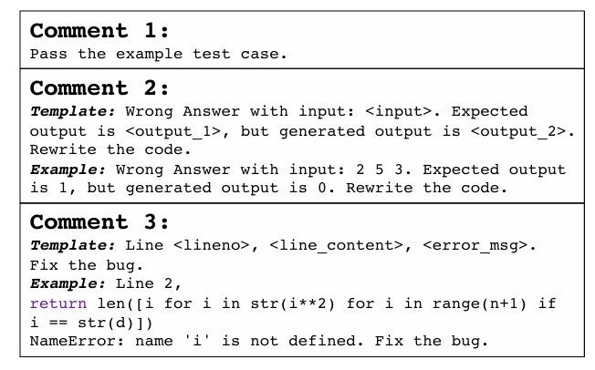
Execution Feedback
05 / 12
Supplementary Comments — the bridge between errors and corrections
✓ Passed
"Pass the example test case."
Editor may still optimize
✗ Wrong Answer
"Expected Y, got Z. Rewrite the code."
Triggers full algorithm rewrite
⚡ Error
"Line N, <code>. <ErrorType>: msg. Fix the bug."
Points to exact line + error type
Figure 4 — Supplementary Comment templates

Slide 6
Fault-Aware Code Editor
06 / 12
Technical design of the neural editor model
INPUT FORMAT
[SOS] description [CODE] program [CMNT] comment [EOS] → Ĉ (corrected code)
Sequence-to-Sequence
Model: PyCodeGPT-110M
Training: GOLD Objective
› Input: (N, S, C) triplet
› Decoder-only transformer
› Off-policy importance weight
› N = problem description
› Fine-tuned on APPS-train
› Focus on high-likelihood tokens
› S = LLM-generated code
› ~4,500 programs per LLM
› Encourages copying valid code
› C = supplementary comment
› ~19% shared prefix retained
› Output: corrected code Ĉ

Slide 7
Experimental Setup
07 / 12
Datasets · Models · Metrics
📊 APPS Dataset
HumanEval
9 LLMs
Split | Problems | Avg. Tests
Train (APPS-train) | 5,000 | 5.56
Dev (APPS-dev) | 598 | 4.03
Test – Introductory | 1,000 | 21.19
Test – Interview | 3,000 | 21.19
Test – Competition | 1,000 | 21.19
› 164 programming problems
› 8.08 avg. hidden tests
› OpenAI benchmark
› Out-of-distribution test
GPT-3 (175B)
GPT-J (6B)
InCoder-1B
GPT-Neo 1.3B
Metrics
CodeGen-2B
GPT-Neo 125M
› pass@k — % problems solved
› sol@k — total correct programs
› k ∈ {1, 5, 10}
CodeGen-350M
PyCodeGPT
text-davinci-002

Slide 8
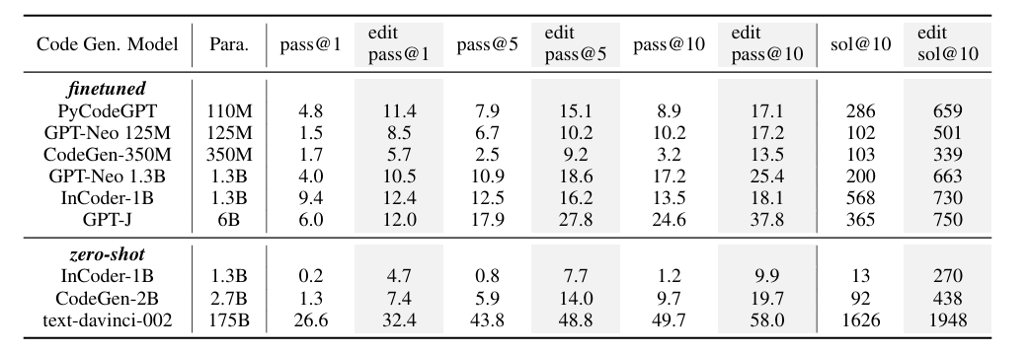
Results
08 / 12
Self-Edit improves all 9 models across all metrics
+89%
+31%
+48%
GPT-3 (175B)
26.6% → 32.4% pass@1
APPS-dev
pass@1 avg.
APPS-test
pass@1 avg.
HumanEval
pass@1 avg.
Table 2 — APPS-dev: pass@k and sol@10 across 9 LLMs (finetuned & zero-shot)

Slide 9
Self-Edit vs. CodeRanker
09 / 12
Editing outperforms ranking with far fewer samples
Feature | CodeRanker | Self-Edit ✓
Approach | Reranking | Editing
Programs needed | 100 per problem | 1–5 per problem
pass@1 APPS-test | 0.3% | 0.68%
Run time | ≥ 110 sec | ~ 12 sec
LLM calls | Many | Few
Problems solved | Baseline | +19 more
Key Advantages
✓
Less compute resources
✓
Fewer LLM API calls
✓
Better pass@1 accuracy
✓
Works with limited budget
✓
More practical for real use
✓
Constant sample overhead

Slide 10
Ablation Studies
10 / 12
What matters most in the system?
Study 1 — Remove Comments
Study 2 — Multiple Edit Rounds
Setting | @1 dev | @5 dev | @1 test
Base model | 4.8 | 7.9 | 0.2
After edit ✓ | 11.4 | 15.1 | 0.6
No comments | 9.4 | 11.5 | 0.3
Setting | dev @1 | test @1
After 1st edit ✓ | 11.4 | 0.64
After 2nd edit | 11.7 | 0.40 ↓
Conclusion
Conclusion
One edit round is optimal. A second round hurts on APPS-test because:
› Editor was trained on LLM outputs
› At test time, it edits its own output
› Creates a train / test distribution gap
› Single-round editing is the right choice
Execution feedback is the most critical component.
Without comments, APPS-test performance barely improves.
Losing comments ≈ losing most of the gain.
Feedback = the most important component
One round = optimal — more hurts

Slide 11
Limitations & Future Work
11 / 12
Honest assessment of current boundaries and next directions
⚠ Current Limitations
🚀 Future Directions
✗
Small editor (110M params)
✓
Larger editor models
May lack capacity for very complex bugs and deep algorithmic issues
Experiment with CodeGen-2B+ architectures for deeper corrections
✗
Small training dataset
✓
Richer training data
Only ~10 samples per problem (~4.5k programs total per LLM)
More diverse samples, extended coverage of problem types
✗
Single-round editing only
✓
Multi-round editing models
Multi-round iteration degrades on APPS-test distribution
Specially designed for sequential self-correction pipelines
✗
Compute cost gaps
✓
In-context learning
No full computational comparison against all post-processing baselines
Leverage GPT-4 as both base model and editor — no training needed

Slide 12
Conclusion
Generate
→
Execute
→
Edit
→
Submit
01
Average +89% improvement on APPS-dev pass@1 across all 9 LLMs tested
02
A tiny 110M editor improved even GPT3-175B: pass@1 26.6% → 32.4%
03
Editing outperforms ranking — fewer samples, better results, less compute
04
Generalizes to out-of-distribution benchmarks (HumanEval +48%)
"Instead of generating more — generate smarter, execute, and fix."

Slide 13

Interactive Activity
Apply the Self-Edit framework — debug real code scenarios
🔍 Identify Errors
💬 Write Feedback
🔧 Fix the Bug

