Slide 1
Big Data and Cloud Computing: New Wine or just New Bottles?
VLDB’2010 Tutorial
Divy Agrawal, Sudipto Das, and Amr El Abbadi
Department of Computer Science
University of California at Santa Barbara

Slide 2
Outline
Data in the Cloud
Data Platforms for Large Applications
Key value Stores
Transactional support in the cloud
Multitenant Data Platforms
Concluding Remarks

Slide 3
Key Value Stores
Key-Valued data model
Key is the unique identifier
Key is the granularity for consistent access
Value can be structured or unstructured
Gained widespread popularity
In house: Bigtable (Google), PNUTS (Yahoo!), Dynamo (Amazon)
Open source: HBase, Hypertable, Cassandra, Voldemort
Popular choice for the modern breed of web-applications

Slide 4
Important Design Goals
Scale out: designed for scale
Commodity hardware
Low latency updates
Sustain high update/insert throughput
Elasticity – scale up and down with load
High availability – downtime implies lost revenue
Replication (with multi-mastering)
Geographic replication
Automated failure recovery

Slide 5
Lower Priorities
No Complex querying functionality
No support for SQL
CRUD operations through database specific API
No support for joins
Materialize simple join results in the relevant row
Give up normalization of data?
No support for transactions
Most data stores support single row transactions
Tunable consistency and availability
Avoid scalability bottlenecks at large scale

Slide 6
Interplay with CAP
Consistency, Availability, and Network Partitions
Only have two of the three together
Large scale operations – be prepared for network partitions
Role of CAP – During a network partition, choose between Consistency and Availability
RDBMS choose consistency
Key Value stores choose availability [low replica consistency]

Slide 7
Why sacrifice Consistency?
It is a simple solution
nobody understands what sacrificing P means
sacrificing A is unacceptable in the Web
possible to push the problem to app developer
C not needed in many applications
Banks do not implement ACID (classic example wrong)
Airline reservation only transacts reads (Huh?)
MySQL et al. ship by default in lower isolation level
Data is noisy and inconsistent anyway
making it, say, 1% worse does not matter
[Vogels, VLDB 2007]

Slide 8
C and A: In a Network Partition
Dynamo – quorum based replication
Multi-mastering keys – Eventual Consistency
Tunable read and write quorums
Larger quorums – higher consistency, lower availability
Vector clocks to allow application supported reconciliation
PNUTS – log based replication
Similar to log replay – reliable log multicast
Per record mastering – timeline consistency
Major outage might result in losing the tail of the log

Slide 9
Too many choices – Which system should I use?

Slide 10
Benchmarking Serving Systems [Cooper et al., SOCC 2010]
A standard benchmarking tool for evaluating Key Value stores
Evaluate different systems on common workloads
Focus on performance and scale out

Slide 11
Benchmark tiers
Tier 1 – Performance
Latency versus throughput as throughput increases
“Size-up”
Tier 2 – Scalability
Latency as database, system size increases
“Scale-up”
Latency as we elastically add servers
“Elastic speedup”

Slide 12
Workload A – Update heavy
50/50 Read/update

Slide 13
Workload B – Read heavy
95/5 Read/update

Slide 14
Workload E – short scans
Scans of 1-100 records of size 1KB

Slide 15
Summary
Different databases suitable for different workloads
Evolving systems – landscape changing dramatically
Active development community around open source systems
In-house systems enriched or redesigned
MegaStore (Google): support for transactions and declarative querying
Spanner (Google): Rumored to have move extensive transactional support across data centers

Slide 16
Outline
Data in the Cloud
Data Platforms for Large Applications
Key value Stores
Transactional support in the cloud
Multitenant Data Platforms
Concluding Remarks

Slide 17
Transactions in the Cloud Why should I care?
Low consistency considerably increases complexity
Facebook generation of developers cannot reason about inconsistencies
Consistency logic duplicated in all applications
Often leads to performance inefficiencies
Are transactions impossible in the cloud?

Slide 18
Design Principles

Slide 19
Design Principle (I)
Separate System and Application State
System metadata is critical but small
Application data has varying needs
Separation allows use of different class of protocols

Slide 20
Design Principle (II)
Limit interactions to a single node
Allows systems to scale horizontally
Graceful degradation during failures
Obviate need for distributed synchronization

Slide 21
Design Principle (III)
Decouple Ownership from Data Storage
Ownership refers to exclusive read/write access to data
Partition ownership – effectively partitions data
Decoupling allows light weight ownership transfer

Slide 22
Design Principle (IV)
Limited distributed synchronization is practical
Maintenance of metadata
Provide strong guarantees only for data that needs it

Slide 23
Two Approaches to Scalability
Data Fusion
Enrich Key Value stores
GStore: Efficient Transactional Multi-key access [ACM SOCC’2010]
Data Fission
Cloud enabled relational databases
ElasTraS: Elastic TranSactional Database [HotClouds2009;Tech. Report’2010]

Slide 24
Data Fusion: GStore

Slide 25
Atomic Multi-key Access [Das et al., ACM SoCC 2010]
Key value stores:
Atomicity guarantees on single keys
Suitable for majority of current web applications
Many other applications need multi-key accesses:
Online multi-player games
Collaborative applications
Enrich functionality of the Key value stores

Slide 26
Key Group Abstraction
Define a granule of on-demand transactional access
Applications select any set of keys to form a group
Data store provides transactional access to the group
Non-overlapping groups

Slide 27
Horizontal Partitions of the Keys
Key Group
Keys located on different nodes
A single node gains ownership of all keys in a KeyGroup
Group Formation Phase

Slide 28
Key Grouping Protocol
Conceptually akin to “locking”
Allows collocation of ownership at the leader
Leader is the gateway for group accesses
“Safe” ownership transfer: deal with dynamics of the underlying Key Value store
Data dynamics of the Key-Value store
Various failure scenarios
Hides complexity from the applications while exposing a richer functionality

Slide 29
Implementing GStore
Application Clients
Transactional Multi-Key Access
Grouping Middleware Layer resident on top of a Key-Value Store
Grouping Layer
Transaction Manager
Grouping Layer
Transaction Manager
Grouping Layer
Transaction Manager
Key-Value Store Logic
Key-Value Store Logic
Key-Value Store Logic
Distributed Storage
G-Store

Slide 30
Data Fission: ElasTraS

Slide 31
Elastic Transaction Management [Das et al., HotCloud 2009, UCSB TR 2010]
Designed to make RDBMS cloud-friendly
Database viewed as a collection of partitions
Suitable for standard OLTP workloads:
Large single tenant database instance
Database partitioned at the schema level
Multi-tenant with large number of small databases
Each partition is a self contained database

Slide 32
Elastic Transaction Management
Elastic to deal with workload changes
Dynamic Load balancing of partitions
Automatic recovery from node failures
Transactional access to database partitions

Slide 33
Application Clients
Application Logic
ElasTraS Client
DB Read/Write Workload
Metadata Manager
TM Master
Lease
Management
Health and Load Management
Master Proxy
MM Proxy
OTM
OTM
Txn Manager
Log Manager
OTM
P₁
P₂
P_{n}
DB Partitions
Durable Writes
Distributed Fault-tolerant Storage

Slide 34
Other Approaches

Slide 35
Database on S3 [Brantner et al., SIGMOD 2008]
Simple Storage Service (S3) – Amazon’s highly available cloud storage solution
Use S3 as the disk
Key-Value data model – Keys referred to as records
An S3 bucket equivalent to a database page
Buffer pool of S3 pages
Pending update queue for committed pages
Queue maintained using Amazon SQS

Slide 36
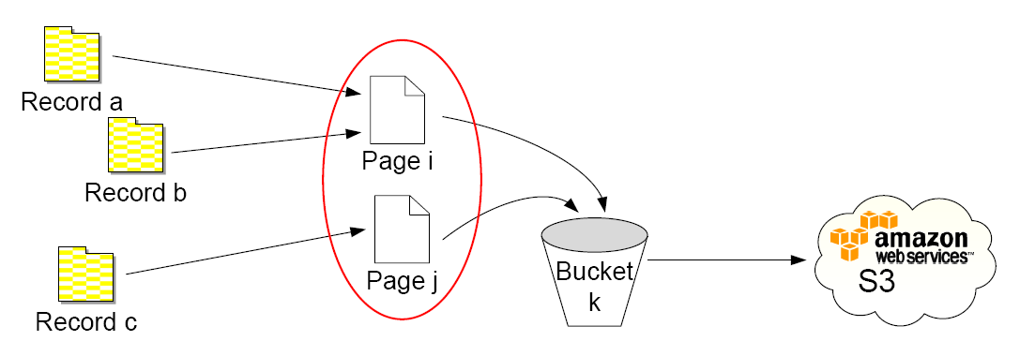
Database on S3
Slides adapted from authors’ presentation

Slide 37
Step 1: Clients commit update records to pending update queues
Client
Client
Client
S3
Pending Update Queues (SQS)
Slides adapted from authors’ presentation

Slide 38
Step 2: Checkpointing propagates updates from SQS to S3
Client
Client
Client
S3
Pending Update Queues (SQS)
ok
ok
Lock Queues (SQS)
Slides adapted from authors’ presentation

Slide 39
Consistency Rationing [Kraska et al., VLDB 2009]
Not all data needs to be treated at the same level consistency
Strong consistency only when needed
Support for a spectrum of consistency levels for different types of data
Transaction Cost vs. Inconsistency Cost
Use ABC-analysis to categorize the data
Apply different consistency strategies per category
Slides adapted from authors’ presentation

Slide 40
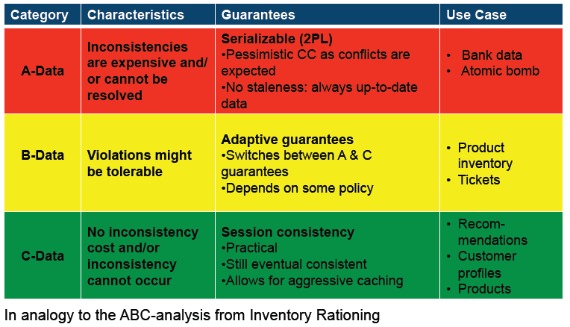
Consistency Rationing
Classification
Slides adapted from authors’ presentation

Slide 41
Adaptive Guarantees for B-Data
B-data: Inconsistency has a cost, but it might be tolerable
Often the bottleneck in the system
Potential for big improvements
Let B-data automatically switch between A and C guarantees

Slide 42
B-Data Consistency Classes
 | Characteristics | Use Cases | Policies
General | Non-uniform conflict rates | Collaborative editing | General Policy
Value Constraint | Updates are commutative A value constraint/limit exists | Web shop Ticket reservation | Fixed threshold policy Demarcation policy Dynamic Policy
Time based | Consistency does not matter much until a certain moment in time | Auction system | Time based policy
Slides adapted from authors’ presentation

Slide 43
General Policy - Idea
Apply strong consistency protocols only if the likelihood of a conflict is high
Gather temporal statistics at runtime
Derive the likelihood of an conflict by means of a simple stochastic model
Use strong consistency if the likelihood of a conflict is higher than a certain threshold
Slides adapted from authors’ presentation

Slide 44
Unbundling Transactions in the Cloud [Lomet et al., CIDR 2009]
Transaction component: TC
Transactional CC & Recovery
At logical level (records, key ranges, …)
No knowledge of pages, buffers, physical structure
Data component: DC
Access methods & cache management
Provides atomic logical operations
Traditionally page based with latches
No knowledge of how they are grouped in user transactions
Query Processing
Concur-
rency
Control
Recovery
TC
DC
Access
Methods
Cache
Manager
Slides adapted from authors’ presentation

Slide 45
Why might this be interesting?
Multi-Core Architectures
Run TC and DC on separate cores
Extensible DBMS
Providing of new access method – changes only in DC
Architectural advantage whether this is user or system builder extension
Cloud Data Store with Transactions
TC coordinates transactions across distributed collection of DCs without 2PC
Can add TC to data store that already supports atomic operations on data
Slides adapted from authors’ presentation

Slide 46
Extensible Cloud Scenario
Application 1
Application 2
calls
calls
deploys
Cloud Services
TC1:
transactional
recovery&CC
TC3:
transactional
recovery&CC
DC1:
tables&indexes
storage&cache
DC4:
tables&indexes
storage&cache
DC5:
RDF & text
DC6:
3D-shape
index
Slides adapted from authors’ presentation

Slide 47
Architectural Principles
View DB kernel pieces as distributed system
This exposes full set of TC/DC requirements
Interaction contract between DC & TC
Slides adapted from authors’ presentation

Slide 48
Interaction Contract
Concurrency: to deal with multithreading
no conflicting concurrent ops
Causality: WAL
Receiver remembers request => sender remembers request
Unique IDs: LSNs
monotonically increasing– enable idempotence
Idempotence: page LSNs
Multiple request tries = single submission: at most once
Resending Requests: to ensure delivery
Resend until ACK: at least once
Recovery: DC and TC must coordinate now
DC-recovery before TC-recovery
Contract Termination: checkpoint
Releases resend & idempotence & causality requirements
Slides adapted from authors’ presentation

Slide 49
And the List Continues
Relational Cloud [MIT]
Cloudy [ETH Zurich]
epiC [NUS]
Deterministic Execution [Yale]
…
Some interesting papers being presented at this conference

Slide 50
Commercial Landscape Major Players
Amazon EC2
IaaS abstraction
Data management using S3 and SimpleDB
Microsoft Azure
PaaS abstraction
Relational engine (SQL Azure)
Google AppEngine
PaaS abstraction
Data management using Google MegaStore

Slide 51
Evaluation of Cloud Transactional Stores [Kossmann et al., SIGMOD 2010]
Focused on the performance of the Data management layer
Alternative designs evaluated
MySQL on EC2
AWS (S3, SimpleDB, and RDS)
Google AppEngine (MegaStore, with and without Memcached)
Azure (SQL Azure)

Slide 52
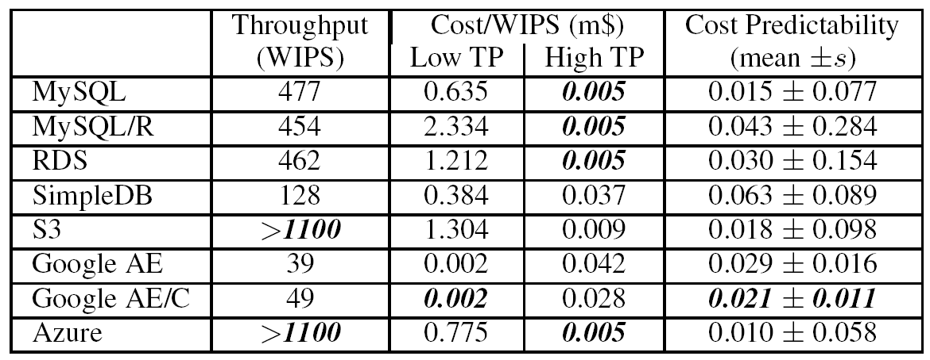
Scalability and Cost

Slide 53
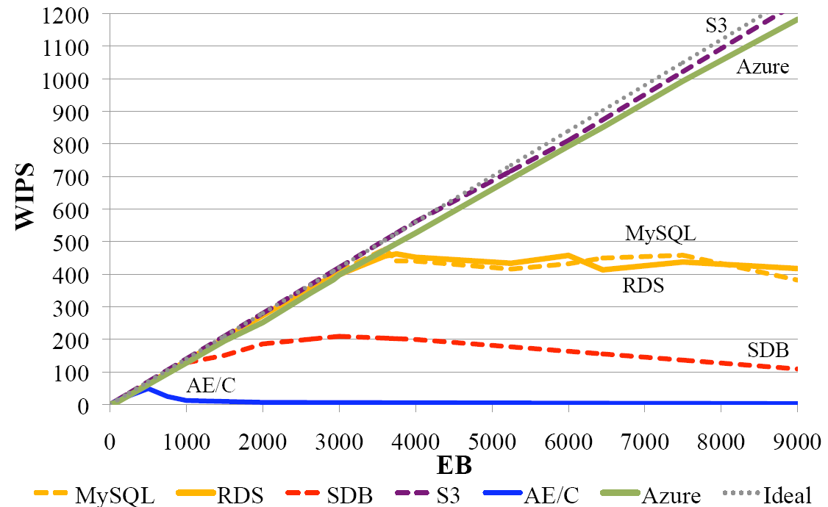
Scalability
Slides adapted from authors’ presentation

Slide 54
Outline
Data in the Cloud
Data Platforms for Large Applications
Multitenant Data Platforms
Multi-tenancy Models
Multi-tenancy for SaaS
Multi-tenancy for Cloud Platforms
Concluding Remarks

Slide 55
Multitenancy
Multi-tenancy is a paradigm in which a service provider hosts multiple clients (tenants) on a single shared stack of software and hardware
Virtualization – Multitenancy in the hardware layer
Major enabling technology for cloud infrastructure
Virtualization in the database tier

Slide 56
Capturing the “Long Tail” in Multi-tenant Applications
Size
large
Large Number of
small tenants
small
Slides adapted from a presentation by B. Reinwald

Slide 57
Multi Application vs. Multi-tenant Application Scenario
Multi Application Scenario
Support a very large number of database applications (with different schemas)
…
…
…
…
…
user₁
user₁₀₀
user₁
user₁₀₀
…
user₁
user₁₀₀
user₁
user₁₀₀
user₁
user₁₀₀
user₁
user₁₀₀
App₁
App₂
App_{10k}
App₁
App₂
…
App_{10k}
…
DB₁
DB₂
DB_{10k}
…
Database
Virtualization
DB₁
DB₁₀
Slides adapted from a presentation by B. Reinwald

Slide 58
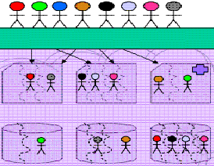
Multi-tenancy Challenges
DB Multi-Tenant Layer
Virtual Multi-Tenant Layer
Virtual Multi-Tenant Layer
Virtual Multi-Tenant Layer
Isolation, Scalability, Performance, Customization, Resource Utilization, Metering …
Slides adapted from a presentation by B. Reinwald

Slide 59
Multitenancy Trade-offs
App1
App2
App3
App1
App1
App2
App2
App3
App3
App1
App1
App2
App2
App3
AA₁
AA₂
AA₃
App3
Application
OS
OS
OS
OS
OS
OS
Hardware
Hardware
Hardware
Hardware
Tenant 1
Lower App Development Effort and Time to Market
Tenant 2
Effective Resource Usage and Scaling, More Complex Design
Tenant 3

Slide 60
Multi-tenancy Resource Sharing and Isolation
MT Sharing Model | Isolation | Description
None | none | Tenants are on different machines. No Sharing
Shared Hardware | VM | Tenants are on the same hardware but isolated in different virtual machines
Shared VM | OS User | Tenants are on the same virtual machine but isolated by OS user authentication (OS level protection)
Shared OS level | DB instance | Tenants share the OS but have different DB instances
Shared DB Instance | DB | Tenants are in the same DB instance but isolated using different databases
Shared Table | Row | Tenants are in the same tables but isolated by row level security
Slides adapted from a presentation by B. Reinwald

Slide 61
Multitenancy Trade-offs
 | Isolated Databases | Separate Schemas | Shared Tables
Simplicity | simple | simple (but need naming and mapping schemes) | hard
Customizability (schema) | high | high | low
Rigorous Isolation (regulatory law) | best | moderate | lowest
Resource Cost/tenant | high | low | lowest
#Tenants | Low | large | Largest
Slides adapted from a presentation by B. Reinwald

Slide 62
Multitenancy Trade-offs
 | Isolated Databases | Separate Schemas | Shared Tables
Tools | tools to deal w/ large number of DBs | tools to deal w/ large number of tables | n/a
DB implementation cost | Lowest (query routing and simple mapping layer) | Low (query routing, simple mapping layer and query mapping) | High (query routing, simple mapping layer, query mapping, row-level isolation)
Scalability | Per tenant | Need some data/load balancing w/ dynamic migration | Need some data/load balancing w/ dynamic migration
Query Optimization | Less critical | Less critical | Critical (wrong plan over very large tables is disastrous)
Per Tenant Query Performance | As usual | need query governance | Need query governance and tenant-specific statistics
Slides adapted from a presentation by B. Reinwald

Slide 63
Force.com architecture Shared table approach [Weissman et al., SIGMOD 2009]
Metadata driven architecture
Tenant specific customizations information stored as metadata
Engine uses metadata to generate virtual application components at runtime
Metadata is key – cache metadata
Application data stored in a large shared table – referred to as the heap
Materialize some virtual tables
Pivot tables used for indexing, maintaining relationships, uniqueness constraints
A collection of pivot tables used

Slide 64
Shared table design
The heap stores all application data
Generic schema – flex columns
Native database index and query processing cannot be applied directly
Metadata used to interpret data from the heap
Application server logic for data re-mapping
Strongly typed pivot tables act as index
Advanced optimization techniques such as chunk folding proposed [Aulbach et al, SIGMOD 2008]

Slide 65
Supporting Large Number of Small Applications [Yang et al., CIDR 2009]
“Small” applications ⇨data fits into a single machine
Each tenant stored in a single MySQL instance
Use shared-nothing MySQL installation
Build the distributed control fabric
Query routing
Failure detection and Load balancing
Guaranteeing SLAs
Similar to the shared process abstraction

Slide 66
Research Challenges
Right sharing abstraction
Shared table design popularly used for SaaS
Is this the right sharing model for PaaS?
Tenant isolation, both for security and performance
Supporting diverse schemas

Slide 67
Research Challenges
High Availability, Failover and Load Balancing
Large number of instances and databases
At the database level, or below the database
Distributed Fabric
Manageability
Many different levels of failure detection
Scale out

Slide 68
Research Challenges
Performance
Single tenant vs. multitenant
Governance
Benchmarks
Resource Models
Cost-efficiency
Performance guarantees
SLAs

Slide 69
Research Challenges
Balance functionality with scale
Most tenants are small
The systems can potentially have hundreds of thousands of tenants
What are the right abstractions for this scale?
What functionality should be supported?

Slide 70
Research Challenges
SLAs and Operating Cost as First-Class features
Important to adhere to SLAs – tenants pays for these SLAs
Minimize the total operating cost – a new optimization goal in system design
Interplay between Cost minimization and SLA satisfaction

Slide 71
Outline
Data in the Cloud
Data Platforms for Large Applications
Multitenant Data Platforms
Concluding Remarks

Slide 72
Scalability Challenges
Storage: 10¹⁸ (Exabytes) ➔ 10²¹ (Zetabytes)
Computing: 16 Million processing nodes/building (100 X 10 X 20 X 20 X 40)
Users: 10⁹ ➔ 10¹⁰
Devices: 10? ➔ 10¹²
Network: 10¹⁸ bytes/year ➔10¹⁸ bytes/year
Number of applications: 10⁵ ➔ 10⁶⁻⁷

Slide 73
Concluding Remarks
Data Management for Cloud Computing poses a fundamental challenge to database researchers:
Scalability
Reliability
Data Consistency
Elasticity
Differential Pricing
Radically different approaches and solutions are warranted to overcome this challenge:
Need to understand the nature of new applications
Database community needs to be involved – maintaining status quo will only marginalize our role.

Slide 74
Acknowledgments
VLDB summer school, Shanghai, 2009
National Science Foundation
National University of Singapore

Slide 75
Questions

Slide 76
References
[Cooper et al., ACM SoCC 2010] Benchmarking Cloud Serving Systems with YCSB, B. F. Cooper, A. Silberstein, E. Tam, R. Ramakrishnan, R. Sears, In ACM SoCC 2010
[Brantner et al., SIGMOD 2008] Building a Database on S3 by M. Brartner, D. Florescu, D. Graf, D. Kossman, T. Kraska, SIGMOD’08
[Kraska et al., VLDB 2009] Consistency Rationing in the Cloud: Pay only when it matters, T. Kraska, M. Hentschel, G. Alonso, and D. Kossmann, VLDB 2009
[Lomet et al., CIDR 2009] Unbundling Transaction Services in the Cloud, D. Lomet, A. Fekete, G. Weikum, M. Zwilling, CIDR’09
[Das et al., HotCloud 2009] ElasTraS: An Elastic Transactional Data Store in the Cloud, S. Das, D. Agrawal, and A. El Abbadi, USENIX HotCloud, 2009
[Das et al., ACM SoCC 2010] G-Store: A Scalable Data Store for Transactional Multi key Access in the Cloud, S. Das, D. Agrawal, and A. El Abbadi, ACM SOCC, 2010.
[Das et al., TR 2010] ElasTraS: An Elastic, Scalable, and Self Managing Transactional Database for the Cloud, S. Das, S. Agarwal, D. Agrawal, and A. El Abbadi, UCSB Tech Report CS 2010-04

Slide 77
References
[Yang et al., CIDR 2009] A scalable data platform for a large number of small applications, F. Yang, J. Shanmugasundaram, and R. Yerneni, CIDR, 2009
[Kossmann et al., SIGMOD 2010] An Evaluation of Alternative Architectures for Transaction Processing in the Cloud, D Kossmann, T. Kraska, Simon Loesing, In SIGMOD 2010
[Aulbach et al., SIGMOD 2009] A Comparison of Flexible Schemas for Software as a Service, S. Aulbach, D. Jacobs, A. Kemper, M. Seibold, In SIGMOD 2009
[Aulbach et al., SIGMOD 2008] Multi-Tenant Databases for Software as a Service: Schema and Mapping Technicques, In SIGMOD 2008
[Weissman et al., SIGMOD 2009] The Design of the Force.com Multitenant Internet Application Development Platform, C.D. Weissman, S. Bobrowski, In SIGMOD 2009
[Jacobs et al., DTW 2007] Ruminations of Multi-Tenant Databases, D. Jacobs, S. Aulbach, In DTW 2007
[Chang et al., OSDI 2006] Bigtable: A Distributed Storage System for Structured Data, F. Chang et al., In OSDI 2006
[Cooper et al., VLDB 2008] PNUTS: Yahoo!'s hosted data serving platform, B. F. Cooper et al., In VLDB 2008
[DeCandia et al., SOSP 2007] Dynamo: amazon's highly available key-value store, G. DeCandia et al., In SOSP 2007

