Slide 1


ML-Powered ADHD Predictor
Sex-Specific Brain Connectivity Patterns for ADHD Prediction using Machine Learning
Presenter:
Kunal Prasad | BCA | CSIT | Final Year PPT, Guru Ghasidas Vishwavidyalaya | May 2025 |

Slide 2
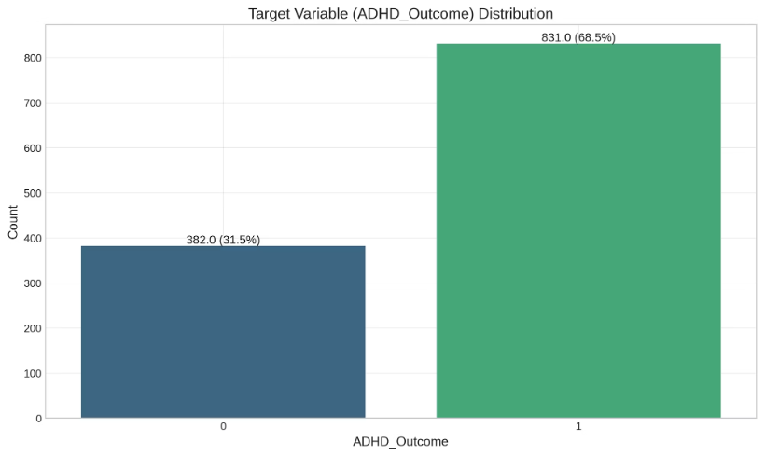
ADHD and Research Context
ADHD Prevalence
WiDS Datathon 2025
11% adolescents affected
Using fMRI and ML to address diagnostic gaps
14% boys, 8% girls
Females often underdiagnosed

Slide 3
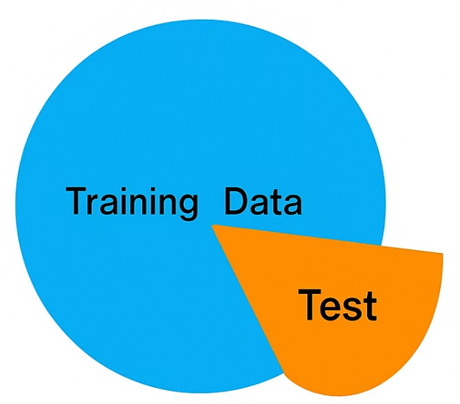
Dataset Overview
Source
Subjects
Healthy Brain Network (HBN)
~1,200 train; ~300 test
Data
fMRI connectomes: 36x36 matrices, 630 features
Metadata: Age, SDQ scores, parent education
1213
row
columns
19931

Slide 4
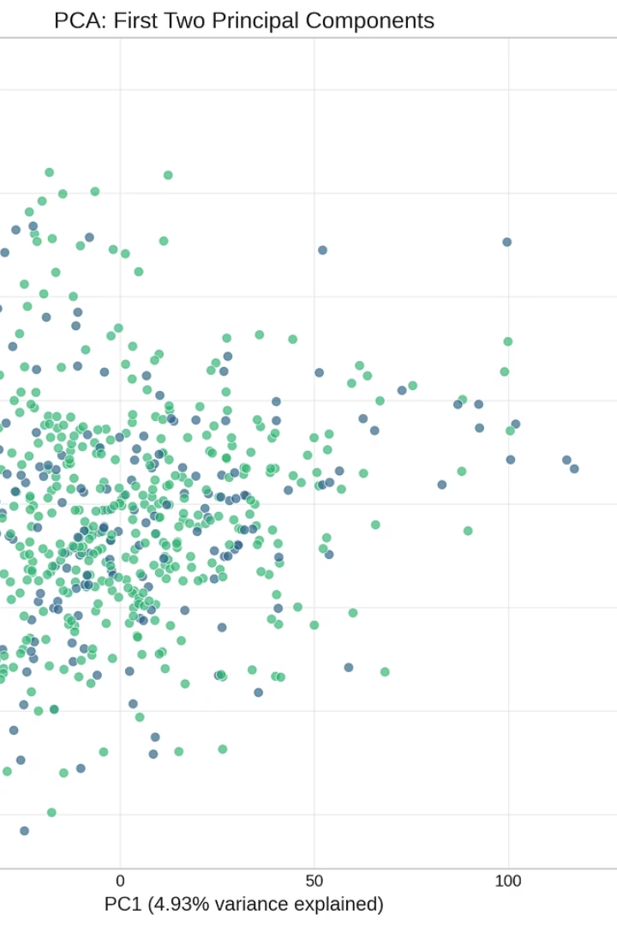



Data Preprocessing
fMRI
Metadata
PCA with ~50 components, 95% variance
Interaction terms, median imputation
Exploratory Data Analysis
14% ADHD males, 8% females; SDQ_Hyperactivity r=0.42
Data → Preprocessing → Feature Engineering → Model Training → Evaluation

Slide 5
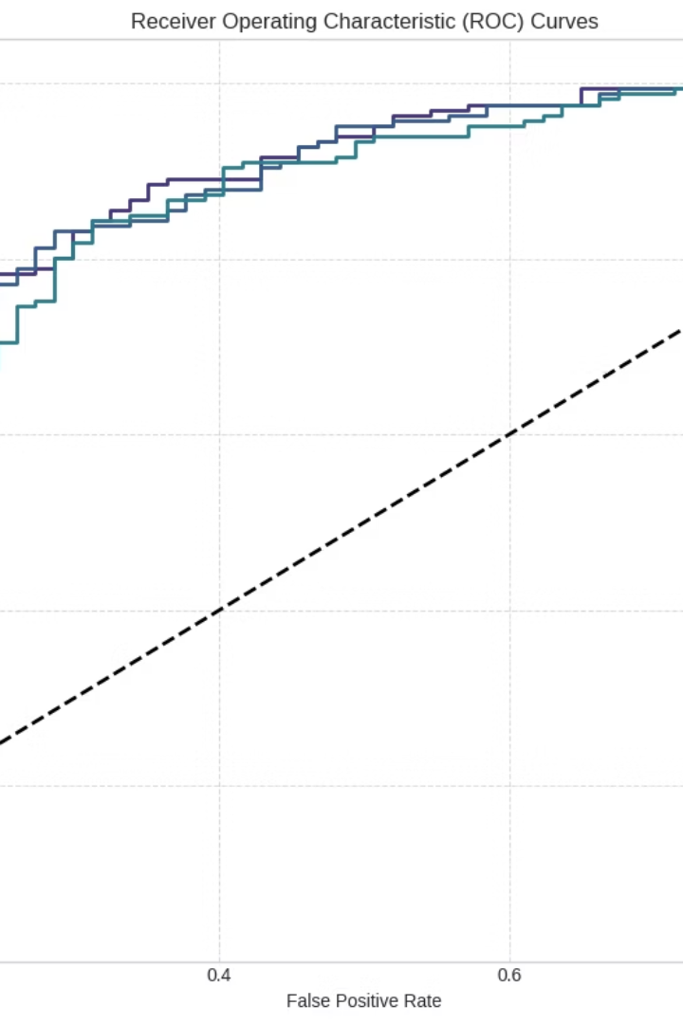
Methodology
Models
Logistic Regression, XGBoost, Random Forest, stacking ensemble
Training
5-fold stratified CV, GridSearchCV
Metrics
ROC-AUC, recall, precision
Interpretability
SHAP values for feature importance

Slide 6
Model Performance
Model
ROC-AUC
Recall
Logistic Regression
0.8668
0.9639
Ensemble
0.8683
0.8977
Ensemble ROC-AUC
Precision & Recall by Sex
0.89 ± 0.02
Males: 85% precision
Logistic Regression Recall
Females: 74% recall
96.4%

Slide 7




Key Findings
DLPFC Connectivity
SDQ Hyperactivity
Top predictor (+0.21 SHAP)
1
2
Important predictor (+0.18 SHAP)
Sex Differences
DMN
4
3
Females: Amygdala
Critical for ADHD diagnosis
Males: Cerebellar

Slide 8
Limitations & Future Work
Future
Limitations
Multi-output ADHD+sex model.
Small sample (~1,200).
EEG diagnostics.
fMRI cost (~$500/scan).
Diverse datasets.
HBN data bias (severe cases).

Slide 9
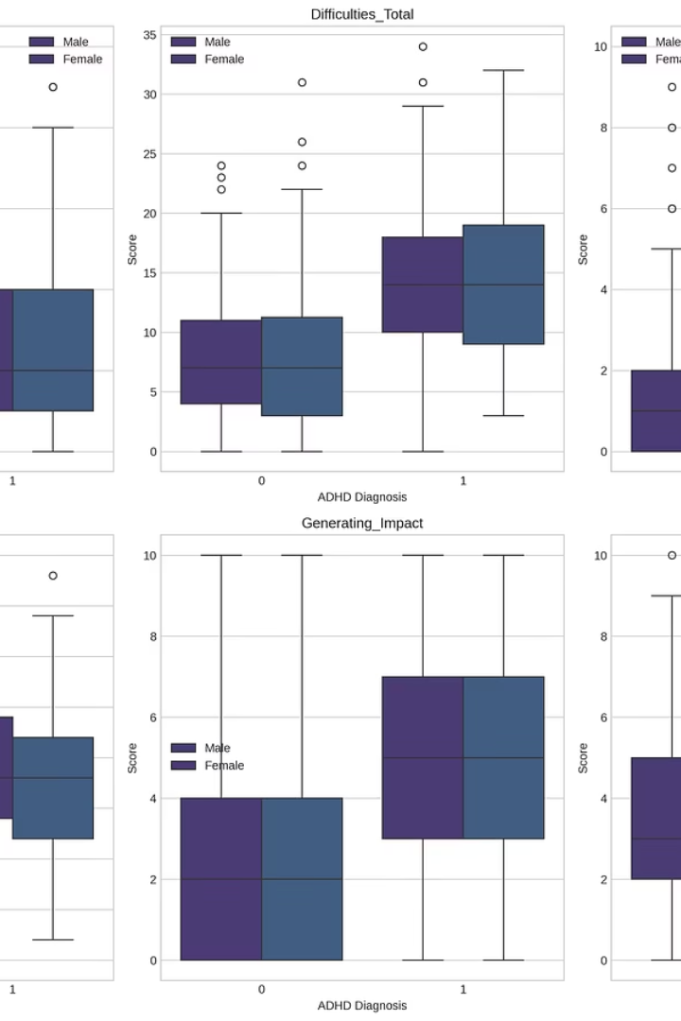
Conclusion
Identified DLPFC, amygdala as key ADHD biomarkers.
Improved female diagnosis via sex-specific patterns.
Open-source pipeline advances neuroscience-ML integration.
“This work contributes to equitable and interpretable ADHD
diagnostics by combining domain-specific neuroscience with ML pipelines”

Slide 10

Thank you for your attention!
Questions welcome!
I sincerely thank | Dr. Babita Majhi, Assistant Professor |
for her invaluable guidance and support throughout this project.

