Slide 1
Campus Facility Maintenance Request Management System
PROJECT 41
Database Management Systems – Project-Based Learning (Final Presentation)
[Student Name] | [Roll No.] | [Program / Section] | Faculty: [Name]
Notes:
Introduce the project: a relational database plus a small Python application for managing campus maintenance complaints end to end. Mention that placeholders on this slide must be replaced with your details.

Slide 2
Manual registers cannot track repairs
?
!
₹
✓
No single view
Overloaded staff
Hidden costs
No closure proof
Which complaints are pending, and for how long?
Technicians get jobs beyond their capacity
Material and labour cost per building is unknown
Requests close without any record of work done
Need: a normalised database with rules enforced inside it, plus a simple application for daily use.
Notes:
Explain the problem: complaints arrive by phone and paper registers. Nobody can see what is pending, who is overloaded, how long requests wait, or what each building costs. The database makes those answers a query.

Slide 3
Objectives and scope
1
Design ER model and 3NF schema (16 entities)
Out of scope
2
Implement SQLite DB: constraints, triggers, views, 40 sample requests
Login and roles
E-mail / SMS alerts
Preventive maintenance
Vendor invoicing
Mobile app
3
Enforce 5 business rules inside the database
4
Build Python/Flask app with parameterised queries and transactions
5
Produce 7+ reports and validate with 19 test cases
Notes:
Five measurable objectives; all were met. Out-of-scope items are listed as future work at the end.

Slide 4
Rules live in the database
Browser UI
Forms, search, dashboard, reports
Why this matters
Rules hold for every user and program
Every status change is logged automatically
Reports are SQL views, always up to date
▼
Flask application (Python)
Input validation • parameterised SQL • transactions • friendly errors
▼
SQLite database
16 tables • 11 indexes • 12 triggers • 8 views
Notes:
Three layers. The browser sends requests to Flask, which validates input and runs parameterised SQL in transactions. SQLite enforces constraints and triggers, so even another program cannot break the rules.

Slide 5
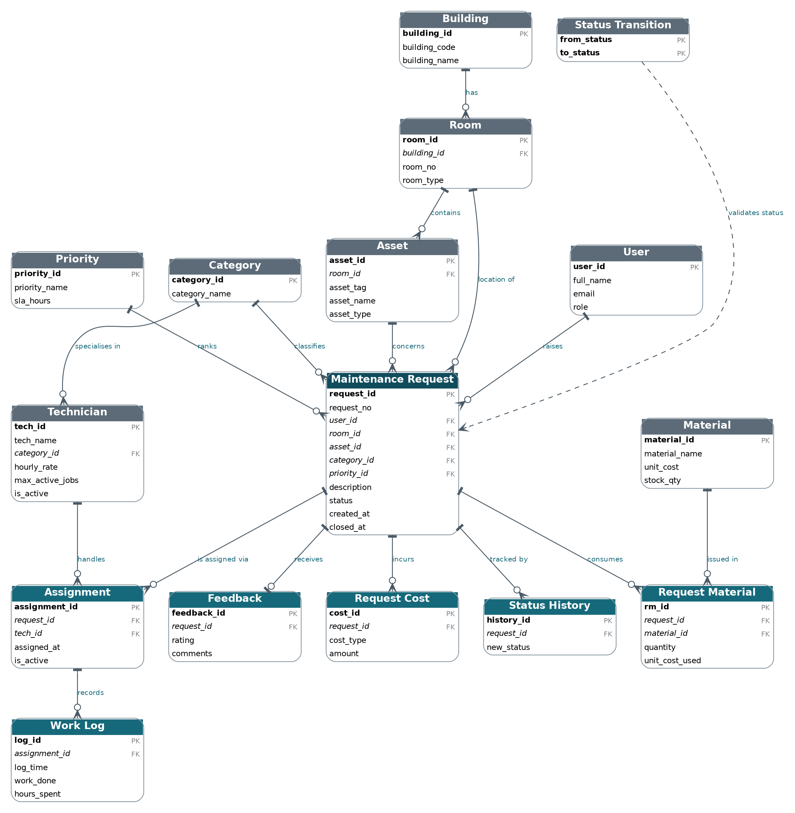
ER diagram: 16 entities around one request
Central entity
Maintenance Request links user, room, asset, category, priority
Associative entity
Request Material resolves the M:N between request and material
Audit and control
Status History and Status Transition drive the workflow
Crow's-foot notation; circle = optional participation
Notes:
The request is the central entity. Assignment, work log, materials, costs, status history and feedback record what happens to it. The diagram was generated from the implemented schema so it matches the database exactly.

Slide 6
Normalised to Third Normal Form
Un-normalised
1NF
2NF
3NF
One register with repeating work, material and status entries
Repeating groups moved to separate tables; atomic columns
Material facts separated from the (request, material) pair
Room → Building, Priority → SLA, Technician → Category held once
▶
▶
▶
Design choice: costs are derived by a view, never stored as totals – no redundancy, no update anomalies.
Notes:
Start from one un-normalised register. 1NF moves repeating groups out, 2NF removes partial dependencies, 3NF removes transitive ones such as request to room to building. All 16 relations also satisfy BCNF.

Slide 7
Five rules enforced by the database
Unique request numbers
UNIQUE(request_no)
Valid status transitions
status_transition table + BEFORE UPDATE trigger
1
4
Closure details required
Table-level CHECK on status, closed_at, remarks
Assignment control
Capacity trigger + one active technician per request
2
5
Non-negative materials and costs
CHECK quantity > 0, amount ≥ 0, stock ≥ 0
Plus: stock check, feedback only after closure, delete guard, automatic status history
3
Notes:
Each rule uses the right mechanism: UNIQUE, CHECK, a transition table with a trigger, and a trigger plus partial unique index for assignment control.

Slide 8
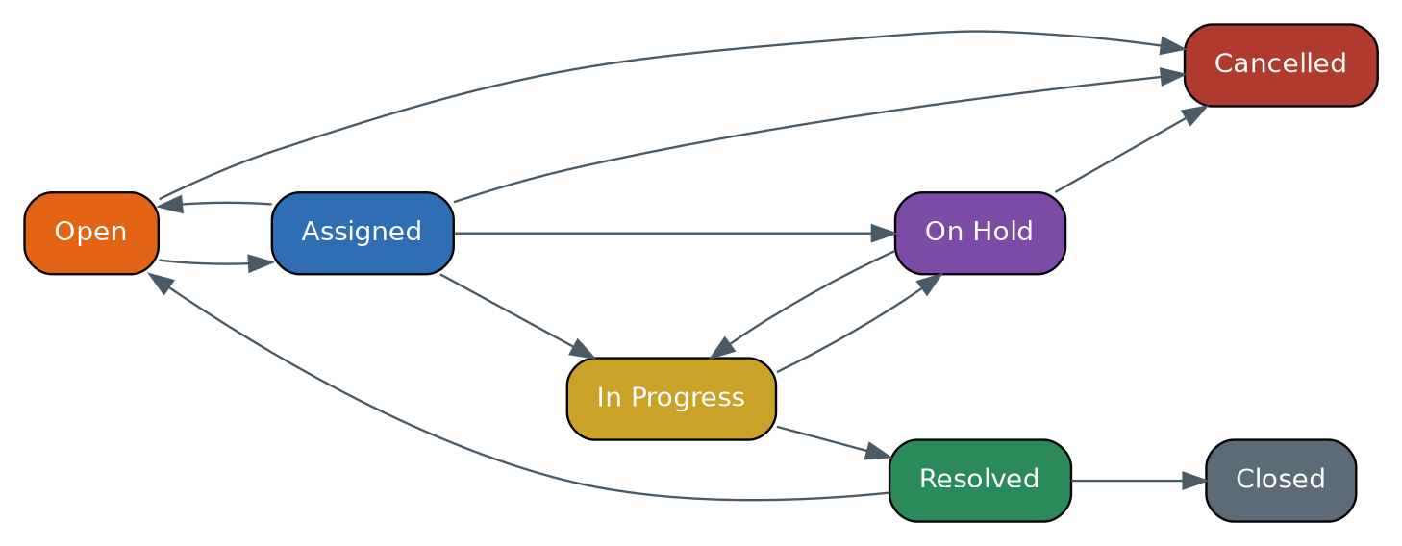
A controlled request life cycle
Automatic effects
Assign → status Assigned
First work log → In Progress
Resolved / Closed / Cancelled → technician released
Every change → history row
Generated from the status_transition table
Notes:
The allowed transitions are stored as data. The UI offers only valid next statuses and the trigger rejects anything else even when SQL is run directly. Terminal states are Closed and Cancelled.

Slide 9
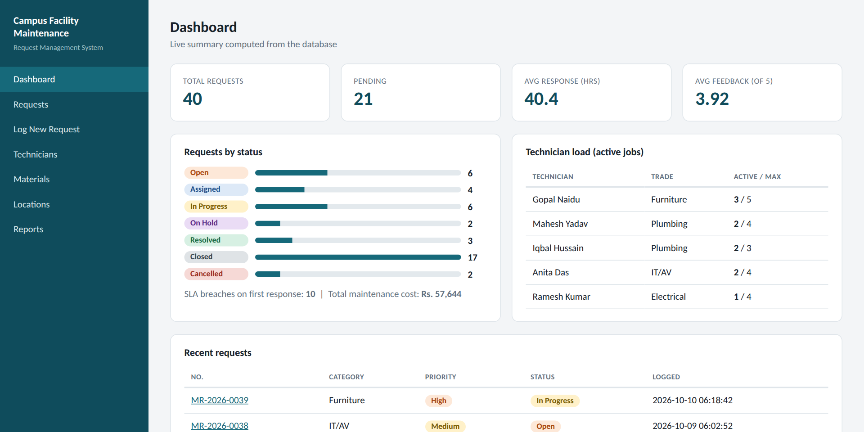
Live dashboard from SQL views
40
requests
21
pending
40.4 h
avg first response
3.92 / 5
avg feedback
Notes:
The dashboard is computed from the database on every load: totals, pending count, average response time against SLA, average feedback, status distribution and technician load.

Slide 10
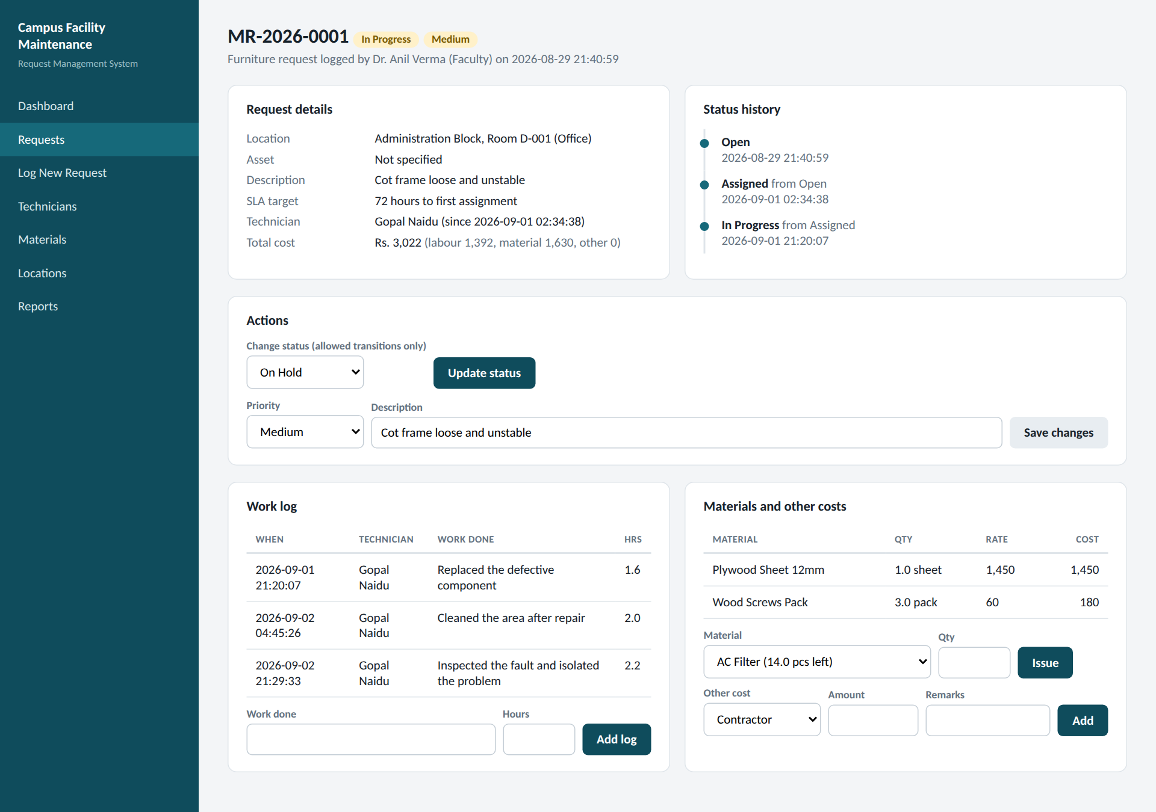
One screen for the whole request
Assign
Technician list shows load, e.g. 2/4 jobs
Work and materials
Hours logged; stock reduced on issue
Status and closure
Only allowed next statuses; remarks required
Cost
Labour + material + other, per request
Notes:
Assignment, work log, materials, extra costs and status history on one page. All actions are parameterised INSERT or UPDATE statements in a transaction.

Slide 11
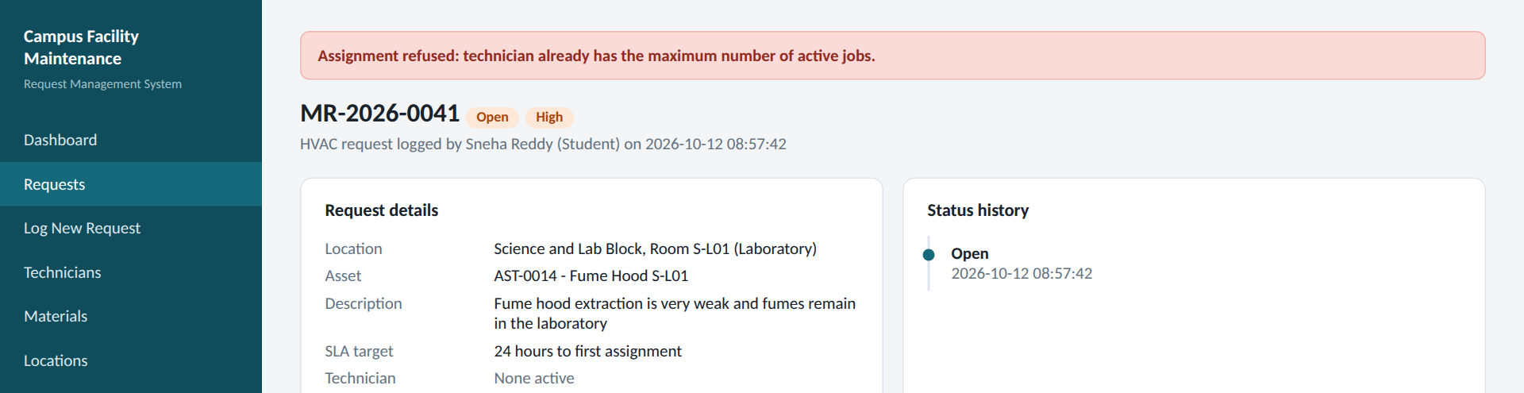
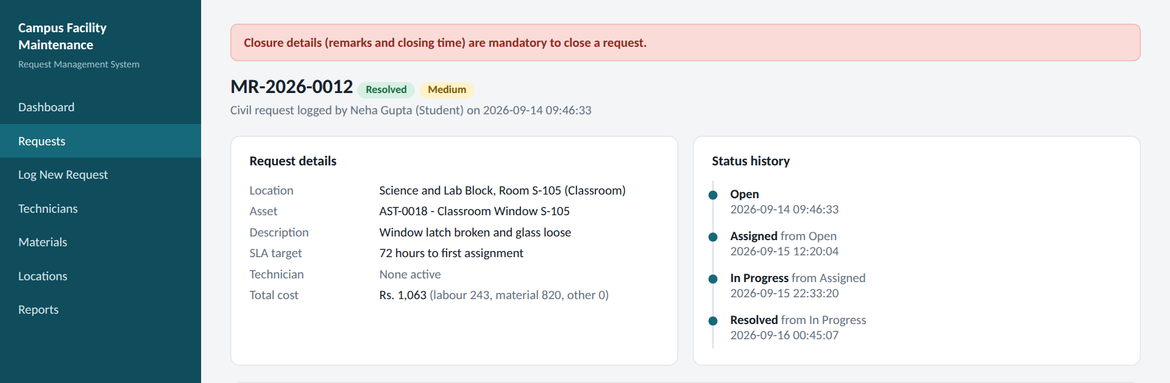
Invalid actions are rejected by the database
Assignment control (capacity trigger)
Closure details required (CHECK)
Every refused operation is rolled back – no partial rows are left behind.
Notes:
Left: a technician at maximum capacity cannot be given another job. Right: a Resolved request cannot be closed without closure remarks. Both messages come from database triggers and constraints, mapped to friendly text.

Slide 12
Reports answer management questions
Notes:
Left: building-wise maintenance cost from the v_building_cost view. Right: active jobs per technician against capacity from v_technician_load. Other reports: pending, ageing, response time and SLA, material use, feedback.

Slide 13
19 of 19 executable tests pass
19/19
Rules in the database
Unique number, invalid transition, closure details, negative cost, capacity, stock, feedback, delete, foreign key
✓
Application validation
Short description, negative quantity, bad rating
test cases passed
✓
Normal operations
Create, assign, close, issue material, search, cancel, reports
✓
Totals in the cost report equal request-wise totals (consistency check).
Notes:
Each test runs on a freshly built database copy. Tests mix positive cases and negative cases that must be rejected. Results shown in the report are the observed output of the script.

Slide 14
A measurable, auditable maintenance workflow
16 tables in 3NF • 12 triggers • 8 views • 19/19 tests
Next: login and roles, notifications, MySQL/PostgreSQL port, mobile UI
Thank you – Questions?
Notes:
Summarise: the database enforces the rules, the app uses it through parameterised queries and transactions, and all tests pass. Then invite questions.

