Slide 1
From 10⁴ genes to one number
A coupling-strength order parameter ρ for cellular dysregulation
Genome-wide dysregulation in antibiotic tolerance and persistence
Random-matrix theory · Gaussian-copula simulations · bacterial scRNA-seq

Slide 2
THE QUESTION
The cell as a strongly-interacting many-body system
A transcriptome is ~10³–10⁴ genes coupled by a regulatory network.
The spin-glass question:
Sherrington–Kirkpatrick — N spins, all-to-all random couplings Jᵢⱼ. The macroscopic state is set by the width J of the coupling distribution, not the ∼N² individual Jᵢⱼ.
Our claim:
the genome-wide regulatory state collapses onto a single coupling strength ρ (shared-variance fraction) — analogous to J. The whole talk: define ρ, recover it from simulations, measure it in data.
Biology, stated once: stress (antibiotics) acts like raising temperature — it melts the ordered network. Tolerant/persister cells = low ρ.

Slide 3
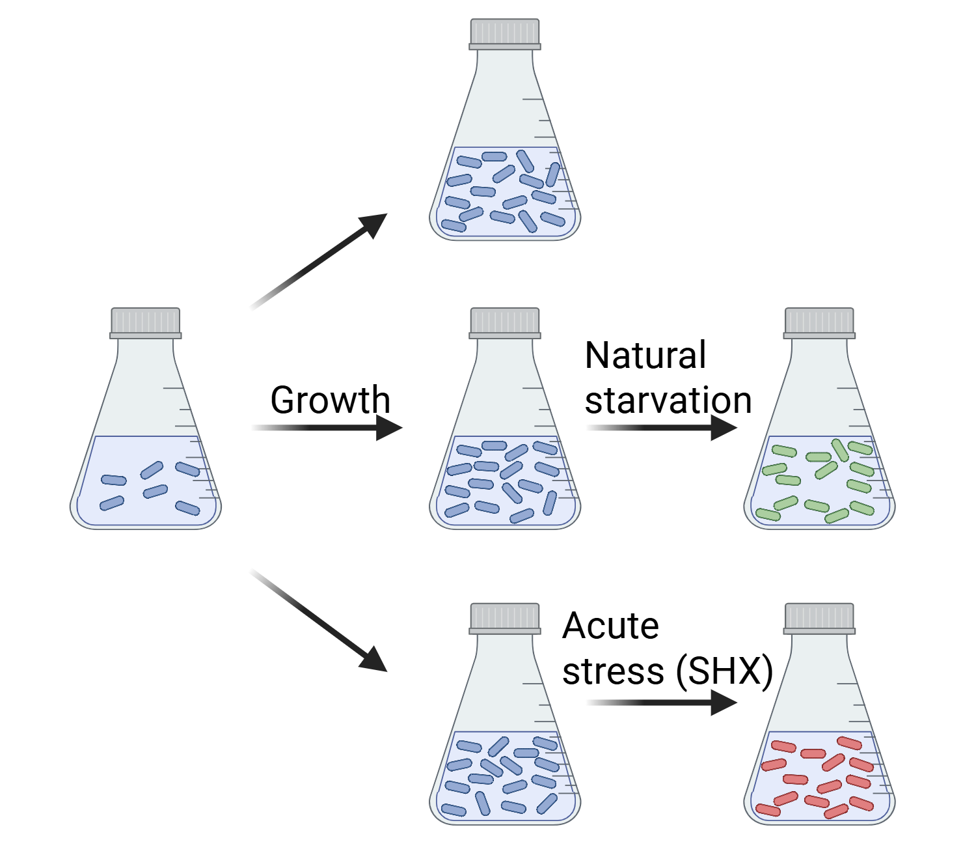
SETUP
The data is a large random matrix
• Count matrix X : n cells × p genes
p ∼ 10³–10⁴, n ∼ 10³ → ratio γ = p/n = O(1)
• Object of interest: the gene–gene correlation matrix
C = (1/n) XᵀX after row-normalize + z-score
• This is the RMT regime
sample correlations are dominated by noise — we need the right null
• Plan
(1) noise null, (2) order parameter, (3) calibrate with simulations, (4) measure data
Single-cell RNA-seq of bacteria under acute stress (experimental setup).

Slide 4
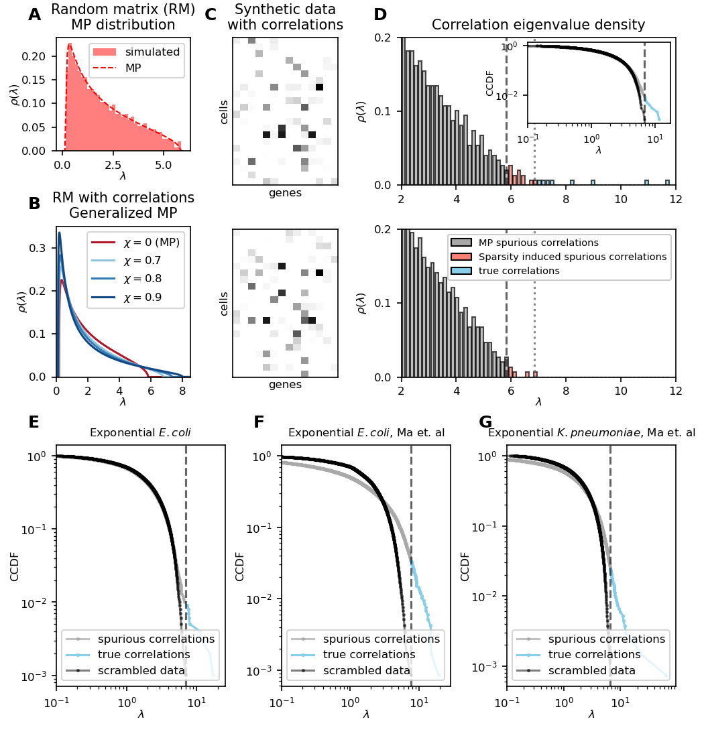
THEORY
Null model, signal, and an order parameter
• Marchenko–Pastur null
independent genes → eigenvalues fill the MP sea λ± = (1±√γ)² (the ρ=0 reference)
• Realize it by scrambling
permute each gene across cells — kills correlations, keeps marginals; matches MP
• Correlations push eigenvalues out
outliers above λ_max^scr = BBP-type transition
• Generalized MP (GMP)
a one-parameter ρ deformation of the bulk — fit ρ to the whole spectrum
• Order parameter:
GMP-Cor = Σ max(λᵢ − λ_max^scr, 0) = spectral weight expelled above the noise edge
Fig 2: random-matrix MP, generalized-MP at ρ=0/0.7/0.8/0.9, eigenvalue density & data CCDFs.

Slide 5
THE MODEL
What ρ means microscopically
Factor model for the ground-truth correlation matrix:
A = √(1−ρ)·I + cluster factors + one global hub factor ; C = AAᵀ, normalized to unit diagonal
ρ = shared-variance fraction — it sets the mean off-diagonal magnitude (the coupling width).
Two-tier structure mirrors the biology at low resolution:
clusters ≈ operons / regulons · global hub ≈ master regulator.
ρ → 1 : tightly coupled, ordered network · ρ → 0 : decoupled, dysregulated.

Slide 6
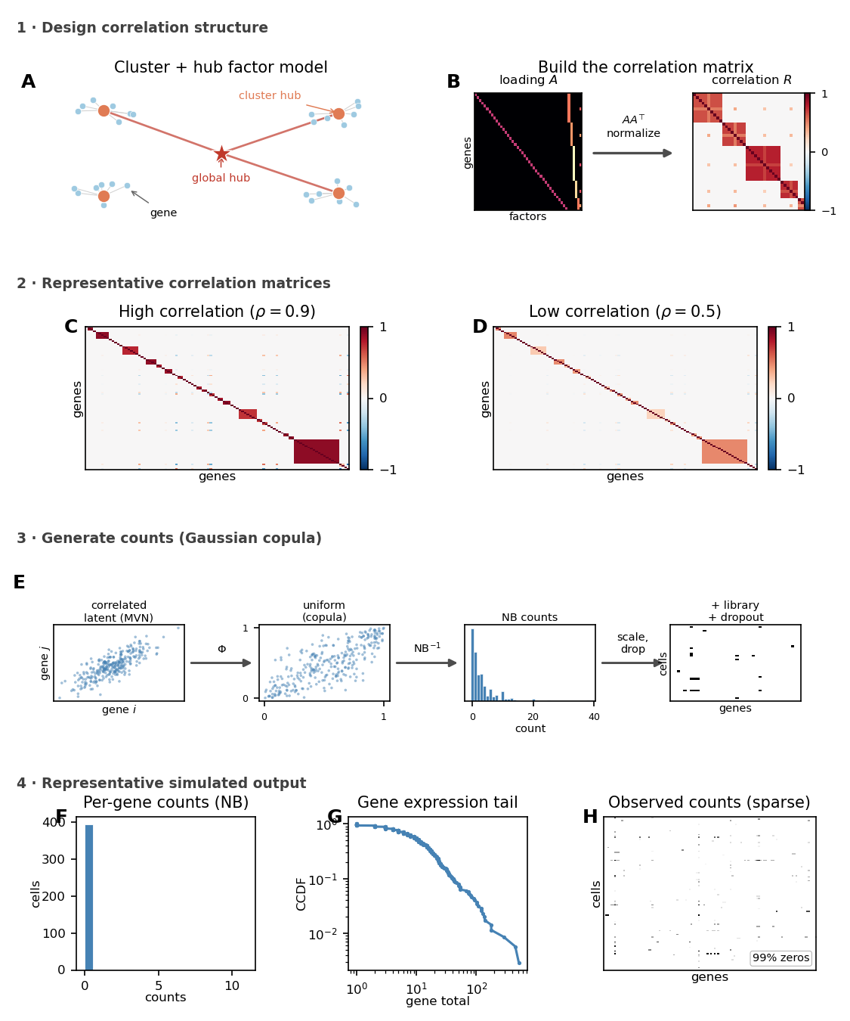
SIMULATIONS
A realistic instrument with known ρ
• Goal
test whether GMP-Cor recovers the microscopic coupling under realistic noise
• Stage 1: structure
build C(ρ) from the cluster+hub factor model
• Stage 2: counts via Gaussian copula
latent z~N(0,C) → Φ → NB counts (inv-Gamma means)
• Realistic nuisances
library-size variation + expression-dependent dropout
• Why it works
two-stage design decouples ground-truth ρ from count-level noise
Fig S2: factor-model network → correlation matrix → copula count pipeline → simulated output.

Slide 7
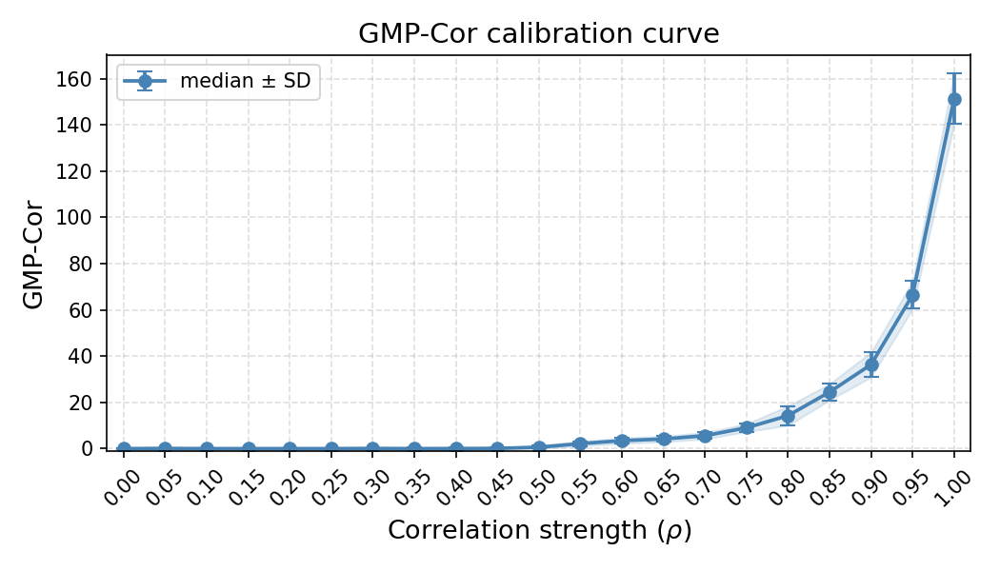
CALIBRATION
Key result: GMP-Cor faithfully recovers ρ
• Sweep ρ, hold structure fixed
only count-sampling noise varies across repeats
• GMP-Cor(ρ) is monotonic
and robust — small error bars over replicates
• The order parameter is invertible
one number reports the microscopic coupling strength
• This is the ‘it works’ slide
spectral readout ↔ hidden ρ, by construction-blind calibration
ρ-sweep calibration: GMP-Cor increases monotonically with the coupling strength ρ.

Slide 8
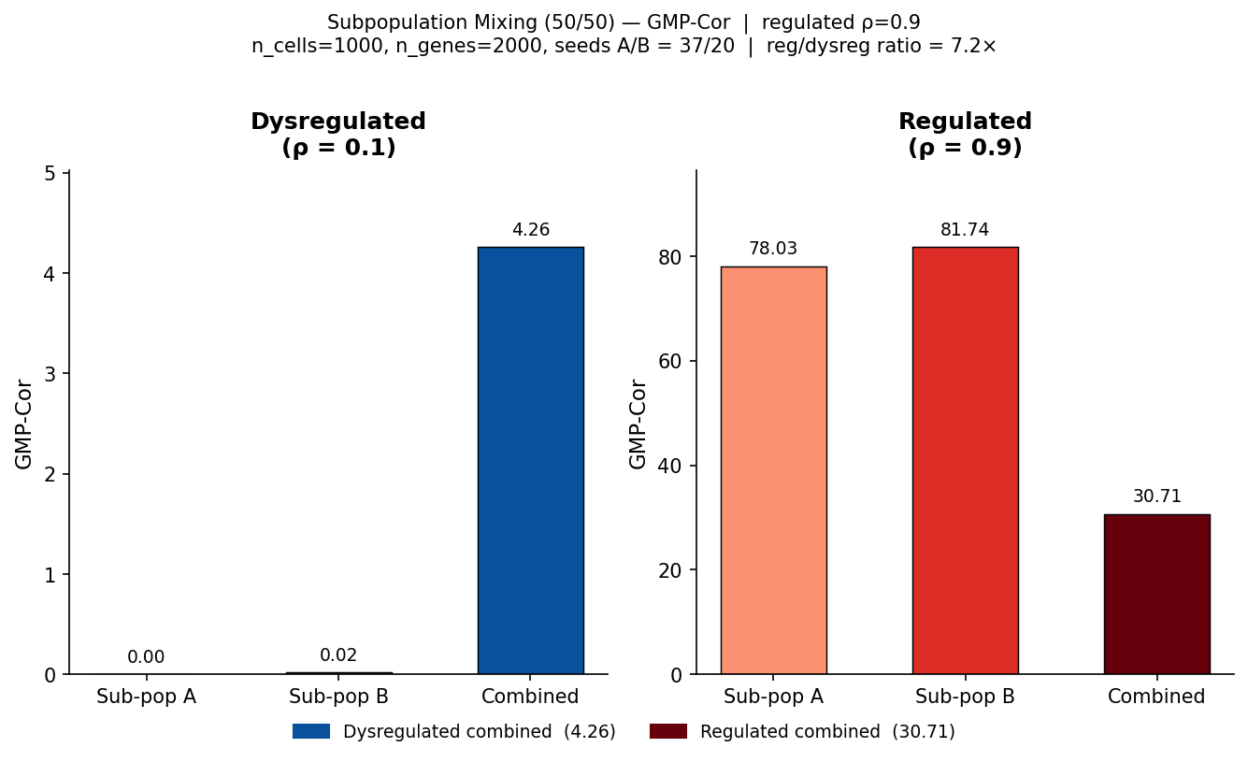
ROBUSTNESS
It measures coupling, not heterogeneity
• The obvious objection
‘you’re just detecting clusters / batch structure’
• Stress test
mix two subpopulations with distinct hub topologies but the same ρ
• Result
GMP-Cor separates a mix of two regulated pops (high ρ) from two dysregulated pops (low ρ)
• Conclusion
the metric reports coupling strength, not mere population mixing
50/50 subpopulation-mixing control: GMP-Cor tracks ρ, not the number of populations.

Slide 9
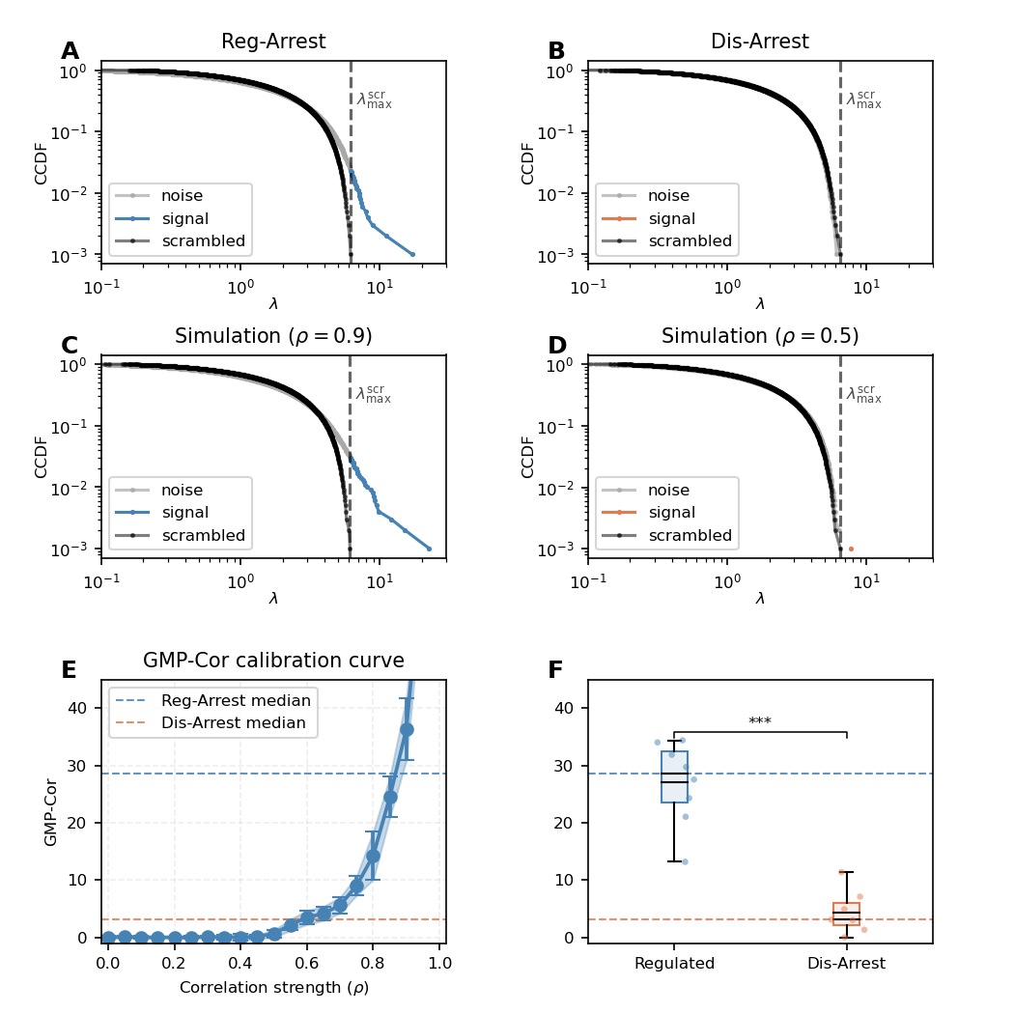
DATA
Real cells fall on the calibration curve
Empirical spectra → fitted ρ
High-ρ vs low-ρ samples have visibly different eigenvalue spectra; each collapses to one ρ.
Simulations match data
ρ=0.9 sim ↔ regulated cells · ρ=0.5 sim ↔ dysregulated cells.
Groups separate on ρ
Regulated vs Dis-Arrest populations land at distinct, significant GMP-Cor — right on the calibration curve.
Fig 3: experimental Reg- vs Dis-Arrest spectra, matched simulations (ρ=0.9 / 0.5), calibration curve, group comparison.

Slide 10
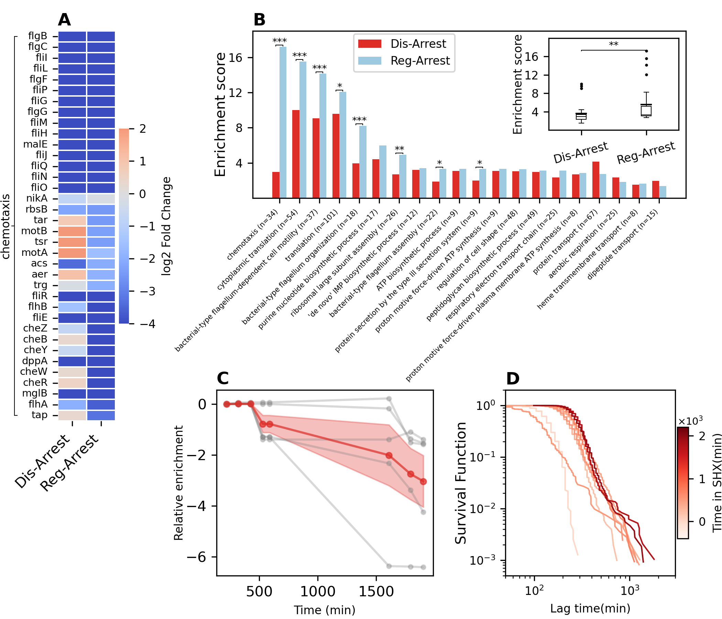
INTERPRETATION
The biology, at low resolution
• Low ρ = persistence/tolerance
globally dysregulated, decoupled regulatory network
• Coordinated programs break down
e.g. coherent gene modules lose their correlation structure
• Phenotype link
dysregulation tracks antibiotic tolerance / lag-time survival
• (Mentioned once — back to the physics)
Fig 4: downstream functional read-out of the dysregulated state.

Slide 11
TAKEAWAY
One number for a 10⁴-dimensional network
What we bought:
(1) a clean RMT null (Marchenko–Pastur via scrambling)
(2) a spectral order parameter, GMP-Cor, with a microscopic meaning (ρ)
(3) a calibrated, robust copula simulator linking the two
The SK payoff:
just as J controls the spin glass without knowing any individual Jᵢⱼ, ρ summarizes the cell’s global regulatory coupling — and stress acts like temperature, melting the ordered network.
Open question: is the loss of coordination a sharp transition in ρ? — thank you / questions.

