Slide 1
1
Final Project
Prostate Cancer – Two Ways of Treatment
Shahar Ron, Matan Anavi, Alon Gutman

Slide 2
The clients and our moderator
2
Prof. Eyal Pening
Project moderator:
Prof. Mark Last
Head of the Radiotherapy Department, Davidof center, Belinsson Hospital
Dr. Constantin Lavarnakov
Head of Radiation Unit in the oncologic layout, Soroka Hospital. Senior lecturer in BGU.

Slide 3
Prostate cancer basics
What you and your loved ones need to know:
3
SOME
MOST
1 in 6
men will be diagnosed with prostate cancer during their lifetime
prostate cancers are aggressive and higher risk
prostate cancers
are not aggressive
and lower risk (favorable pathology)

Slide 4
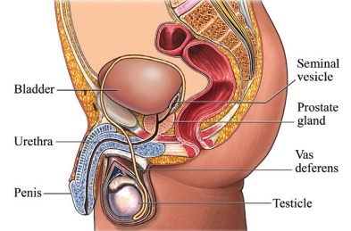
4
Background
The prostate is a gland in the male reproductive system.
3.8% of all deaths caused by cancer in men in 2018.
1
The type of treatment is determined according to the condition of the disease and the patient.
Among them are resection of the prostate gland, hormonal treatment,
chemotherapy
and radiation treatment.
2

Slide 5
Two existing treatment methods:
4
1
The traditional method worldwide
2
Alternative method
Radiation therapy for prostate cancer only (Soroka and Tel Hashomer’s method ).
Radiation therapy for prostate and lymph node. (Belinson’s method )

Slide 6
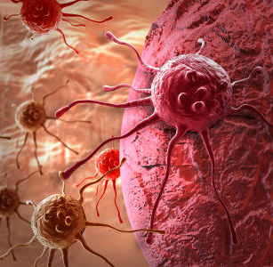
The research
question
1
On which case of prostate cancer should the lymph nodes
be irradiated?
www.yourwebsite.com

Slide 7
Success factors
6
01
Biochemical failure (yes/no) -
An increase of 2 units in two tests.
02
Last status:
1. No evidence of disease (NED)
2. Alive with disease (AWD)
3. Died from disease (DFD)
4. Died without disease (DWD)
5. Lost To FU/Unknow
6. Died with disease

Slide 8
Results
7

Slide 9
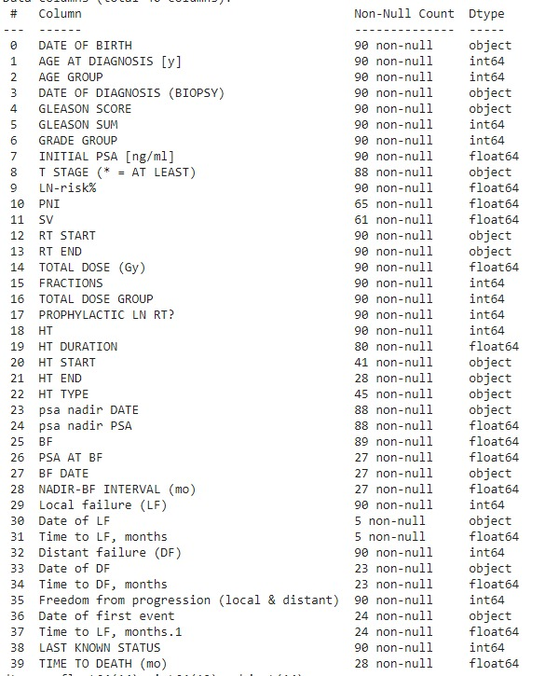
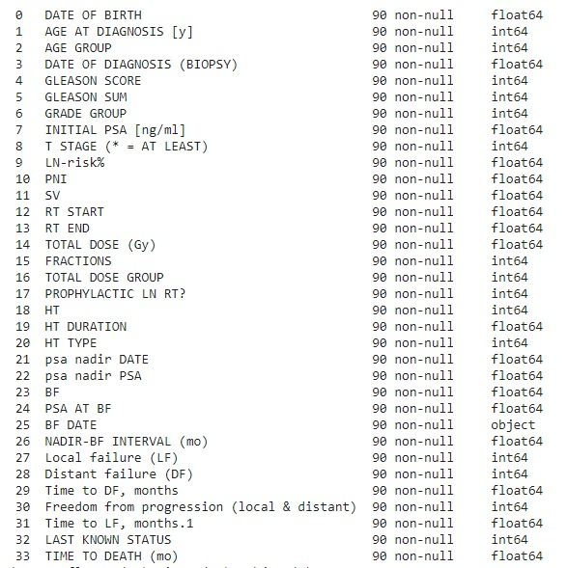
Preprocessing
8

Slide 10
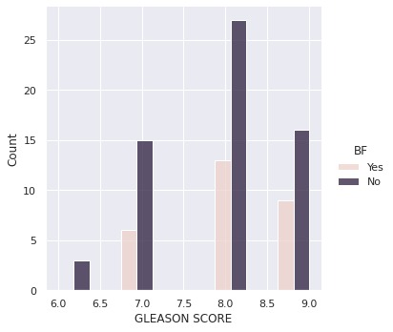
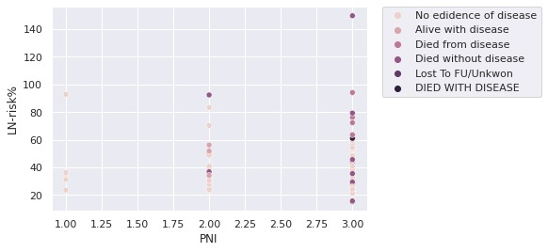
Data exploration
9

Slide 11
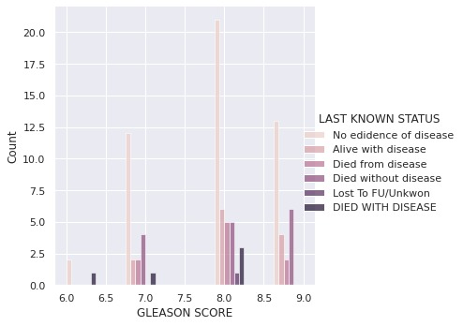
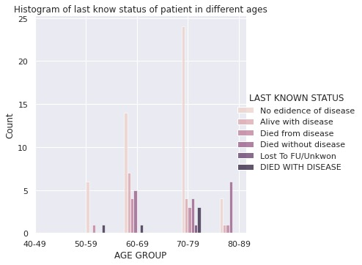
Data exploration
10

Slide 12
Results
11
01
Biochemical failure (yes/no) -
An increase of 2 units in two tests.
01
Simple decision tree for Biochemical failure:
Train accuracy: 0.86 , Test accuracy: 0.86
02
Random forest for Biochemical failure:
Train accuracy: 0.85 , Test accuracy: 0.73
03
Rotation forest for Biochemical failure:
Train accuracy: 0.88 , Test accuracy: 0.82

Slide 13
Results
12
02
Last status:
1. No evidence of disease (NED)
2. Alive with disease (AWD)
3. Died from disease (DFD)
4. Died without disease (DWD)
5. Lost To FU/Unknow
6. Died with disease
01
Simple decision tree for last known status:
Train accuracy: 0.33 , Test accuracy: 0.33
02
Random forest for last known status:
Train accuracy: 0.63 , Test accuracy: 0.42
03
Rotation forest for last known status:
Train accuracy: 0.68 , Test accuracy: 0.26

Slide 14
13
“
Knowing is not enough; we must apply. Willing is not enough; we must do.
”
-Johann Wolfgang von Goethe

Slide 15

Questions?
14

