Slide 1

http://construct.wikispaces.com
A presentation by Tomer Filiba
(tomerfiliba@gmail.com)

Slide 2
Why?
There are many freely-available parsers (AKA unpackers, dissectors, or analyzers) out there, the most famous being ethereal/wireshark.
Besides, everybody has it’s own proprietary parsing framework (SIPA, …)
It’s a saturated market, so why develop yet-another parser?
  Short answer: they all suck
  Longer answer:
    They are doing it all wrong
    They are mission-oriented (hard to extend)
    They are GUI-oriented rather than programmatic
Now let’s talk about that

Slide 3
Goal
Construct’s goal is to replace all current niche-parsers by a unified framework (“one library to parse them all”), with one-obvious-way-to-do-it, follow pythonic paradigms, and require minimal programming skills.
  We are still not there, but we’re on the right track
Unlike other parsers, Construct is declarative, meaning you describe data structures rather than writing procedural code. You can export that description to XML or (theoretically) generate dedicated C code.
Being declarative, we get some bonus points for free:
  Easy to extend, debug and test
  Provable (to some extent)
  Symmetrical (both parsing and building)

Slide 4
Paradigm
Construct is component-oriented.
  Components are the best way for code reuse
  Components promote declarative programming as your code simply connects existing components to create new ones
Component oriented programming is superior to inheritance.
  Inheritance:
    Employee is-a Person, Husband is-a person.
    Different instances, must cover all permutations, refactoring is hard
  Components:
    Worker operates-on a Person, Husband operates-on a Person.
    We can lay out these boxes in different ways each time.
    We can easily replace components (Person → Horse)
  Component-oriented programming is a design choice, not a language-enforced mechanism. You can use that in any language.

Slide 5
Component vs. Inheritance
class Person(object):
def eat...
def sleep...
def walk...
Class Employee(Person):
def work...
def get_salary...
class Husband(Person):
def take_trash_out...
# different persons!!
e = Employee("moshe")
h = Husband("moshe")
e.work()
h.take_trash_out()
# solution?
class HusbandEmployee(Husband, Employee):
...
# think of the number of permutations!
class Person(object):
def eat...
def sleep...
def walk...
class Worker(object):
def __init__(self, entity)...
def work...
def get_salary...
class Husband(object):
def __init__(self, entity)...
def take_trash_out...
p = Person("moshe")
# different “views” of
# the same person
w = Worker(p)
h = Husband(p)
w.work()
h.take_trash_out()

Slide 6
Philosophy
Keep It Simple and Stateless (KISS) principle. Break complicated things down and don’t overdo it.
Each component performs one primitive operation. Combine primitives to accomplish higher-order operations (stacking).
  like unix shell piping
Don’t Repeat Yourself (DRY) principle. If you have to do something more than once or twice, extract it into a macro function
Favor adapters over constructs. Adapters operate at a higher level (objects) than constructs (stream), and are thus easier to implement and less error prone.
Constructs and adapters should be generic; specialize them by macro functions

Slide 7
Architecture
Constructs can be grouped into four families:
  Fields: basic operations; read and write raw data from/to streams
  Sequences: logical hierarchal structuring
  Adapters: data representation conversion
  Meta constructs: dynamically-computed constructs
And one very important concept called macro functions
Apart from the core code of the library, Construct comes with many protocols and file formats, which are both production-ready and serve as excellent examples
I hope people will be sharing their constructs. Just send them over to me, and if they are generic enough, I’ll include them in the distribution.

Slide 8
Fields
Fields are the most basic components: they read and write data from / to the stream. All other constructs never work with the stream directly – they use fields.
There are many fields (signed, unsigned, little-endian, big-endian, byte-fields, bit-fields, integer, floating-point, strings, etc.)
>>> c = UBInt32("foo")
>>> c.parse("\x11\x22\x33\x44")
287454020
>>> c2 = ULInt32("foo")
>>> c2.parse("\x44\x33\x22\x11")
287454020

Slide 9
Sequences
Sequences of sub-components (AKA subconstructs), including other sequences (this feature is referred to as stacking).
The most common sequence is Struct (similar to C’s struct statement)
Other sequences include Repeater, Union, and Sequence (light-weight Struct)
>>> c = Struct("foo",
... UBInt16(“this"),
... Padding(1),
... UBInt8(“that”),
... )
>>> print c.parse("\x12\x34\x00\xff")
Container:
that = 255
this = 4660

Slide 10
Adapters
Adapters are a very important concept in Construct: they convert one type of data representation into another.
  Named values (“Enums”)
  IP-address (32-bit number to dotted string)
Adapters separate the representation from the actual parsing and building, increasing code reuse. Adapters work with objects, while constructs work with the stream.
For example, we can define UBInt16 as a Field that reads two bytes, and then passes them to a adapter that converts them to an integer.
def UBInt16(name):
return FormatAdapter(Field(name, 2), “>H”)

Slide 11
Meta Constructs
Meta constructs use the context to compute their parameters. The context is a dictionary that represents the parsing or building process.
Meta constructs use a function to compute their parameters
There are several meta constructs, including MetaField, MetaRepeater, RepeatUntil and Switch.
The classical example is PascalString – a string that is prefixed by a length field.
>>> c = Struct("foo",
... UBInt8("length"),
... MetaField("data", lambda ctx: ctx["length"]),
... )
>>> c.parse("\x05helloXXX")
Container(data = 'hello', length = 5)

Slide 12
Macro functions
There’s a nice feature of component-oriented programming which I call macro functions or composite constructs (stacked constructs).
Macro functions are wrappers that return a component, hiding all the internal details from the end-user.
The origin of the name “macro” is the C preprocessor’s macros (#define NAME VALUE). The preprocessor replaces all instances of NAME by VALUE.
Similarly, you can “copy-paste” the code of macro functions wherever you call them.
This “macro expansion” occurs in “compile time”, i.e., when the module is first evaluated, not when it the code runs
Macro functions can be trivial (UBInt32) or complex (PascalString or IfThenElse).

Slide 13
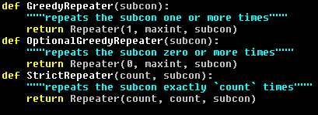


Macro functions
Specialization
Macro expansion

Slide 14
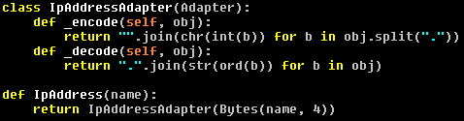
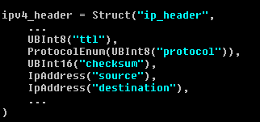
Macro functions
DRY principle,
so others can
reuse it

Slide 15
Future plans
For 2.00:
  Improve OnDemand and better support lazy parsing
  Make the context more intuitive
  Improve BitStruct (some issues with meta constructs)
Later versions:
  Creative way to add CRC checks?
  Improve text processing (context free grammar)
  More formats and protocols
    Hopefully users will contribute
  Write a GUI front-end, like ethereal, but not limited to network protocols.
    Sniff using pypcap
    Allow users to write, test, and patch/debug constructs on-the-fly (uber mega feature)

Slide 16
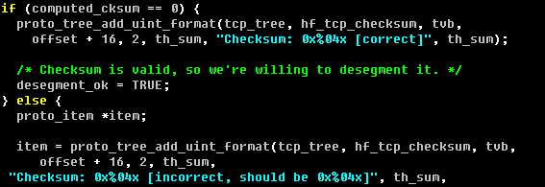
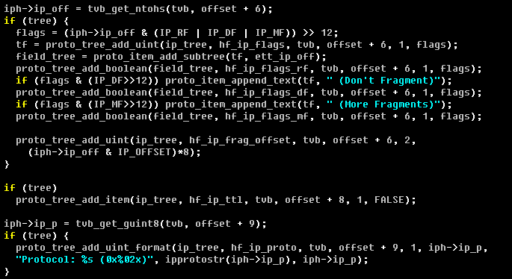
Ethereal (for reference)
Directly adds the
text to the tree!
There is no “object”,
it’s only a string

