Slide 1
Starting point
Legend
BoardGenerator
Values
Dependence
Inheritance
Connection
Main
Connector
Test
View
ProbBrainRandomStart
Model
ProbBrainCornerStart
ProbBrainCenterStart

Slide 2
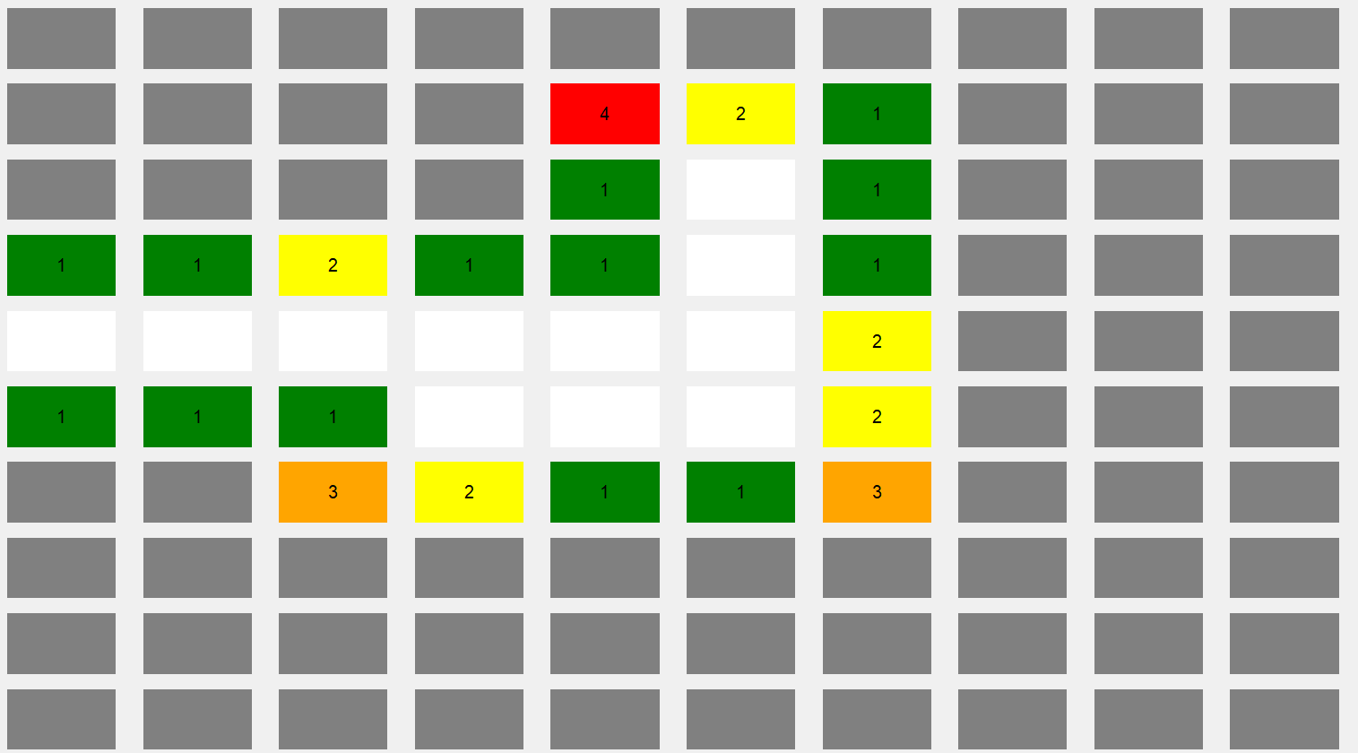

Slide 3
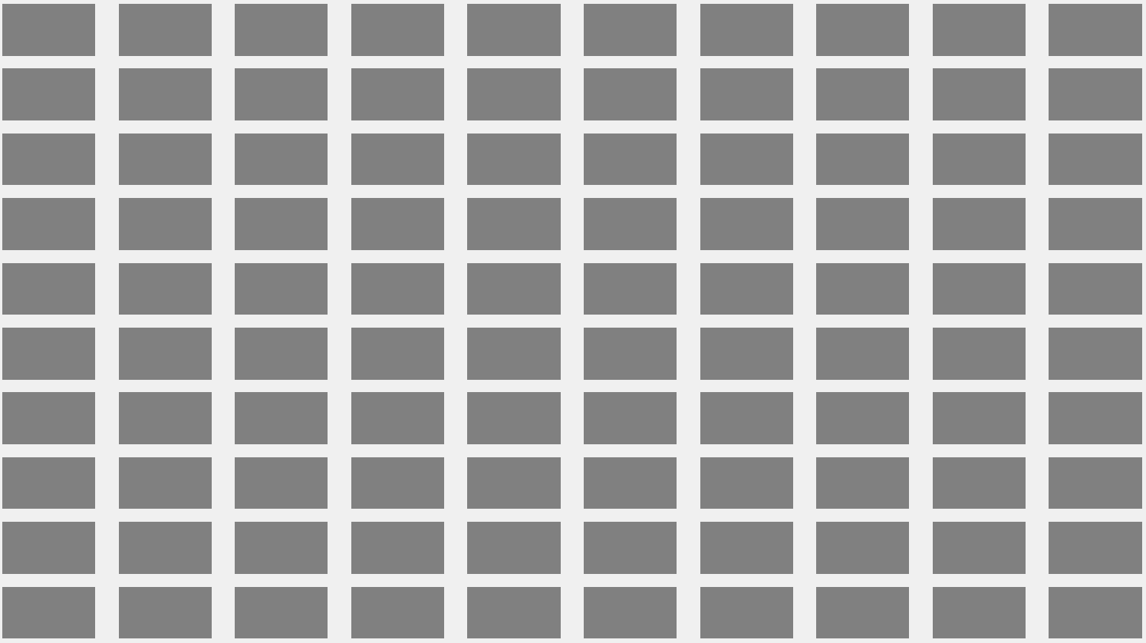

Slide 4
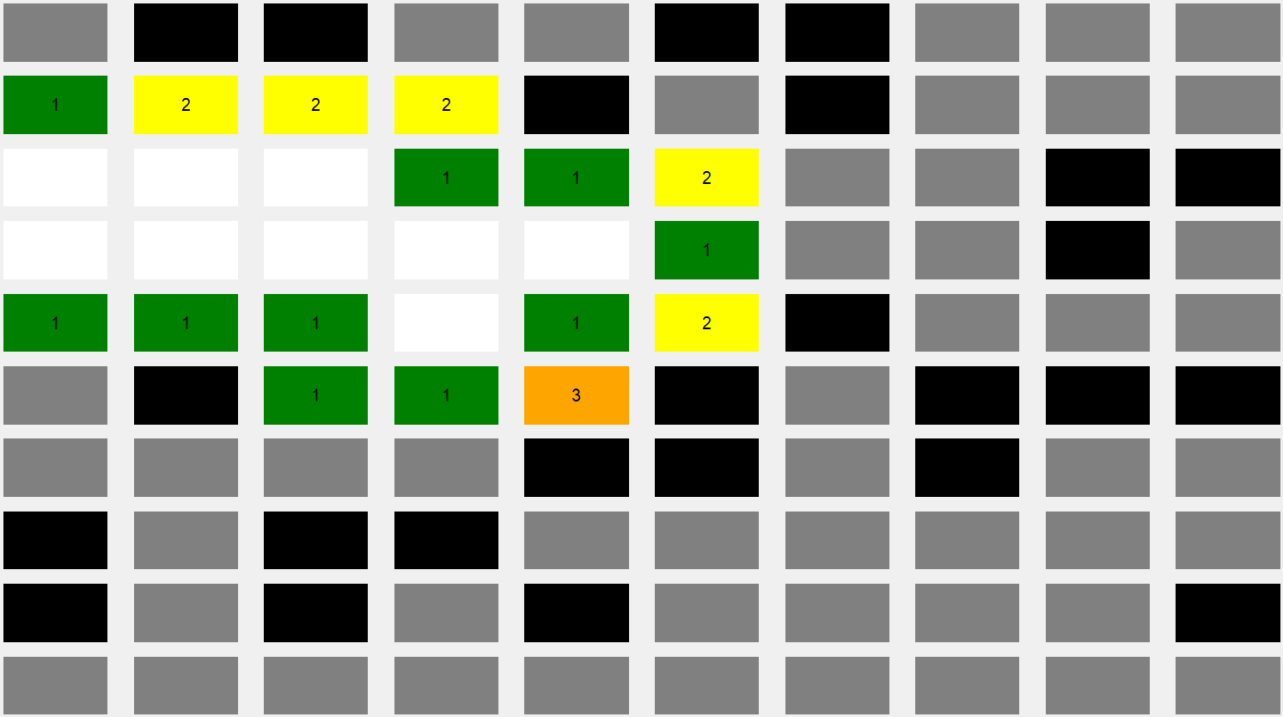

Slide 5
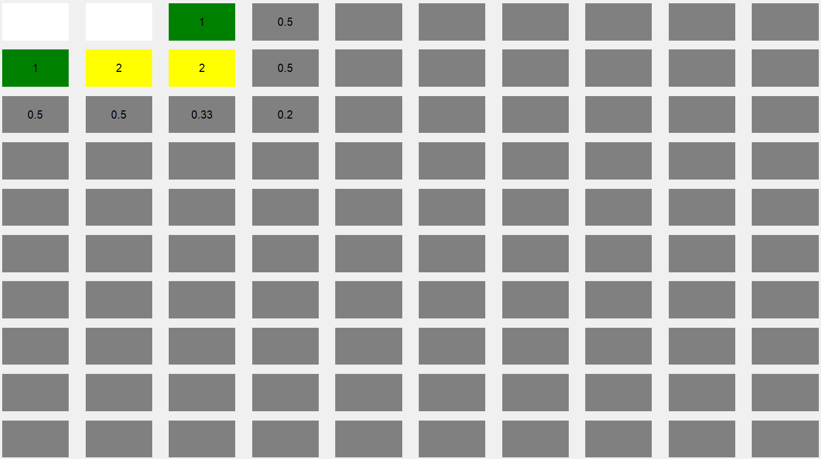

Slide 6
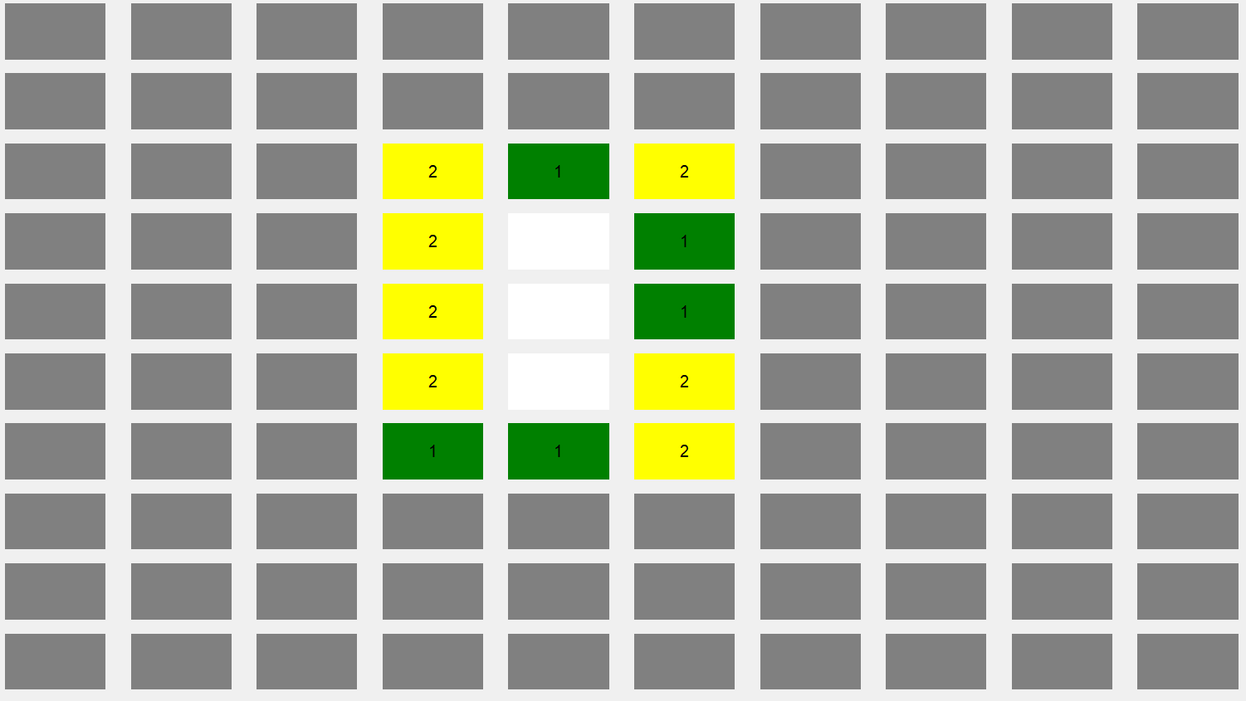

Slide 7
View
Connector
Model
Subsequent Moves
Recursive
Placement
No
Starting point
Pressed a
Tile (Left Click)
Play
Play
First Move (?)
Yes
Handle First Move
Update the pressed Tile
Recursive
Placement
Update
nearby Tiles
Place Mines

Slide 8
View
Connector
Starting point
Pressed a
Tile
(Right Click)
Mark a Bomb
No
Yes
Has been marked (?)
Mark a Bomb
Unmark a Bomb

