Slide 1
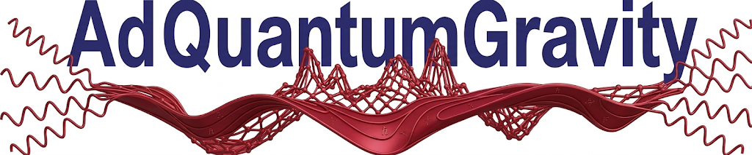
Advanced use cases of AI
A case study from ORBIT: a QFT oriented Mathematica package built purely using AI.
By: Alon Lifshits - AdQuantumGravity
ORBIT case study | Title Slide

Slide 2
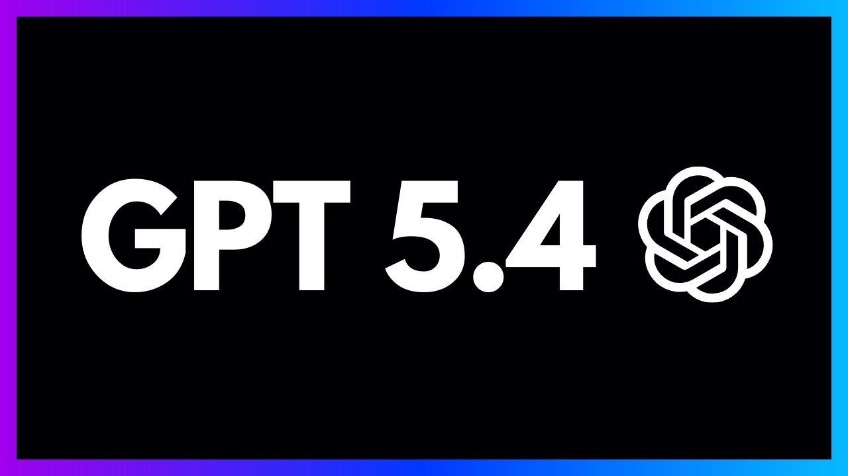
Agentic AI for physics-oriented software development
Agentic AI is most valuable when the task is a long chain of reasoning, code repair, symbolic computation, validation, and reporting.
This project showcased here is a concrete example: the AI agent is utilized to write a complex toolkit, validate it, accelerate the workflow, and correctly extend the physical reasoning.
ORBIT case study | Slide 1

Slide 3
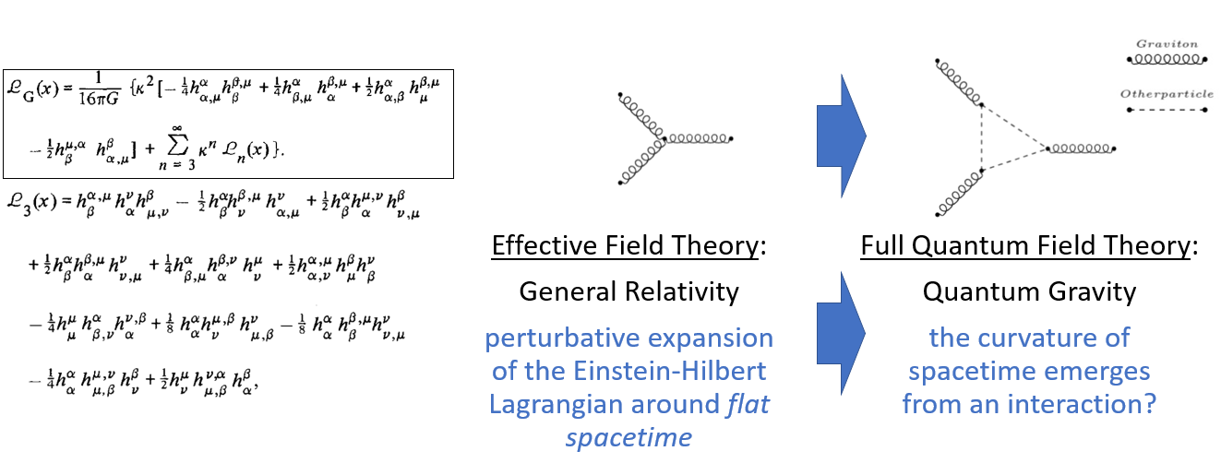
1. Motivation
ORBIT case study | Slide 2

Slide 4
2. The problem at hand
How do we take a Matchete-generated effective Lagrangian, translate it into xAct, remove IBP and field-redefinition redundancies, construct the Einstein-Hilbert (EH) reference through the same operator basis, and determine whether the two match?
Given high-energy model gives low energy effective Lagrangian
Translate syntax to package with built-in tensorial manipulation capabilities
Remove IBP and field-redefinition redundancies
Expand EH + Lambda in the same basis
Solve constraints and isolate leftovers
Matchete
Translation
Reduction
Reference build
Comparison
Success criterion: correctly reduce the Lagrangian, expand the EH Lagrangian correctly, find the known solution from manual calculation done.
ORBIT case study | Slide 3

Slide 5
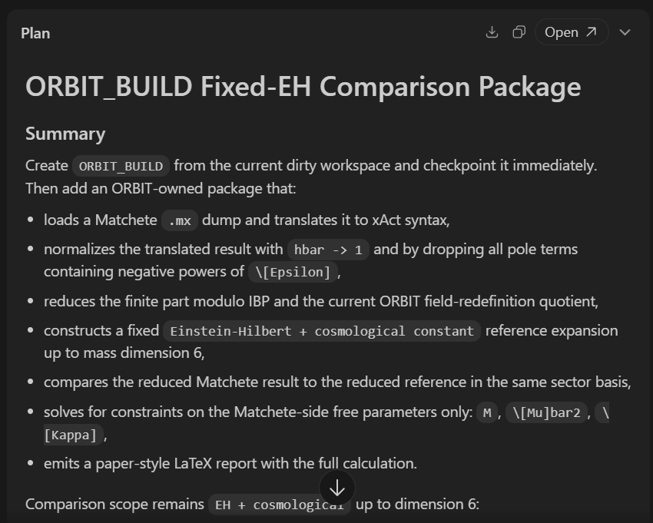
3. The Challenges
Mathematica syntax
Tensor manipulations
Integration by parts
Field redefinitions
Performance
Sanity checks
ORBIT case study | Slide 4

Slide 6
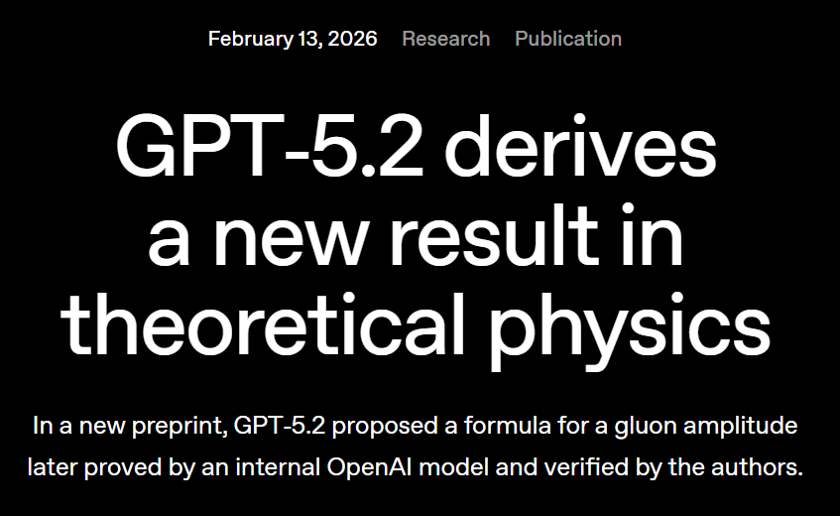
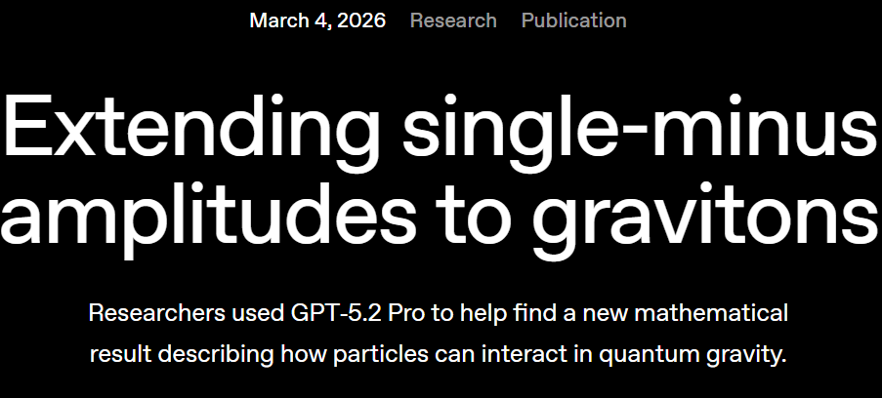
4. The Recent Boom in Agentic AI Usage
What changed
Relevant capabilities
External signals
The move from AI chats to agentic AI and agent first IDEs.
Improvement of agent capabilities both in tool usage and self-debugging capabilities
Codebase management
Symbolic debugging with external tools
Optimization
Long-horizon state tracking through context files and result artifacts
Automatic report generation
OpenAI’s increasing promotion of GPT as a scientific research companion.
OpenAI's 2025 scientific-research evaluation framed agentic systems as end-to-end scientific assistants, not just answer engines.
ORBIT case study | Slide 5

Slide 7
5. Case Study Part I: Repair the ORBIT Core
"debug graviton_basis_toolkit.wl until it works and gives the expected output"
"doesn't fieldRedefinitionsAndIBP.nb provide different results?"
"the single graviton, 2 derivative terms have a physical count of 2, but isn't that a total derivative?"
The agent fixed syntax issues, corrected derivative-partition logic, and made the basis-computation pipeline run again.
This forced a careful comparison between notebook conventions and the package's full sector generation. The discrepancy exposed an IBP canonicalization bug.
The agent traced this to incomplete scalar-derivative canonicalization and fixed the {1,2} sector so it vanished modulo IBP as it should.
Successful physics-guided code changes
Restored scalar-derivative commutation and derivative sorting in the IBP algorithm.
Ensured total derivatives vanish.
Validated corrected counts such as {3,2}: IBPCount = 14, RedefRank = 4, PhysicalCount = 10.
ORBIT case study | Slide 6

Slide 8
Case Study Part II: Build a General Reduction and Validation Workflow
"write a new code that takes a lagrangian and removes the ibp and field-redefinition redundancies"
"test the new code by taking a lagrangian which is the EOM times some general lagrangian"
"create a comprehensive report ... mathematical background, validation, and a worked example"
The agent added a reducer API that splits an input by sector, projects it onto the raw basis, removes IBP, and then quotients by redefinition images where appropriate.
The agent built disguised EOM-image tests in {3,2} and {3,4}; both reduced exactly to zero, confirming the implementation.
The agent generated notebooks, PDFs, and a paper-style LaTeX report documenting the toolkit, algorithms, and validation logic.
Concrete validation outputs
Reduction API exercised on mixed sectors and on redundant EOM images.
Persistent validation scripts, PDF reports, and context tracking were added so crashes would not erase state.
ORBIT case study | Slide 7

Slide 9
Case Study Part III: ORBIT_BUILD and the Fixed-EH Comparison
"continue according to the ORBIT_BUILD fixed-EH comparison plan"
"let's speed up the computation as much as possible"
"did you consider canonical normalization?"
The agent vendored the translator, built the comparison package, added staged checkpointing, and created a live ORBIT_BUILD context file.
The agent identified xPert expansion and basis projection as the bottlenecks, added disk caching for the reference expansion, and removed redundant canonicalization.
The agent derived the exact kinetic prefactor Z_h, separated raw matching from canonically normalized matching, and exposed a genuine sign-convention branch.
Final branch analysis
PC kept crashing. By keeping a context file always updated and by using checkpoints, the agent could keep going without needing any external help, right from the part where the computation stopped.
AI isn’t perfect yet – need to make sure it includes all the correct physics. For example, canonical normalization.
ORBIT case study | Slide 8

Slide 10
Tests, Sanity Checks, and Scientific Guardrails
Sector sanity: Verified that the {1,2} sector vanishes modulo IBP after the canonicalization fix.
IBP tests: Resolved the cubic {3,2} mismatch by identifying the missing IBP reduction and clarifying restricted versus full-sector counting.
Redundant images: Tested L = EOM x delta h with disguised expressions; the reducer returned zero.
Comparing to manual calculation: The package returns the same answer we got for d<=5.
Reference consistency: Checked that the EH {2,2} sector equals the toolkit's Fierz-Pauli Lagrangian in the same reduced basis.
Convention split: Separated raw sign-convention matching from canonical-normalization matching; identified the unresolved kinetic-sign choice.
Unsupported leftovers: At d <= 6 the full run still leaves a non-EH {2,4} sector.
ORBIT case study | Slide 9

Slide 11
What the AI Actually Added, and What Comes Next
Package capabilities
Successful AI-proposed ideas
Next steps
Matchete -> xAct translator integrated into ORBIT
General Lagrangian reducer modulo IBP and field redefinitions
Fixed-EH comparison package with report generation
Skip field-redefinition quotienting in quadratic sectors
Project to the raw basis first, then quotient by stored IBP relations
Searching for EOM*something is hard, go the opposite direction instead
Separate supported and unsupported sector comparisons
Extend the field-redefinition layer beyond the linearized Fierz-Pauli image.
Add fixed-dimension identities, evanescent operators, and gauge-invariance filters.
ORBIT case study | Slide 10

Slide 12
The final report
ORBIT case study | Slide 11

