Slide 1

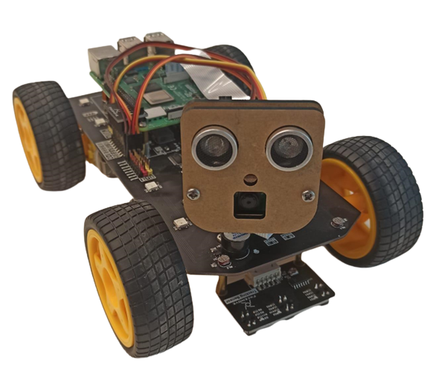

ODORS IDENTITY CONTROLS ROBOT MOVEMENTS

Slide 2
GOAL
The robot will differentiate 3 odors and will move accordingly
Turn right - when it identify Benzaldehyde (Marzipan)
Turn left - When it identify Rosemary
Move straight - when it identify Geraniol (Citrus)

Slide 3

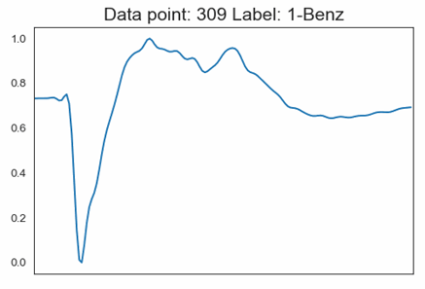
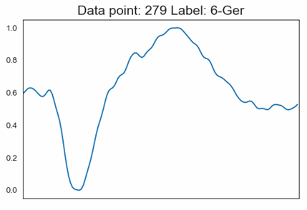
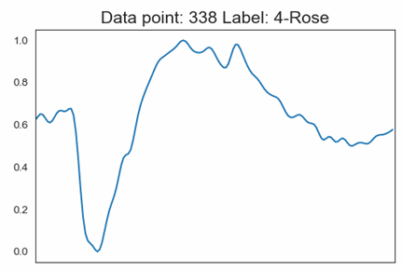
DATA PREPROCESS
Scaling MinMax to the range of [0, 1]

Slide 4
MODELS COMPARISON
01
KNeighborsClassifier
02
SupportVectorClassification
03
GussianNaiveBayes
04
AdaBoostClassifier
05
LogisticRegression
06
RandomForestClassifier

Slide 5
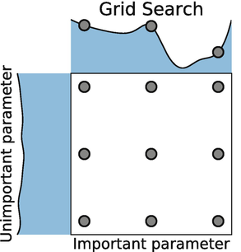
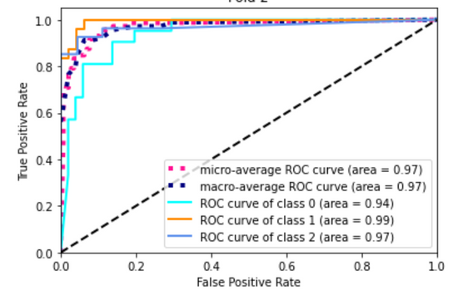
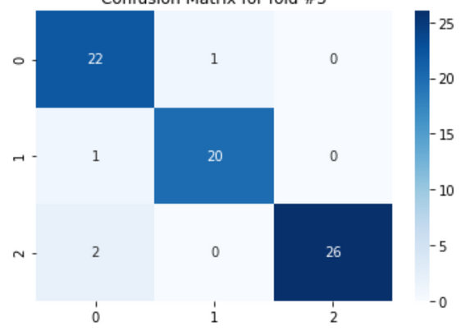
HOW?
Hyperparameters
ROC-AUC
Confusion Matrix

Slide 6
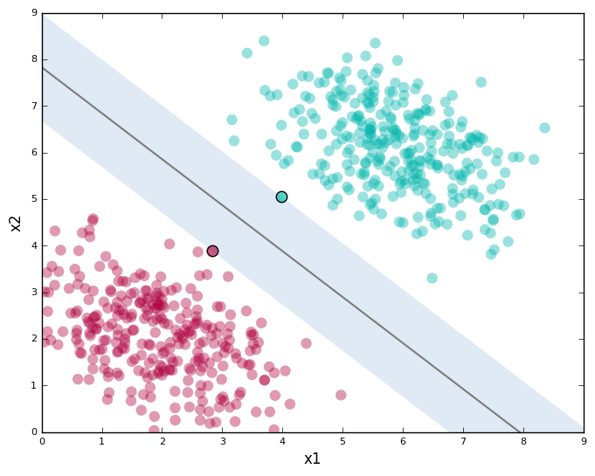
SUPPORT VECTOR MACHINE
Test accuracy score:
93%
Train AUC score:
99%

