Slide 1
“What we talk about
when we talk about successful playlist”
-- Hong Wu (Interview Assignment)

Slide 2
DISCLAIMERS
With limitation/restriction from the given dataset, some estimation/projection are based open data source
which may differ from actual Spotify cases. All charts, visualizations and conclusions are pure for demonstrating
personal data analysis capabilities.
Assumptions on Data
With provided data dictionary, all data is on daily basis, projection made on time goes by 24 hours, 7 days a week
, 31 days per month, simply for calculation convenience, open data is also used.
All scripts, code, and data is available in the following repo
https://github.com/thehongwu/playlist_summary_analysis
Will delete after interview

Slide 3
Technical Sheet – Audience: Data/Tech Team
A little bit on Data Processing
mysql
Spotify API: https://developer.spotify.com/web-api/console/get-playlist/#complete
Python, superset
NLTK

Slide 4
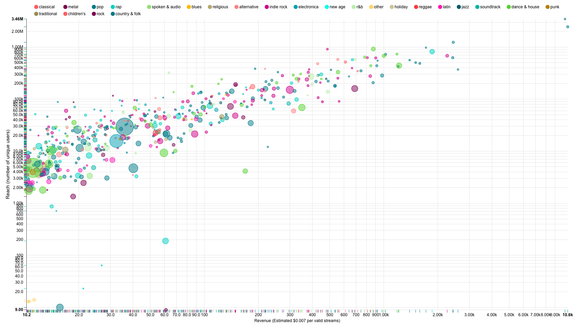
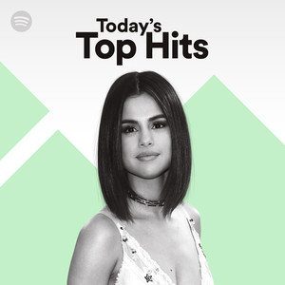

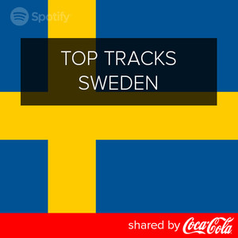
If we talk about #Revenue(Estimated);
If we talk about #Reaches;
Money talks, number$ don’t lie. Top 500 playlist
Revenue estimated daily vs daily reach. (Bubble size – projected engaging time in minutes)
More reaches could potential bring more exposures to brand’s product
or service
3.5 min per track
Source: http://www.bbc.com/news/entertainment-arts-25217353
Log scale applied simply for visualization purpose
Notes:
Of course, Top Hits/Hot on Spotify is favored by rec engine as well thus leads to large exposure

Slide 5
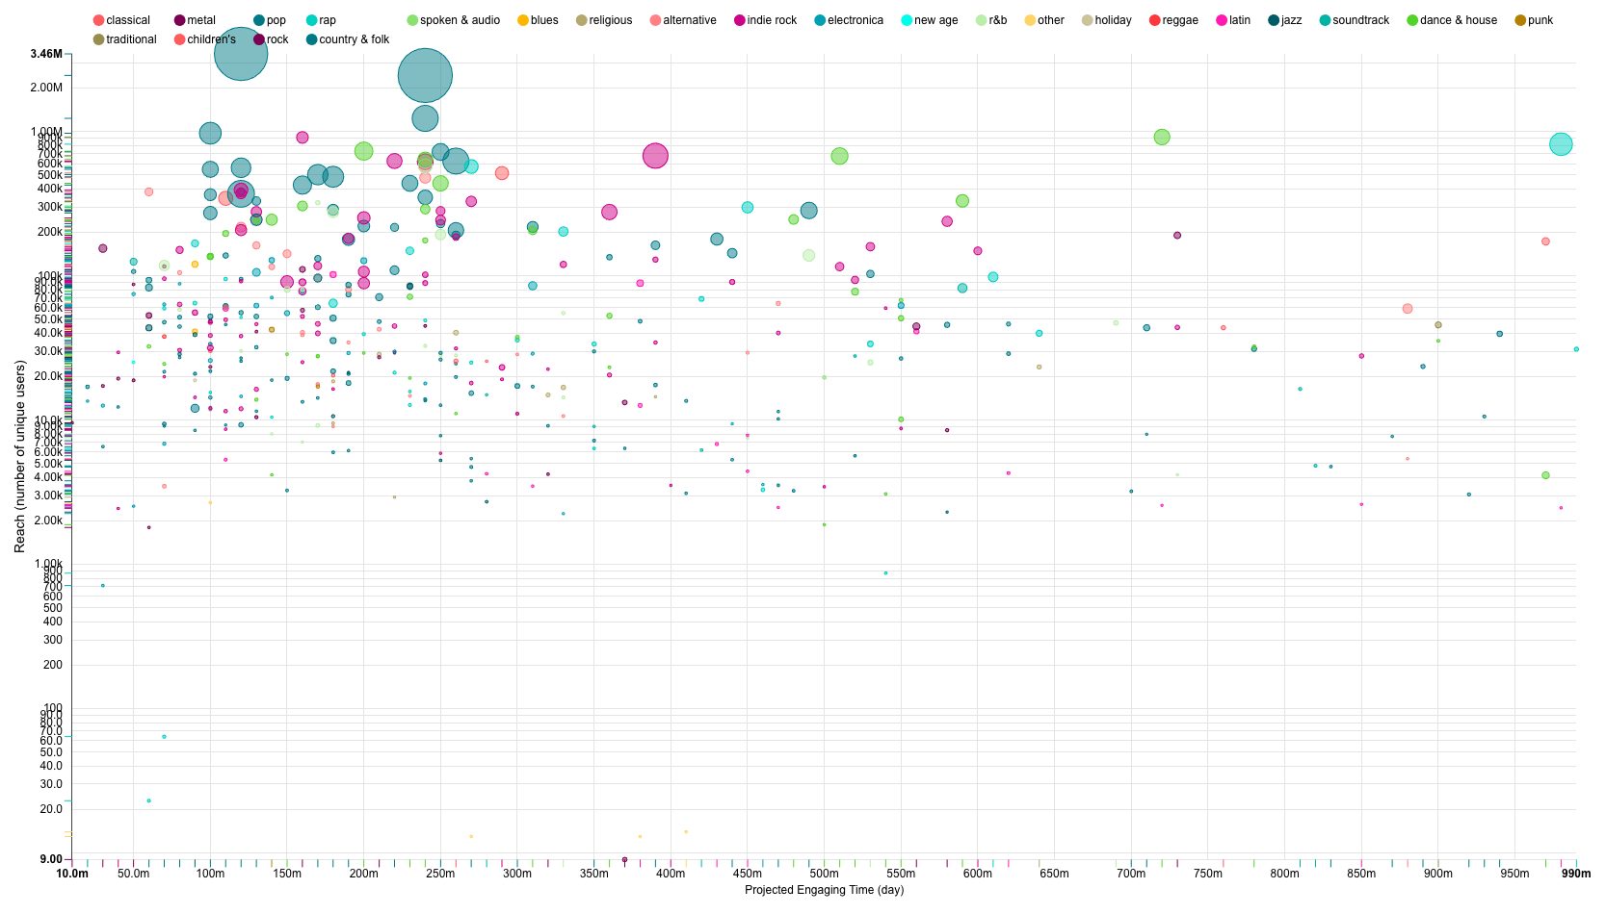
If we talk about #Engaging Time
within Top 500 Playlists
Estimated by assuming average track length: 3.5 min
Projected engaging time of 90%(89.72%) of the total population is less than 1 day (361927 vs. 41439)
The area highlighted in Green is ranging from 100 min to 250 min, roughly 30% confidence band around 148* mins (average engaging time
from Spotify Study)
Source: https://spotifyforbrands.com/us/

Slide 6
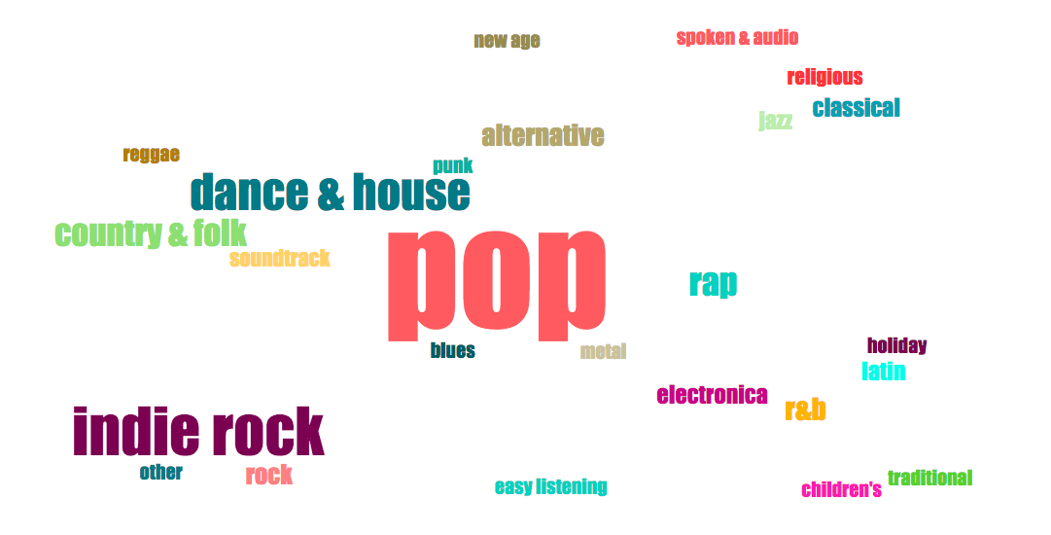
If we talk about #Genre
Word cloud generated from top 1000 playlist
Pop, Indie rock, Dance & House, and Rap are the top tier guys and the rest
Notes:
Of course, Top Hits/Hot on Spotify is favored by rec engine as well thus leads to large exposure

Slide 7
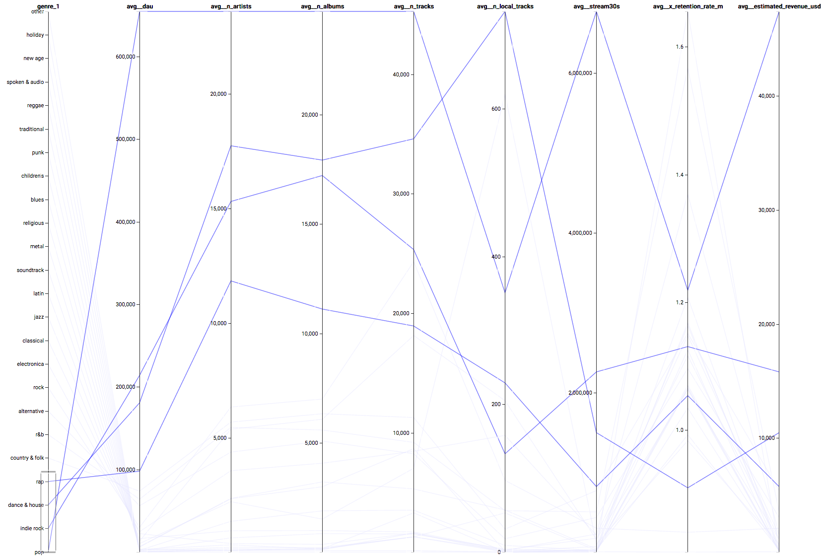
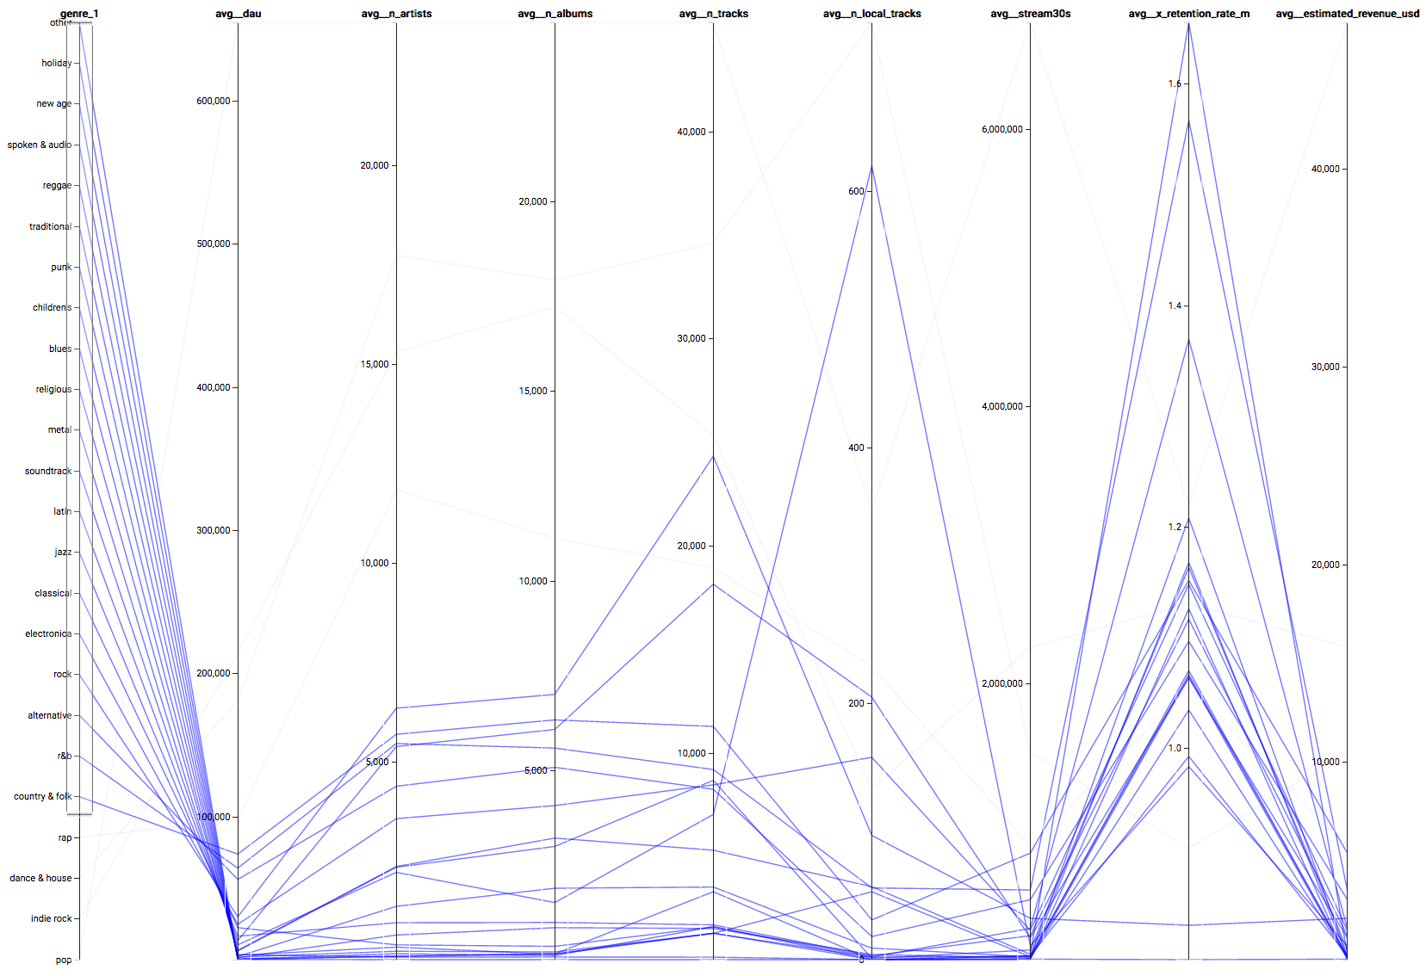
If we talk about #Genre
Parallel coordinates generated from top 1000 playlist
Which verifies the result from word cloud:
“More Active user, more valid stream, more engaging time”
DAU is a “good splitor” which indictors “Potential Two Clusters” in terms of common “metrics”:
{Pop, Indie Rock, Dance & House, Rap}
Vs. {The rest}
Notes:
Of course, Top Hits/Hot on Spotify is favored by rec engine as well thus leads to large exposure

Slide 8
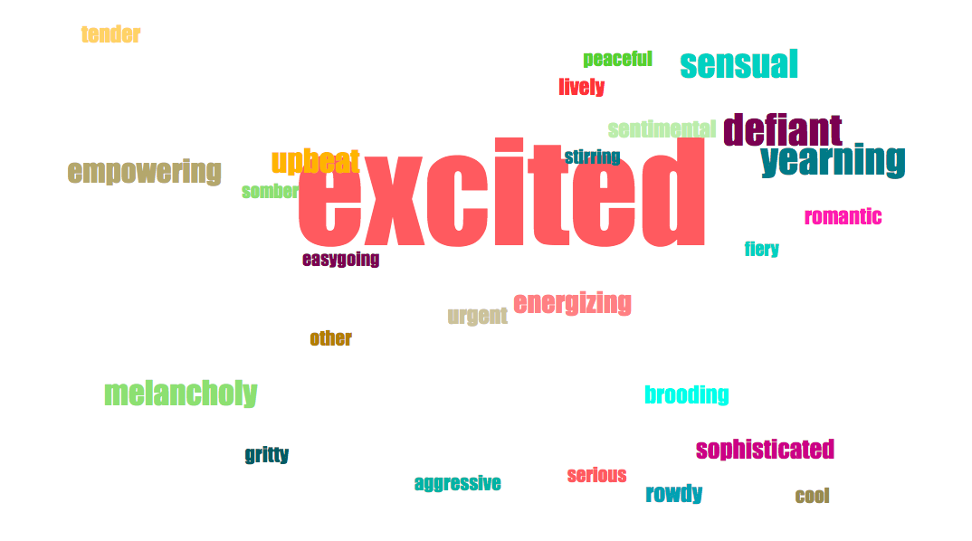
If we talk about #Mood
Word cloud generated from top 1000 playlist
Top moods:
Excited
defiant
yearning
melancholy
Notes:
Of course, Top Hits/Hot on Spotify is favored by rec engine as well thus leads to large exposure

Slide 9
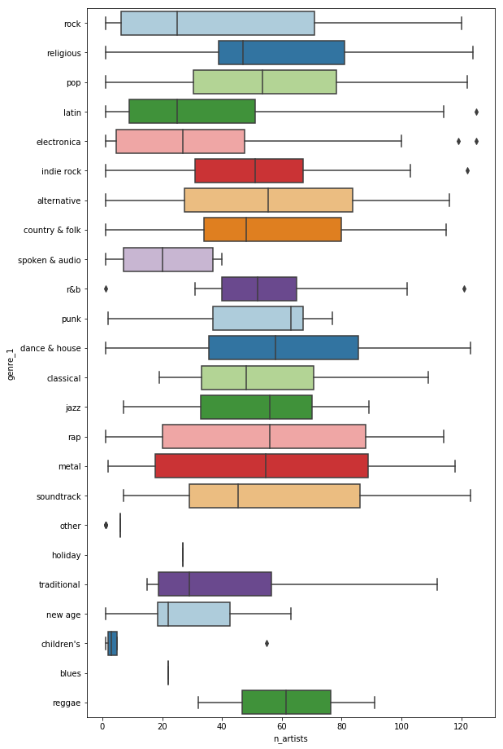
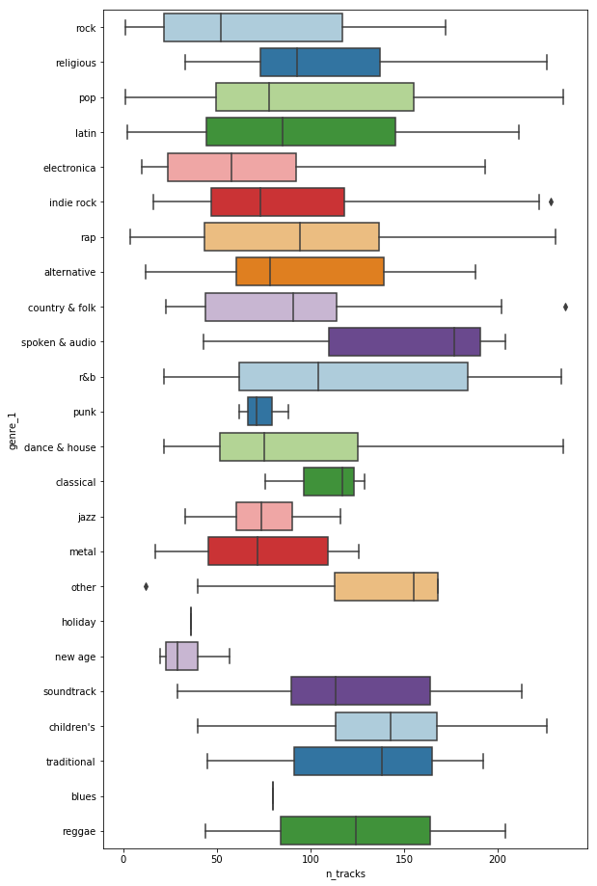
If we talk about
#Tracks/Artists
Boxplot generate from top 1000 playlist
with extreme/anomalies data taken out
We can generalize what a playlist looks like
from this perspective, some highlights:
pop: 81 tracks - 60 artist similar number of album
indie rock: 78 tracks - 58 artist similar number of album
dance & house: 83 tracks - 65 artist similar number of album
rap: 95 tracks - 75 artist similar number of album
Notes:
Of course, Top Hits/Hot on Spotify is favored by rec engine as well thus leads to large exposure

Slide 10
A formula of a “successful” playlist leading to
high engaging and revenue-generation.
NOTE:
Purely from this datasets, and data/metrics perspective along with assumptions
A playlist of
Indie Rock
Defiant
Pop
Excited
around 80ish tracks by 65ish artists bringing
Dance & House
Yearning
Melancholy
Rap

Slide 11
One more thing…

Slide 12
If we talk about #MUSIC
If we talk about #USERS
If we talk about #INTEREST

Slide 13
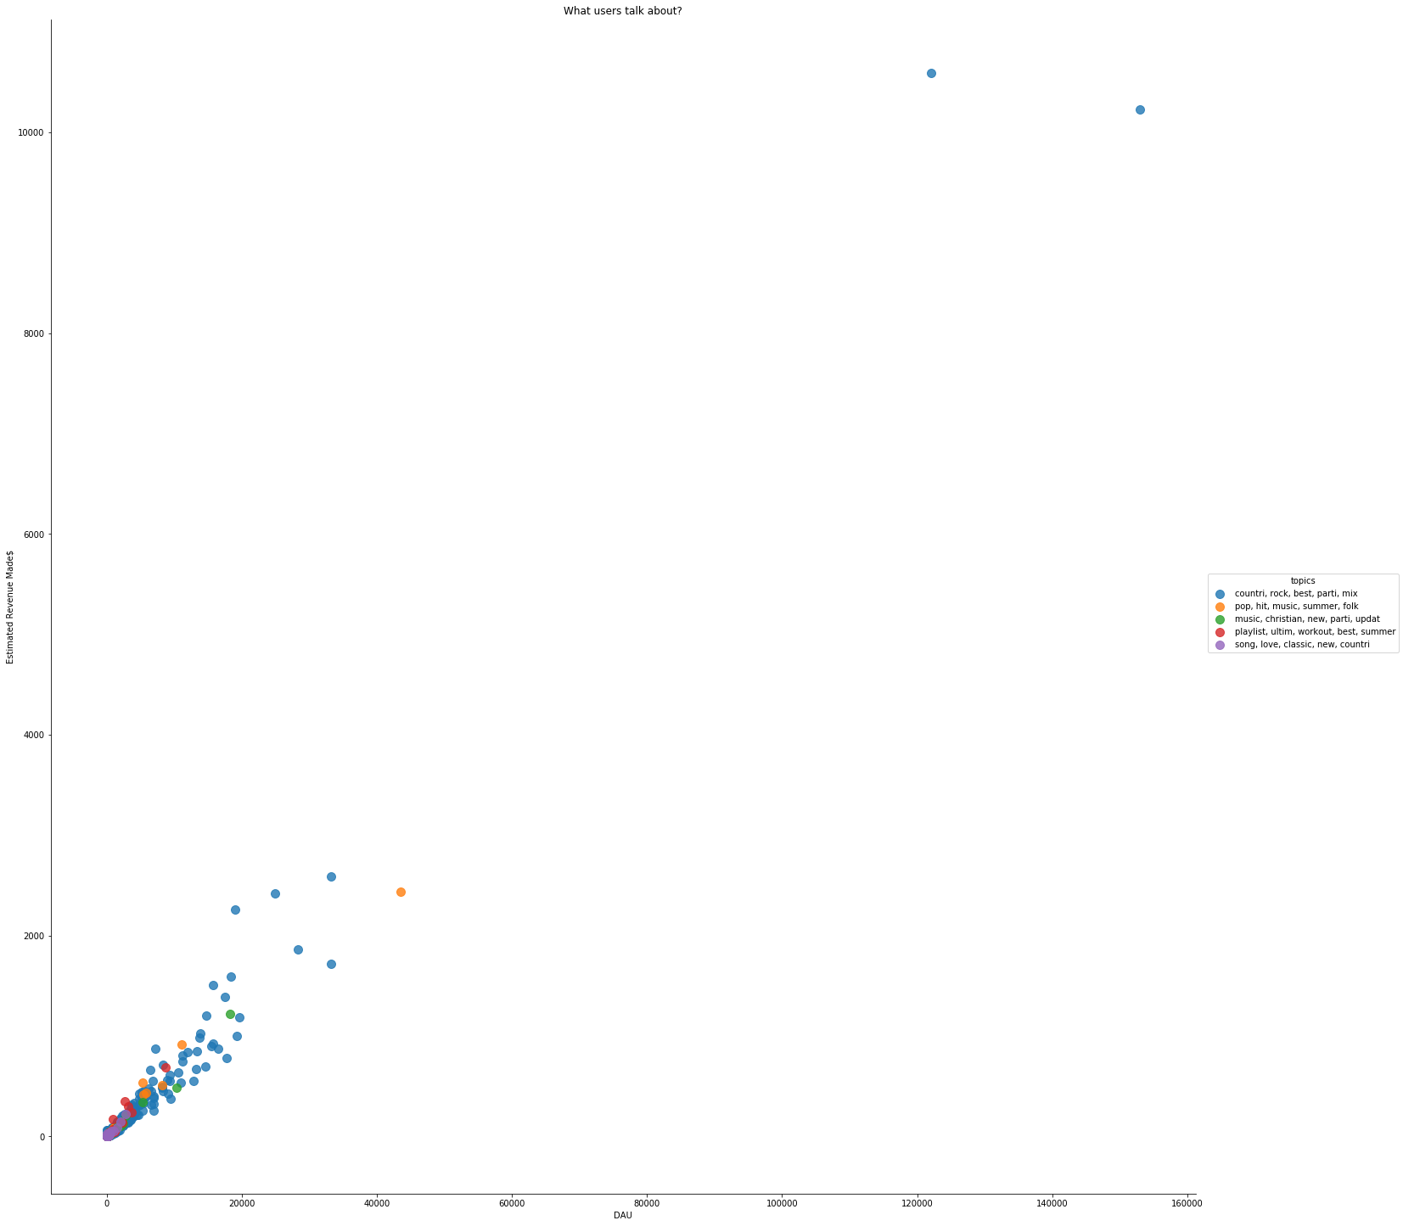
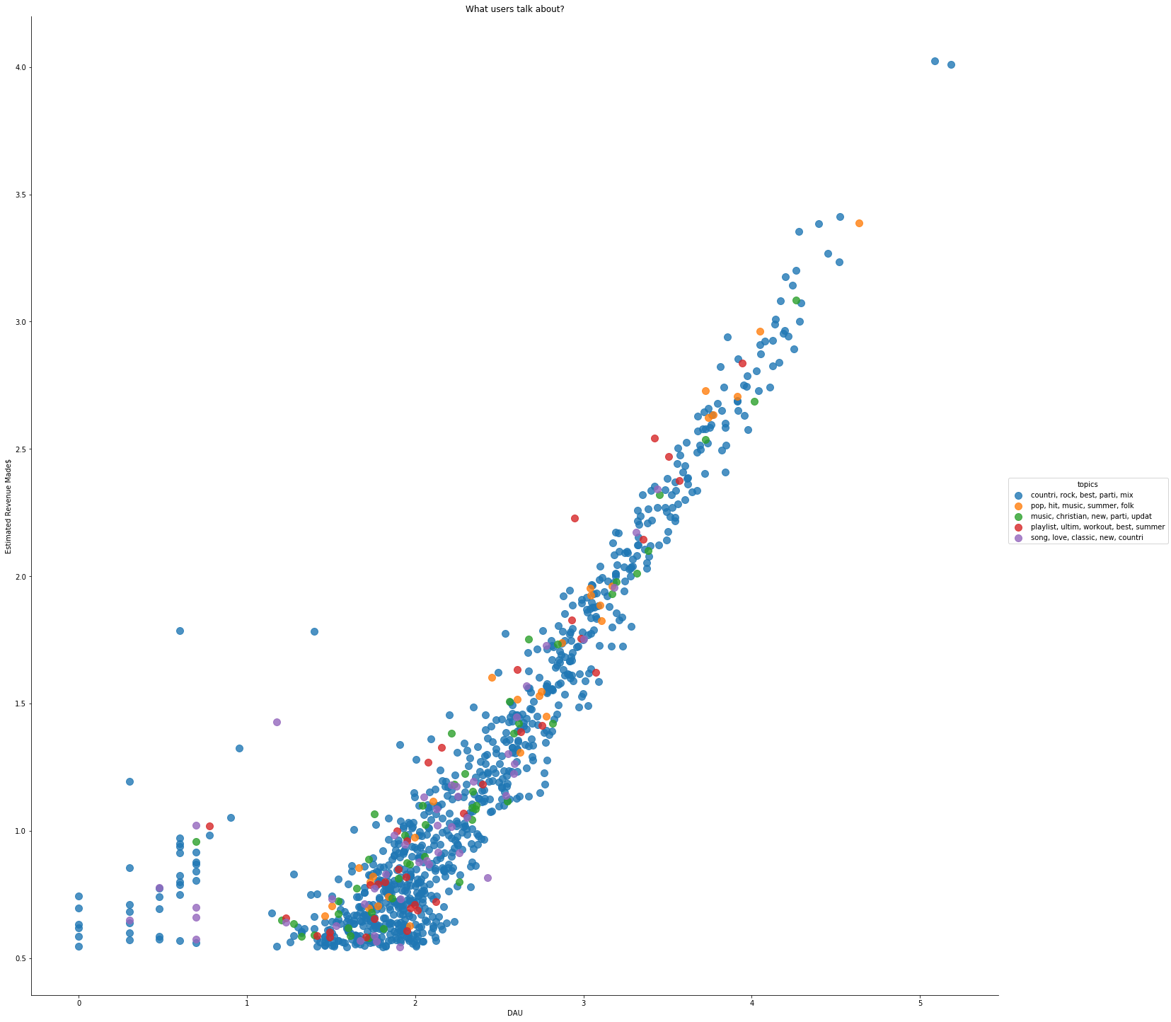


If we talk about #Tastes
With tokens available, we are able to extract top 5 taste
from top 1000 playlists
{countries, rock, best, parties, mix}
{pop, hit, music, summer, folk}
{music, Christian, new, parties, update}
{playlist, ultimate, workout, best, summer}
{song, love, classic, new, countries}
Majority of the active users could be characterized as “Explorers”: loves country music, party and its summer!!! which possibly opens new opportunities for
Brands and advertiser to do targeted marketing, trying new stuffs, new restaraunts, things related to party,
travel, concert etc.
Notes:
Of course, Top Hits/Hot on Spotify is favored by rec engine as well thus leads to large exposure

Slide 14
“What we “REALLY” talk about
when we talk about successful playlist”

Slide 15
Affinity Between Content and Audience

