Slide 1
“What we talk about
when we talk about successful playlist”
-- Hong Wu (Interview Assignment)

Slide 2
DISCLAIMERS
With limitation/restriction from the given dataset, some estimation/projection are based open data source
which may differ from actual Spotify cases. All charts, visualizations and conclusions are pure for demonstrating
personal data analysis capabilities.
Assumptions on Data
With provided data dictionary, all data is on daily basis, projection made on time goes by 24 hours, 7 days a week
, 31 days per month, simply for calculation convenience.

Slide 3
Technical Sheet – Audience: Data/Tech Team
A little bit on Data Processing

Slide 4
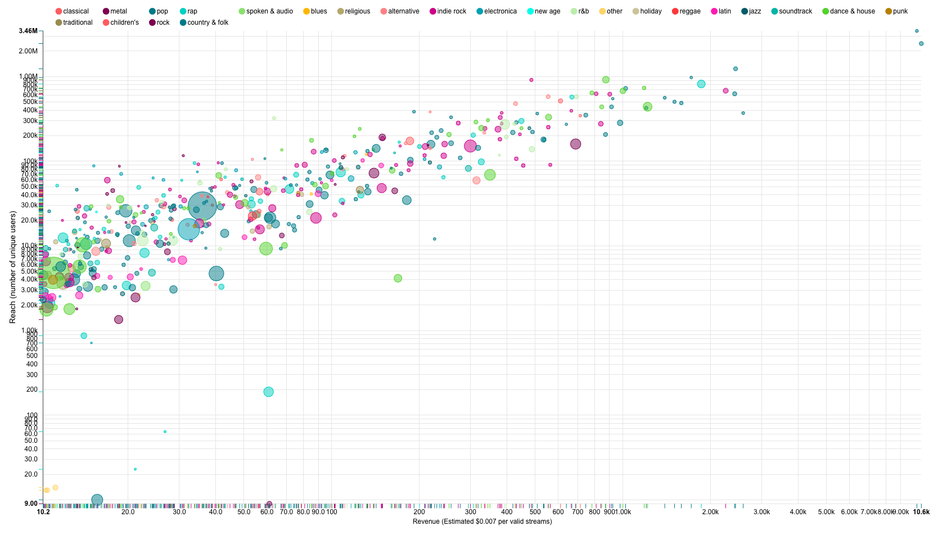


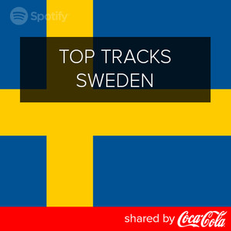
If we talk about #Revenue(Estimated);
If we talk about #Reaches;
Money talks, number$ don’t lie. Top 500 playlist
Revenue estimated daily vs daily reach. (Bubble size – projected engaging time in minutes)
More reaches could potential bring more exposures to brand’s product
or service
3.5 min per track
Source: http://www.bbc.com/news/entertainment-arts-25217353
Log scale applied simply for visualization purpose
Notes:
Of course, Top Hits/Hot on Spotify is favored by rec engine as well thus leads to large exposure

Slide 5
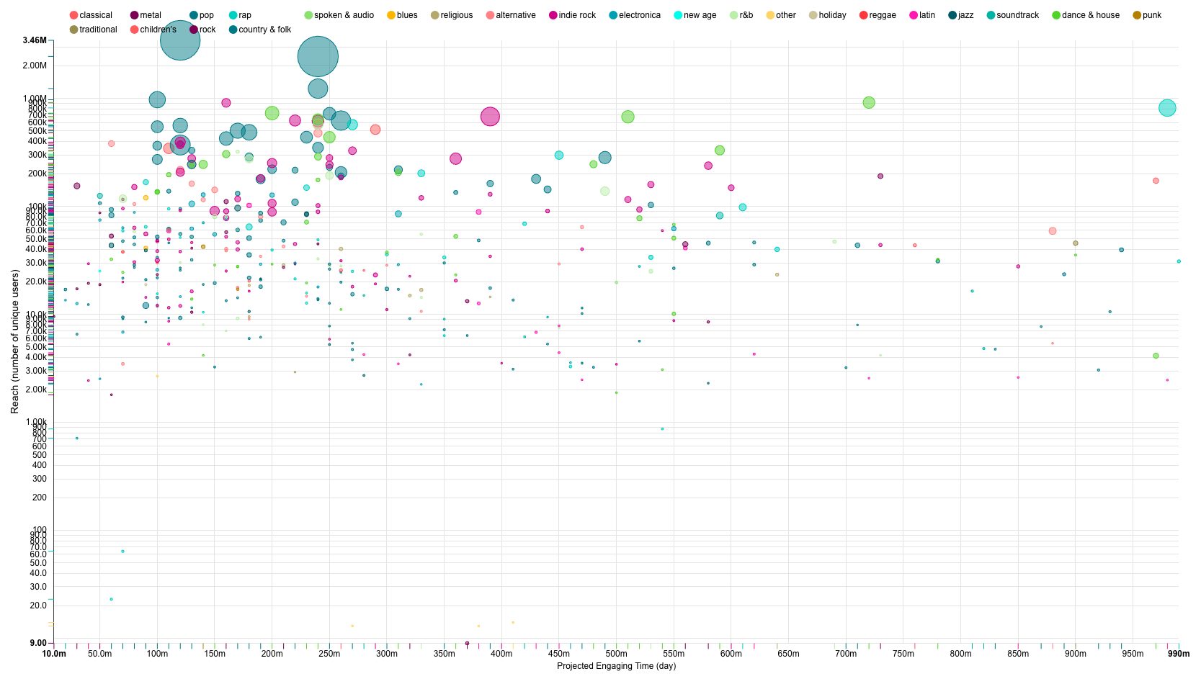
If we talk about #Engaging Time
within Top 500 Playlists
Estimated by assuming average track length: 3.5 min
Projected engaging time of 90%(89.72%) of the total population is less than 1 day (361927 vs. 41439)
The area highlighted in Green is around 100 min to 250 min, roughly 30% confidence band around 148* mins (average engaging time
from Spotify Study)
Source: http://www.bbc.com/news/entertainment-arts-25217353

