Slide 1
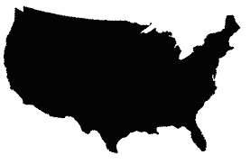
National intake
mean
Subnational intake
means
Subnational intake
distributions
150
150
100 mg/day
100
100
50
50
Data: COSIMO-Aglink model
Imputation: None
Guided by: GENUS database
Imputation: 56 nations – nearest neighbor
2 nutrients – SPADE analysis
Guided by: SPADE + dietary surveys
Imputation: 36% of sex-age groups
178 nations - nearest
neighbor used for both

