Slide 1
Bulls & Cows
Author: Alon Shlomi

Slide 2
The game
Bulls and Cows is a code-breaking mind or paper and pencil game for two or more players.

Slide 3
Gameplay Overview
Each turn, the player inputs a constant-digit number.
The other player then responds with the number of 'cows' and 'bulls’.
A 'bull' refers to a correct digit in the correct position, while a 'cow' refers to a correct digit in the wrong position.
The player uses this feedback to make educated guesses and eventually reach the correct number.

Slide 4
Solving Approaches
Brute Force Approach
Algorithm Approach
trying every possible combination of four digits.
Our Algorithmic approach takes an educated guess from his calculated options table.
The algorithm can reduce the number of guesses segnifintily.

Slide 5

The Algorithm
In 1996 Tetsuro Tanaka proved that the minimum expected game length for the code-breaker to crack the code is 5.213, assuming that the code-maker uses a code of length four with six possible symbols.
The proof involves analyzing the possible outcomes of the game and calculating the expected length of the game based on the probabilities of those outcomes. It turns out that the optimal strategy for the code-breaker is to make their first guess randomly and then use a specific set of subsequent guesses that are designed to maximize the information gained from each feedback response.

Slide 6
The Algorithm Functions
createTable | This method generates a list of all possible numbers of the given number of digits.
createTheNumber | An assortment of graphic resources that are suitable for use in this presentation
createGuess | This method chooses a random number from the list of possible numbers generated by createTable function. Only used when no number is sent.
findBH | This method compares the current guess to the secret number and calculates the number of bulls and cows in the guess.
reduceTable | This method narrows down the list of possible numbers based on the result of the previous guess. It loops through each number in the list of possible numbers and checks if it produces the same number of bulls and cows as the previous guess. If it does, the number is kept in the list; otherwise, it is removed.
getCounter | This method returns the number of tries it took to guess the number.

Slide 7
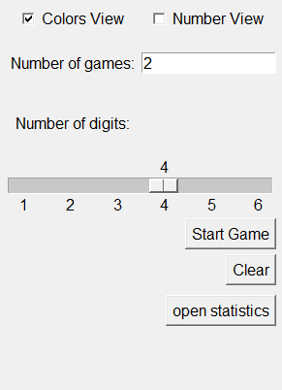
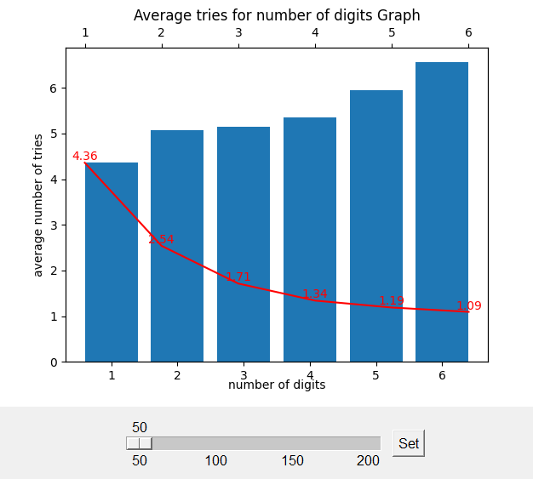
UI Seting & Satatistics
Game controls
Game statistics
Checkboxes for change between number's results view or color's results view.
Entry for the number of games will play.
Slider for the number of digits in the secret.
Buttons for start game, clear results, open/close statistics.
Slider for choosing the number of games statistics
Bar Graph of the average number of guesses for each number of digits in the secret.
Red graph that shows the average number of tries/number of digits

Slide 8
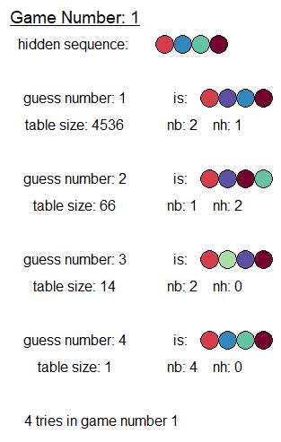
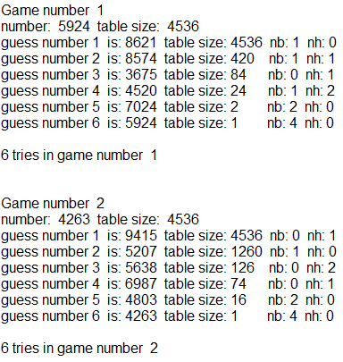
UI Results View
Color
Numbers
Game statistics
For each game, it shows:
The game number.
The secret number.
The starting table size
All the guesses.
The total number of guesses.
For each guess, it shows:
The guess number.
The guess.
The current table size.
The number of bulls and cows

Slide 9
Thanks!
Do you have any questions?
Alon.shlomi@s.afeka.ac.il
References:
https://www.grin.com/document/312138
https://en.wikipedia.org/wiki/Bulls_and_Cows

