Slide 1

E-Commerce
A comparison by Brandon Rowe

Slide 2
The Good, the Bad and the Ugly
Good
BestBuy.com
Functional
Informational
Excellent Search & Navigation
Easy to use
Simple Graphics
Related Text and Images
Bad
Shop.com
Non-optimal Search
Navigation is disorganized
Text and images do not advertise products
Tough to figure out what products are sold on the site

Slide 3
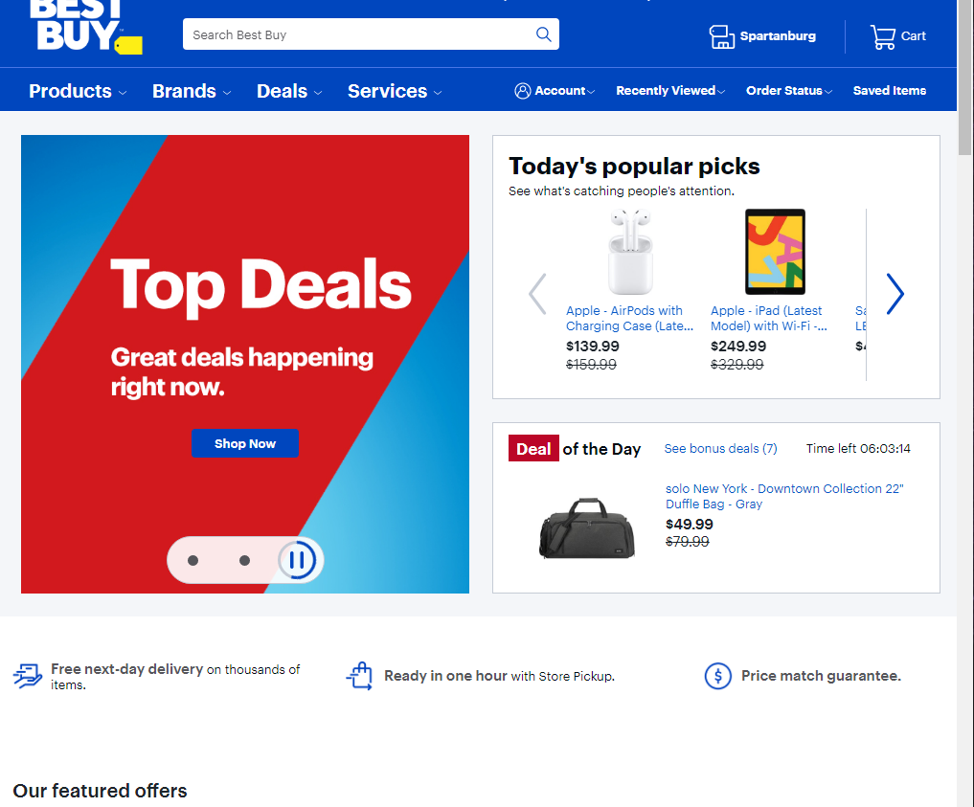
Best Buy Homepage
Best buy has redundant links, reliable search, valuable text and image content that describes the products and great navigation within the site. Best buy has department navigation so one does not have to use the search function to find products.

Slide 4
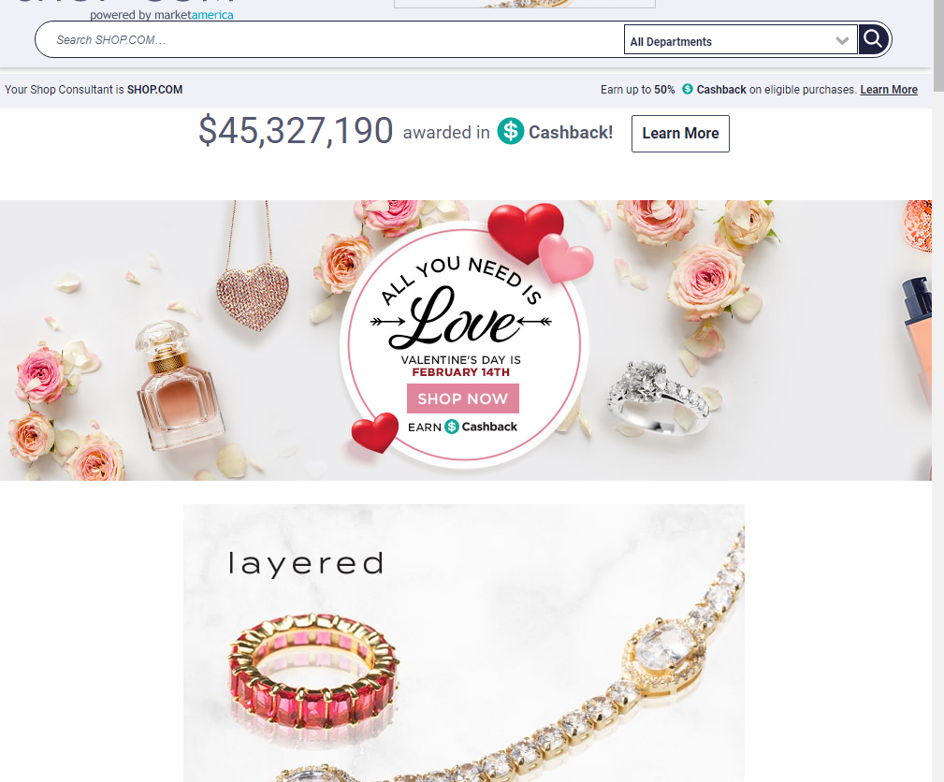
Shop.com Homepage
Less readable and provides less indication of what is sold on the site. One has to locate items with the navigation or search function. Neither tell the user what is sold on the site. Lack of text and images to support search and functionality.

Slide 5
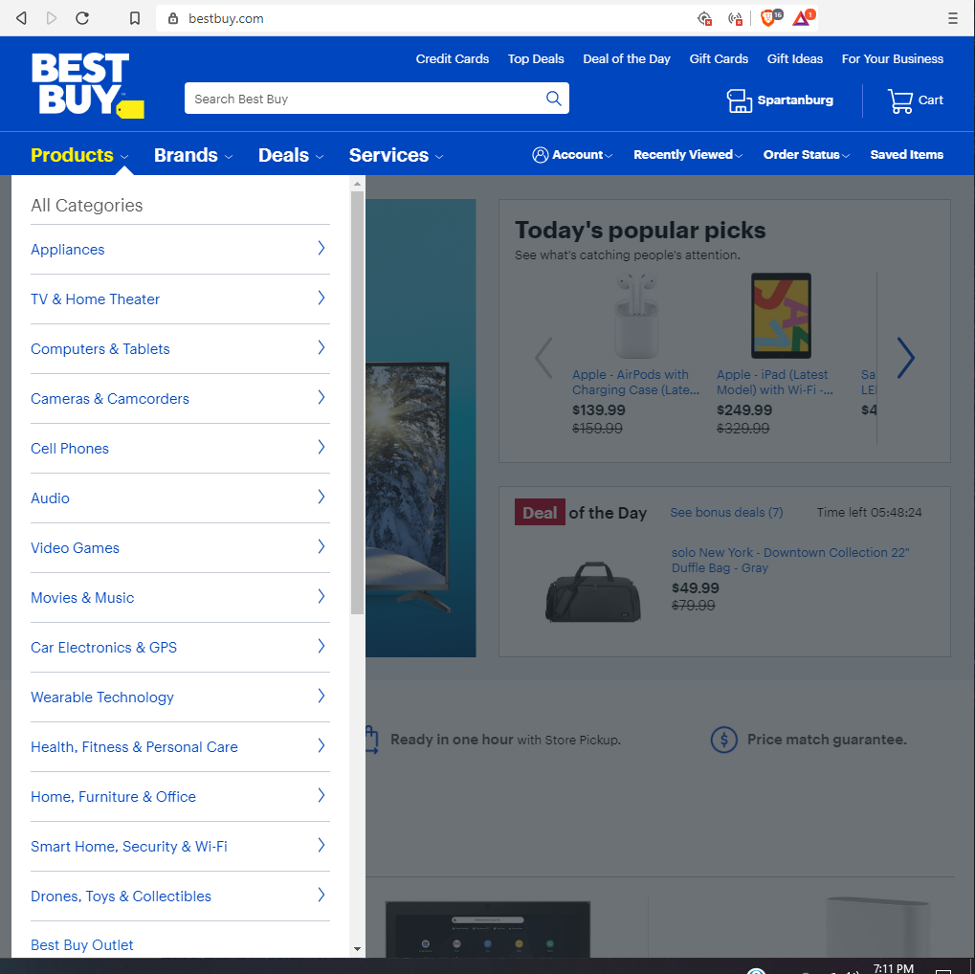
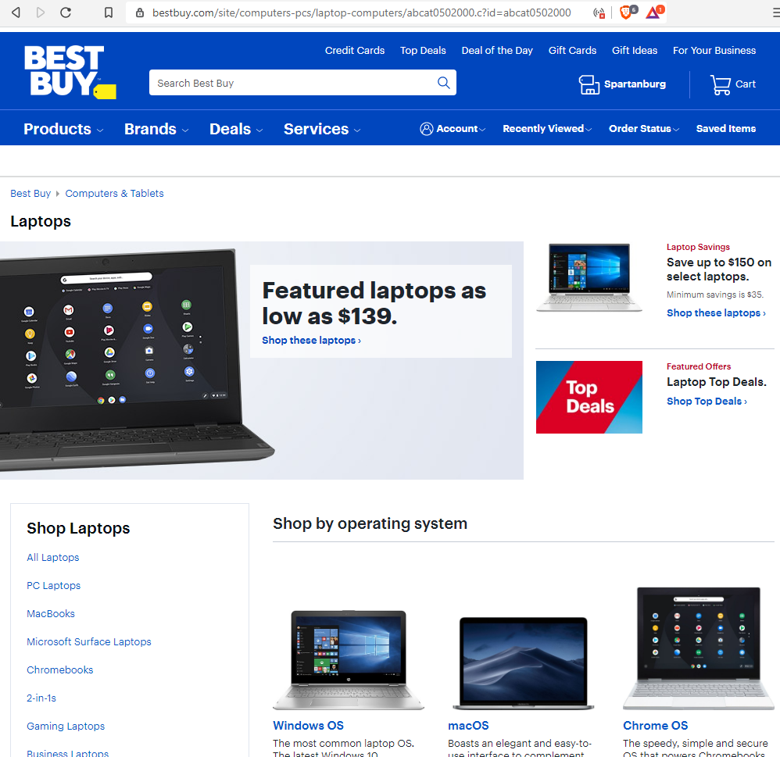

Slide 6
Best Buy does an excellent job of providing many ways to locate the same thing. Their navigation is a hierarchy of folders that allows customers to narrow their results by subsections that cut to lower folders in the hierarchy. Best Buy provides top searched products on the homepage with links to view full pages of similar products. Best Buy provides links to navigate their site at the top and bottom of the page. All of the text and images are neat and clearly identify the products available and help the customer locate those products efficiently. The site is very easy to use and responds according to expectation.

Slide 7
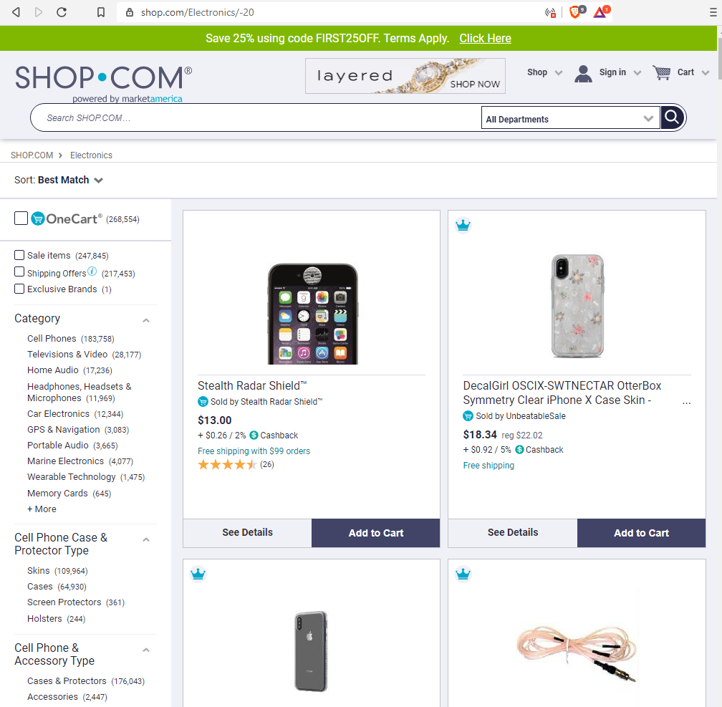
Shop.com search function does not contain sorting and filtering nor does it automatically organize the search results by some key identifier like price in ascending/descending. Without searching the exact item, it is difficult to locate the items that are for sale. This is a poor form of searching when there is no filtering.

Slide 8
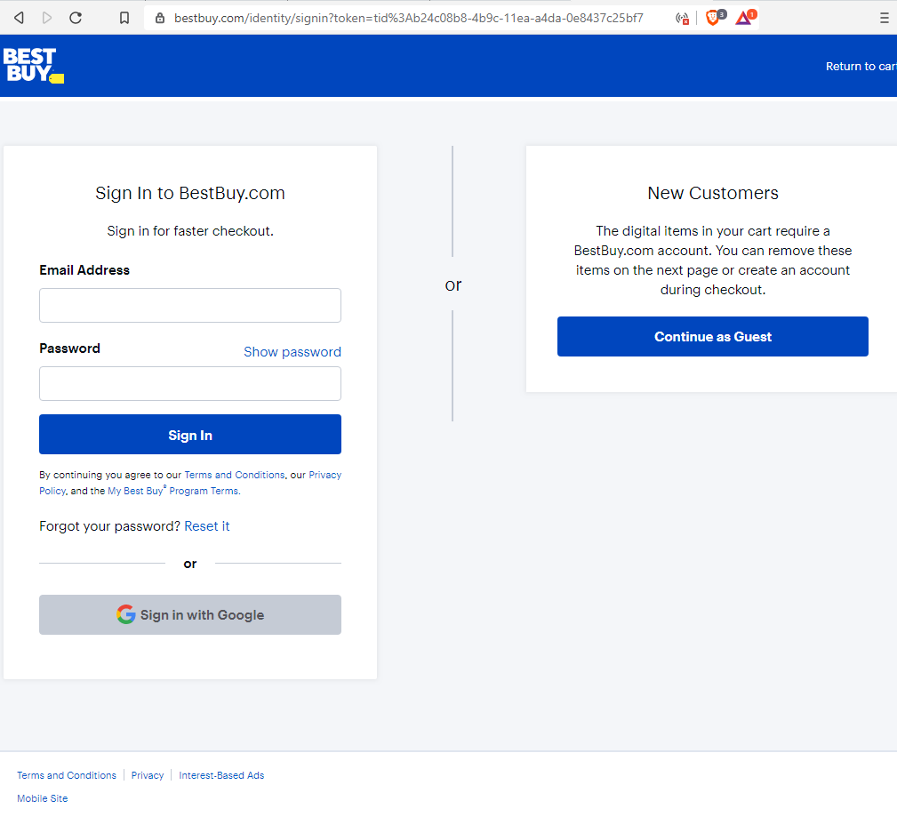
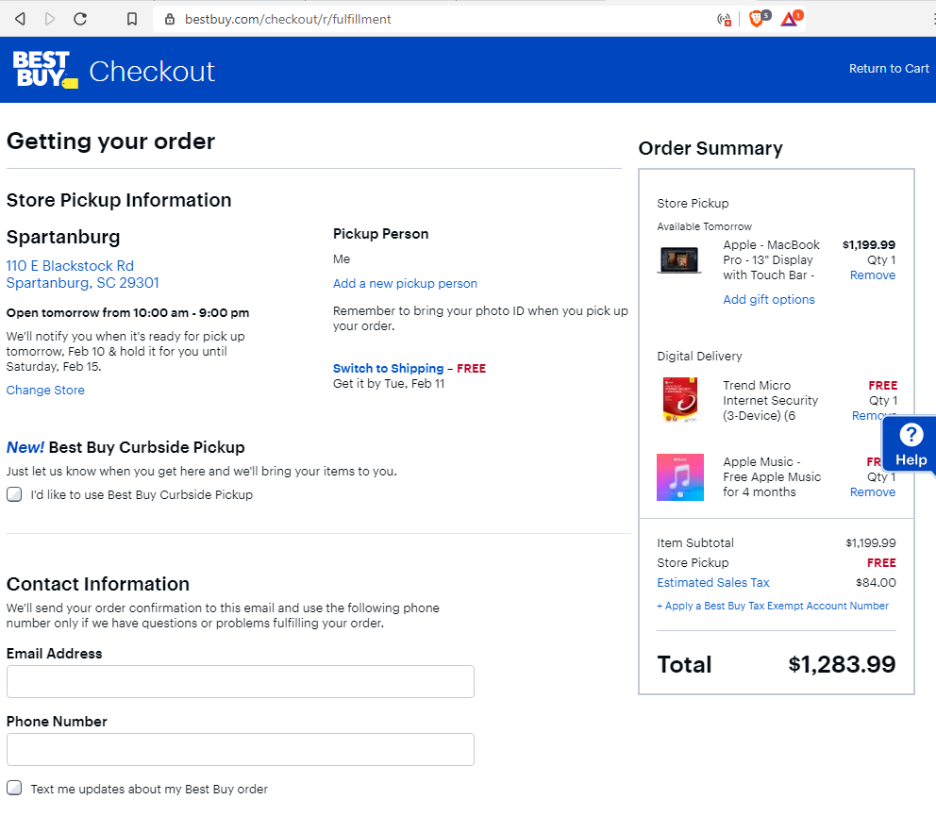
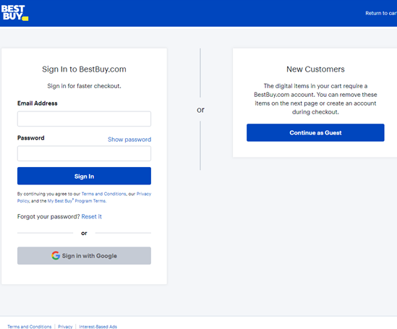
Best Buy Checkout
Best Buy checkout is quick and easy to use. They provide options for registered customers and customers that want to checkout without creating an online account. Process is seamless with expected payment and shipping options.

Slide 9
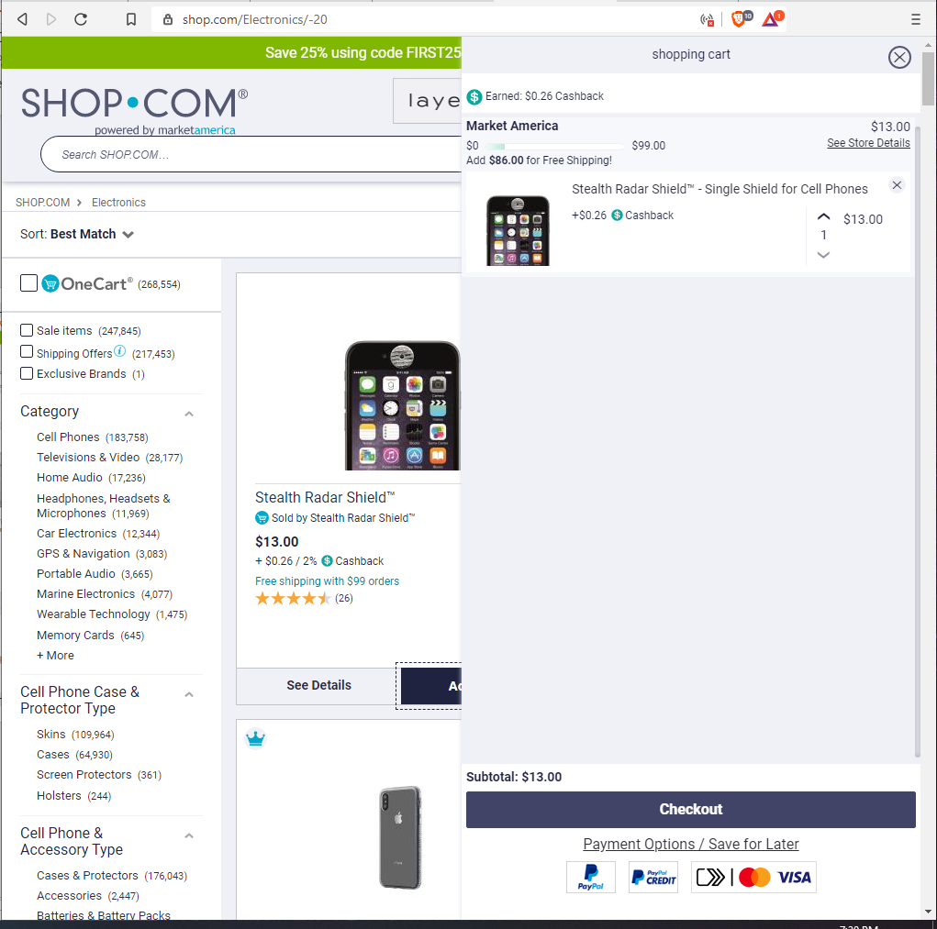
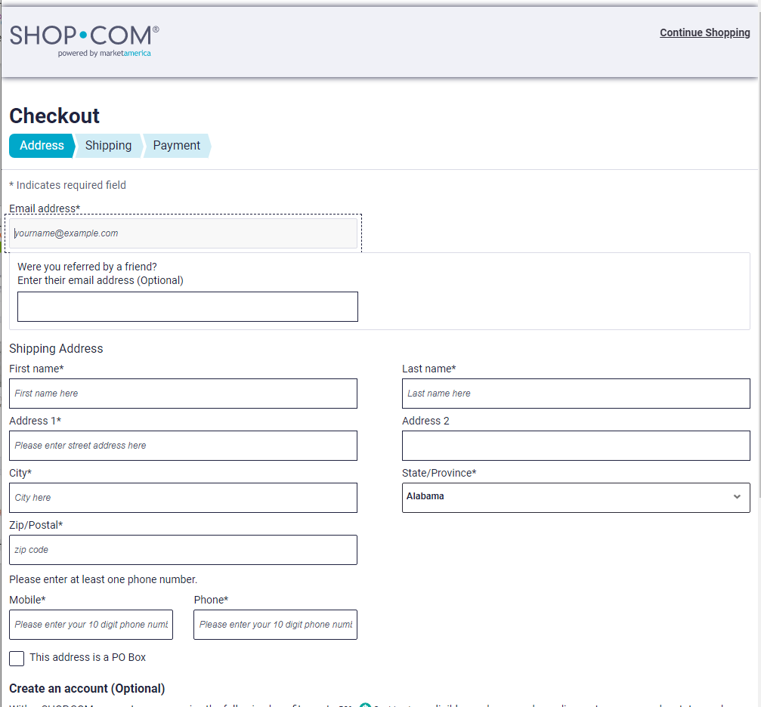

Slide 10
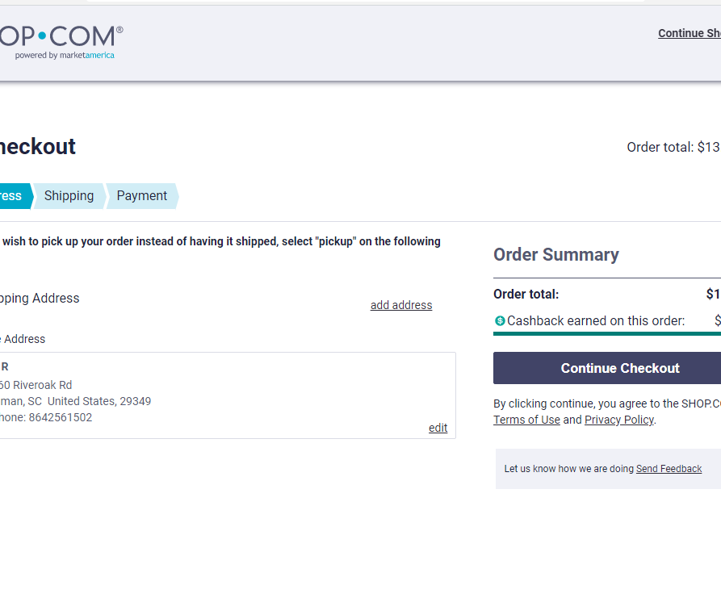
Shop.com Checkout
Shop.com provides similar functionality to most e-commerce sites but does not allow a user to checkout as guest. User must register an account or login before they can make a purchase. This complicates the ease of use and functionality in checking out.

Slide 11
Comparison of E-Commerce
Discuss the pros of bestbuy.com and how they provide excellent functionality.
Provide examples of comparison and details that could save shoppers time and headache.
Discussed the cons of shop.com even though the overall site is decent.

