Slide 1
Bank Marketing Campaign
Alonso Vega
vegaa@umich.edu

Slide 2
I. Introduction

Slide 3
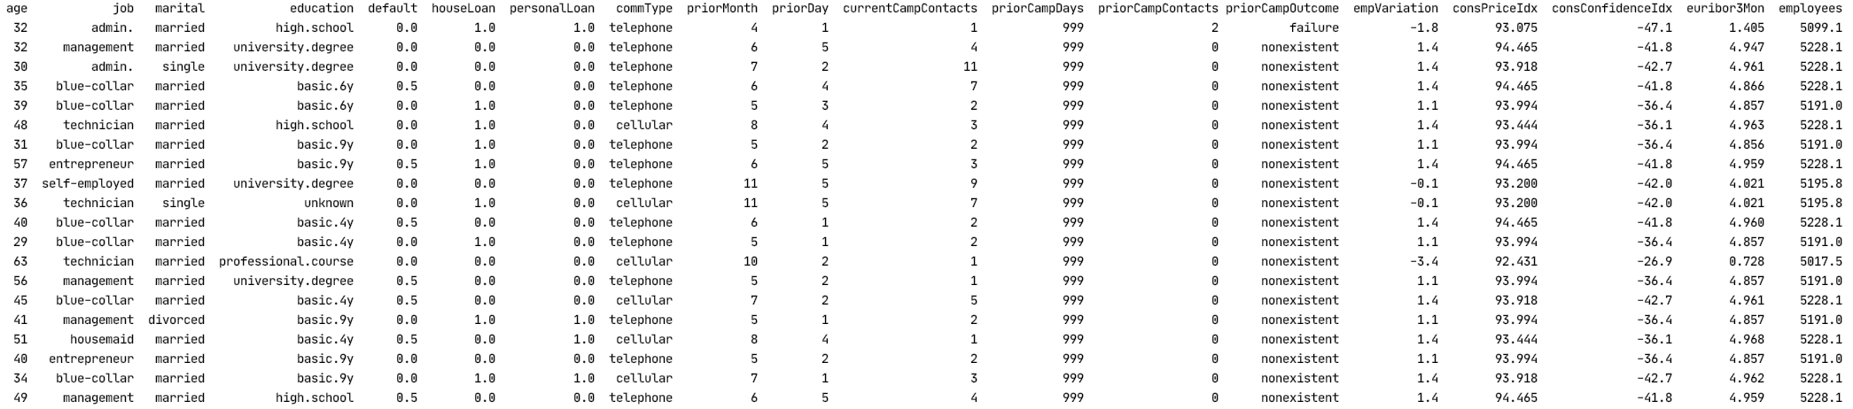
II. Data
Did client invest in bank deposit?
personal info.
previous Campaign
mapping
comm.
financial life
personal
Economy

Slide 4
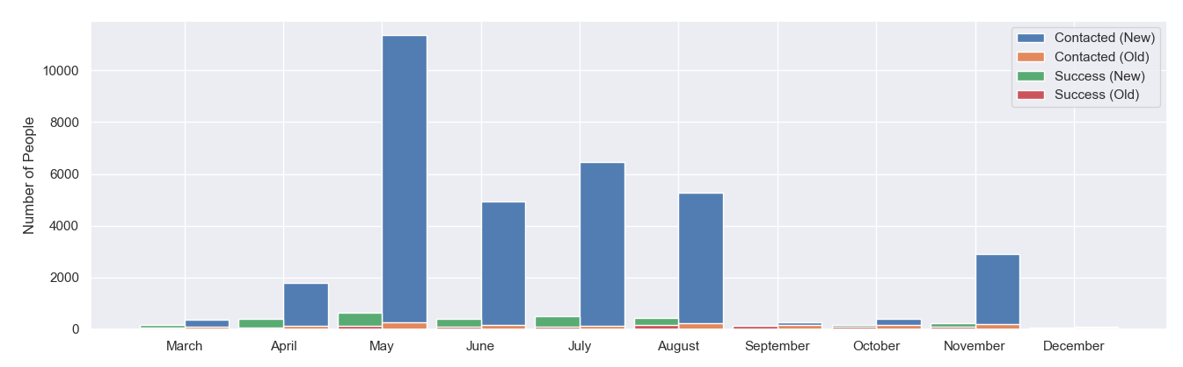

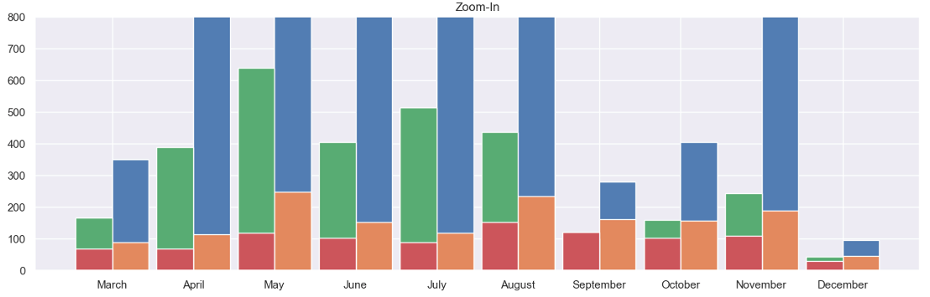
III. History
Zoom

Slide 5
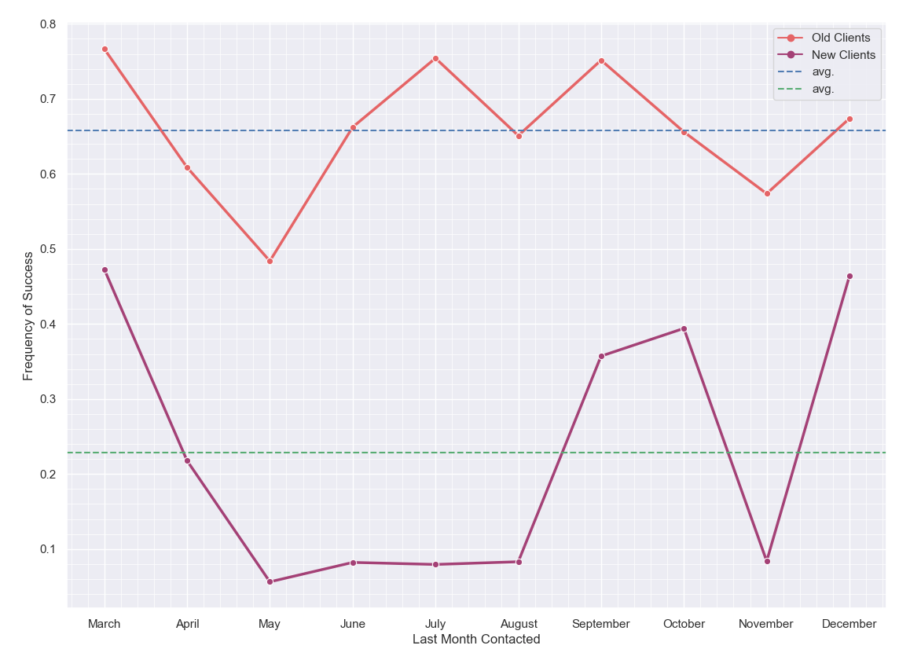
Most Contacts

Slide 6
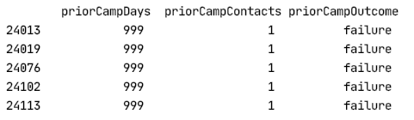
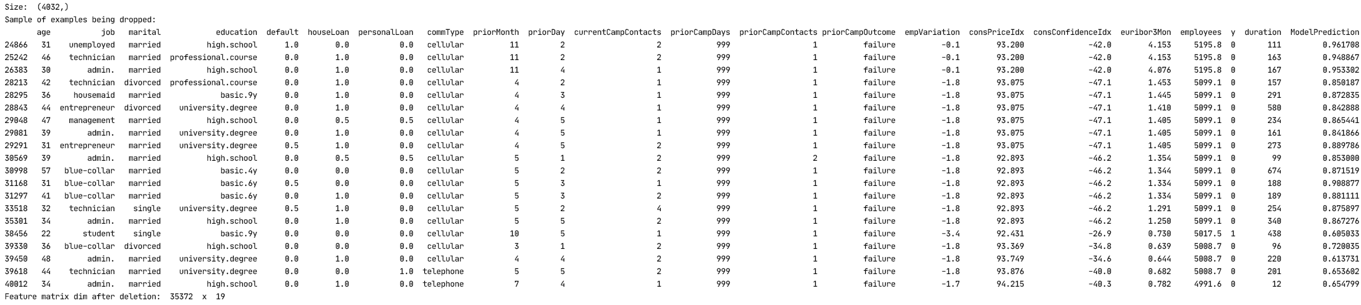
IV. Contradiction
10.23% == 4032 obs.
35372 obs.

Slide 7

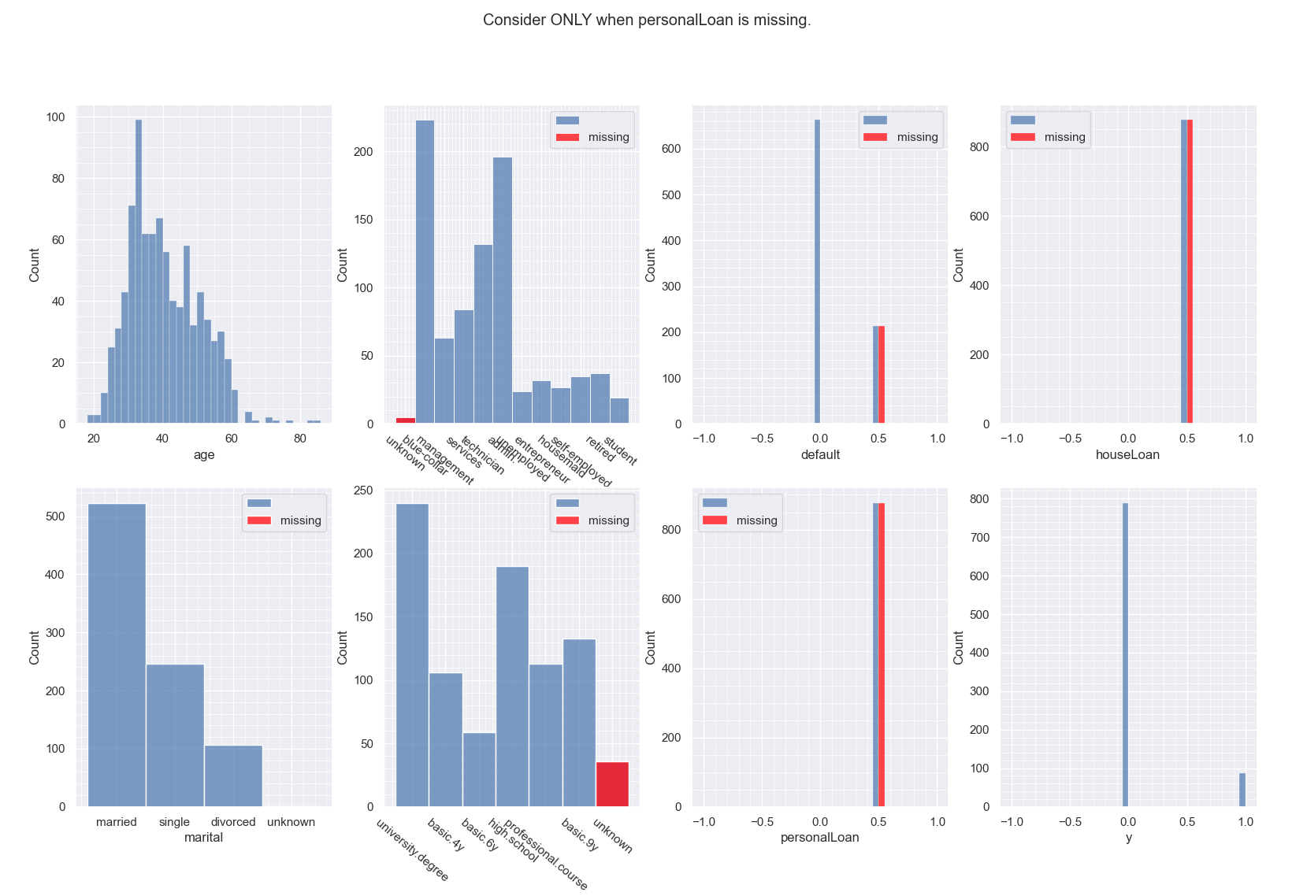
V. Missing Data Analysis
Consider ONLY when personalLoan is missing.

Slide 8

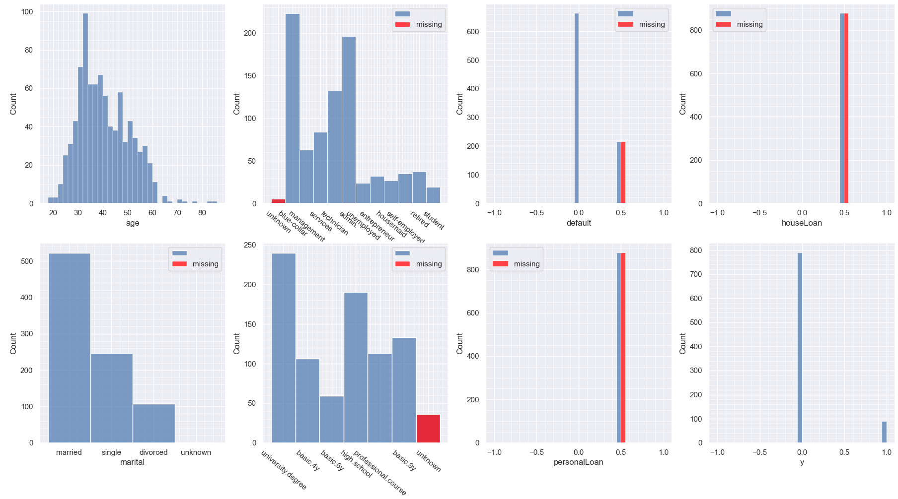
Consider ONLY when houseLoan is missing.

Slide 9
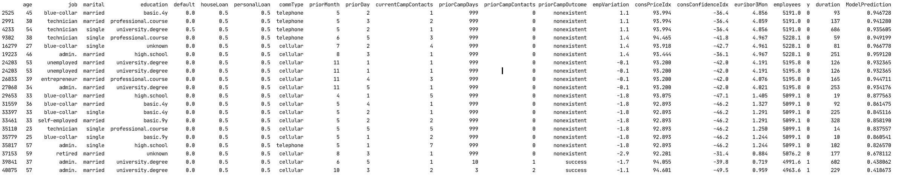
2.5% == 877 obs.
34495 obs.

Slide 10
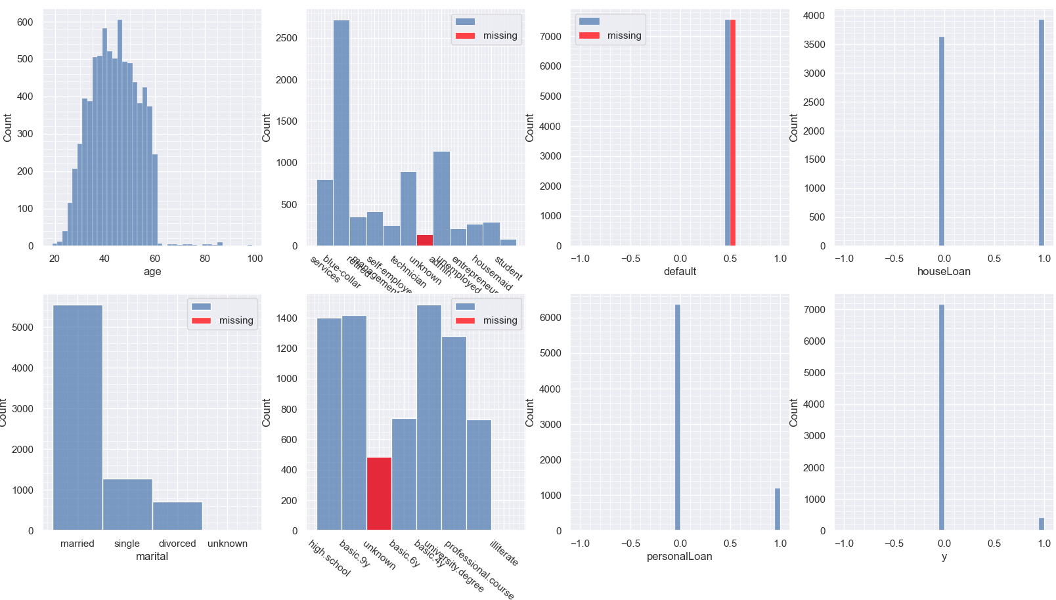

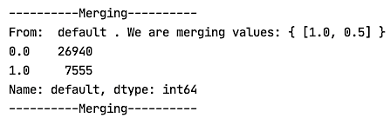
Consider ONLY when default is missing.

Slide 11
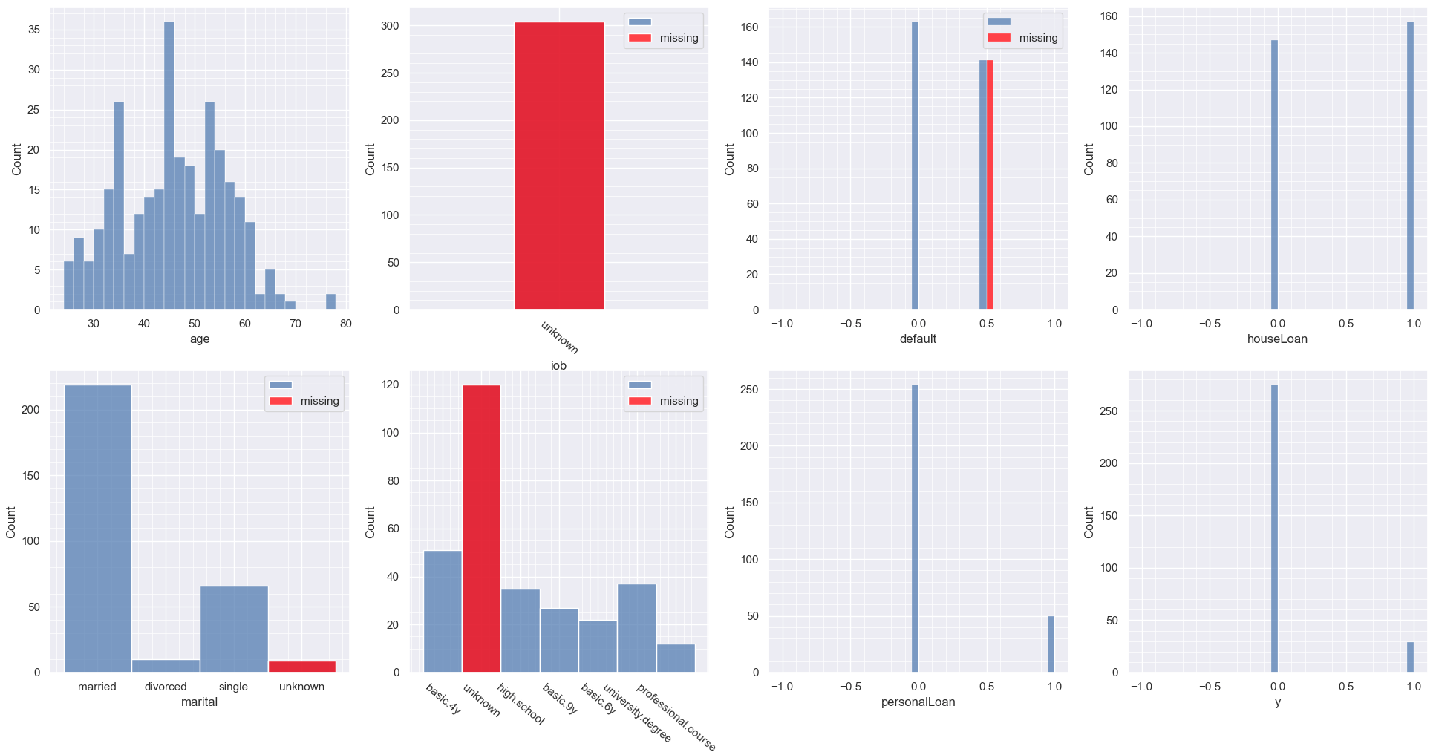
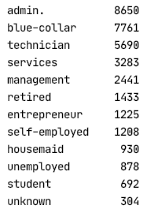
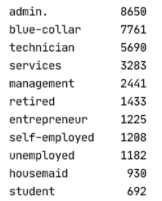
Consider ONLY when job is missing.
merge

Slide 12
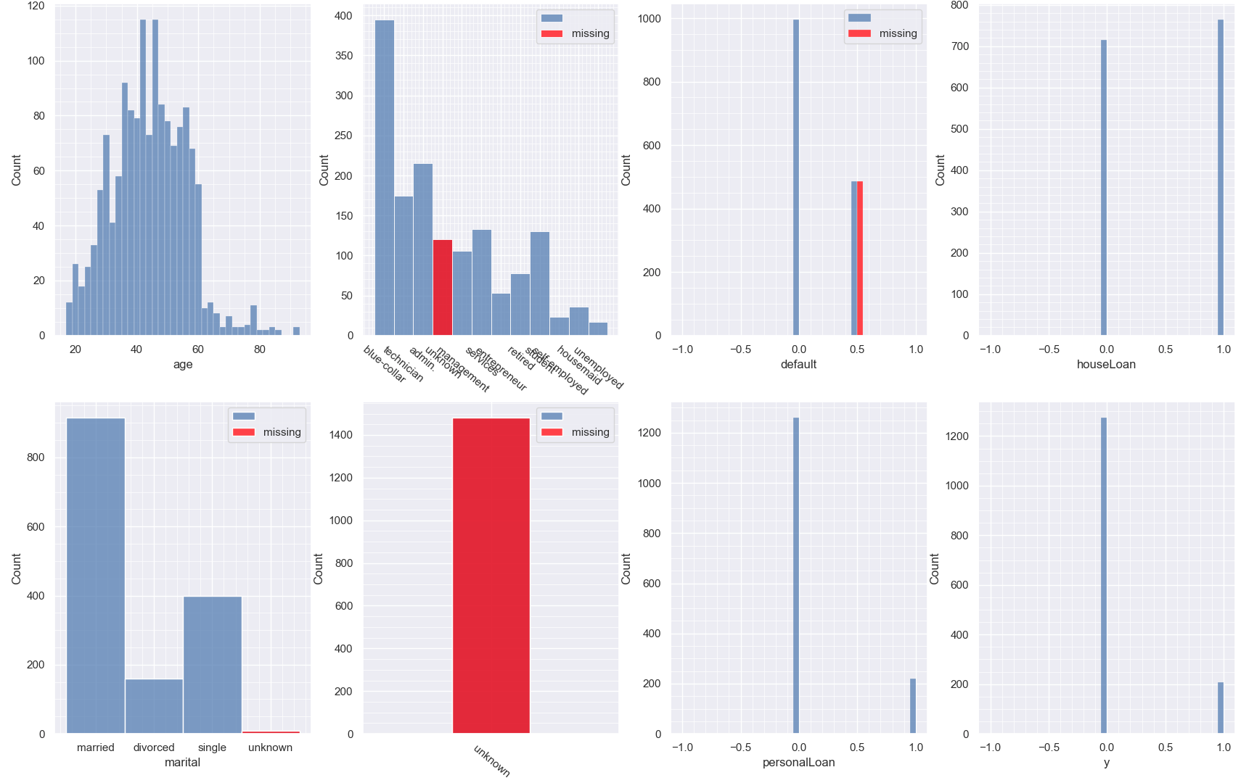
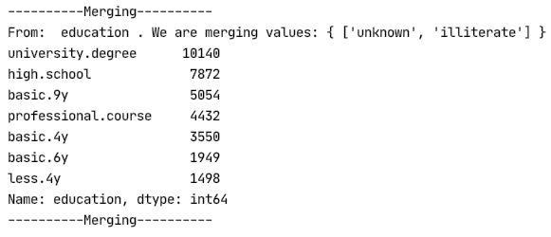

Slide 13
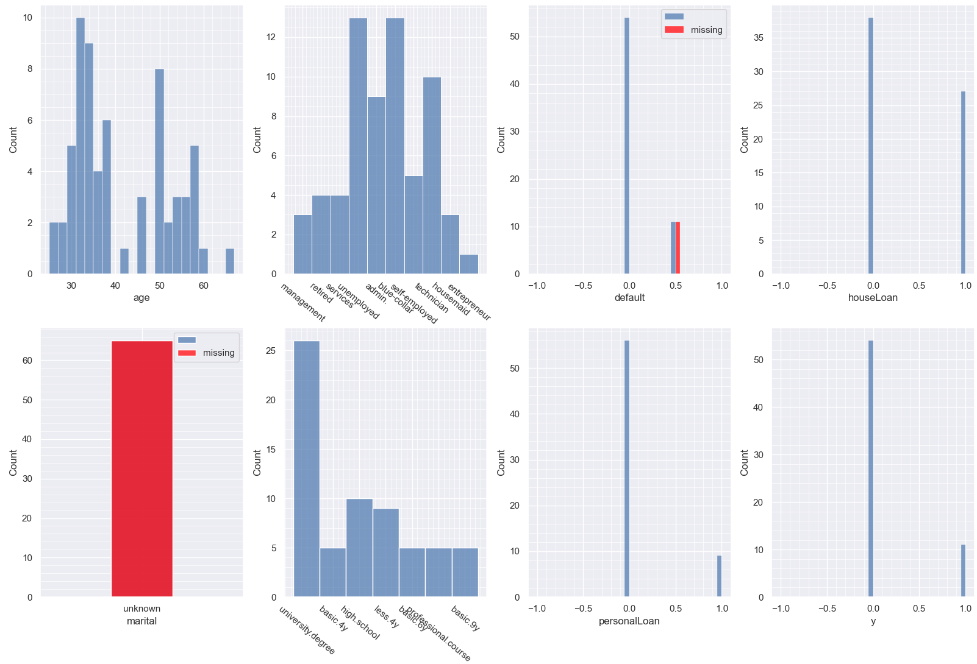
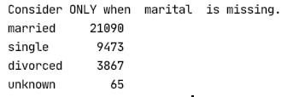
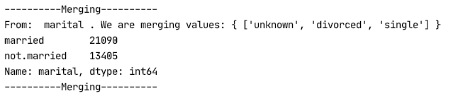

Slide 14
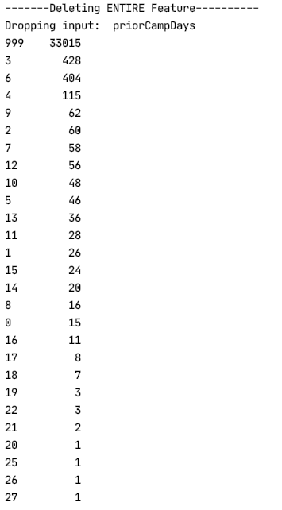
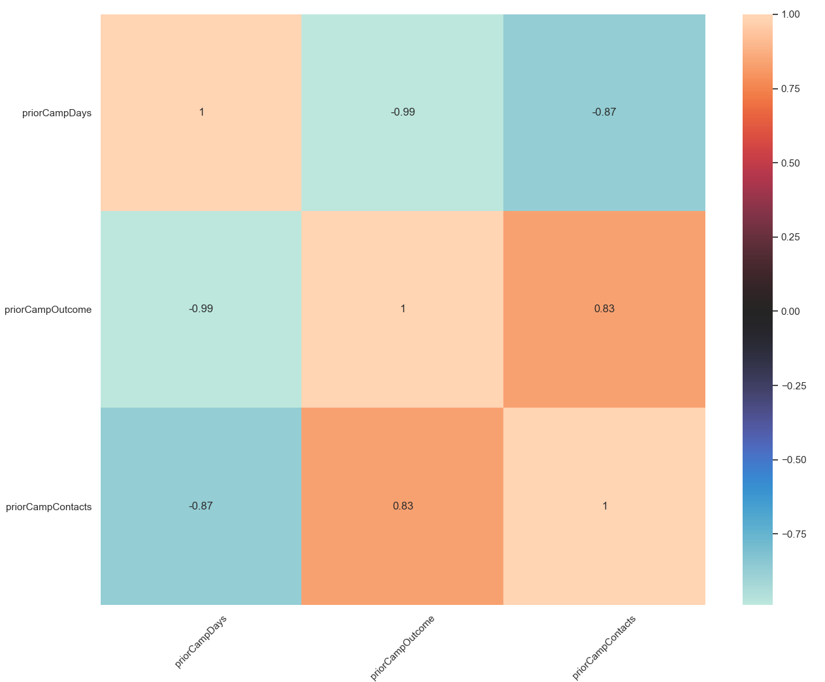
VI. Nonessential

Slide 15
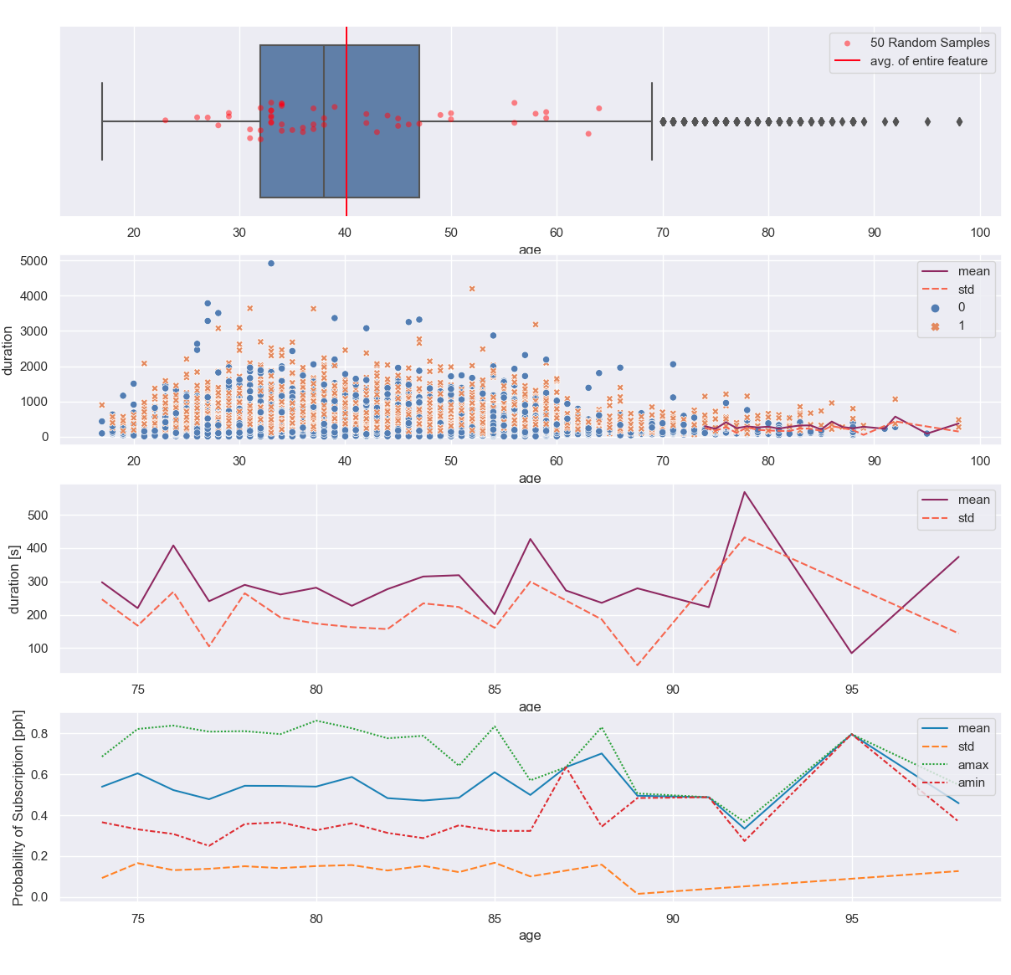
VII. Outliers
Zoom

Slide 16
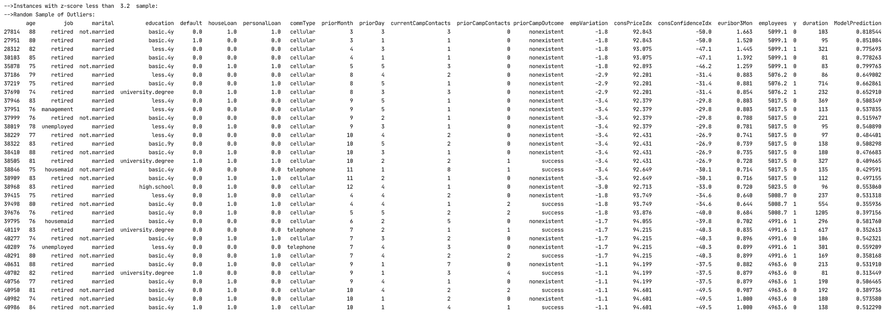
0.65% == 223 obs.
34495 obs.

Slide 17
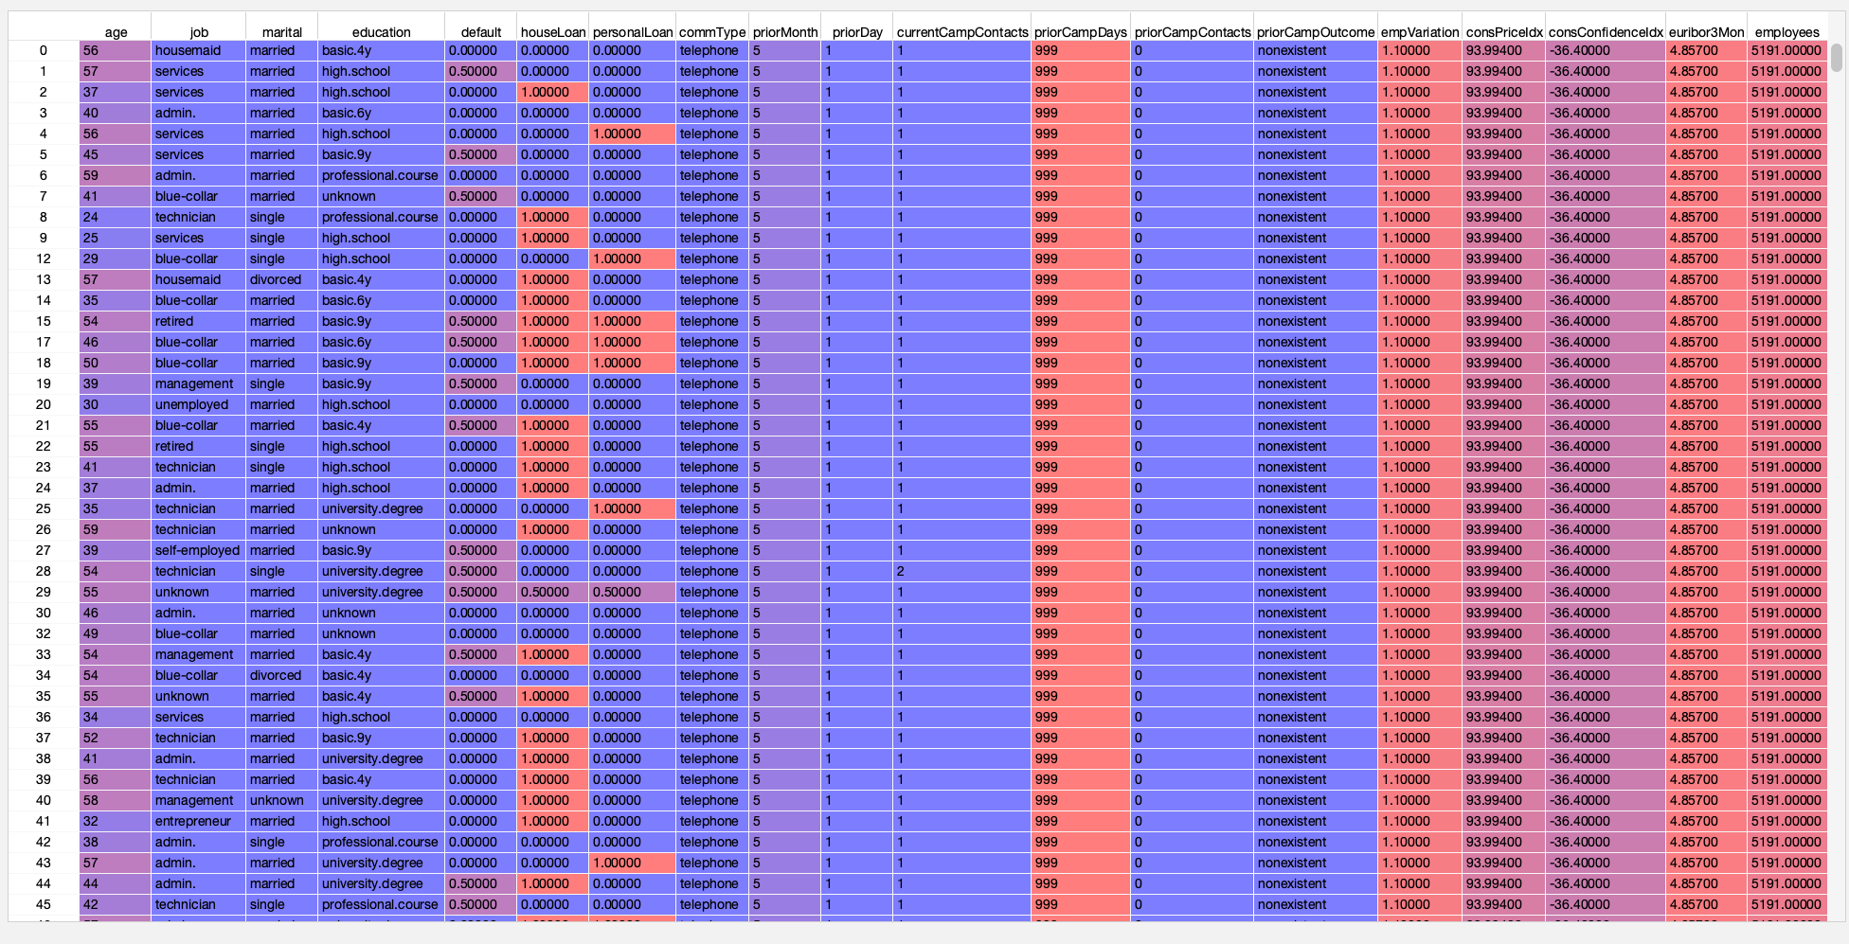
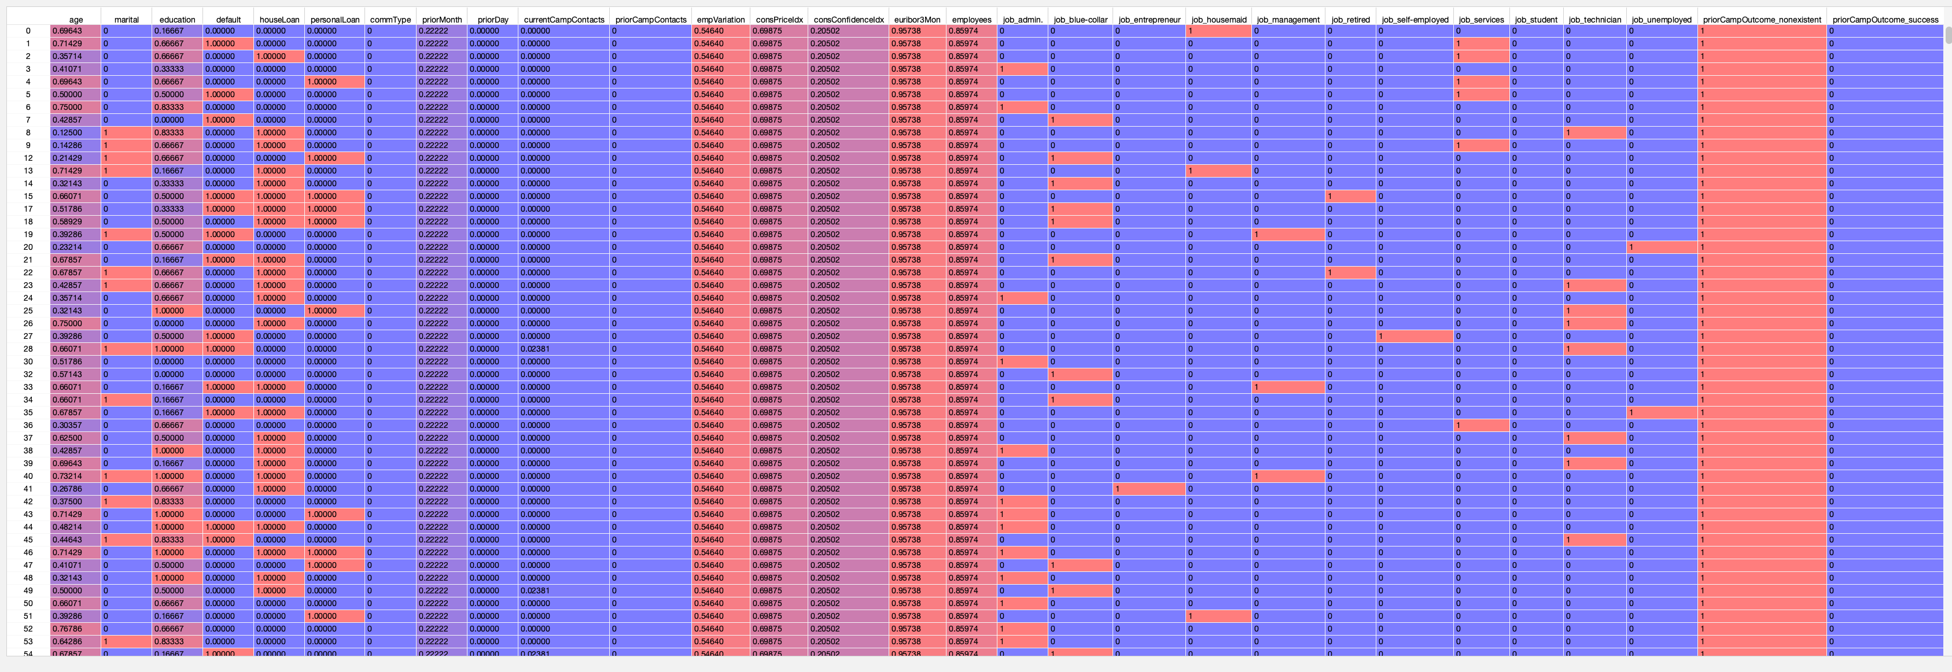
VIII. Reformatting

