Slide 1

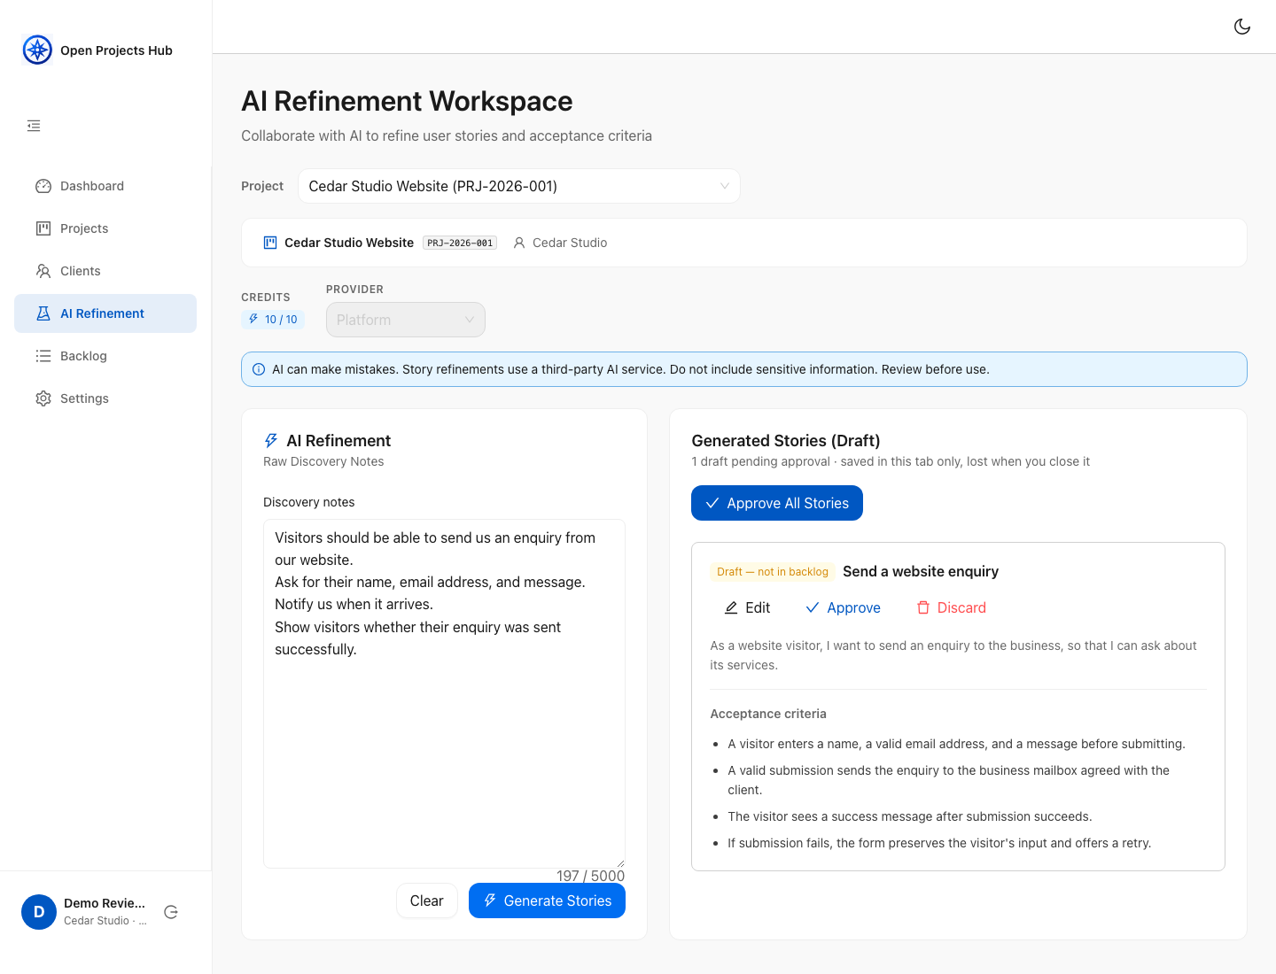
Open Projects Hub
From raw client notes to an approved, shareable backlog. AI proposes; the freelancer decides.
Alonso Villanueva Naranjo
Máster de Desarrollo con IA · Final project
oph.alonsovndev.com
Illustrative UI · fictional data · mocked API responses
Notes:
Introduce the problem and human-controlled workflow. The pictured interface uses fictional Cedar Studio data and intercepted API responses. It illustrates the implemented UI, not a recorded live-provider response or production transaction.

Slide 2
Client requirements arrive messy
Before any code is written, a freelancer has to turn informal input into something both sides agree on.
1
2
3
Ambiguous input
Scattered context
Risky sharing
Requests start as emails, calls or a list of ideas. Scope and intent have to be clarified first.
Notes, stories and decisions drift away from the client and project they belong to.
Clients need to see what was agreed, without access to the freelancer's internal workspace.
Who it's for: freelancers and small teams, their clients, and contributors studying Clean Architecture.
Notes:
The problem: client input is informal, context gets scattered, and sharing requirements safely is hard. The target users are freelancers and small teams, plus their clients, who only need read access.

Slide 3
One workflow from notes to an agreed backlog
1
2
3
4
5
Client & project
AI refinement
Human review
Approved backlog
Client Review
Organize work per client, with up to 3 active projects per workspace.
Paste raw notes; an AI provider drafts user stories with acceptance criteria.
Edit, discard or approve each draft. Drafts stay in the browser tab.
Only approved stories are stored. Filter and export to Markdown.
The client reads approved stories with an access code. No account needed.
AI proposes, the freelancer decides. Nothing reaches the backlog or the client without explicit human approval.
Notes:
Walk through the five steps. Emphasize step 3: the human-in-the-loop review. Unapproved drafts never touch the database (ADR-019).

Slide 4
Refinement: AI drafts, the freelancer decides
UI WALKTHROUGH 1 / 3
1
Raw notes in
Paste the client's own words, up to 5,000 characters per request.
2
Candidate stories out
Each draft has a user story and acceptance criteria to edit, approve or discard.
3
Choose a provider
Use platform credits or a personal Gemini, OpenAI or DeepSeek key.
Illustrative UI walkthrough · fictional data · mocked API responses
Notes:
Use this zoomed UI capture to explain the note-to-draft interaction and Edit, Approve and Discard controls. The screenshot uses fictional notes and mocked API responses; it does not establish a real AI result or successful approval transaction. Platform credits and personal Gemini, OpenAI or DeepSeek keys are supported.

Slide 5
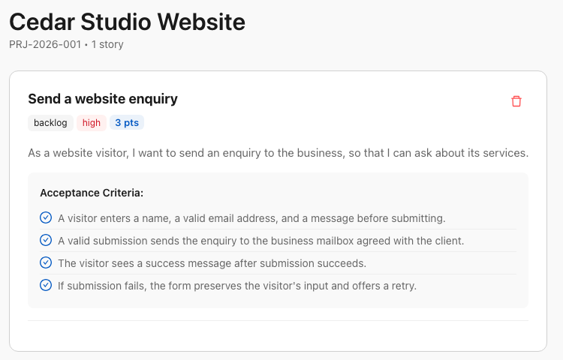
Approved backlog, ready to share
UI WALKTHROUGH 2 / 3
1
Only what was agreed
The backlog holds approved stories, with priority and estimate.
2
Markdown export
Export a project's scope to Markdown for proposals or repositories.
3
Workspace isolation
Workspace-owned data is scoped to the caller's workspace and role.
Illustrative UI walkthrough · fictional data · mocked API responses
Notes:
The cropped screenshot focuses on the approved story and acceptance criteria; application navigation and the Export button are outside this crop. This is a staged UI state, not backend persistence evidence. The implemented exporter uses approved stories. Tenant-owned data is scoped to the caller workspace and authorized role.

Slide 6
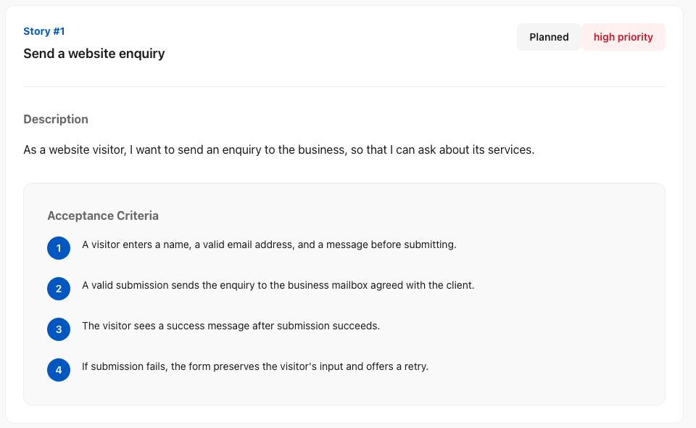
Client Review: read-only, no account
UI WALKTHROUGH 3 / 3
1
One access code
The freelancer shares a code per project; replacing it revokes access.
2
Minimal data
Clients see approved stories only, never workspace or internal data.
3
Shared project view
Clients see the latest approved backlog when they reload.
Illustrative UI walkthrough · fictional data · mocked API responses
Notes:
Client Review is account-free and read-only. This screenshot uses fictional data and a staged public API response. A shared project access code can be regenerated to revoke the previous code. The client reloads to fetch newly approved stories; this is not a live-push or polling interface.

Slide 7
A modular monolith with Clean Architecture
Presentation & Infrastructure
11 feature slices, same four layers
FastAPI routers · SQLAlchemy repositories · AI and email adapters
auth
user
Application
workspaces
clients
Use cases · ports · DTOs
projects
refinement
stories
backlog
Domain
client_review
ai_config
Entities · value objects · business rules. No framework imports.
dashboard
Dependencies point inward; one composition root wires the adapters. The React app mirrors it with feature slices and RTK Query at the API boundary.
Notes:
The API is a modular monolith: eleven feature modules, each with domain, application, infrastructure and presentation layers. Dependencies point inward. The frontend follows the same feature-slice idea.

Slide 8
Production: Cloudflare edge + one EC2 host
Cloudflare
EC2 · us-east-2
Runtime services
API proxy + DNS
api-oph.alonsovndev.com
HTTPS 443
Caddy · /v1/*
AI providers
Gemini · OpenAI
DeepSeek
API HTTPS
Users'
browser
FastAPI container
Workers: web + docs
oph.alonsovndev.com
oph-docs.alonsovndev.com
Resend
email codes
Static HTTPS
PostgreSQL 15
EBS persistence
Docker Compose · single host
RELEASE & CONFIGURATION
GitHub Actions → GHCR image
Engineer → SSM Run Command
Host pulls image + SSM secrets
Manual: deploy-release.sh <tag> · Terraform: host, networking, SSM, budgets and DNS
Ingress: 443 from Cloudflare IP ranges · Origin TLS: Full · No automated DB backups or failover
Notes:
The browser separately fetches static web/docs assets from Workers and calls the API through the Cloudflare API proxy. HTTPS reaches Caddy, then the FastAPI container and PostgreSQL on one EC2 host in us-east-2. AI and email are runtime services. GitHub Actions only publishes the GHCR image. An engineer runs deploy-release.sh with AWS credentials, invoking SSM Run Command; host deployment reads SSM parameters and pulls the tagged image. Terraform is applied locally. Cloudflare Full encrypts the origin leg without validating the origin certificate; no automated database backups or failover exist.

Slide 9
AI that stays under human control
1
Pluggable providers
2
Credits or your own key
Gemini, OpenAI and DeepSeek behind one port, plus a mock adapter for local development and tests.
Free platform credits per workspace, or a personal API key encrypted at rest (ADR-018).
3
Client-side drafts
4
Defensive handling
Drafts use browser session storage. Only approval saves a story to the database (ADR-019).
Input limits, sanitization and structured parsing of model output. A human approves every story.
Notes:
Providers are adapters behind a port. Personal keys are encrypted at rest. Unapproved drafts are stored in browser session storage so they survive reloads within the tab, but are not persisted server-side. Closing the tab loses them. Structured output parsing and sanitization reduce specific risks; they do not guarantee model accuracy or comprehensive prompt-injection resistance.

Slide 10
Security and quality built into the workflow
1
Security
2
Quality gates
Access token in memory; refresh in an HttpOnly cookie
bcrypt passwords and emailed verification codes
Workspace-owned data scoped to the caller workspace
Admin and Member roles enforced by the API
Content Security Policy on the web app
Ingress allowlists Cloudflare IPs; secrets in SSM
API: Ruff, Bandit, non-integration pytest
Migrations: upgrade/downgrade on test PostgreSQL
API mypy is advisory; integration tests excluded
Web: ESLint, Vitest, types + build; no E2E in CI
Docs: types + build; infra: fmt + validate
feature → dev → main with CI checks
Configured checks are not fresh passing results. Hosted branch-rule enforcement was not queried.
Notes:
Separate configured controls from verification outcomes. Tenant-owned queries are workspace-scoped; authentication and public review have their own access paths. The origin security group allowlists Cloudflare address ranges, not a cryptographically authenticated Cloudflare account. API CI excludes integration tests and mypy is advisory. The migration upgrade/downgrade check uses a temporary PostgreSQL database; it is not a production rollback guarantee. Web E2E is outside CI. Branch-rule enforcement and fresh hosted results were not queried.

Slide 11
Built with AI as an engineering partner
1
Spec first
Ideas become clarified, phased plans in specs/ before any code is written.
TOOLS
Claude Code
OpenCode
GitHub Copilot
2
Agent instructions in every repo
AGENTS.md, CLAUDE.md and repo standards give agents the architecture and rules.
DECISION IN PRACTICE · ADR-019
Before: drafts saved server-side.
Product decision: remove draft storage.
After: browser-only drafts; approval saves a story.
3
Skills and reviewer agents
Reusable skills and reviewer agents support architecture, implementation and verification.
4
Decisions recorded
24 ADRs keep the reasoning behind each choice available to people and agents.
THE RULE
AI assists. I verify and own every merge.
Notes:
Explain AI-assisted development through specs, repository instructions, skills, review, and human responsibility. ADR-019 supplies a concrete documented example of human direction: the initial implementation persisted drafts in story_drafts; the product owner rejected that storage, and the design moved to browser-only drafts with approval as the save boundary. The ADR does not identify who proposed the original implementation, so do not attribute that proposal to an AI or invent a rejected AI conversation.

Slide 12
Delivered capabilities, evidence and open gaps
OBJECTIVE
DELIVERED CAPABILITY
EVIDENCE / GAP
Human-controlled requirements
Notes → AI draft → approval → backlog
Use cases + approval tests exist. Quality and time gains are unmeasured.
Controlled client sharing
Project access code + read-only approved stories
Public response + isolation tests exist. Shared codes lack individual auditing.
Inspectable engineering
Four repositories, 24 ADRs, CI and Terraform
Source and verification artifacts are available. CI coverage has documented gaps.
Implementation and test artifacts are not a fresh passing test run.
Open risks: no user study · no automated DB backups or failover · origin certificate not validated · AI can be wrong
Notes:
Discuss objectives, delivered capabilities, and the exact available evidence. Refinement/approval and client-review tests are source artifacts; this slide does not report a fresh passing run or completed user study. No time-saving, usability or model-quality result has been measured. Remaining risks include a single host without automated backups or failover, origin TLS without certificate validation, shared project access without per-stakeholder audit, advisory API type checking, excluded API integration tests, and web E2E outside CI. Source: docs/00-context/evidence-and-limitations.md.

Slide 13
Thank you
NEXT STEPS
TRY IT
Evaluate with real freelancers: time saved and clarity
oph.alonsovndev.com
Automated database backups and strict origin TLS
DOCUMENTATION
Playwright end-to-end tests in CI
oph-docs.alonsovndev.com
Manual story ordering and per-stakeholder review access
PROJECT REPOSITORIES
API
Web
Infra
Docs
Notes:
Close with the next evaluation and hardening steps. The application and documentation links are clickable. Four separate clickable source links point directly to the API, web, infrastructure and documentation repositories. Do not include test-user credentials in this public file; provide them through the private submission form.

