Slide 1
Data Working Group Preliminary Data
Onega,Morton,Lindsay,Alonzi
4/6/2018

Slide 2
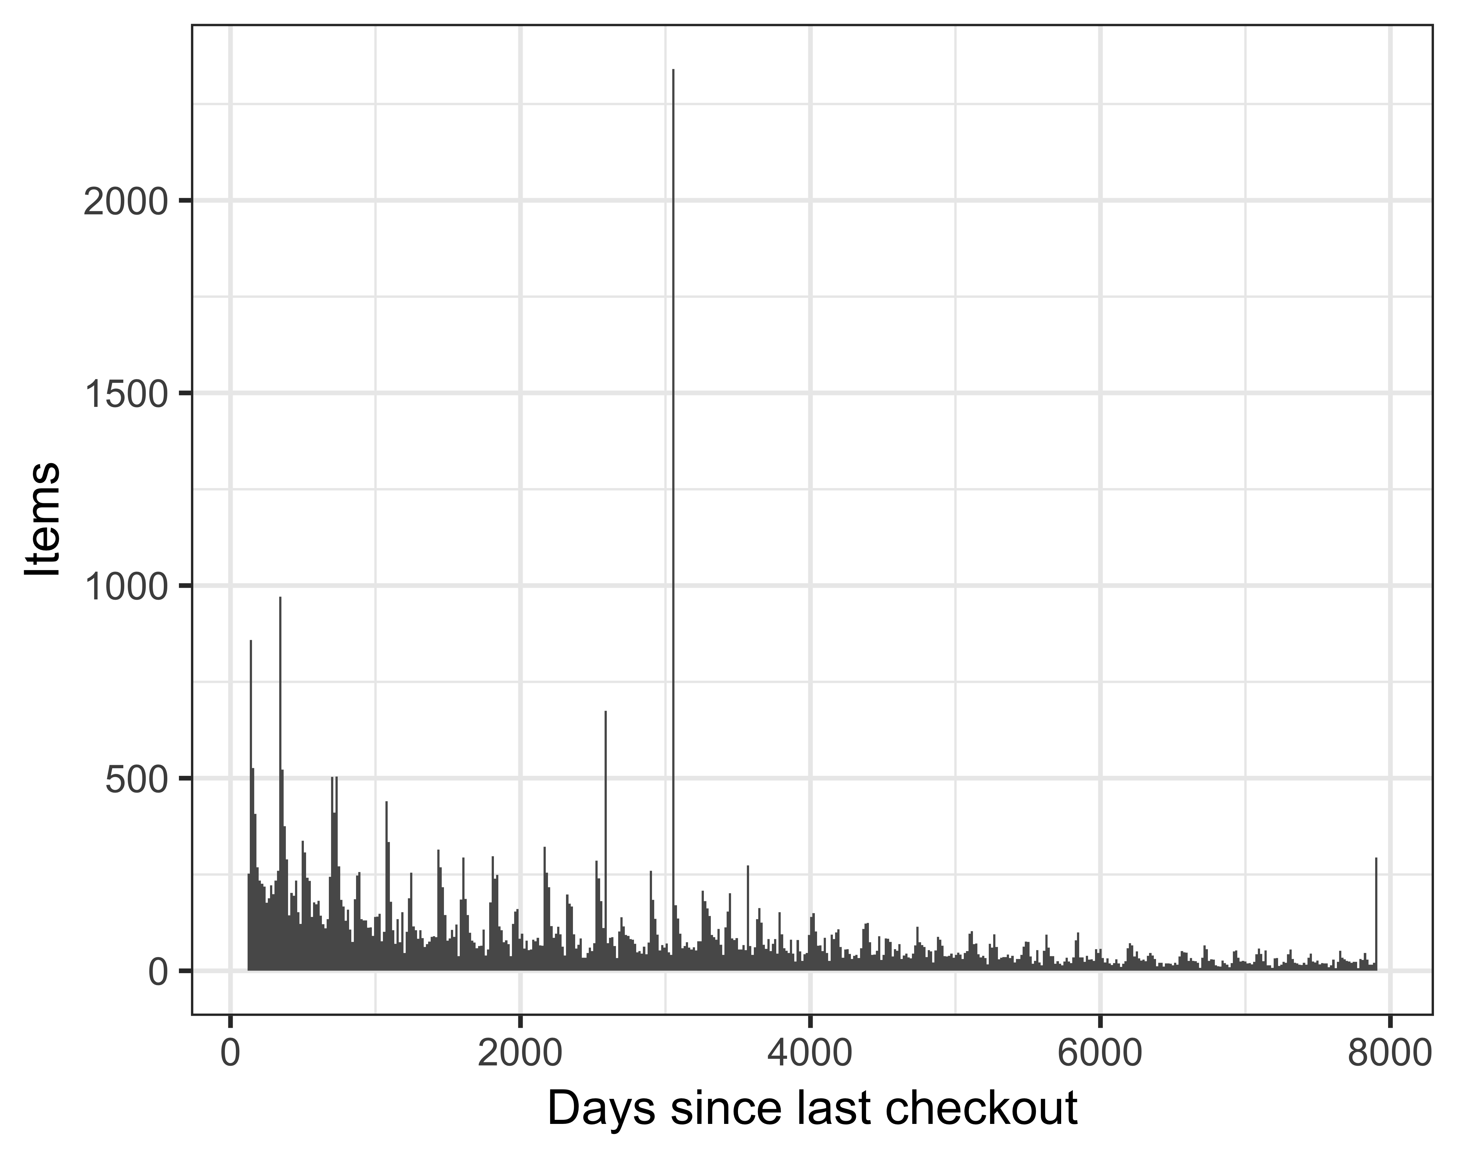
Note the spike at 3000 days ago ~ Dec 1 2009

Slide 3
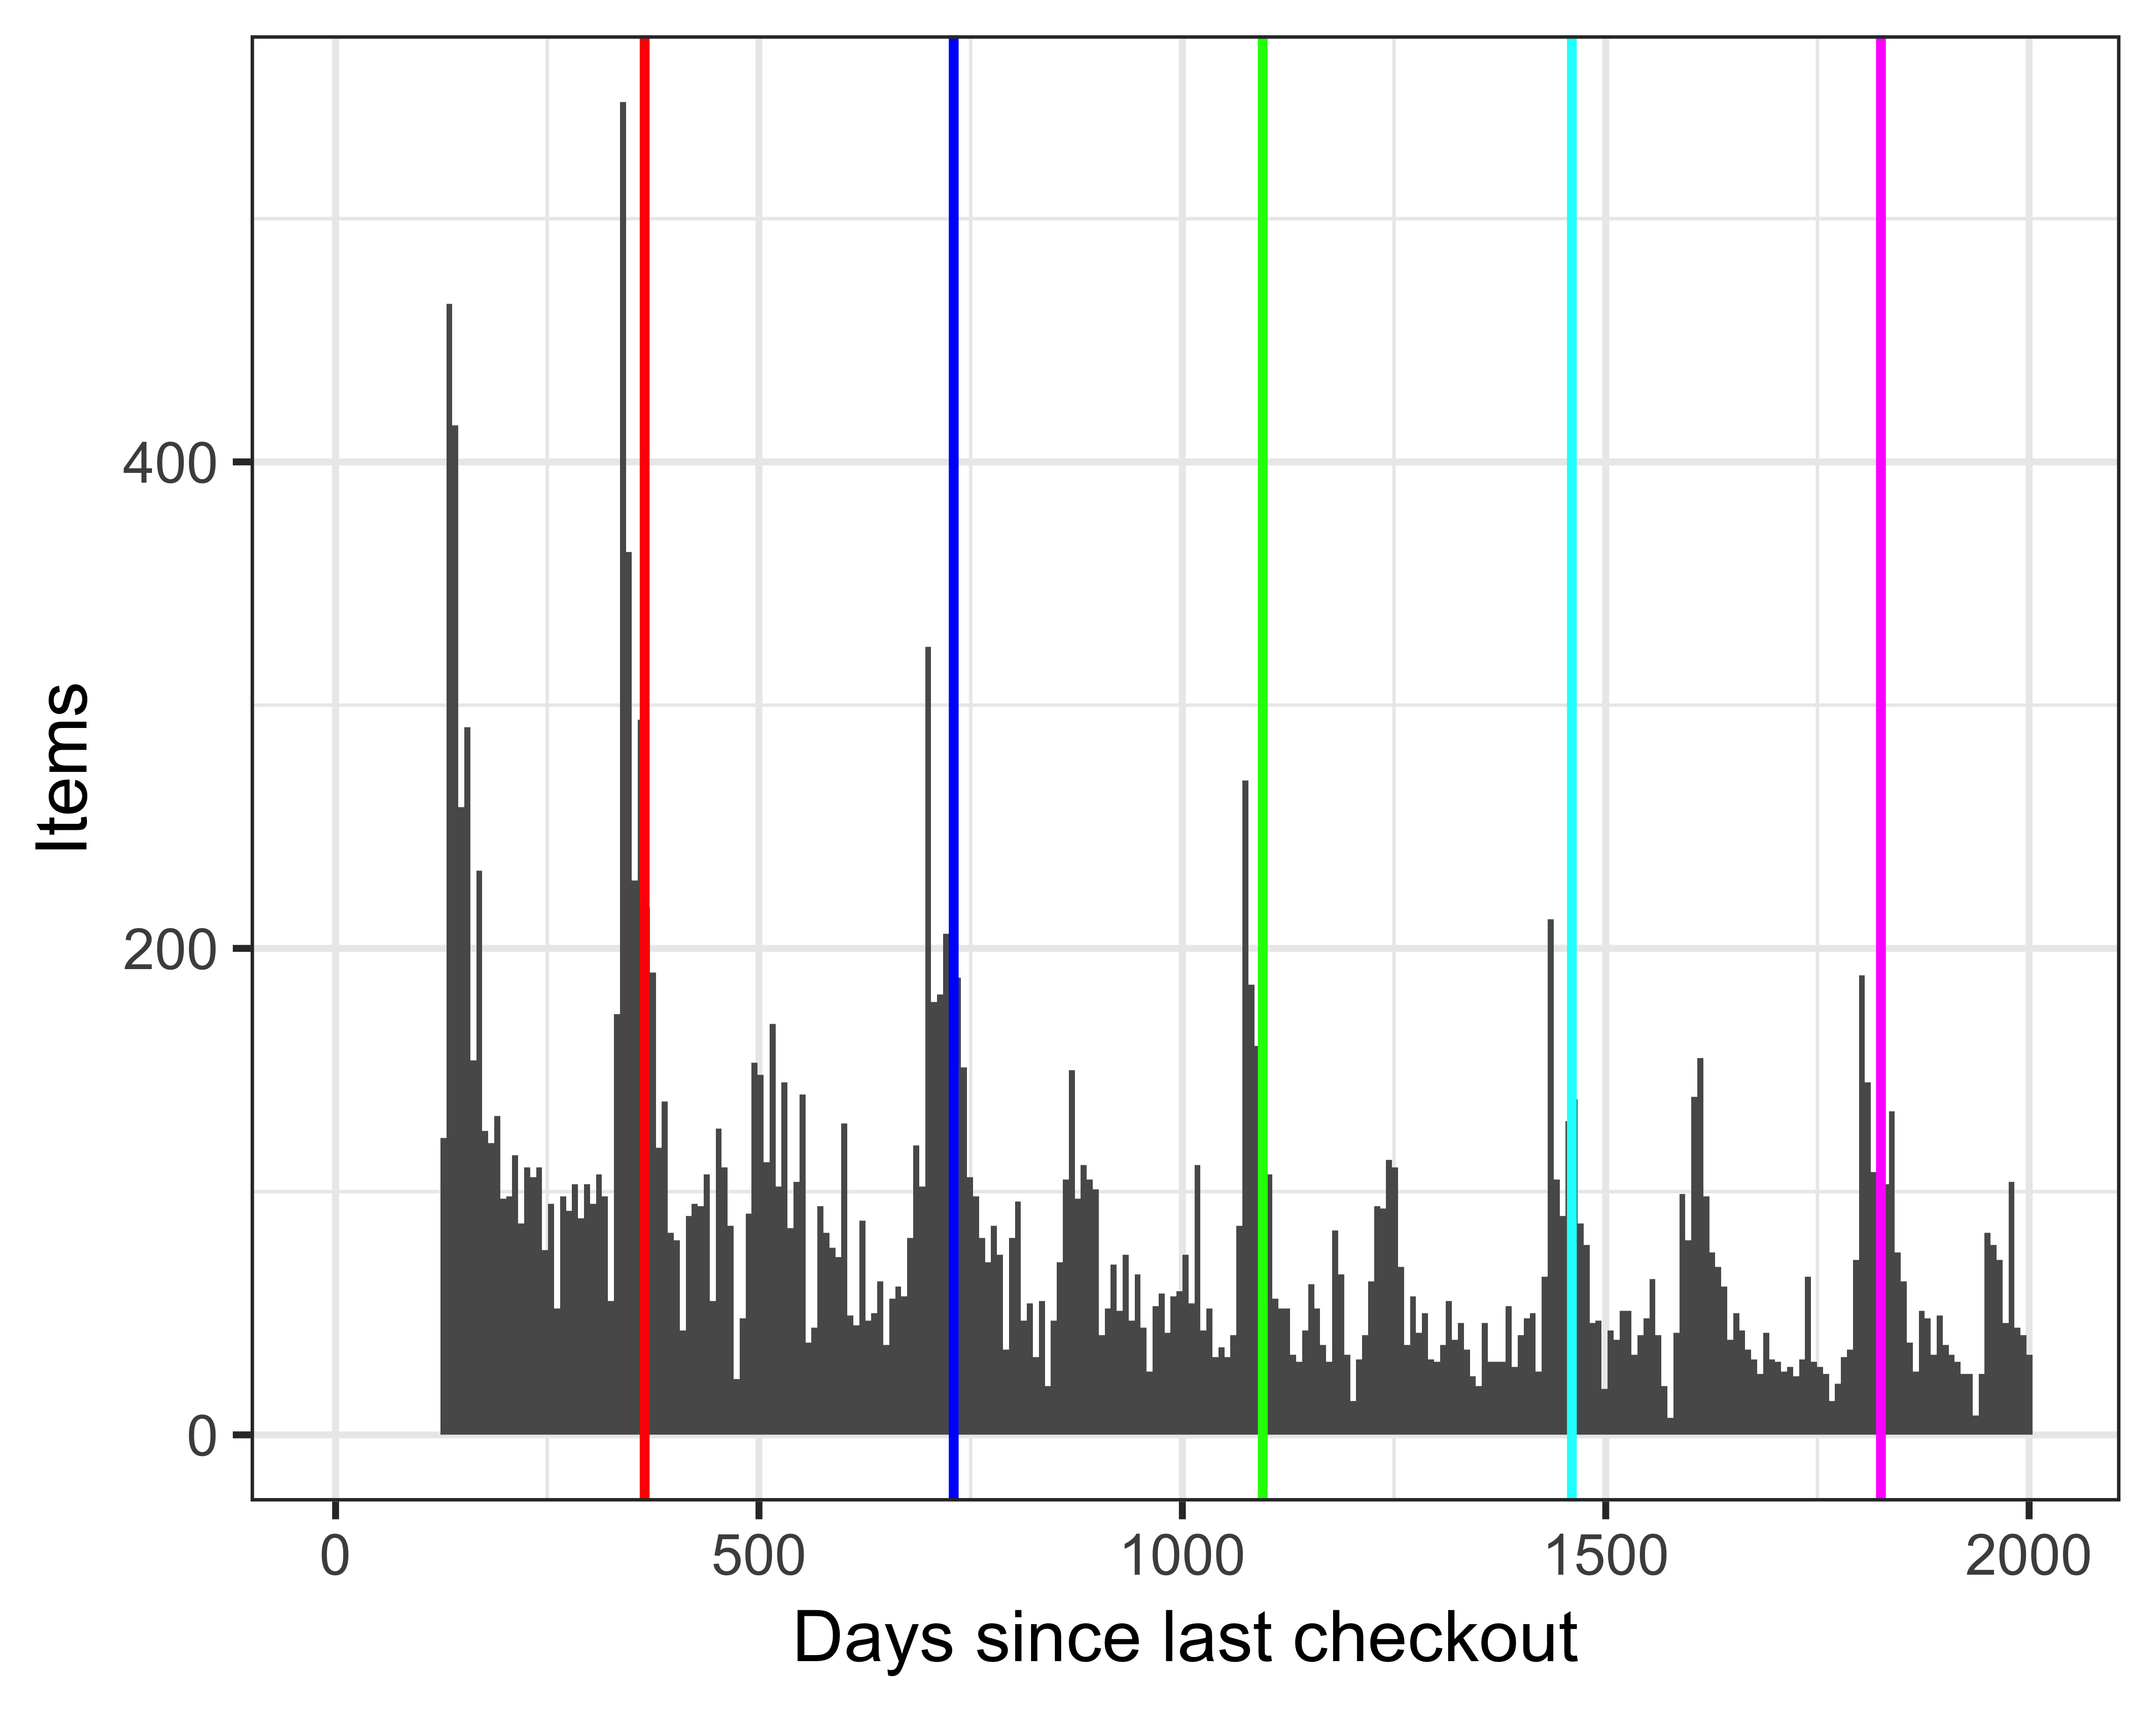
Lines are spaced 365 days apart Note the periodic structure

Slide 4
Model
x =
Beta[1]*days_since_last_checkout +
Beta[2]*total_checkouts +
…
Beta[n]*additional features
Beta[i] are free parameters
By Qef (talk) - Created from scratch with gnuplot, Public Domain, https://commons.wikimedia.org/w/index.php?curid=4310325

Slide 5
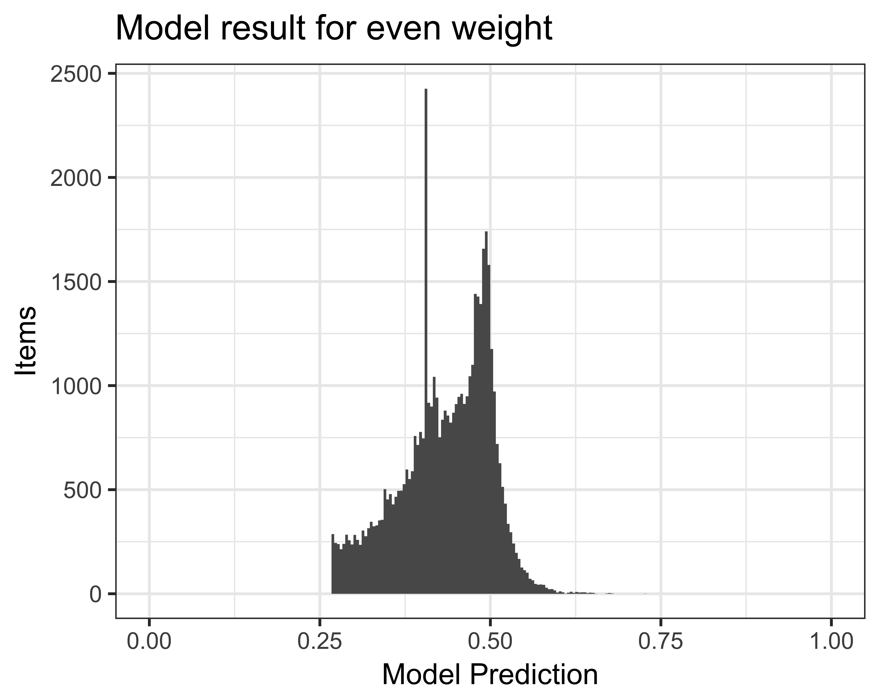
Beta=(-1,1)

Slide 6
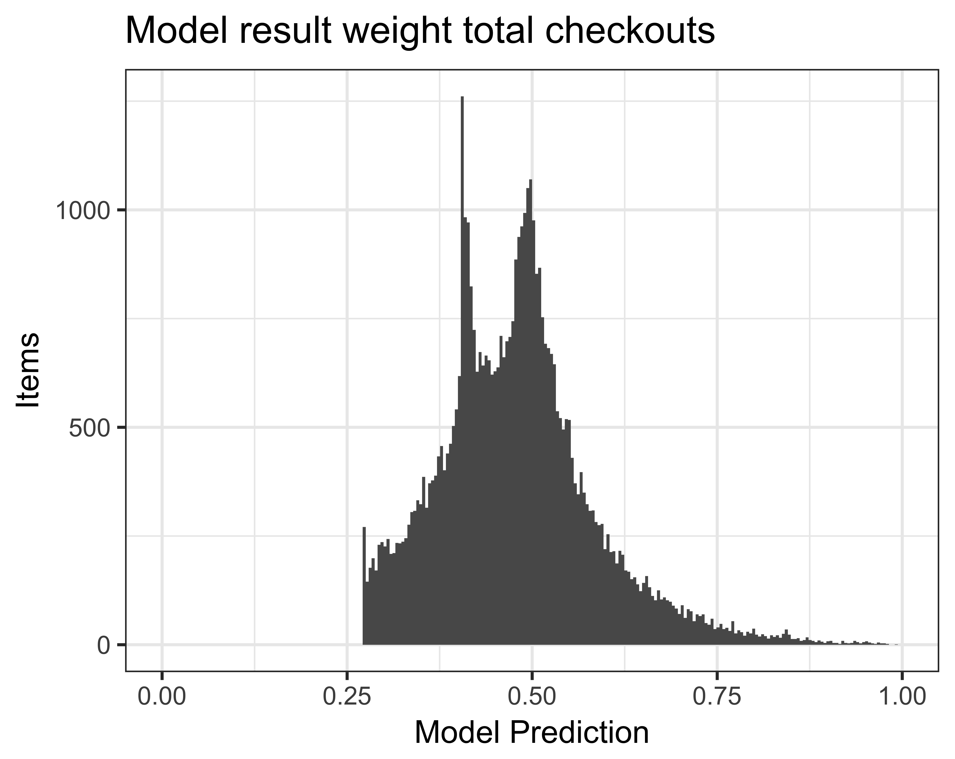
Model Cutoff
Action 1
Cutoff
Action 2

Slide 7
Beta=(-1,5)

Slide 8
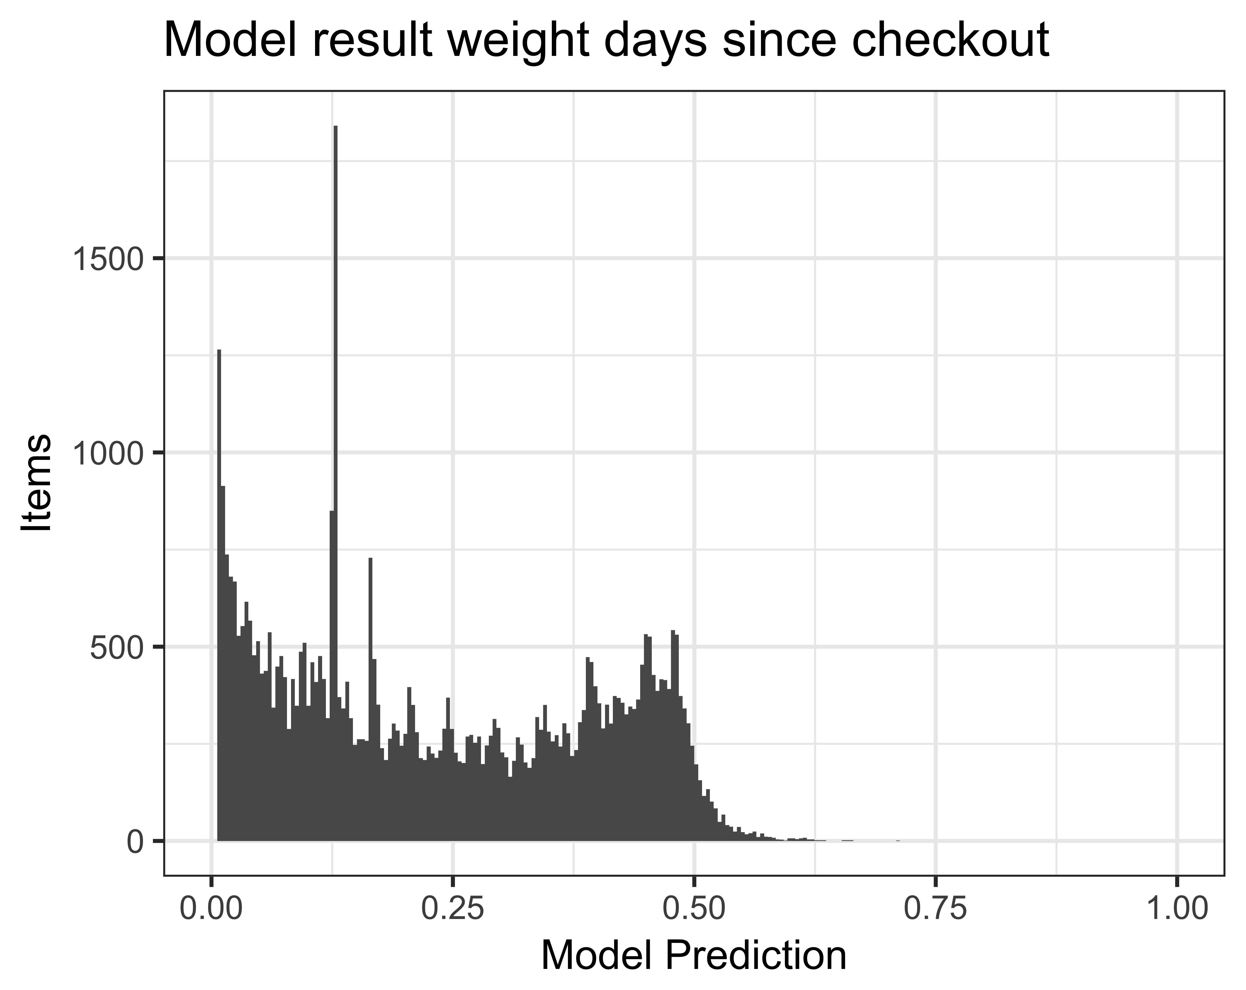
Beta=(-5,1)

Slide 9
Model Cutoff
Action 1
Action 2
Cutoff

