Slide 1
Banking Dataset Case Project
Data Analysis on a real time data set of a marketing campaign run by Portugese Bank
April 2024
Aryan Singhal
©2020-2021 MSLIDES Copyright

Slide 2
Table of Contents
01
02
03
04
Introduction
Data Assessing: Problems and Workarounds
Exploratory Data Analysis
Key Findings

Slide 3
01.
Introduction

Slide 4

Summary
The dataset captures detailed records of 45,211 customer interactions from a Portuguese bank's direct marketing campaigns conducted through phone calls between May 2008 and November 2010. The primary goal is to predict whether a customer will subscribe to a term deposit product. Information includes customer attributes (age, profession, marital status, education, financial product holdings), campaign details (contact method, timing, call duration, previous outcomes), and potentially external factors like interest rates. Analyzing this data aims to determine the overall conversion rate of the campaigns, identify the key customer and campaign characteristics driving subscription decisions, and potentially uncover temporal trends that might impact future marketing strategies.

Slide 5
Column Descriptions
age: This column represents the age of the bank client. It's a numeric variable indicating the age in years.
job: This column indicates the type of job the client has. It's a categorical variable with options such as "admin.", "unknown", "unemployed", "management", etc.
marital: This column represents the marital status of the client. It's a categorical variable with options such as "married", "divorced", or "single".
education: This column indicates the level of education of the client. It's a categorical variable with options such as "unknown", "secondary", "primary", or "tertiary".
default: This column indicates whether the client has credit in default. It's a binary variable with options "yes" or "no".
balance: This column represents the average yearly balance in euros for the client. It's a numeric variable.

Slide 6
housing: This column indicates whether the client has a housing loan. It's a binary variable with options "yes" or "no".
loan: This column indicates whether the client has a personal loan. It's a binary variable with options "yes" or "no".
contact: This column represents the type of communication used to contact the client. It's a categorical variable with options such as "unknown", "telephone", or "cellular".
day: This column represents the last contact day of the month. It's a numeric variable.
month: This column represents the last contact month of the year. It's a categorical variable with options such as "jan", "feb", "mar", etc.
duration: This column represents the duration of the last contact in seconds. It's a numeric variable.

Slide 7
campaign: This column represents the number of contacts performed during this campaign and for this client. It's a numeric variable.
pdays: This column represents the number of days that passed by after the client was last contacted from a previous campaign. It's a numeric variable where -1 means the client was not previously contacted.
previous: This column represents the number of contacts performed before this campaign and for this client. It's a numeric variable.
poutcome: This column represents the outcome of the previous marketing campaign. It's a categorical variable with options such as "unknown", "other", "failure", or "success".
y: This column is the target variable and indicates whether the client has subscribed to a term deposit. It's a binary variable with options "yes" or "no".

Slide 8
Additional Info
Year column is missing in the data but the data is arranged in chronological order.We can use this fact to come up with the year column's values

Slide 9
02.
Data Assessing: Problems and Workarounds

Slide 10
PROBLEMS
Dirty Data:
Messy Data:
:
Completeness Issues : Presence of null values , missing column
Validity Issues : Duplicate Entries and wrong data type assigned to columns
Redundant Columns
Missing Columns

Slide 11
WORKAROUNDS
All missing values have been replaced with the string ‘No Data’
Duplicate entries removed.
Data Type of columns Corrected.
Redundant/Unnecessary columns also removed.

Slide 12
03.
Exploratory Data Analysis

Slide 13
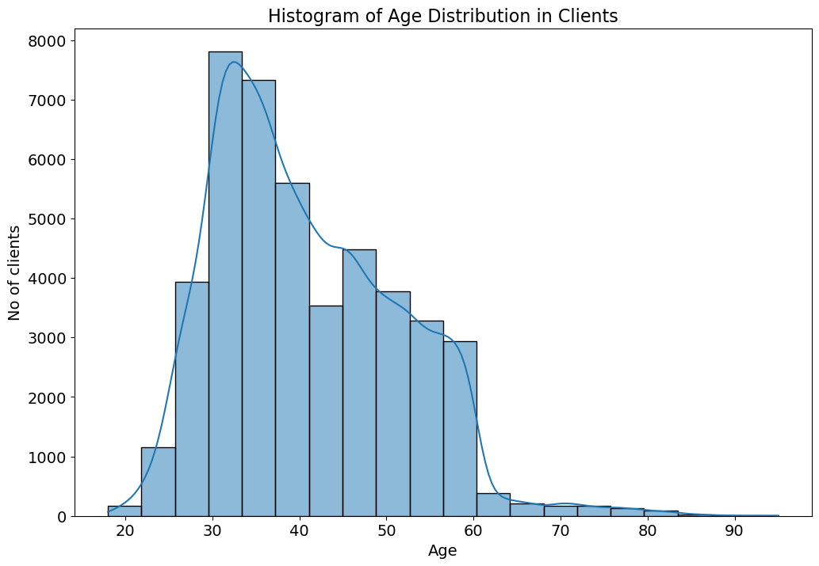
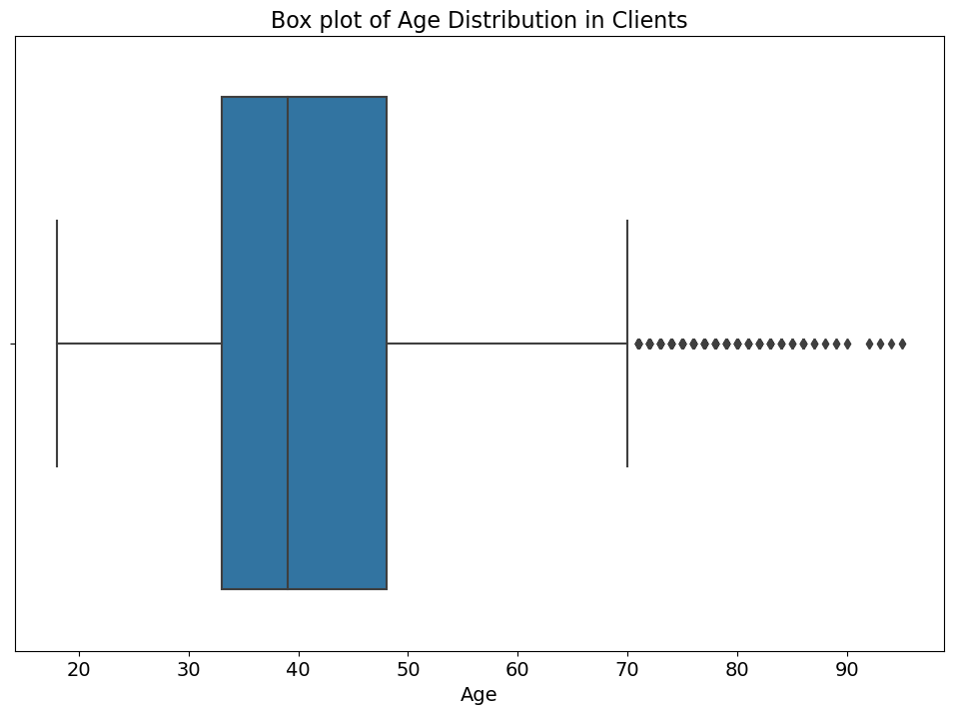
FINDINGS
Graph 1 : Age vs Clients
1. 43% of the clients are between the age of 30 and 40.
2. Clients above the age of 70 are classified as outliers (487 such entries).
3. The age column data is Normally Distributed.
4. The median is 39 years.
Findings:

Slide 14
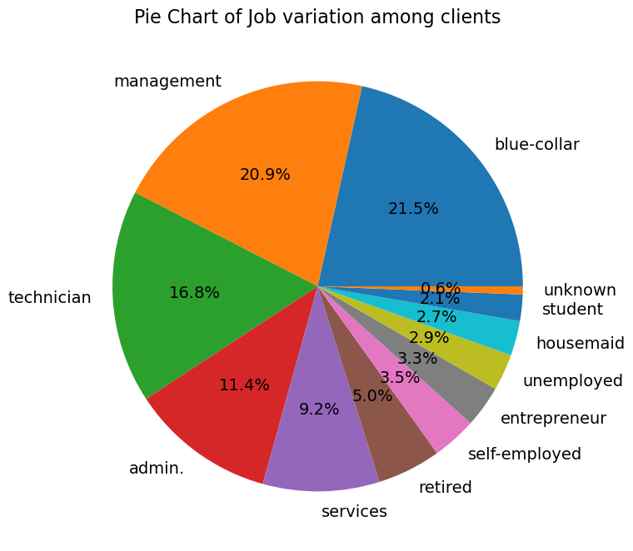
FINDINGS
Graph 2 : Job Variation among Clients
Majority of the clients(42.4%) have blue collar jobs or are in some management role.
There are relatively fewer clients who are self-employed, entrepreneurs, unemployed, housemaids, and students.
The 'student' and 'unknown' categories have the smallest number of clients.
Only 2.1% of the clients are students which is very less.
Findings:

Slide 15
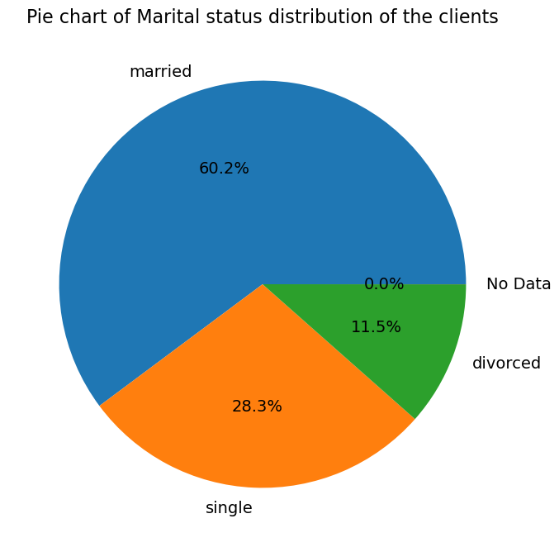
FINDINGS
Graph 3 : Marital Status of Clients
Majority of the clients(42.4%) have blue collar jobs or are in some management role.
Only 2.1% of the clients are students which is very less.
There are relatively fewer clients who are self-employed, entrepreneurs, unemployed, housemaids, and students.
The 'student' and 'unknown' categories have the smallest number of clients.
Findings:

Slide 16
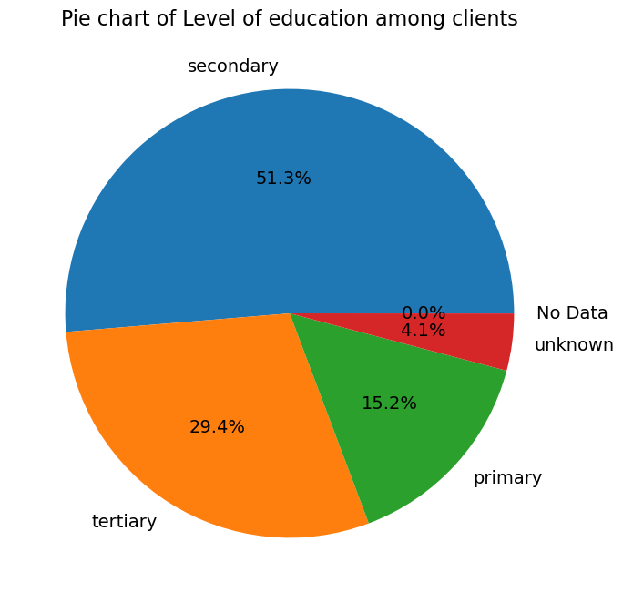
FINDINGS
Graph 4 : Level of Education of Clients
Findings:
Majority of the clients(51.3%) have completed their secondary education.
The next substantial group consists of clients with tertiary education, indicating a significant number of clients with higher education.
Clients with primary education form a smaller proportion compared to the other two educational levels.
There is a category of clients for whom the level of education is unknown.
A small fraction of the data does not have education level information, indicated as "No Data".

Slide 17
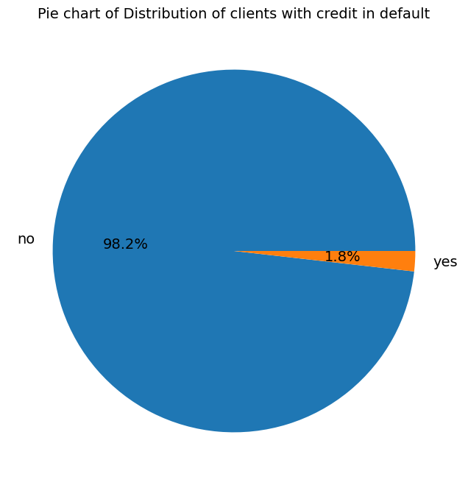
FINDINGS
Graph 5 : Default Status of Clients
Findings:
Only 1.8%(815) of the clients have credit in default

Slide 18
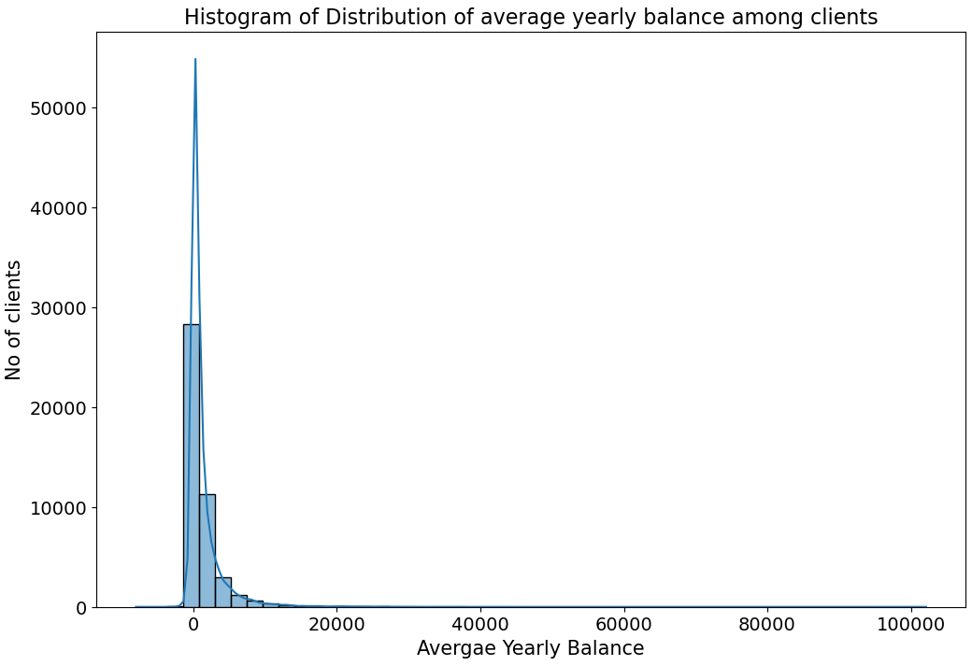
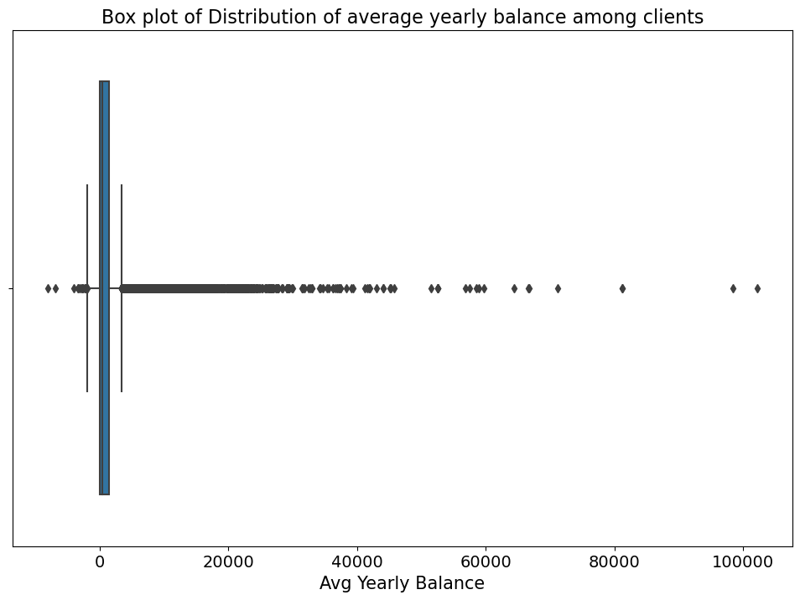
FINDINGS
Graph 6 : Avg Yearly Balance of Clients
Findings:
There are very few clients with an average yearly balance above 20,000 euros, indicating that high balances are rare within this client base.
The distribution is right-skewed, with most clients clustered in the lower balance range and outliers with high balances.
The median balance 448 which is relatively low, suggesting that the typical client does not have a large average yearly balance.

Slide 19
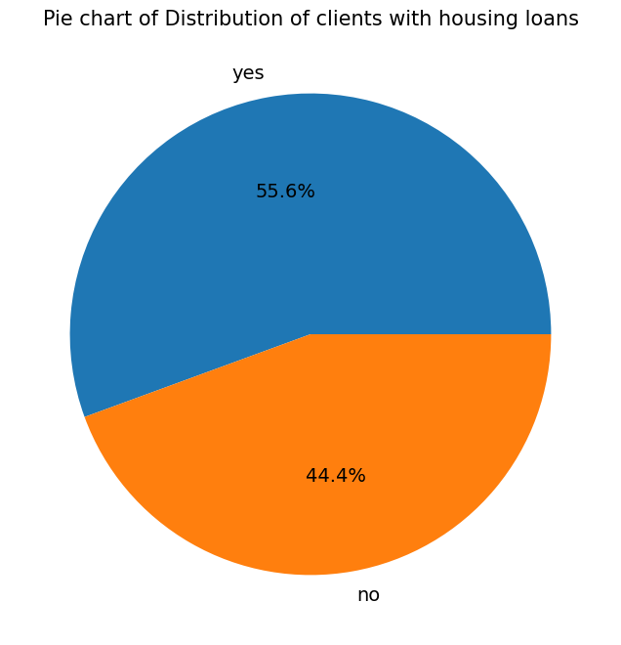
FINDINGS
Graph 7 :Clients with Housing Loans
Findings:
Majority of the clients(55.6%) contacted have housing loans.

Slide 20
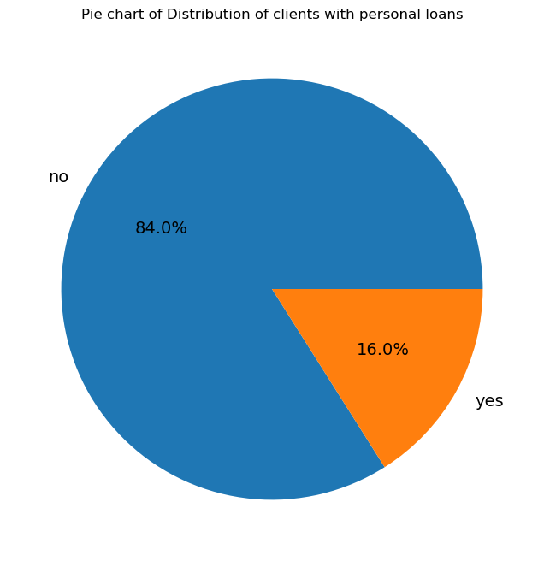
FINDINGS
Graph 8 :Clients with Personal Loans
Findings:
Majority of the clients(84%) contacted don’t have any personal loans.

Slide 21
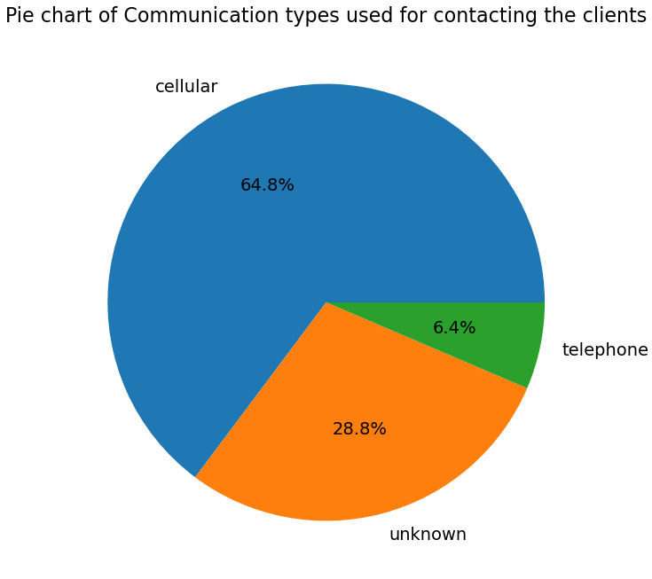
FINDINGS
Graph 9 : Communication Types used for contacting Clients
Findings:
64.8 % pf the clients were contacted using a cellular medium.
Only 6.4 % of the clients were contacted using telephone.
A very large percentage of the clients (28.8%) were contacted using unknown means.

Slide 22
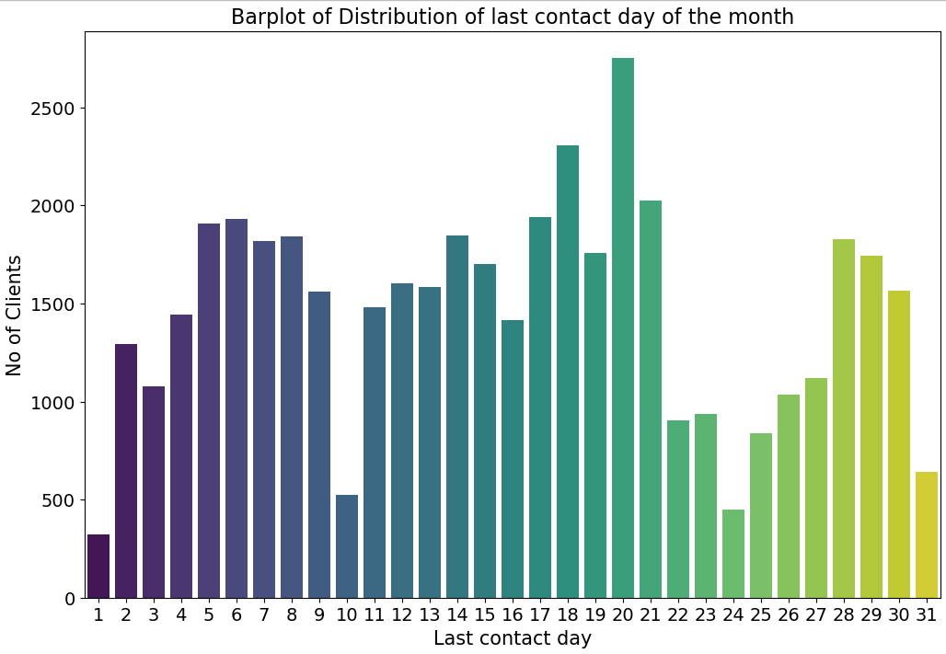
FINDINGS
Graph 10 : Distribution of Last Contact Day of Clients
Findings:
The distribution of last contact days is not uniform across the month.
There is a significant peak around the middle of the month, specifically on day 20, indicating a higher frequency of client contacts on that day.
The beginning and especially the end of the month (including the 31st) exhibit lower contact rates.

Slide 23
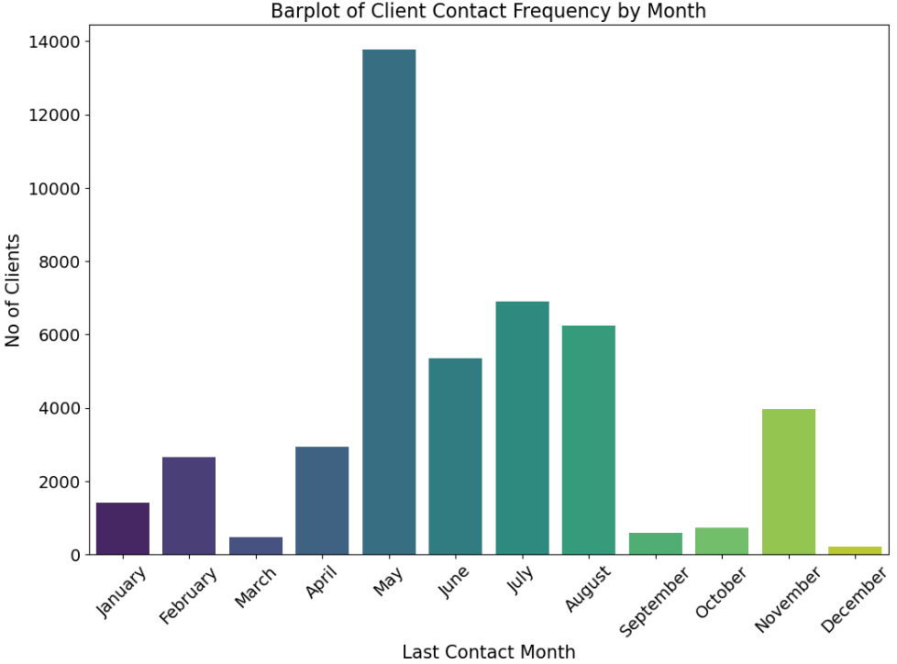
FINDINGS
Graph 11 : Distribution of Last Contact Month of Clients
Findings:
The contact frequency is significantly higher in May than in any other month, suggesting that this is a peak period for the marketing campaign.
The lowest contact frequencies are observed in the months of January, February, and December, indicating a possible seasonal downturn in marketing activities.
The months of June, July, August, and November show a moderate level of contact frequency.

Slide 24
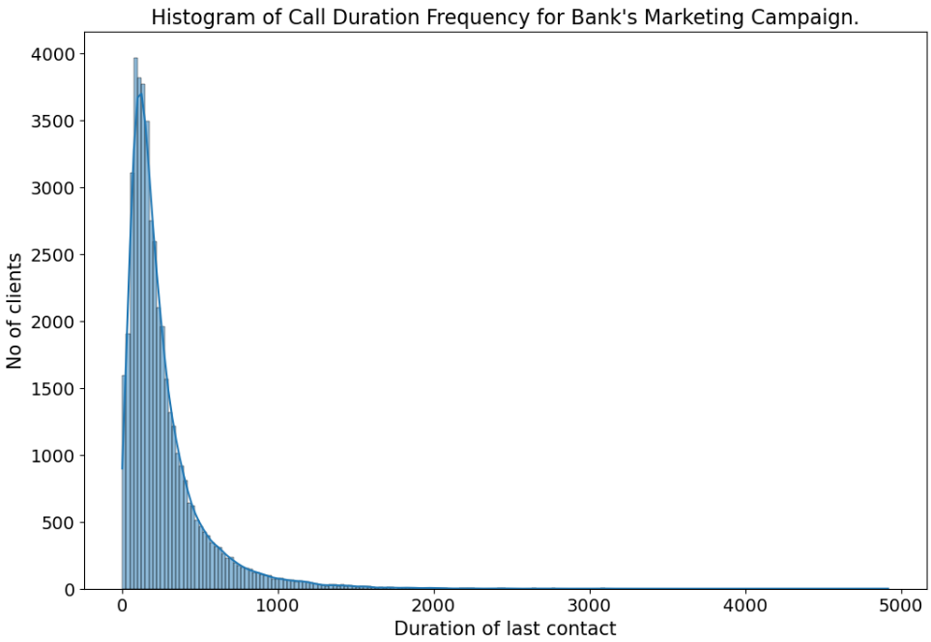
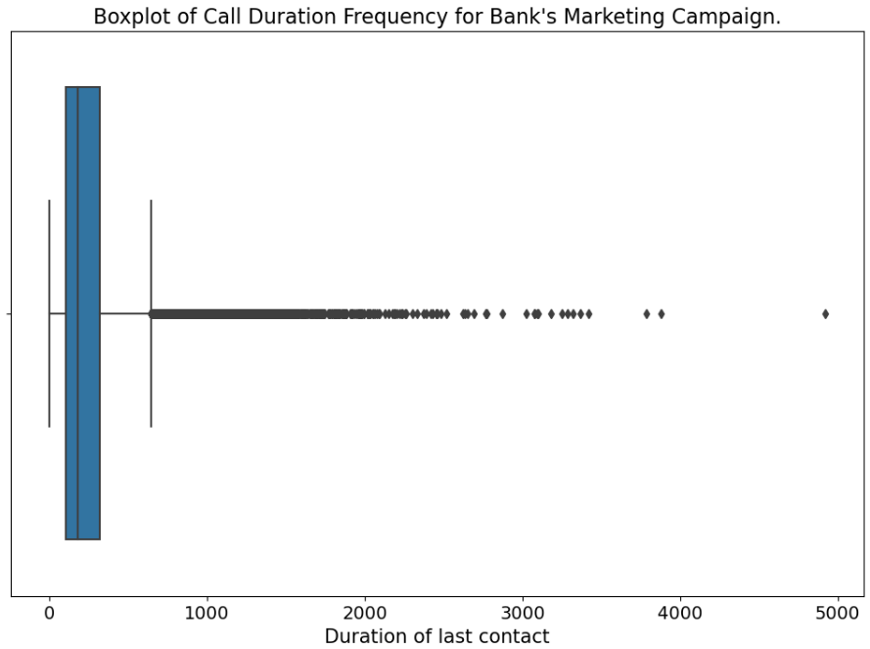
FINDINGS
Graph 12 : Distribution of Duration of Last Contact with Clients
Call durations averaged 258 seconds but were heavily right-skewed, indicating most calls were short with a few significantly longer ones.
The high frequency of short calls suggests a focus on efficient interactions, potentially due to the nature of the campaign.
Very few calls were exceptionally long, implying that extended conversations were not the norm.
Findings:

Slide 25
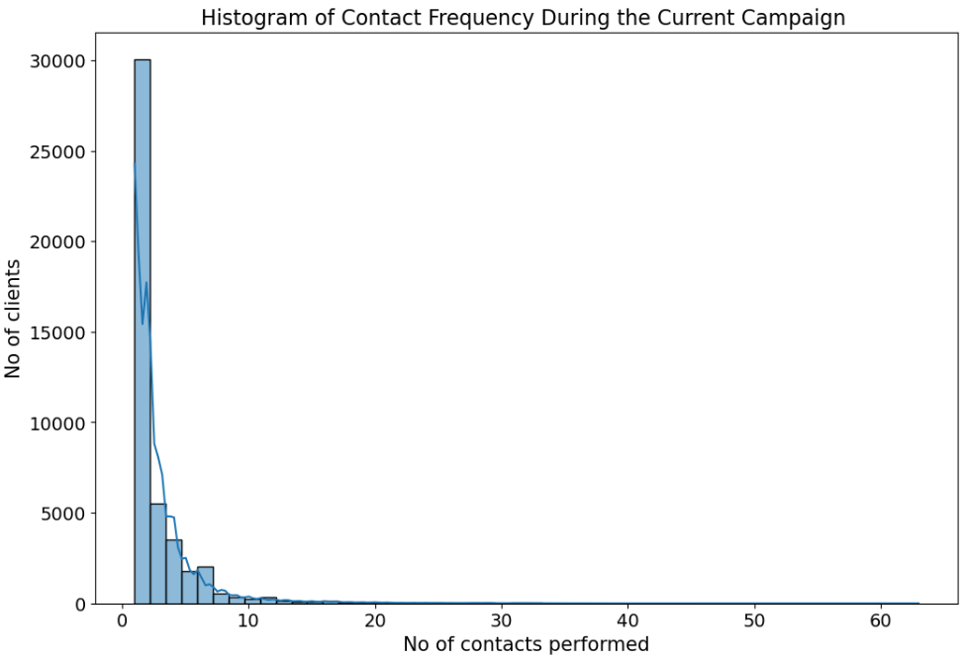
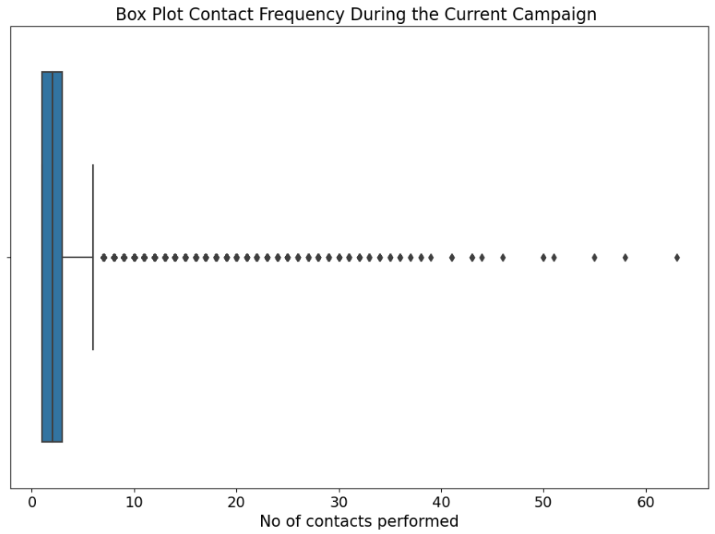
FINDINGS
Graph 13 : No of Contacts performed during the Campaign
Findings:
Client contact frequency is heavily right-skewed, with most clients contacted only a few times, and a small number contacted very frequently.
The campaign primarily emphasizes short interactions, with 86.46% of clients receiving fewer than 5 contacts.
There are outliers where clients were contacted with significantly greater frequency than the avg.

Slide 26
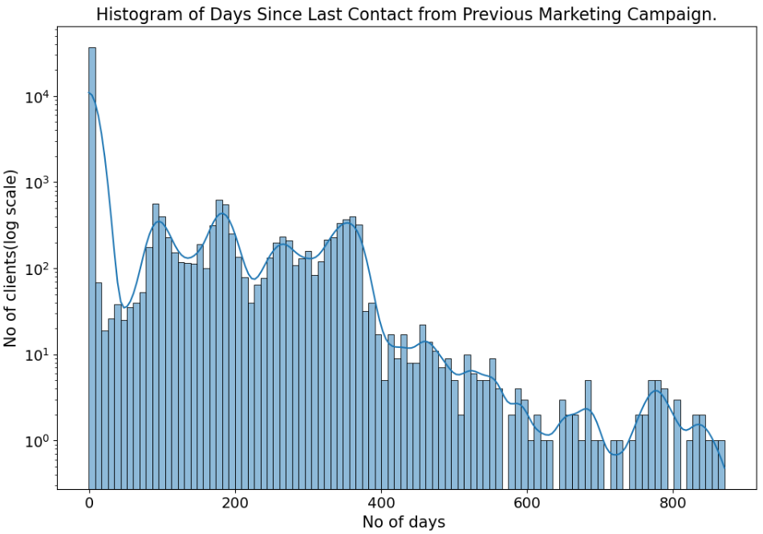
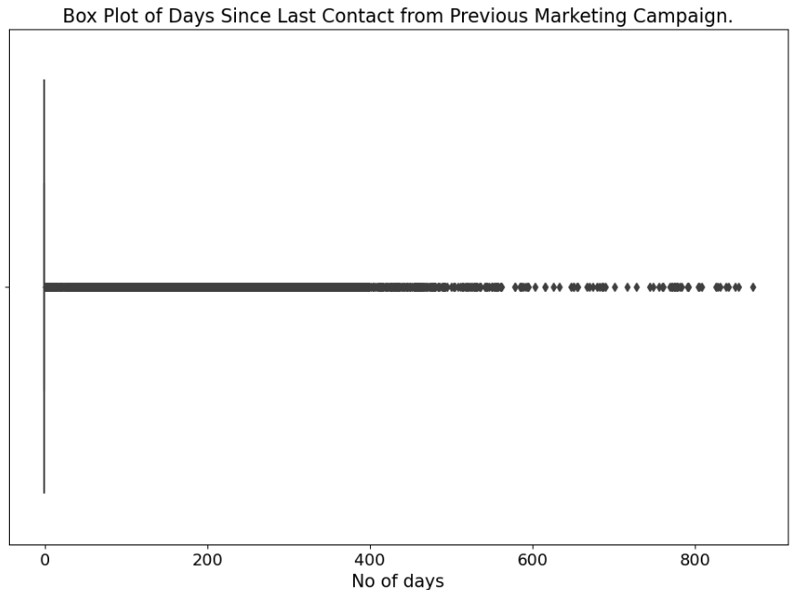
FINDINGS
Graph 14 : No of days since Last Contact from a Previous Campaign
A vast majority of clients (81.73%) have never been contacted before, suggesting a focus on acquiring new customers or a significant lapse since prior campaigns.
The re-contact timeframe is heavily right-skewed, with most re-contacts happening recently, but a long tail indicating some clients haven't been contacted in a long time (outliers).
Minor peaks after the initial spike suggest there may be concentrated efforts to re-contact clients at specific intervals.
Findings:

Slide 27
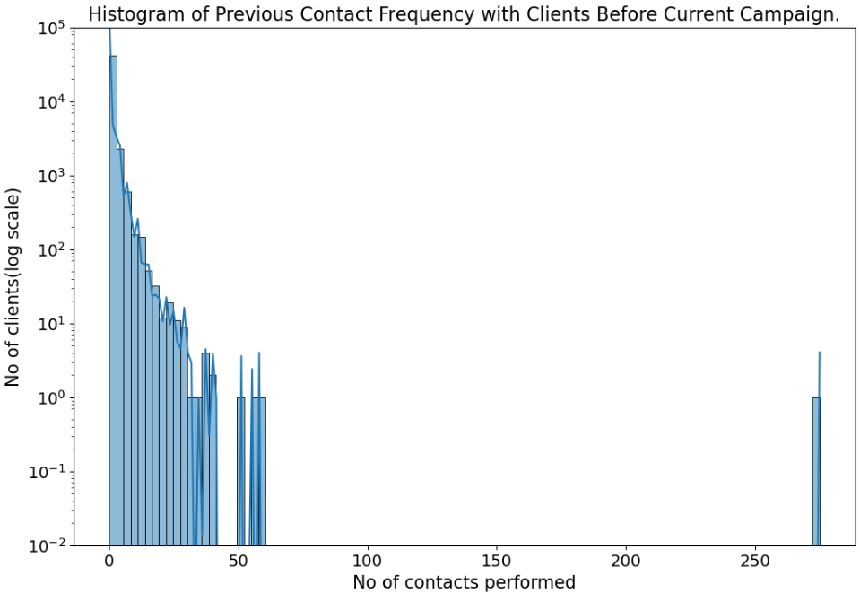
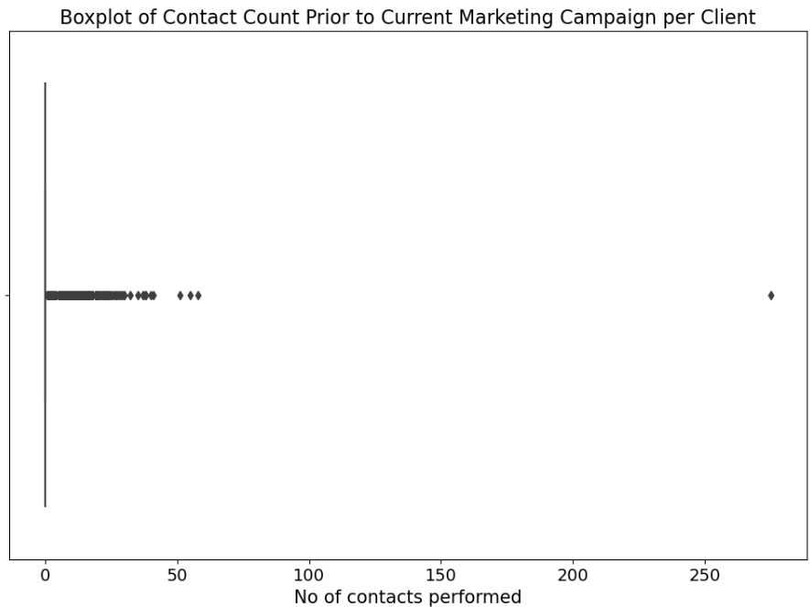
FINDINGS
Graph 15 : No of Contacts performed before Current Campaign
Most clients (81.73%) had zero prior contacts, and contact frequency drops sharply as previous interactions increase. This suggests a strong focus on new customer acquisition or minimal re-engagement.
The number of prior contacts is heavily right-skewed, with a long tail indicating a few clients received significantly more outreach than the majority.
Findings:

Slide 28
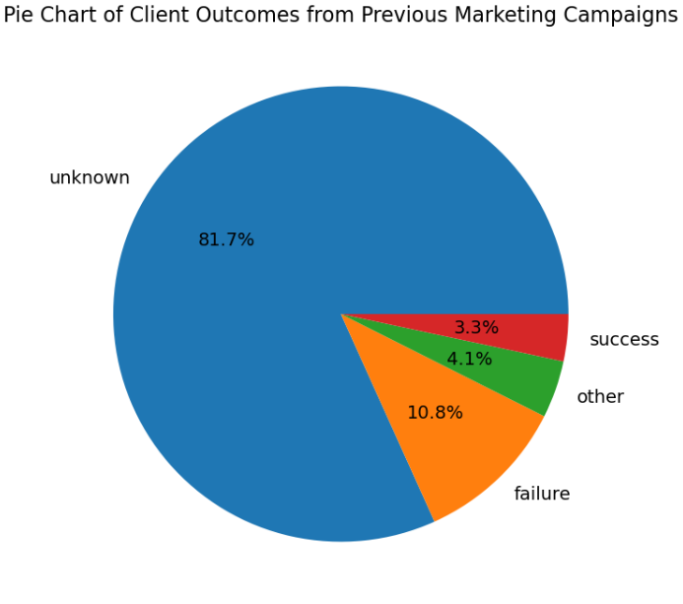
FINDINGS
Graph 16 : Outcomes of Previous Marketing Campaigns
The vast majority (81.7%) of campaign outcomes are unknown, highlighting a critical need to improve data collection and tracking.
Only a small fraction of outcomes are known (10.8% failures, 3.3% successes), limiting the ability to analyze what works and what doesn’t
The 4.1% in the 'other' category suggests a need to refine outcome definitions for more informative analysis..
Findings:

Slide 29
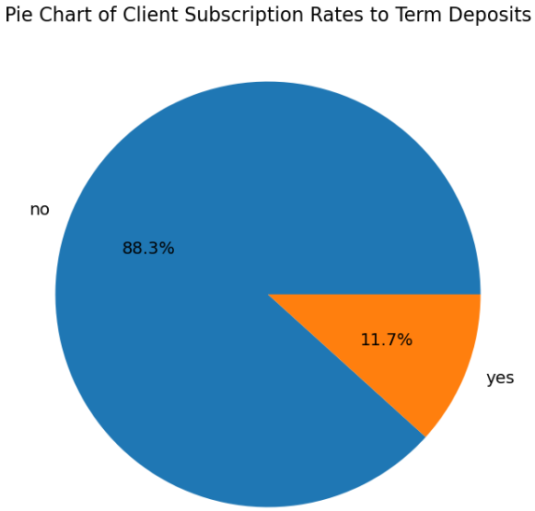
FINDINGS
Graph 17 : Outcomes of Previous Marketing Campaigns
A large majority (88.3%) of clients did not subscribe to a term deposit, indicating a need to improve conversion strategies.
The 11.7% who subscribed represent a valuable segment to study for understanding factors driving successful conversions.
The disparity between subscribers and non-subscribers highlights potential for significant growth by optimizing the offering, targeting, or follow-up strategies to convert more clients.
Findings:

Slide 30
04.
Key Findings

Slide 31
Subscription rates for term deposits are strongly influenced by client age. Younger clients (18-30) are less likely to subscribe, while a steady increase is observed with age, notably peaking in the 60+ demographic.
Term deposit subscription rates vary significantly based on client occupation. Retirement and student status correlate with higher subscription rates, while blue-collar and entrepreneur occupations exhibit lower rates.
Marital status significantly influences term deposit subscription rates. Single clients exhibit the highest rates, followed by divorced clients, while married clients have lower rates.
Education level appears to correlate with term deposit subscription rates. Clients with tertiary education demonstrate the highest rates, followed by those with secondary education. Clients with primary education have the lowest subscription rates.
Client default history strongly correlates with term deposit subscription likelihood. Those with no defaults exhibit significantly higher subscription rates, while those with a history of default show much lower rates.

Slide 32
Clients with extremely low balances (<10000 euros) have and exceptionally low likelihood of subscribing to the term deposit.
Clients without housing loans demonstrate a higher propensity to subscribe to term deposits compared to those with mortgages. This suggests that major financial commitments like housing loans may influence investment decisions.
Clients without existing personal loans demonstrate a significantly higher likelihood of subscribing to term deposits compared to those with loans
Contacting clients via cellular phones results in the highest term deposit subscription rate, outperforming telephone contact and the "unknown" category.
Term deposit subscriptions exhibit significant variation across the year. March demonstrates the highest rates, while mid-year months (June/July) show lower rates, and an increasing trend is noted towards the year-end.

Slide 33
Thanks!
©2020-2021 MSLIDES Copyright

