Slide 1

Wine Quality Case Project
Analyze the chemical properties of red wines to identify key factors influencing quality, helping winemakers optimize production and improve product appeal.
A case study carried out by Aryan Singhal

Slide 2

OUTLINE
Introduction
Data cleaning
Key visualizations
Decision Tree
+
Random Forest

Slide 3
Introduction
Summary of Dataset
Column Descriptions
This dataset contains various physicochemical properties and quality ratings for red wine samples. The features (fixed acidity, volatile acidity, citric acid, etc.) are used to predict the quality of the wine, which is rated on a scale from 0 to 10.
fixed acidity: Non-evaporating acids.
volatile acidity: Evaporating acids.
citric acid: Adds freshness.
residual sugar: Remaining sugar.
chlorides: Salt content.
free sulfur dioxide: Unbound SO2.
total sulfur dioxide: Total SO2.
density: Mass per volume.
pH: Acidity level.
sulphates: Prevents spoilage.
alcohol: Alcohol content.
quality: Quality sore.

Slide 4

Data cleaning
Resolving issues of messy and dirty data

Slide 5
Issues with Dataset
Dirty Data
Messy Data
Duplicate Rows
NOT APPLICABLE

Slide 6
Key visualizations
Visualizations from the dataset

Slide 7
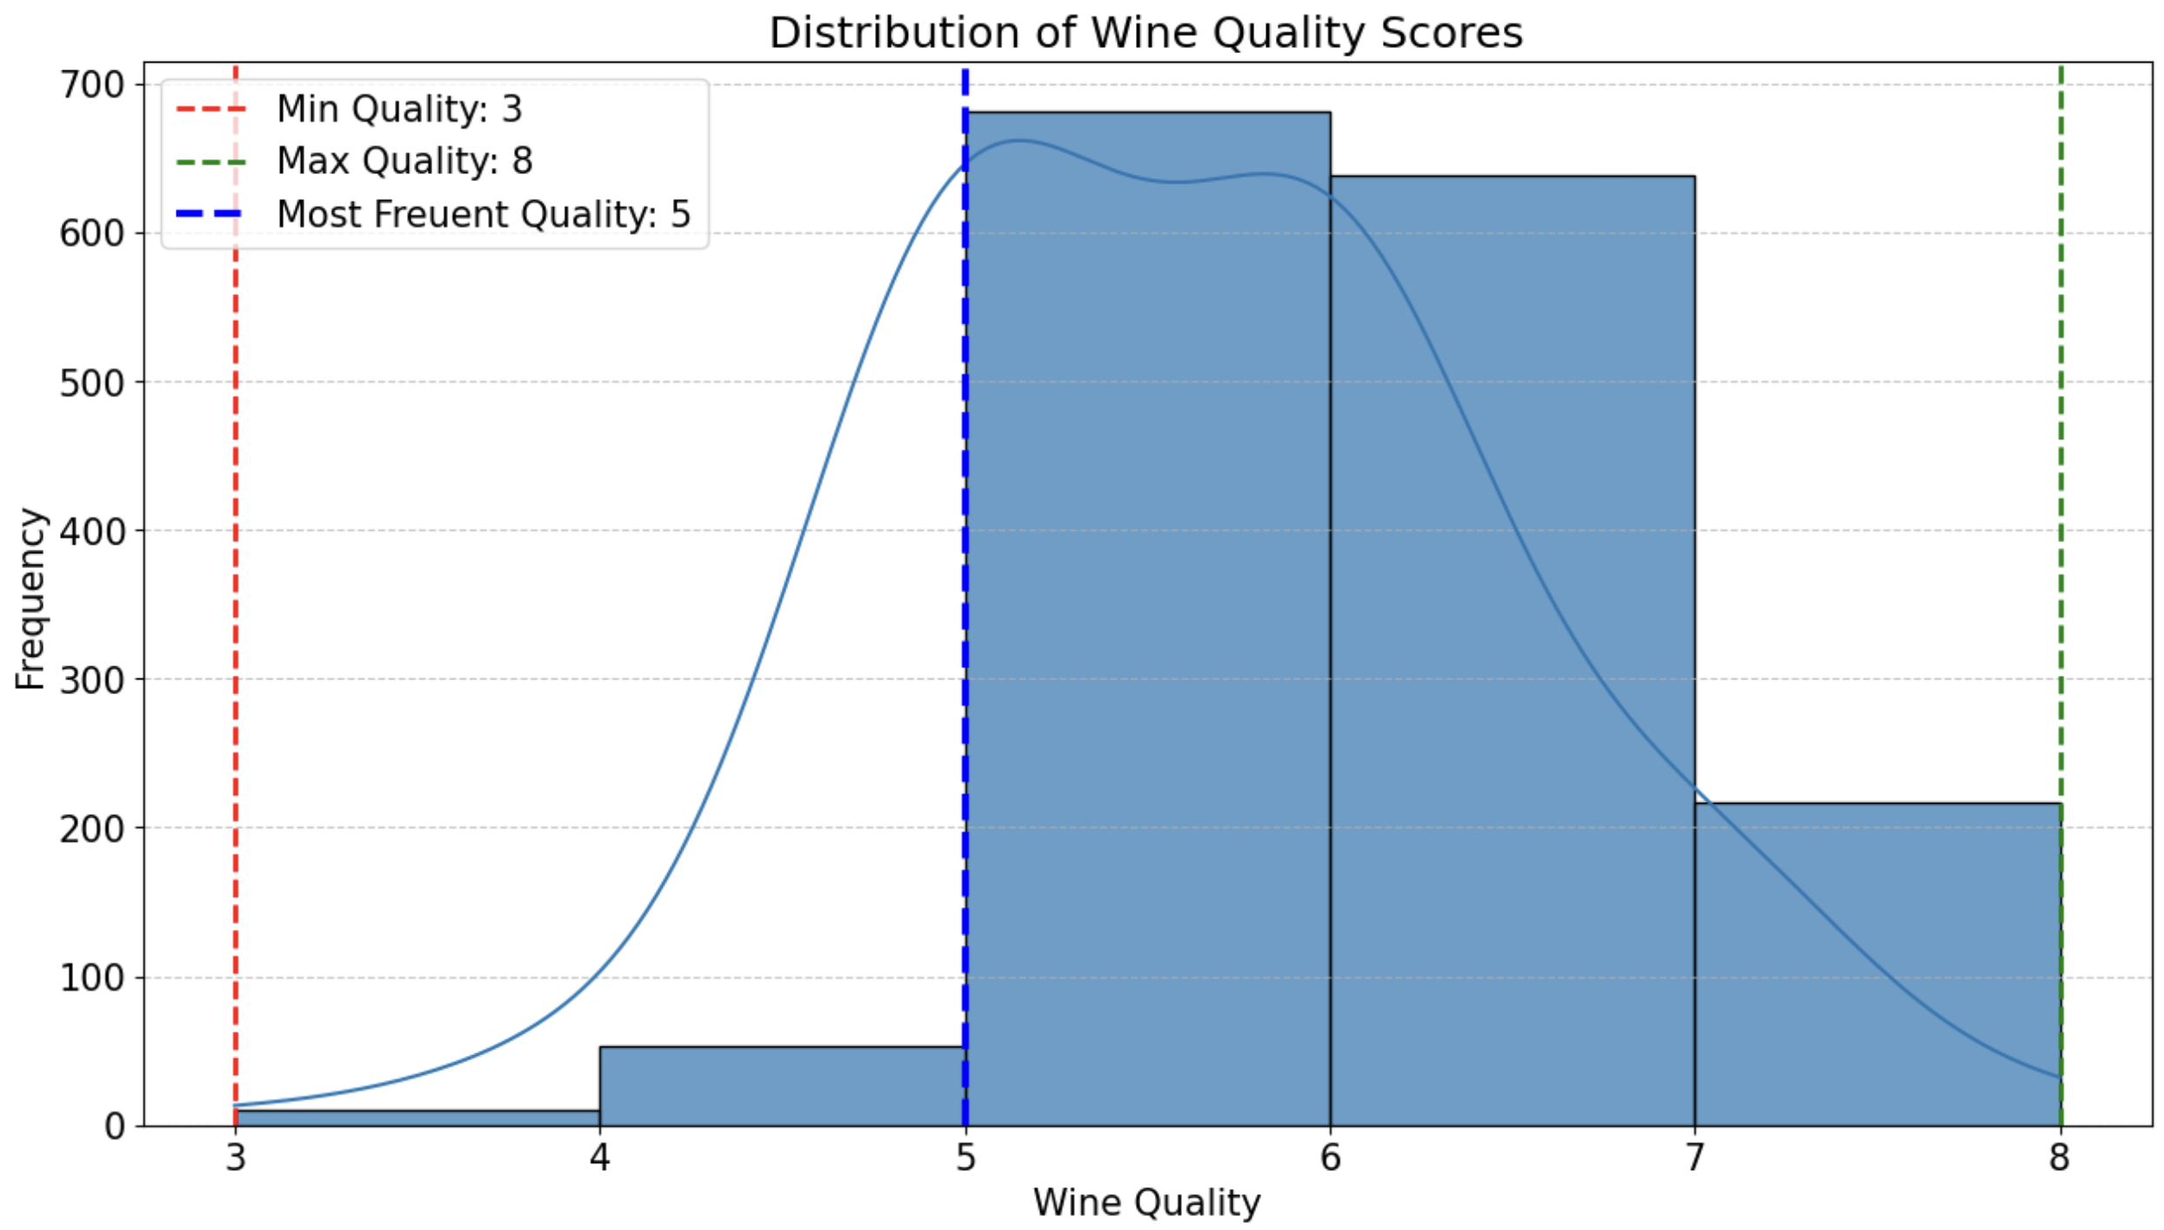
Chart 1: Wine Quality Scores
Most wines have a quality score of 5; quality ranges from 3 (min) to 8 (max), showing a slight left skew.

Slide 8
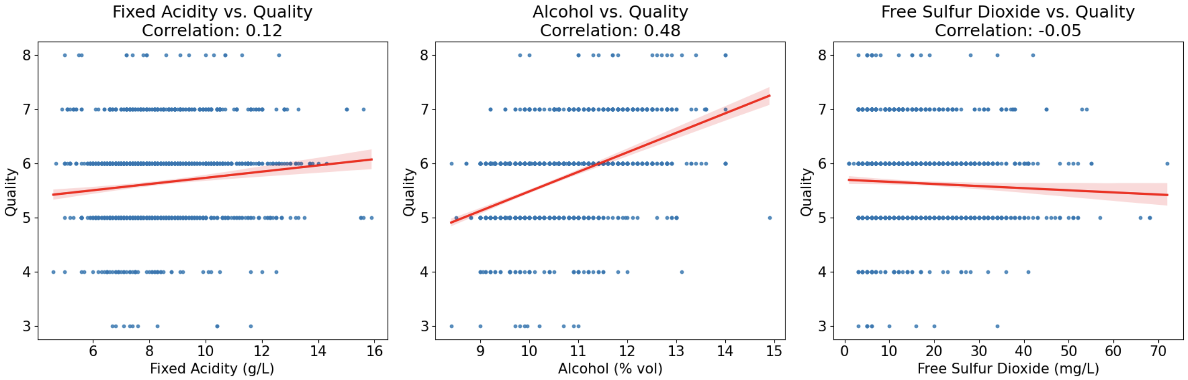
Chart 2: Correlation of metrics with quality
Fixed Acidity: Weak positive effect on quality (0.12).
Alcohol: Moderate positive effect on quality (0.48).
Free Sulphur Dioxide: Negligible effect on quality (-0.05).

Slide 9
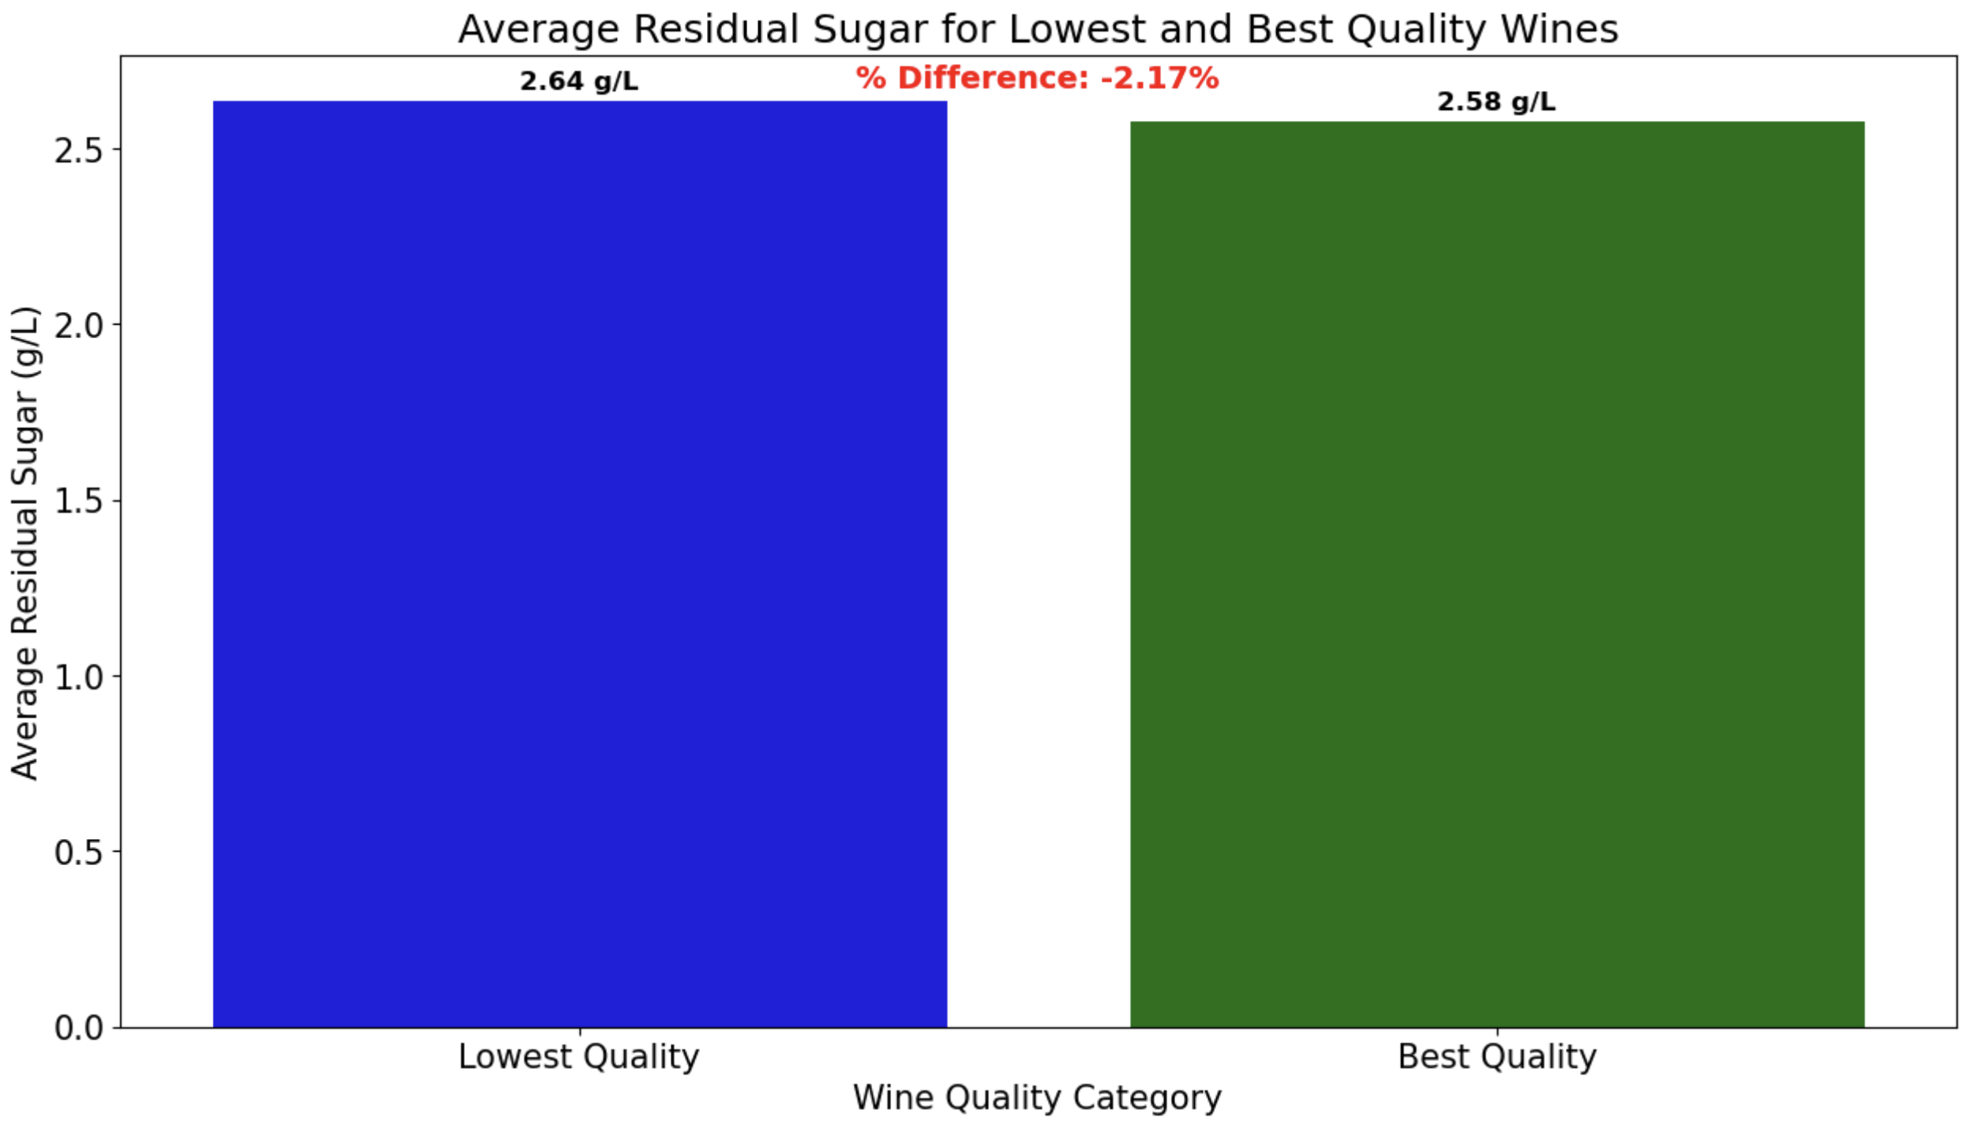
Chart 3: Avg. Residual sugar vs Quality
Residual sugar is almost the same for both low and high-quality wines, with only a -2.17% difference.

Slide 10
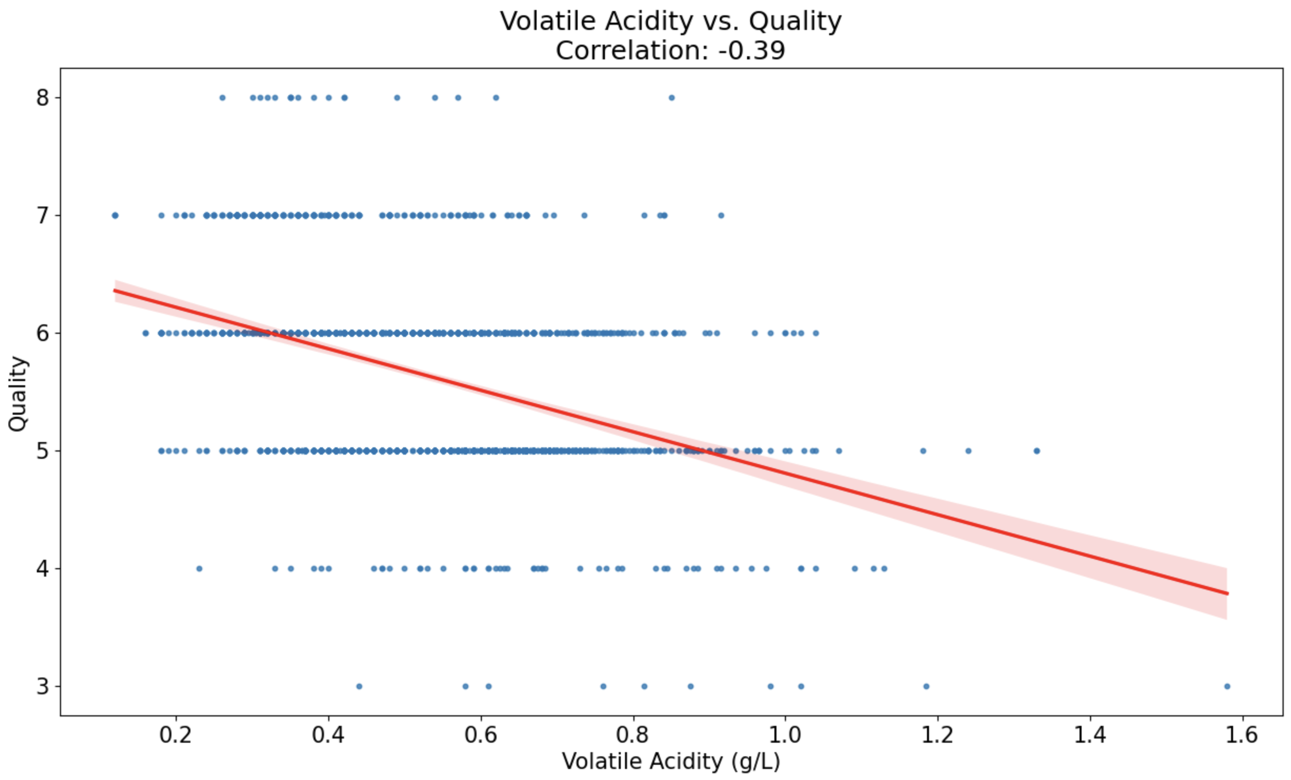
Chart 4: Volatile Acidity vs Quality
Higher volatile acidity moderately correlates with lower wine quality (-0.39).

Slide 11

Decision Tree + Random Forest

Slide 12
Workflow
Train-Test Split
Decision Tree
Random Forest (n_estimators=100)

Slide 13
Decision Tree vs Random Forest
Accuracy
50.7%
Accuracy
66.9%

Slide 14
THANK YOU!

