Slide 1
FPGA: 64x1mux implementation
GROUP E
Ahiezer Lopez
Joe Si
Sander Zuckerman

Slide 2
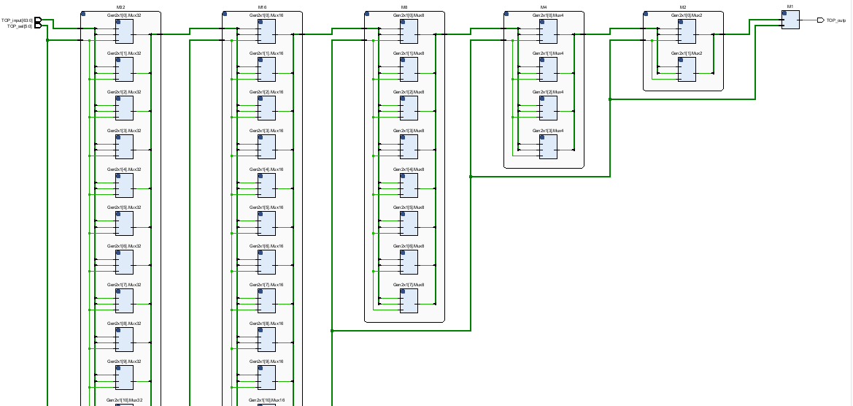
Contributions:
64 x 1 mux
Joe Si
16x1 mux Implementation
Ahiezer Lopez
Simulation/textio
Sander Zuckerman

