Slide 1
FPGA: 5x32 Decoder
GROUP E
Ahiezer Lopez
Joe Si
Sander Zuckerman

Slide 2
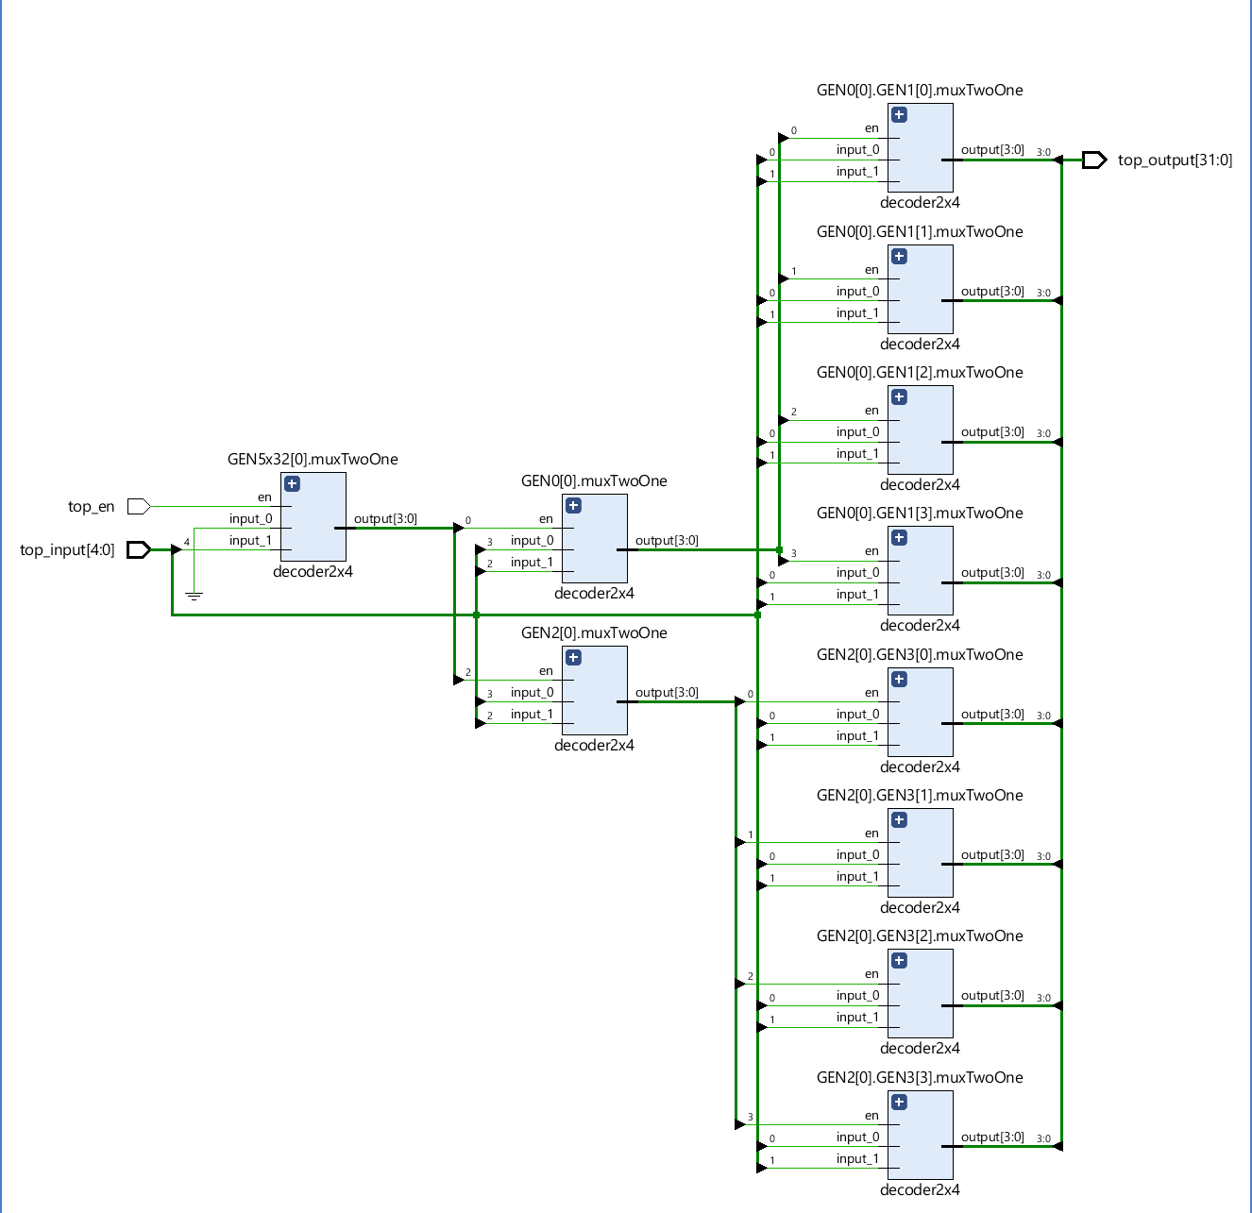
Contributions:
5x32 decoder Implementation
Joe Si
5x32 decoder
Ahiezer Lopez
Simulation/textio
Sander Zuckerman

