Slide 1
BCD Counter
GROUP E
Ahiezer Lopez
Joe Si
Sander Zuckerman

Slide 2
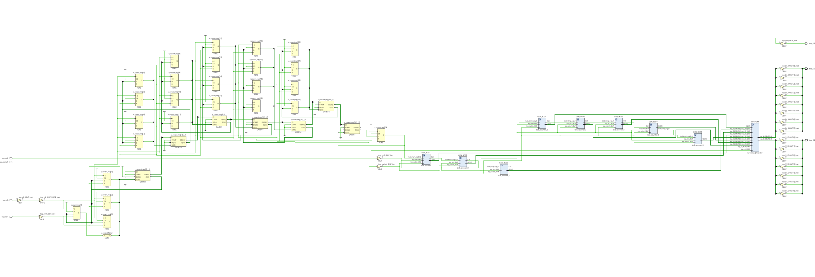
Contributions:
BCD-SS Implementation
Joe Si
BCD Counter/SS
Ahiezer Lopez
BCD Counter/SS
Sander Zuckerman

