Slide 1
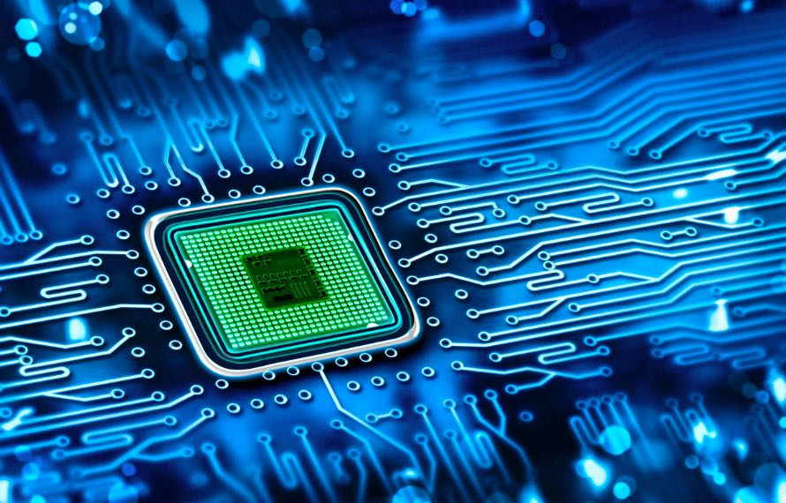
Lab #7
System
Joe Si
Ahiezer Lopez
Sander Zuckerman

Slide 2
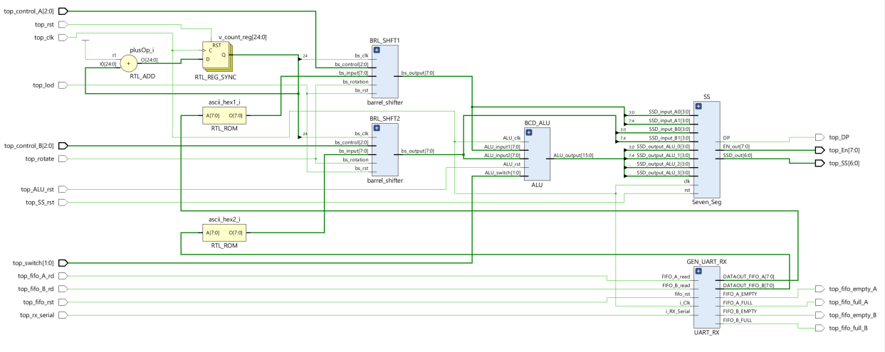
Contributions:
Connections/UART
Sander Zuckerman
Connections/UART
Joe Si
Connections/UART
Ahiezer Lopez

