Slide 1
ECE 4304
LAB #8
Ahiezer Lopez
Joe Si
Sander Zuckerman

Slide 2
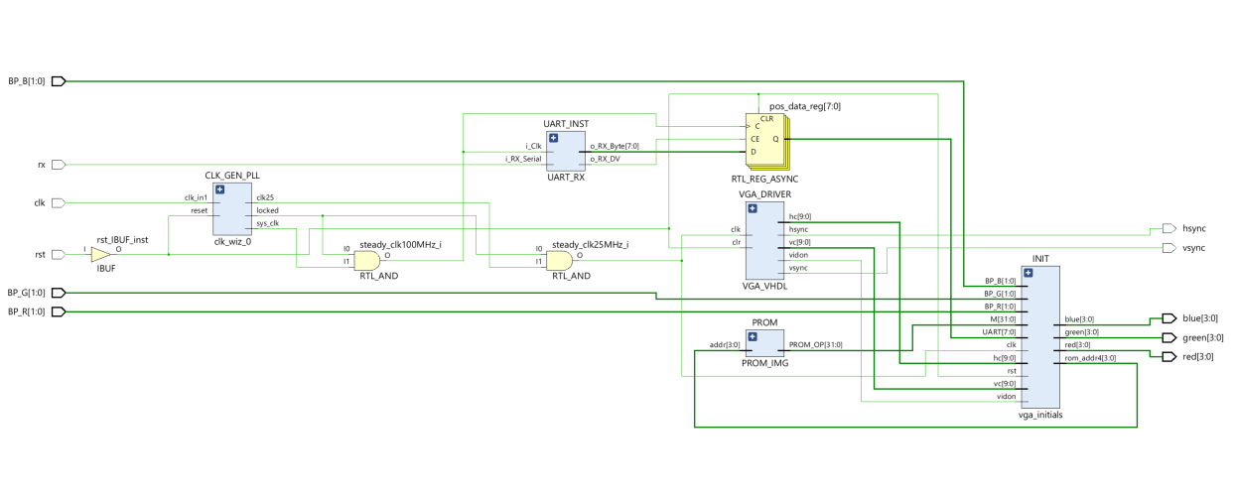
Contributions
VGA Color
Sander Zuckerman
VGA Color
Joe Si
VGA Move
Ahiezer Lopez

