Slide 1
CSc 553 Principles of Compilation 01. Background
Saumya Debray
The University of Arizona
Tucson, AZ 85721

Slide 2
Course Objectives
Understand advanced concepts in compiler design and implementation, esp. program analysis and optimization.
Understand how source language programs are implemented at the machine level.

Slide 3
Compilers
A compiler (more generally, translator) maps source language strings to “equivalent” target language strings. E.g.:
gcc : C/C++ programs to assembly/machine code
f2c : Fortran programs to C programs
latex2html: Latex documents to HTML documents
javac : Java programs to JVM byte code
ps2pdf: PostScript files to PDF files

Slide 4
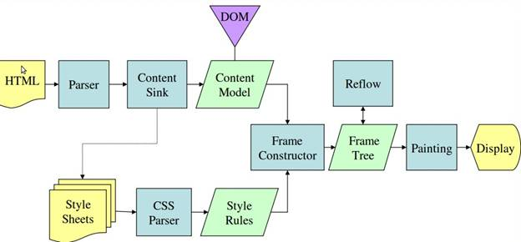
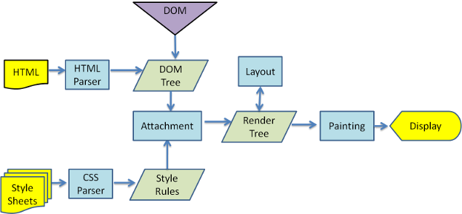
A very commonly used translator: The Web Browser
Gecko
(rendering engine for Firefox):
Webkit
(rendering engine for Safari and Chrome):
front end
back end
front end
back end
Source: How Browsers Work: Behind the Scenes of Modern Web Browsers, by Tali Garsiel & Paul Irish. http://www.html5rocks.com/en/tutorials/internals/howbrowserswork/

Slide 5
Languages
Syntax:
“structural” aspects of program units.
specified by a grammar.
Semantics:
the “meaning,” i.e., behavior, of program units.
specified using actions associated with grammar rules.

Slide 6
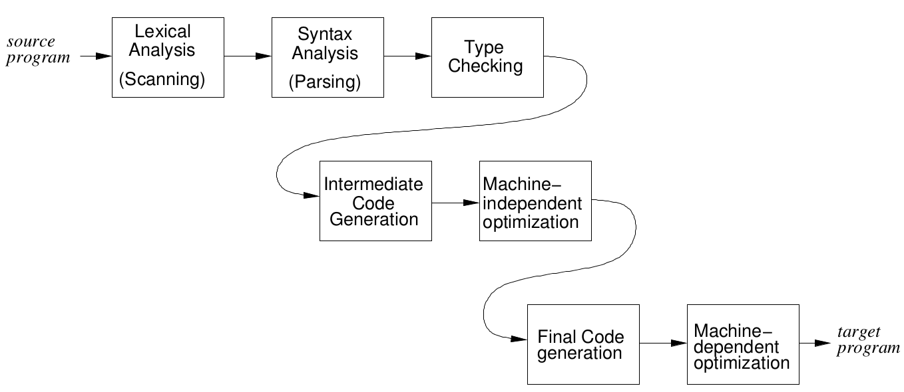
Structure of a compiler (“phases”)

Slide 7
Structure of a compiler (“phases”)
high-level IR
(syntax trees)
low-level IR
(3-addr code)

Slide 8
Structure of a compiler (“phases”)
Front end
high-level IR
(syntax trees)
low-level IR
(3-addr code)
Back end

Slide 9
Phases of a Compiler
Lexical analysis (“scanning”)
Reads in program, groups characters into “tokens”
Syntax analysis (“parsing”)
Structures token sequence according to grammar rules of the language.
Semantic analysis
Checks semantic constraints of the language.
Intermediate code generation
Translates to “lower level” representation.
Program analysis and code optimization
Improves code quality.
Final code generation.

Slide 10
Grouping of Phases
Front end: machine-independent phases:
Lexical analysis
Syntax analysis
Semantic analysis
Intermediate code generation
some code optimization
Back end: machine-dependent phases:
Final code generation
machine-dependent optimizations
CSc 453
CSc 553

