Slide 1
CSc 553 Principles of Compilation 03. Intermediate Representations
Saumya Debray
The University of Arizona
Tucson, AZ 85721

Slide 2
Intermediate Code Generation
lexical analysis
syntax analysis
static checking
intermediate code generation
final code generation
source
code
final
code
tokens
intermediate code
(aka intermediate representation, IR)

Slide 3
Why Intermediate Code?
Closer to target language.
simplifies code generation.
Machine-independent.
simplifies retargeting of the compiler.
Allows a variety of optimizations to be implemented in a machine-independent way.
Many compilers use several different intermediate representations (IRs).

Slide 4
Different Kinds of IRs
Graphical IRs: the program structure is represented as a graph (or tree) structure.
Example: parse trees, syntax trees, DAGs.
Linear IRs: the program is represented as a list of instructions for some virtual machine.
Example: three-address code.
Hybrid IRs: combines elements of graphical and linear IRs.
Example: control flow graphs with 3-address code.

Slide 5
Graphical IRs: Abstract Syntax Trees (aka “syntax trees”)

Slide 6
Syntax Trees
program
Program structure
code
refers to
data
Compiler structure
syntax tree
refers to
symbol table
a tree representation
of the structure of the
program
information about
variables and functions

Slide 7
Syntax Trees
program
Program structure
code
refers to
data
Compiler structure
syntax tree
refers to
symbol table
A syntax tree shows the structure of a program:
each node represents a computation to be performed
leaf nodes (variable names) refer to symbol table entry
its children represent what that computation is performed on

Slide 8
Syntax Trees: Structure
Expressions:
leaves: identifiers or constants;
internal nodes are labeled with operators;
the children of a node are its operands.
Statements:
a node’s label indicates what kind of statement it is;
the children correspond to the components of the statement.
+
*
u
v
w
if
exp
S_{true}
S_{false}

Slide 9
Example
FunDef
name
body
StmtSeq
StmtSeq
 | ∅
int abs(int x) {
if (x < 0){
x = −x;
}
return x;
}
If
 |  | ∅
Source code
Return
<
Assign
Syntax tree
Symbol table
name: abs
type: func
...
Var
Var
IntConst
0
Var
Uminus
name: x
type: int
...
Var

Slide 10
Example
FunDef
name
body
StmtSeq
StmtSeq
 | ∅
int abs(int x) {
if (x < 0){
x = −x;
}
return x;
}
If
 |  | ∅
Source code
Return
<
Assign
Syntax tree
Symbol table
name: abs
type: func
...
Var
Var
IntConst
0
Var
Uminus
name: x
type: int
...
Var

Slide 11
Example
FunDef
name
body
StmtSeq
StmtSeq
 | ∅
int abs(int x) {
if (x < 0){
x = −x;
}
return x;
}
If
 |  | ∅
Source code
Return
<
Assign
Syntax tree
Symbol table
name: abs
type: func
...
Var
Var
IntConst
0
Var
Uminus
name: x
type: int
...
Var

Slide 12
Example
FunDef
name
body
StmtSeq
StmtSeq
 | ∅
int abs(int x) {
if (x < 0){
x = −x;
}
return x;
}
If
 |  | ∅
Source code
Return
<
Assign
Syntax tree
Symbol table
name: abs
type: func
...
Var
Var
IntConst
0
Var
Uminus
name: x
type: int
...
Var

Slide 13
Example
FunDef
name
body
StmtSeq
StmtSeq
 | ∅
int abs(int x) {
if (x < 0){
x = −x;
}
return x;
}
If
 |  | ∅
Source code
Return
<
Assign
Syntax tree
Symbol table
name: abs
type: func
...
Var
Var
IntConst
0
Var
Uminus
name: x
type: int
...
Var

Slide 14
Example
FunDef
name
body
StmtSeq
StmtSeq
 | ∅
int abs(int x) {
if (x < 0){
x = −x;
}
return x;
}
If
 |  | ∅
Source code
Return
<
Assign
Syntax tree
Symbol table
name: abs
type: func
...
Var
Var
IntConst
0
Var
Uminus
name: x
type: int
...
Var

Slide 15
Example
FunDef
name
body
StmtSeq
StmtSeq
 | ∅
int abs(int x) {
if (x < 0){
x = −x;
}
return x;
}
If
 |  | ∅
Source code
Return
<
Assign
Syntax tree
Symbol table
name: abs
type: func
...
Var
Var
IntConst
0
Var
Uminus
name: x
type: int
...
Var

Slide 16
Example
FunDef
abs
StmtSeq
StmtSeq
 | ∅
int abs(int x) {
if (x < 0){
x = −x;
}
return x;
}
If
 |  | ∅
Source code
Return
<
Assign
Syntax tree
Var
x
Var
x
IntConst
0
Var
x
Uminus
to reduce clutter, we may omit explicit references
from the syntax tree to the symbol table
Var
x

Slide 17
Information in syntax tree nodes
Information is added to syntax tree nodes as compilation progresses:
parsing:
node type
children
type checking:
value type
code generation:
location where an expression’s value is stored
intermediate code generated for the tree rooted at the node

Slide 18
EXERCISE
Given the syntax tree:
What source code expression(s) could this have come from?
+
a
*
2
b

Slide 19
EXERCISE
Given the syntax tree:
What source code expression(s) could this have come from?
‒
‒
w
u
v

Slide 20
EXERCISE
Given the syntax tree nodes:
Use exactly this set of nodes to construct a syntax tree corresponding to an expression whose value is 0.
+
‒
1
2
3

Slide 21
Summary
Syntax trees and symbol tables are used together to represent programs inside a compiler
syntax trees represent code structure
nodes represent operations, which are applied to the node’s children
symbol tables hold information about user-defined symbols (variables, functions, etc.)
scope rules of C, Java, etc., require using a stack of symbol tables

Slide 22
Linear IRs

Slide 23
Linear IRs
Source language programs often use features not available in target language code. E.g.:
x = (a+b)/(c-d)*2
asm doesn’t support multiple operations in an instruction
need to save intermediate results as they are computed
while (x > 0) { x--; y++}
asm doesn’t support complex grouping of statements and arbitrary control flow
need a way to decompose complex control flow into something simpler

Slide 24
Linear IRs
A linear IR consists of a sequence of instructions that execute in order.
“machine-independent assembly code”
Instructions may contain multiple operations, which (if present) execute in parallel.
They often form a starting point for hybrid representations (e.g., control flow graphs).

Slide 25
Linear IRs 1: Three-address code

Slide 26
Three Address Code
Instructions are of the form ‘x = y op z,’ where x, y, z are variables, constants, or “temporaries”.
At most one operator allowed on RHS
no “built-up” expressions
instead, expressions are computed using temporaries (compiler-generated variables).
The specific set of operators represented, and their level of abstraction, can vary widely.

Slide 27
Three Address Code: Example
Source:
if ( x + y*z > x*y + z)
a = 0;
Three Address Code:
t1 = y*z
t2 = x+t1 // x + y*z
t3 = x*y
t4 = t3+z // x*y + z
if (t2 ≤ t4) goto L
a = 0
L:

Slide 28
An Example Intermediate Instruction Set
Procedure call/return:
param x, k (x is the k^{th} param)
retval x
call p
enter p
leave p
return
retrieve x
Type Conversion:
x = cvt_A_to_B y (A, B base types) e.g.: cvt_int_to_float
Miscellaneous
label L
Assignment:
x = y op z (op binary)
x = op y (op unary);
x = y
Jumps:
if ( x op y ) goto L (L a label);
goto L
Pointer and indexed assignments:
x = y[ z ]
y[ z ] = x
x = &y
x = *y
*y = x.

Slide 29
EXERCISE
Source code
3-address code
x = (a+b*2)/c
?

Slide 30
x = (a+b*2)/c
Three-address code:
tmp1 = b * 2
tmp2 = a + tmp1
tmp3 = tmp2 / c
x = tmp3

Slide 31
Example
Source code
3-address Code
int fact(int n) {
int p = 1;
while (n > 0) {
p *= n;
n –= 1;
}
return p;
}
enter fact
p = 1
L0: if n <= 0 goto L1
tmp0 = p * n
p = tmp0
tmp1 = n – 1
n = tmp1
goto L0
L1: leave
return p

Slide 32
Three Address Code: Representation
Each instruction represented as a structure called a quadruple (or “quad”):
contains info about the operation, up to 3 operands.
for operands: use a bit to indicate whether constant or ST pointer.
E.g.:
x = y + z if ( x ≥ y ) goto L
op
src1
src2
dest
PLUS
op
src1
src2
dest
IF_GE
y’s symbol table entry
y’s symbol table entry
z’s symbol table entry
z’s symbol table entry
x’s symbol table entry
instr. labeled L
next pointer
next pointer

Slide 33
Three Address Code: Representation
typedef enum {
... // integer constant
... // symbol table pointer
... // ...
} OperandType;
typedef struct {
OperandType operand_type;
union {
int iconst; // integer const.
symtabnode *stptr;
...
} val;
} Operand
op
src1
src2
dest
PLUS
y’s symbol table entry
z’s symbol table entry
x’s symbol table entry
next pointer
(in linked list of 3-addr instructions)

Slide 34
Three Address Code: Representation
typedef struct {
enum OpType op; // PLUS, MINUS, etc.
Operand src1; // source operand 1
Operand src2; // source operand 2
...
} Quad;
op
src1
src2
dest
PLUS
y’s symbol table entry
z’s symbol table entry
x’s symbol table entry
next pointer
(in linked list of 3-addr instructions)

Slide 35
Linear IRs 2: Stack machine code

Slide 36
Stack Machine Code
Sometimes called “one-address code”
Assumes the presence of an operand stack
Most operations:
fetch (pop) their operands from the stack
perform the operation
push the result back on the stack.

Slide 37
Stack-machine vs. Three-address code
Example: code for “x*y + z”
Three Address Code
Stack machine code
tmp1 = x
tmp2 = y
tmp3 = tmp1 * tmp2
tmp4 = z
tmp5 = tmp3 + tmp4
push x
push y
mult
push z
add

Slide 38
Stack Machine Code
The code for an operation ‘op x₁, …, x_{n}’ is:
push x_{n}
…
push x₁
op
Example: JVM code for ‘x = 2∗y – 1’:
iconst 1 /* push the integer constant 1 */
iload y /* push value of integer variable y */
iconst 2
imul /* after this, stack contains: ⟨(2*y), 1⟩ */
isub
istore x /* pop stack, store to integer variable x */

Slide 39
Stack Machine Code: Features
Compact
instruction operands often don’t have to be named explicitly
this shrinks the size of the IR.
Necessitates new operations for manipulating the stack, e.g., “swap top two values”, “duplicate value on top.”
Simple to generate and execute.
Interpreted stack machine codes easy to port.

Slide 40
Generating Stack Machine Code
Essentially just a post-order traversal of the syntax tree:
void gencode(struct syntaxTreeNode ∗tnode )
{
if ( IsLeaf( tnode ) ) { … }
else {
n = tnode→n_operands;
for (i = n; i > 0; i--) {
gencode( tnode→operand[i] ); /* traverse children first */
} /* for */
gen_instr( opcode_table[tnode→op] ); /* code for the node */
} /* if [else] */
}

Slide 41
EXERCISE
Source code
Stack-machine code
x = (a+b*2)/c
?

Slide 42
EXERCISE
Syntax tree
Stack-machine code
+
?
[ ]
5
array indexing
a
[ ]
b
1

Slide 43
EXERCISE
Stack machine code (JVM)
Source code
iload a
iload b
iadd
iload a
iload b
sub
div
iconst 1
add
?

Slide 44
Hybrid IRs

Slide 45
Hybrid IRs
Combine features of graphical and linear IRs:
linear IR aspects capture a lower-level program representation;
graphical IR aspects make control flow behavior explicit.
Examples:
control flow graphs
static single assignment form (SSA).

Slide 46
Hybrid IRs 1: Control Flow Graphs

Slide 47
Control Flow Graphs: Definition
A control flow graph for a function is a directed graph G = (V, E) such that:
each v ∈ V is a straight-line code sequence (“basic block”);
there is an edge a → b ∈ E iff control can go directly from a to b.

Slide 48
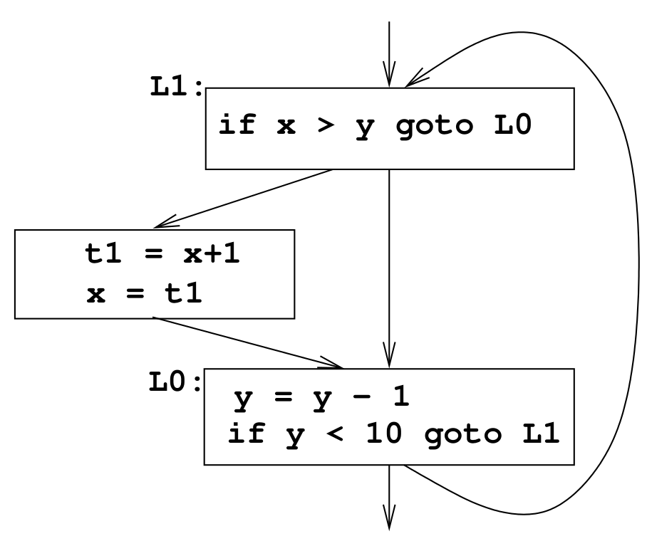
Control Flow Graphs: Example
Three-address Code
Control flow graph
L1: if x > y goto L0
t1 = x+1
x = t1
L0: y = y - 1
if y < 10 goto L1

Slide 49
Basic Blocks
Definition: A basic block B is a sequence of consecutive instructions such that:
control enters B only at its beginning; and
control leaves B only at its end (under normal execution); and
This implies that if any instruction in a basic block B is executed, then all instructions in B are executed.
for program analysis purposes, we can treat a basic block as a single entity.

Slide 50
Identifying Basic Blocks
Determine the set of leaders, i.e., the first instruction of each basic block:
the entry point of the function is a leader;
any instruction that is the target of a branch is a leader;
any instruction following a (conditional or unconditional) branch is a leader.
For each leader, its basic block consists of:
the leader itself;
all subsequent instructions up to, but not including, the next leader.

Slide 51
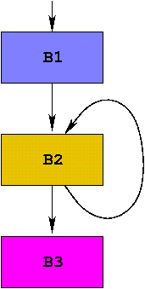
Example
int dotprod(int a[], int b[], int N) {
int i, prod = 0;
for (i = 1; i ≤ N; i++) {
prod += a[i]∗b[i];
}
return prod;
}
No. | Instruction | leader? | Block No.
1 | enter dotprod | Y | B1
2 | prod = 0 |  | B1
3 | i = 1 |  | B1
4 | t1 = 4*i | Y | B2
5 | t2 = a[t1] |  | B2
6 | t3 = 4*i |  | B2
7 | t4 = b[t3] |  | B2
8 | t5 = t2*t4 |  | B2
9 | t6 = prod+t5 |  | B2
10 | prod = t6 |  | B2
11 | t7 = i+i |  | B2
12 | i = t7 |  | B2
13 | if i ≤ N goto 4 |  | B2
14 | retval prod | Y | B3
15 | leave dotprod |  | B3
16 | return |  | B3

Slide 52
Constructing Control flow graphs
Algorithm:
Identify basic blocks
For each block B:
if B ends in a branch instruction:
add an edge to each possible control flow target
else:
add an edge to the textually next basic block (i.e., the block that follows B in terms of instruction order)
Issues:
handling function calls
entry and exit blocks

Slide 53
Handling function calls
Two approaches
treat the call instruction as ending the block
in this case, need to keep the next block connected to the call
treat the call instruction as not ending a block
in this case, need to deal with possible side effects of the call

Slide 54
Hybrid IRs 2: Static Single-Assignment Form

Slide 55
Static Single Assignment Form: Definition
An IR is in SSA form if every assignment is to a distinct variable name
(i.e., each variable is assigned exactly once)
Motivation: simplifies and enhances several analyses and optimizations
⇒ “single assignment”
In the program’s IR, not during execution
⇒ “static”

Slide 56
Static Single Assignment Form: Example
Three-address Code
SSA
x = a + b
y = x * 2
x = x – 1
y = y + 1
x = x * y
y = x / 3
x₁ = a + b
y₁ = x₁ * 2
x₂ = x₁ – 1
y₂ = y₁ + 1
x₃ = x₂* y
y₃ = x₃ / 3

Slide 57
Static Single Assignment Form
The Static Single Assignment (SSA) form of a program makes information about variable definitions and uses explicit.
this can simplify program analysis
constructing the intermediate representation (SSA) is more work
Most modern compilers (e.g., GCC, clang) use SSA representations.

Slide 58
SSA: Handling control flow merges
Code
SSA
if (x < 0) {
x = ‒ x
}
y = 2 * x
x₁ < 0?
T
x₂ = ‒ x₁
F
y₁ = 2 * x???
Problem: How to indicate which “version” of x to use here?

Slide 59
SSA: Handling control flow merges
SSA uses a notational convention called φ-functions to combine definitions of a variable at a merge point:
x₁ < 0?
T
φ(x₁, x₂) = | x₁ if F branch taken
 | x₂ if T branch taken
x₂ = ‒ x₁
F
x₃ = φ(x₁, x₂)
y₁ = 2 * x₃

Slide 60
SSA: Handling control flow merges
x₁ = ...
x_{i} = ...
x_{k} = ...
...
...
x_{n} = φ(x₁, ..., x_{k})
φ-functions:
placed by the compiler as necessary at merge points
Conceptually: At runtime, if control reaches the φ-function along the branch where x_{i} is defined, then φ “selects” x_{i} as its value.
Implementation: map {x₁, x₂, ..., x_{k}} to the same location.

Slide 61
SSA Form: φ - Functions
x₁ = …
y₁ = …
z₁ = …
x₂ = …
y₂ = …
z₂ = …
x = φ(x₁, x₂)
y = φ(y₁, y₂)
z = φ(z₁, z₂)
On entry to a basic block, all the φ-functions in the block execute (conceptually) in parallel.

Slide 62
SSA Form: Example
Original code
IR in SSA form
x =
y =
while (x < 100) {
x = x+1
y = y+x
}
z = x*y
x₀ = ...
y₀ = ...
L0:
x₁ = φ(x₀, x₂)
y₁ = φ(y₀, y₂)
if (x₁ ≥ 100) goto L1
x₂ = x₁ + 1
y₂ = y₁ + x₂
goto L0
L1:
z = x₁ * y₁

Slide 63
SSA Form: Issues
Constructing a (good) SSA representation for a program
Mapping SSA representations to lower-level code
To be discussed later

