Slide 1
Real Time Chat Application using Firebase API
Oguzhan Demir
Alihan Kucukgokdemir

Slide 2
Project Description
Our project provides it’s users to chat in real time.As a backend service , we used Firebase API.
Features:
Sign up & Login activities,
Instantly chat with contacts,
Chat history ,
No significant impact on battery consumption.

Slide 3
Android Features
Contacts Contract
The contract between the contacts provider and applications.
Telephony Manager
Provides access to information about the telephony services on the device. Applications can use the methods in this class to determine telephony services and states, as well as to access some types of subscriber information. (country code, operator etc.)

Slide 4
Firebase
Firebase is an API service to store and sync data in real-time. What this means is that you don’t have to worry about the backend server, database, or real-time component.All of that is handled for you by Firebase.The picture below shows the Dashboard that is provided by Firebase.

Slide 5
Why Firebase?
Cloud storage
Synchronize data in real time
Greater app responsiveness
Great for apps where multi player games , collaborative social features , live interaction , data changes frequently (finance)

Slide 6
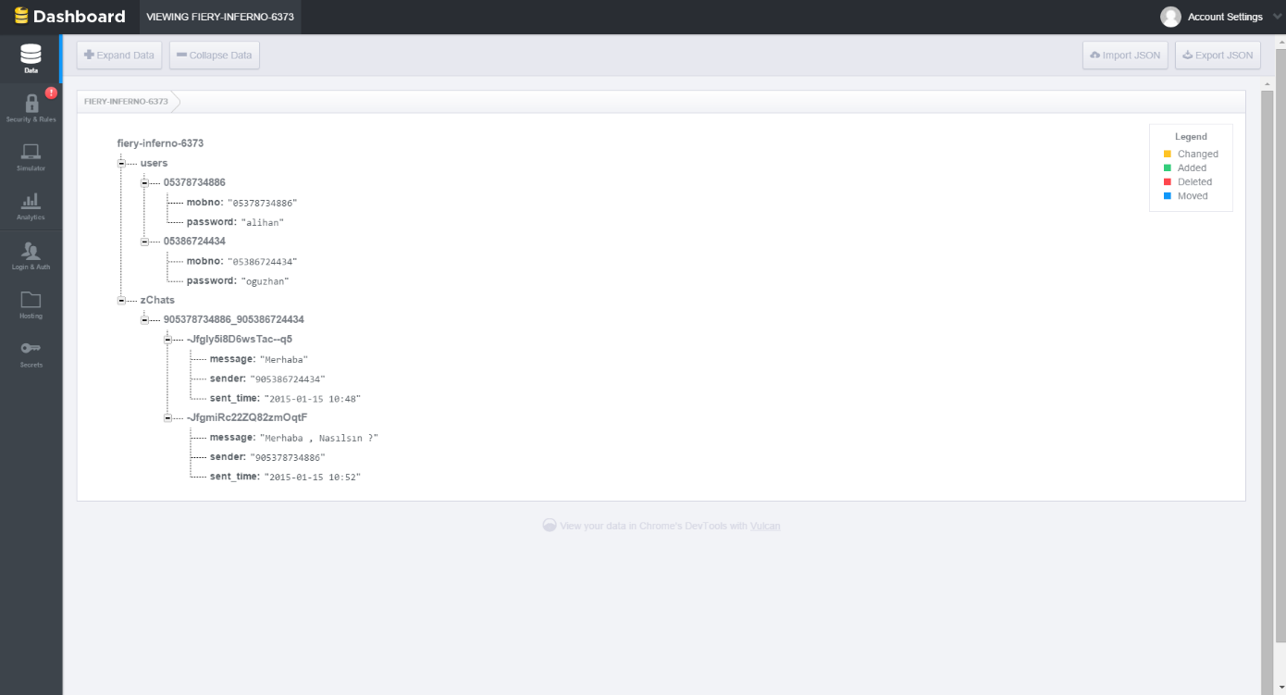
Firebase Dashboard

Slide 7
Firebase Configuration
Our first step was to setup a Firebase account, We have created a new Firebase application instance, and configured the authentication for it. Firebase gave us standard URL where the application data is stored.Firebase generates an API key.Users communicate each other with the key.

Slide 8
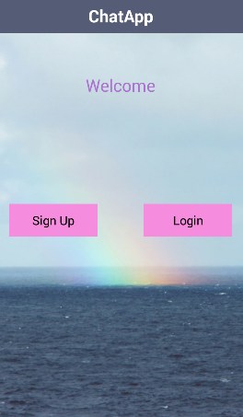
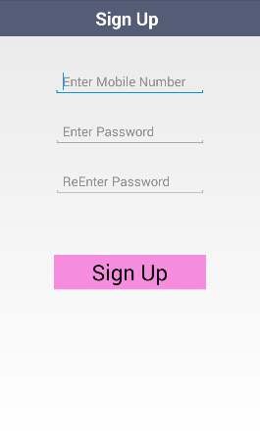
Application Interfaces
The applications’s main activity.
Simple sign up and login button.
Sign up activity
Get users information.
Save the Mobile Number& Password to database.

Slide 9
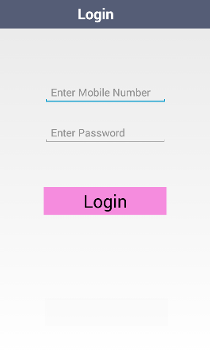
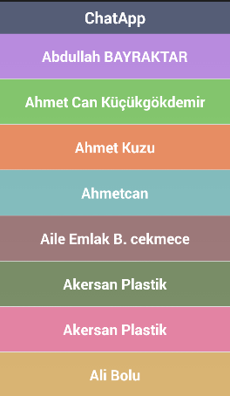
Application Interfaces
User contacts activity
Contains contacts list.
Getting information with using android.telephony package
Login activity.
Login with mobile number and password
Control with the database.

Slide 10
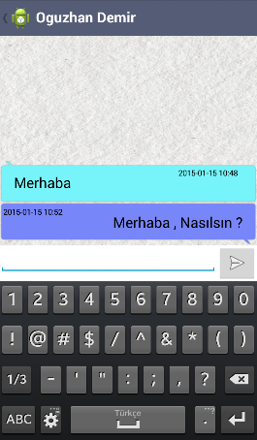
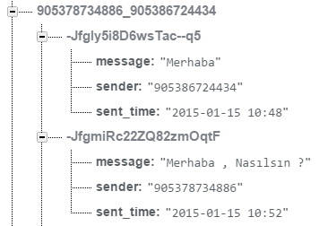
Application Interfaces
User activity where the user chat with his/her friend.
It keeps the history between users.

Slide 11
References
Akersan pilastik

