Slide 1
Novel Contribution
Understanding the factors that can influence a student’s test score in an achievement test.

Slide 2
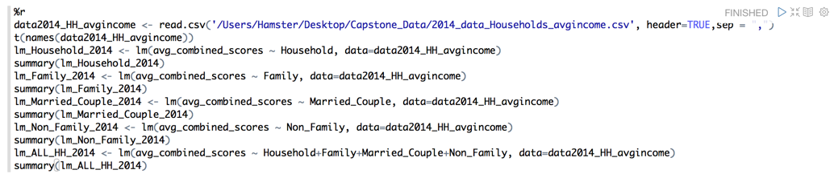
Demonstration in Zeppelin
2014
Linear regression of average combined test scores and the different types of households

Slide 3
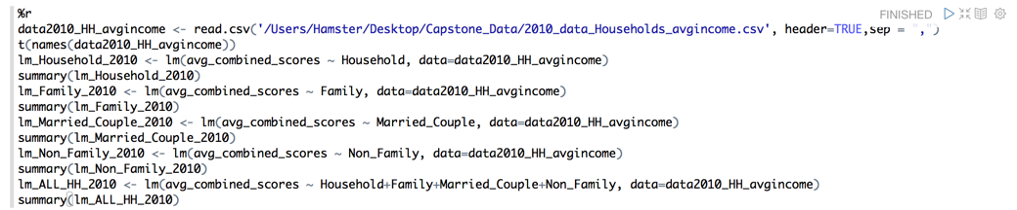
Demonstration in Zeppelin
2010
Linear regression of average combined test scores and the different types of households

Slide 4
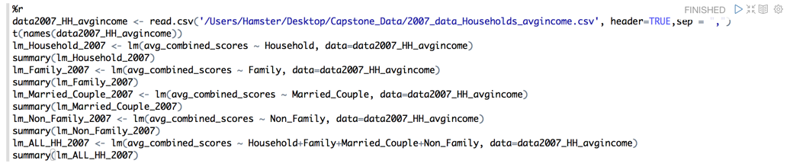
Demonstration in Zeppelin
2007
Linear regression of average combined test scores and the different types of households

Slide 5
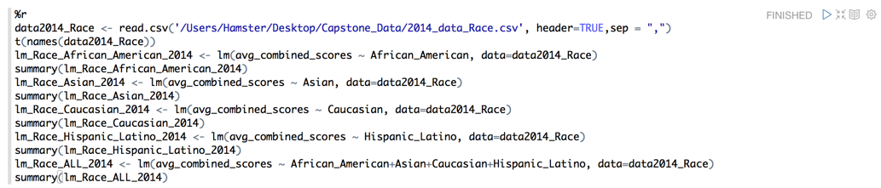
Demonstration in Zeppelin
2014
Linear regression of average combined test scores and the different races

Slide 6

Demonstration in Zeppelin
2010
Linear regression of average combined test scores and the different races

Slide 7
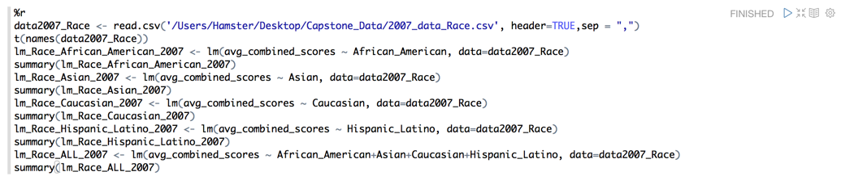
Demonstration in Zeppelin
2007
Linear regression of average combined test scores and the different races

Slide 8
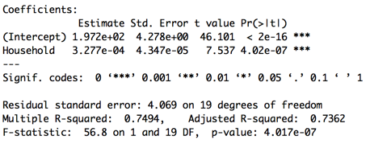
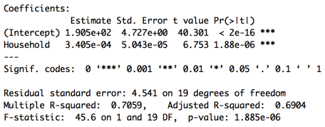
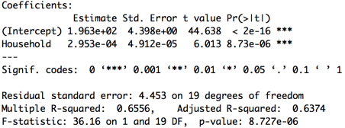
Results Summary in Tables and Charts
Linear regression of average combined test scores and average income of household
2014 | 2010 | 2007

Slide 9
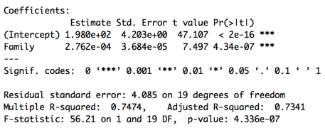
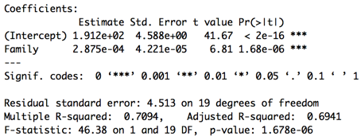
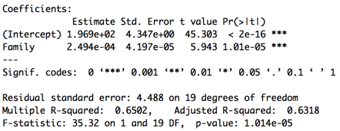
Results Summary in Tables and Charts
Linear regression of average combined test scores and average income of family
2014 | 2010 | 2007

Slide 10
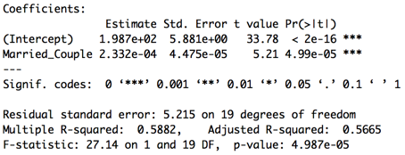
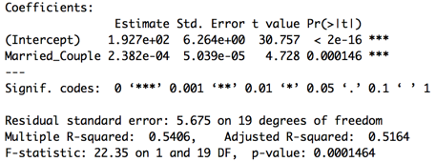
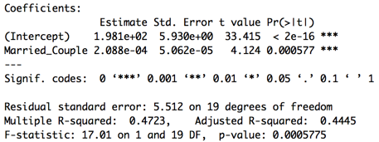
Results Summary in Tables and Charts
Linear regression of average combined test scores and average income of married couple
2014 | 2010 | 2007

Slide 11
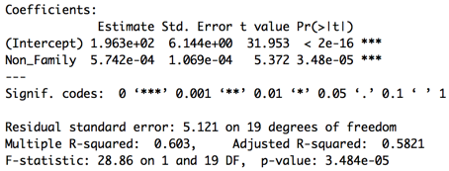
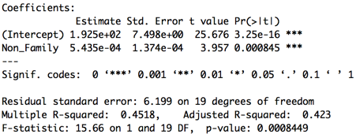
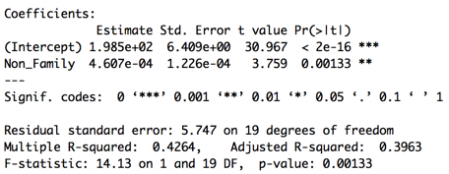
Results Summary in Tables and Charts
Linear regression of average combined test scores and average income of non family
2014 | 2010 | 2007

Slide 12
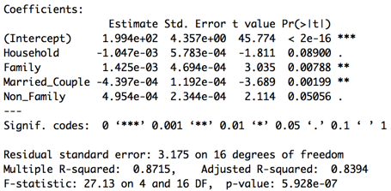
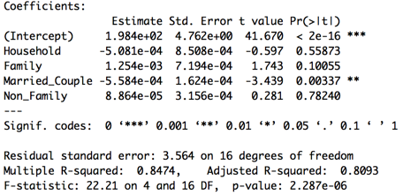
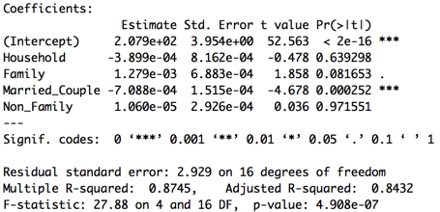
Results Summary in Tables and Charts
Multiple linear regression of average combined test scores and average income of all household types
2014 | 2010 | 2007

Slide 13
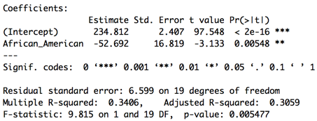
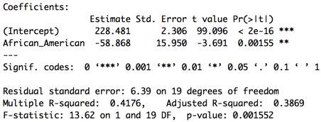
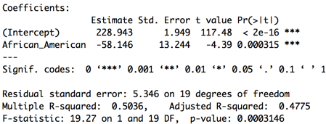
Results Summary in Tables and Charts
Linear regression of average combined test scores and African American
2014 | 2010 | 2007

Slide 14
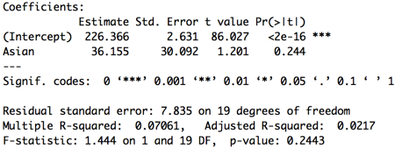
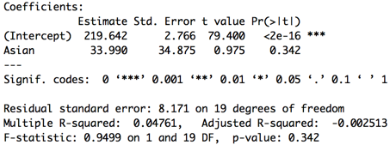
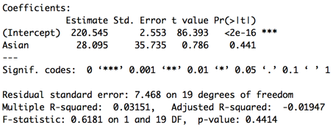
Results Summary in Tables and Charts
Linear regression of average combined test scores and Asian
2014 | 2010 | 2007

Slide 15
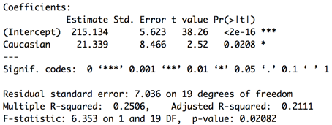
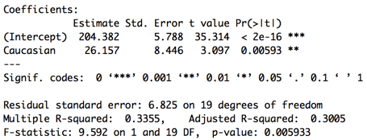
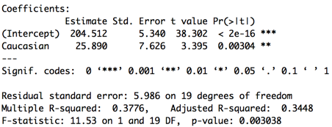
Results Summary in Tables and Charts
Linear regression of average combined test scores and Caucasian
2014 | 2010 | 2007

Slide 16
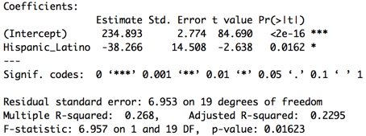
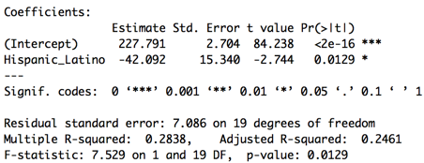
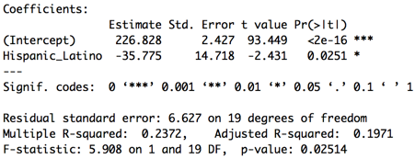
Results Summary in Tables and Charts
Linear regression of average combined test scores and Hispanic or Latino
2014 | 2010 | 2007

Slide 17
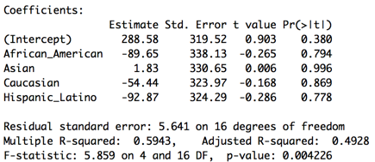
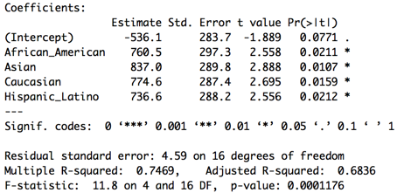
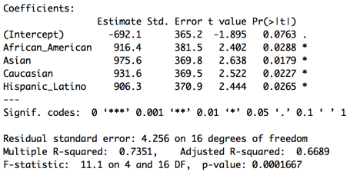
Results Summary in Tables and Charts
Multiple linear regression of average combined test scores and all races
2014 | 2010 | 2007

Slide 18
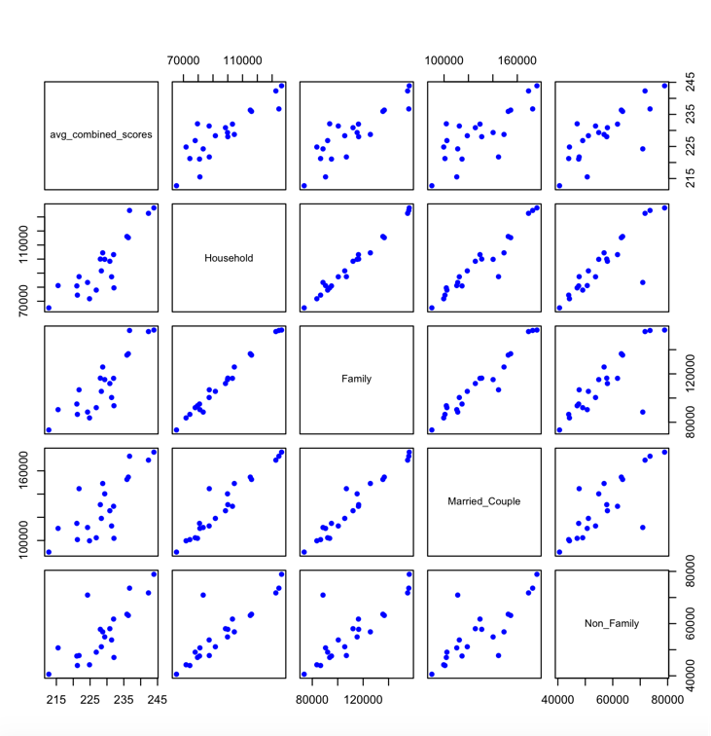
Results Summary in Tables and Charts
2014 Matrix Scatterplot of Average Test Scores and Average Income of Household, Family, Married Couple, and Non Family

Slide 19
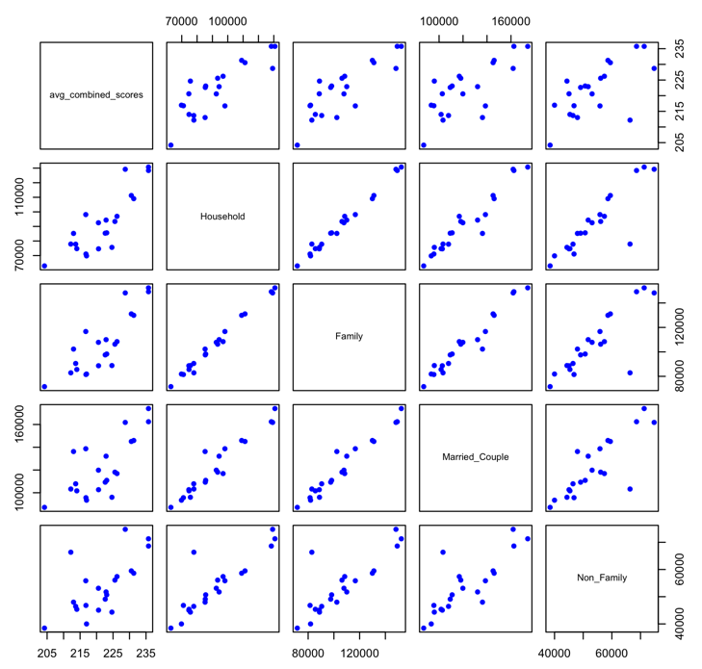
Results Summary in Tables and Charts
2010 Matrix Scatterplot of Average Test Scores and Average Income of Household, Family, Married Couple, and Non Family

Slide 20
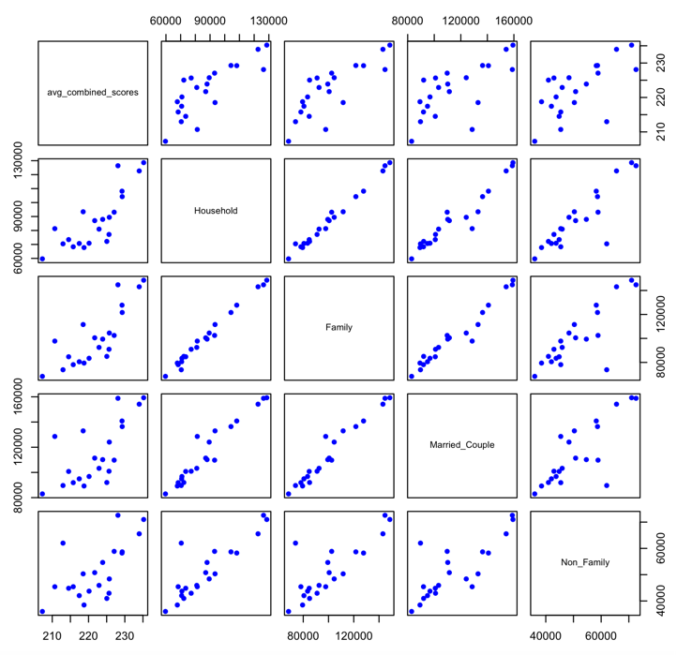
Results Summary in Tables and Charts
2007 Matrix Scatterplot of Average Test Scores and Average Income of Household, Family, Married Couple, and Non Family

