Slide 1
Capstone of Asuncion Los Banos
Statistics & Modeling
Coding with Performance on Big Data
Communicating Results for Decision-Making
Venn Diagram of Data Science Skills

Slide 2


Contribution of Competitor’s Article
Dahl, G. B., & Lochner, L. (2012). The impact of family income on child achievement: Evidence from the earned income tax credit. The American Economic Review, 102(5), 1927-1956.
Utilized an instrumental variable strategy to estimate the causal effect of income on children’s math and reading scores.
Data used were from Earned Income Tax Credit (EITC) and Children of the NLSY (Bureau of Labor Statistics).
Gordon B. Dahl
Lance Lochner
Notes:
Speak more about the competitor’s contribution.

Slide 3
Description of Your Contribution
“Understand the factors that can influence a student’s test score in an achievement test.”
Notes:
Inform audience the types of standardized tests.

Slide 4
Data Source and Content
Data from 2014, 2010, and 2007
High School Proficiency Assessment (HSPA)
Average household income and ethnicity from the U.S. Census Bureau’s American FactFinder
High School Proficiency Assessment (HSPA)
Reading Scores
Math Scores
Household Type
Household
Families
Married Couple
Non Family
Race
African American
Asian
Caucasian
Hispanic or Latino
Partially
Proficient
Proficient
Advanced
Proficient
200
250
Proficient
Cut Score
Advanced Proficient
Cut Score
Notes:
Inform audience why 2014, 2010, 2007 – housing bubble was from 2007 to 2010, then see if there was any changes 4 years after the housing bubble ended
Define what the HSPA was and its history
Explain the different types of household

Slide 5
Your Method
Statistical method using linear regression
avg_combined_scores = β₀ + β₁(Average income by household type)
avg_combined_scores = β0 + β1(Race by type)
Multiple linear regression
avg_combined_scores = β₀ + β₁(Household) + β₂(Families)
+ β₃(Married Couple) + β₄(Non Family)
avg_combined_scores = β₀ + β₁(African American) + β₂(Asian)
+ β₃(Caucasian) + β₄(Hispanic or Latino)
R Interpreter for Apache Zeppelin

Slide 6
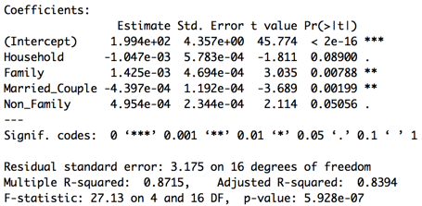
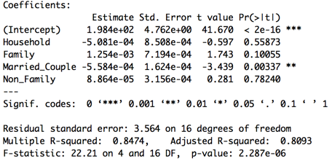
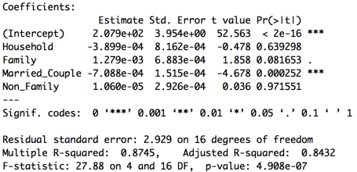
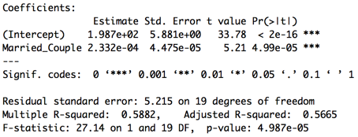
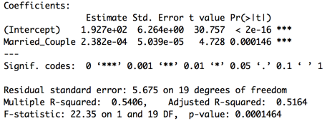
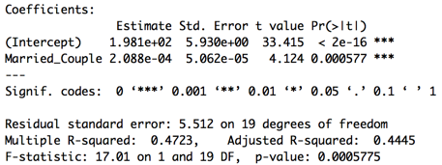
Quantitative Results 1
Multiple linear regression of average income by all household types
2014 | 2010 | 2007
Single linear regression of average income of married couple
 | 2014 | 2010 | 2007
Married Couple

Slide 7
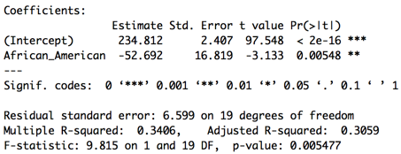
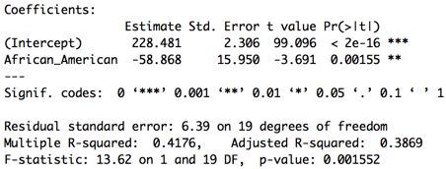
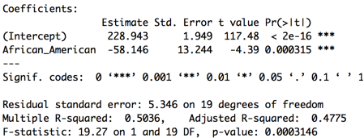
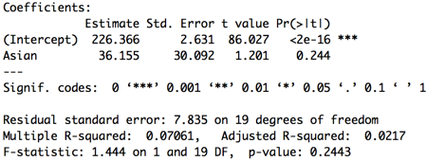
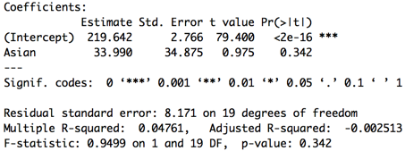
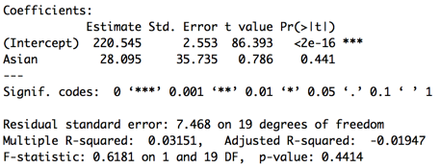
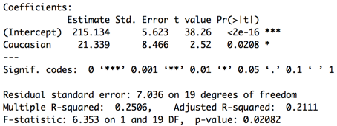
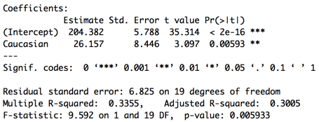
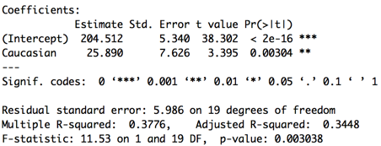
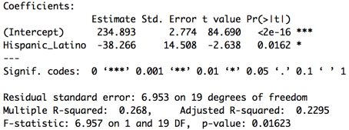
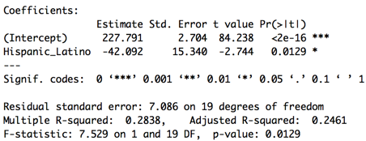
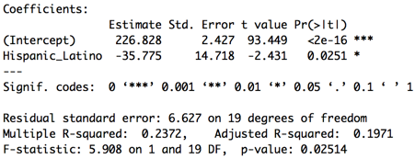
Quantitative Results 2
Single linear regression by race type
 | 2014 | 2010 | 2007
African American
Asian
Caucasian
Hispanic or Latino

Slide 8
Discussion: Comparison With Your Competitor
Competitor’s Results
Your Results
Correlated family income with test scores.
Found short term score improvements of six percent, with one standard deviation for every $1,000 increase in income, for low-income families.
Income effects may be greatest among economically disadvantaged families
Income and race has an influential factor to test score.
The single linear regression completed by average income by household showed a $10,000 increase in in average income translate into an increase in the average test score of the county for 2014, 2010, and 2007.
Being African American or Hispanic has an influence on test scores.

Slide 9
Performance on Big Data: Time Measurements
Data Preparation (Exporting from State of NJ and US Census) | 2 hours
Load data set in Apache Zeppelin | <1 second
Run linear regression for each household type | <5 second
Run multiple linear regression for all household | <1 second
Run linear regression for each race type | <5 second
Run multiple linear regression for all race | <1 second
Look at descriptive statistics | <4 second

Slide 10
Conclusion
Average income and race has an effective factor on achievement test scores, yet it may not be the main influencing factor.
Students living in poor households may have a worse home environment or other characteristics that cannot be observed.
How can the information in this capstone help in real life?

Slide 11
Quiz for Your Classmates
What statistical method was used?
What programming tool was used?
What scientific contribution was made?
What idea could be useful for your project?

