Slide 1
Selected State of the Art Article
My selected article that represents the technique I want to outperform for my Capstone Project is:
Dahl, G. B., & Lochner, L. (2012). The impact of family income on child achievement: Evidence from the earned income tax credit. The American Economic Review, 102(5), 1927-1956.

Slide 2
Impact of Family Income on Child
Using data from the US government’s Earned Income Tax Credit records, they applied an “instrumental variable strategy” that established an underlying relationship between measurable expansions in family income and corresponding increases in children’s math and reading scores. They found short term score improvements of six percent, with one standard deviation for every $1,000 increase in income, for low income families.

Slide 3
Impact of Family Income on Child
Utilizing an instrumental variable strategy to estimate causal effect of income on children’s math & reading achievements.
Identification was from nonlinear changes in the Earned Income Tax Credit.
Baseline estimates imply that a $1,000 increase in income raises combined math and reading test scores by 6% in the short run.
Test gains are larger for children from disadvantaged families.

Slide 4
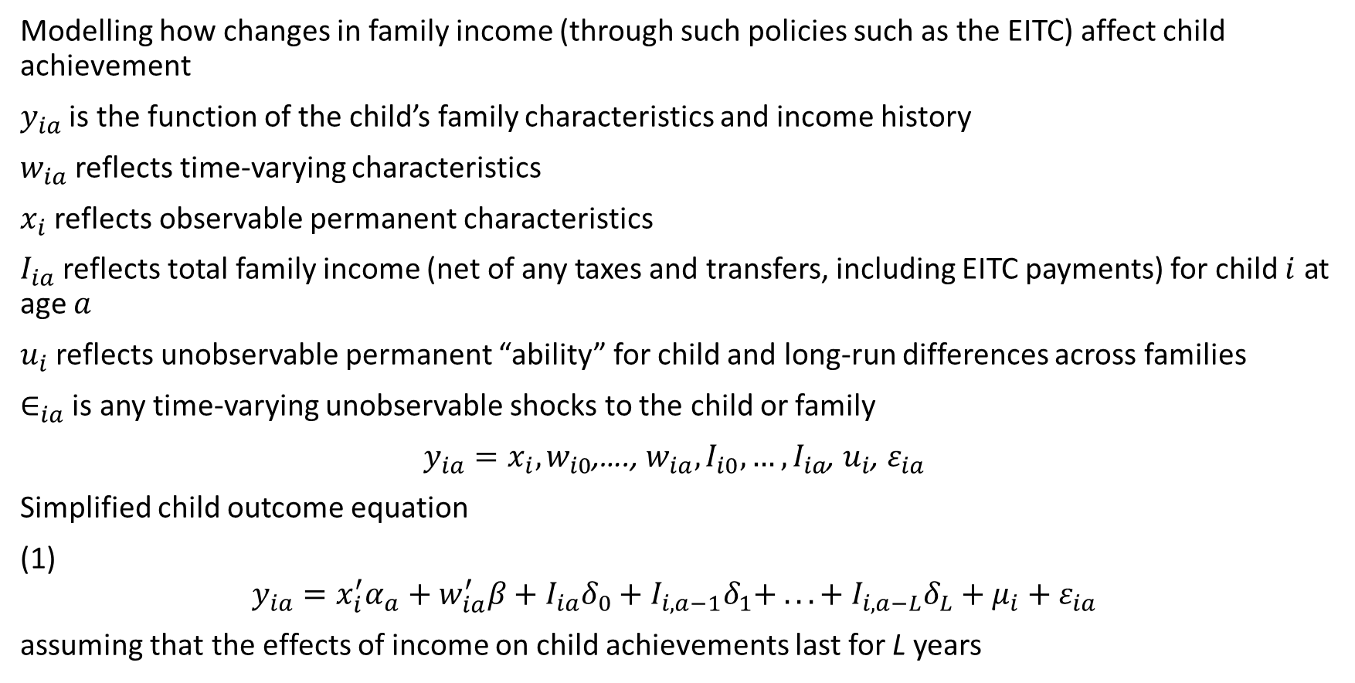
Methodology
Modelling how changes in family income (through such policies such as the EITC) affect child achievement
$y_{ia}$ is the function of the child’s family characteristics and income history
$w_{ia}$ reflects time-varying characteristics
$x_{i}$ reflects observable permanent characteristics
$I_{ia}$ reflects total family income (net of any taxes and transfers, including EITC payments) for child $i$ at age $a$
$u_{i}$ reflects unobservable permanent “ability” for child and long-run differences across families
$∈_{ia}$ is any time-varying unobservable shocks to the child or family
$y_{ia}=x_{i}, w_{i0}$,…., $w_{ia},I_{i0},…,I_{ia}$, $u_{i}$, $ε_{ia}$
Simplified child outcome equation
(1)
$$y_{ia}=x_{i}^{′}α_{a}+w_{ia}^{′}β+I_{ia}δ_{0}+I_{i,a−1}δ_{1}+ . . . + I_{i,a−L}δ_{L}+μ_{i}+ε_{ia}$$
assuming that the effects of income on child achievements last for L years

Slide 5

Methodology
Simplified child outcome equation
(1)
$$y_{ia}=x_{i}^{′}α_{a}+w_{ia}^{′}β+I_{ia}δ_{0}+I_{i,a−1}δ_{1}+ . . . + I_{i,a−L}δ_{L}+μ_{i}+ε_{ia}$$
assuming that the effects of income on child achievements last for L years
This equation abstracts from the possibility that income has different effects at different ages (effects depend only on the time elapsed when income is earned and when child achievement is measured) or at different point sin income distribution.

Slide 6
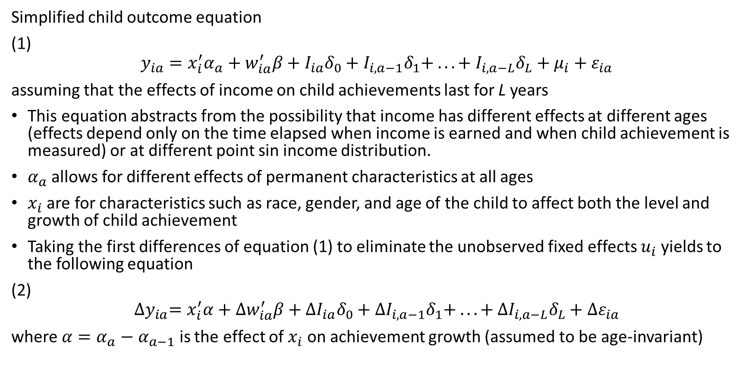
Methodology
Simplified child outcome equation
(1)
$$y_{ia}=x_{i}^{′}α_{a}+w_{ia}^{′}β+I_{ia}δ_{0}+I_{i,a−1}δ_{1}+ . . . + I_{i,a−L}δ_{L}+μ_{i}+ε_{ia}$$
assuming that the effects of income on child achievements last for L years
This equation abstracts from the possibility that income has different effects at different ages (effects depend only on the time elapsed when income is earned and when child achievement is measured) or at different point sin income distribution.
$α_{a}$ allows for different effects of permanent characteristics at all ages
$x_{i}$ are for characteristics such as race, gender, and age of the child to affect both the level and growth of child achievement
Taking the first differences of equation (1) to eliminate the unobserved fixed effects $u_{i}$ yields to the following equation
(2)
$${∆y}_{ia}=x_{i}^{′}α+{∆w}_{ia}^{′}β+{∆I}_{ia}δ_{0}+{∆I}_{i,a−1}δ_{1}+ . . . + {∆I}_{i,a−L}δ_{L}+∆ε_{ia}$$
where $α=α_{a}−α_{a−1}$ is the effect of $x_{i}$ on achievement growth (assumed to be age-invariant)

Slide 7
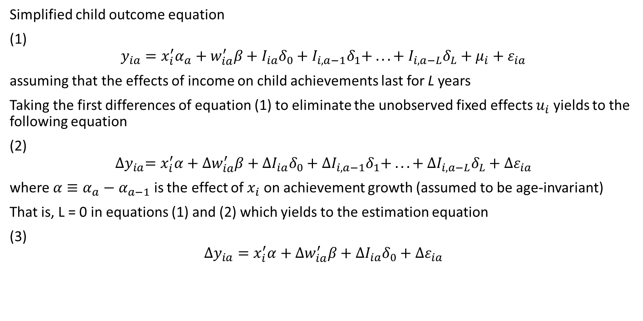
Methodology
Simplified child outcome equation
(1)
$$y_{ia}=x_{i}^{′}α_{a}+w_{ia}^{′}β+I_{ia}δ_{0}+I_{i,a−1}δ_{1}+ . . . + I_{i,a−L}δ_{L}+μ_{i}+ε_{ia}$$
assuming that the effects of income on child achievements last for L years
Taking the first differences of equation (1) to eliminate the unobserved fixed effects $u_{i}$ yields to the following equation
(2)
$${∆y}_{ia}=x_{i}^{′}α+{∆w}_{ia}^{′}β+{∆I}_{ia}δ_{0}+{∆I}_{i,a−1}δ_{1}+ . . . + {∆I}_{i,a−L}δ_{L}+∆ε_{ia}$$
where $α≡α_{a}−α_{a−1}$ is the effect of $x_{i}$ on achievement growth (assumed to be age-invariant)
That is, L = 0 in equations (1) and (2) which yields to the estimation equation
(3)
$$∆y_{ia}=x_{i}^{′}α+∆w_{ia}^{′}β+∆I_{ia}δ_{0}+∆ε_{ia}$$

Slide 8

Methodology
Estimation equation
(3)
$$∆y_{ia}=x_{i}^{′}α+∆w_{ia}^{′}β+∆I_{ia}δ_{0}+∆ε_{ia}$$
serves as the baseline and receives empirical support in their analysis. They stated that it was difficult empirically to estimate more general models that allowed prior income in every year since birth to affect child outcomes. They estimated specifications that allow one or two year lags.

Slide 9
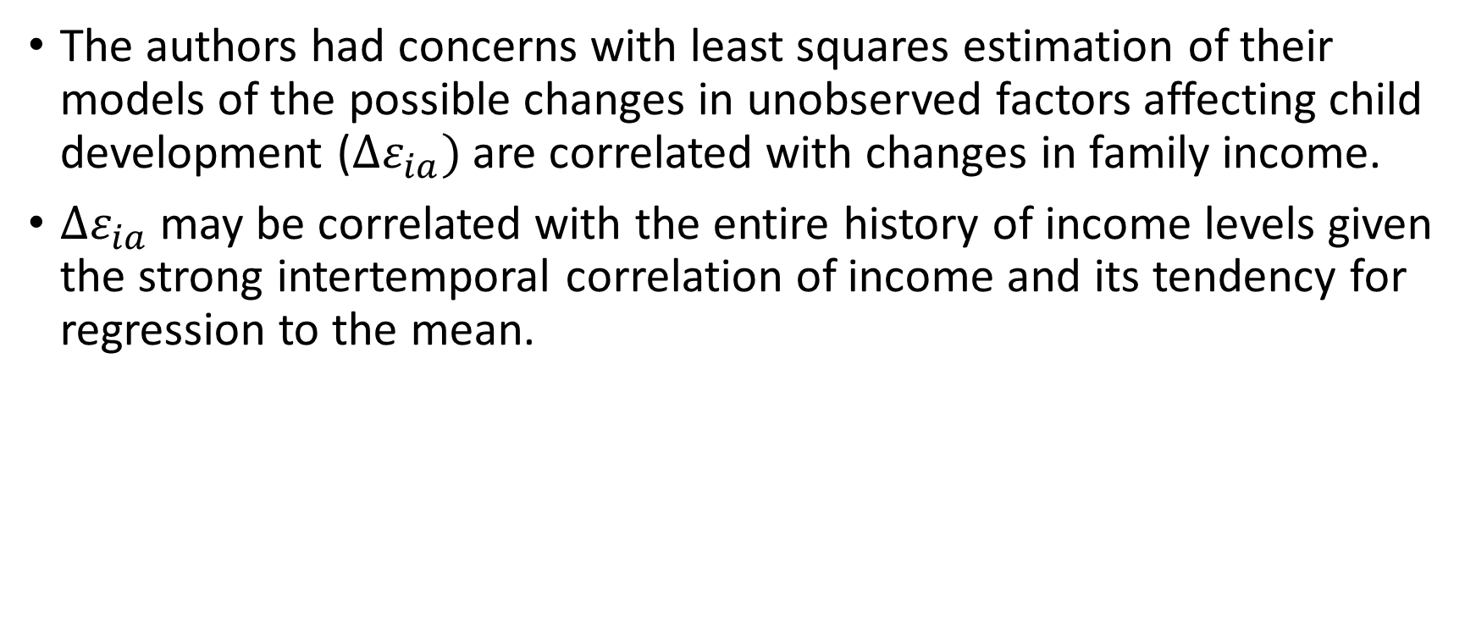
Changes in EITC to Estimate the Effects of Income
The authors had concerns with least squares estimation of their models of the possible changes in unobserved factors affecting child development ($∆ε_{ia})$ are correlated with changes in family income.
$∆ε_{ia}$ may be correlated with the entire history of income levels given the strong intertemporal correlation of income and its tendency for regression to the mean.

Slide 10
Changes in EITC to Estimate the Effects of Income
To address that problem they employed an instrumental variables (IV) estimation strategy that takes advantage of major changes in the EITC to estimate the effects of income on children.
They decided to focus on the “contemporaneous effects” model from equation 3 and take a similar approach in estimating the more general model implied in equation 2, which allowed them lasting effects of income on children.

Slide 11
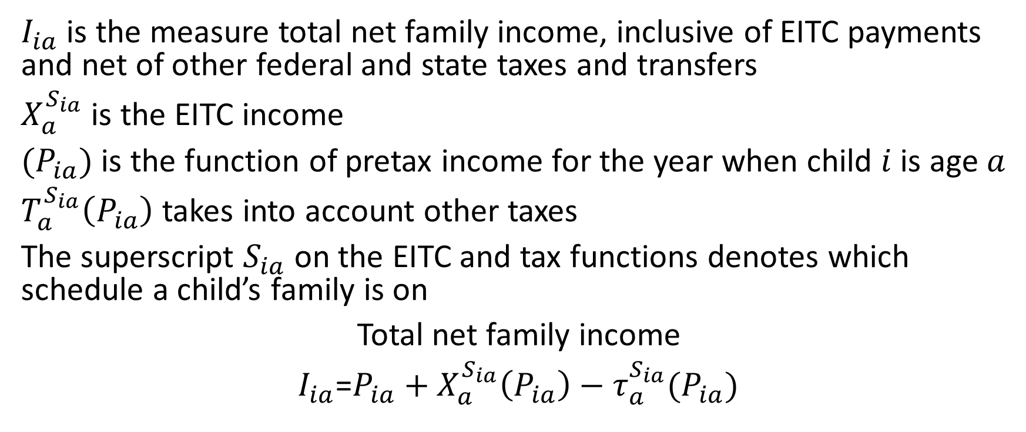
Changes in EITC to Estimate the Effects of Income
$I_{ia}$ is the measure total net family income, inclusive of EITC payments and net of other federal and state taxes and transfers
$X_{a}^{S_{ia}}$ is the EITC income
$(P_{ia})$ is the function of pretax income for the year when child $i$is age $a$
$T_{a}^{S_{ia}}\left(P_{ia}\right)$ takes into account other taxes
The superscript $S_{ia}$ on the EITC and tax functions denotes which schedule a child’s family is on
Total net family income
$I_{ia}$=$P_{ia}+X_{a}^{S_{ia}}\left(P_{ia}\right)−τ_{a}^{S_{ia}}(P_{ia})$

Slide 12
Changes in EITC to Estimate the Effects of Income
The variation in the EITC schedules over time was central to their analysis and the way EITC expansions have differentially augmented the incomes of different families.
Their IV estimation strategy assumes that changes in the EITC structure are independent of idiosyncratic family circumstances.

Slide 13
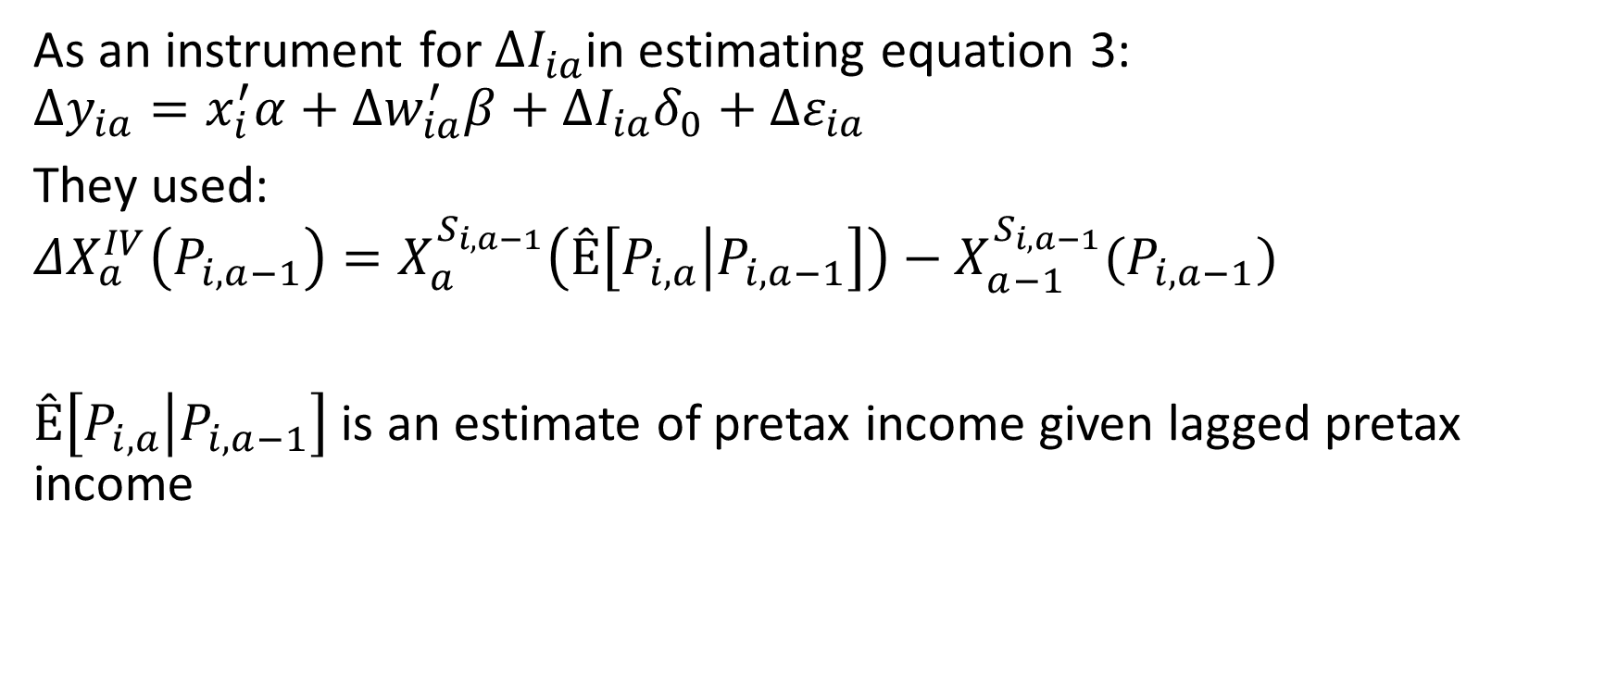
Changes in EITC to Estimate the Effects of Income
As an instrument for $ΔI_{ia}$in estimating equation 3:
$$∆y_{ia}=x_{i}^{′}α+∆w_{ia}^{′}β+∆I_{ia}δ_{0}+∆ε_{ia}$$
They used:
$$ΔX_{a}^{IV}\left(P_{i,a−1}\right)=X_{a}^{S_{i,a−1}}\left(Ê\left[P_{i,a} | P_{i,a−1}\right]\right)−X_{a−1}^{S_{i,a−1}}(P_{i,a−1})$$
$Ê\left[P_{i,a} | P_{i,a−1}\right]$ is an estimate of pretax income given lagged pretax income

Slide 14
Data - Income
EITC
Earned income
Unearned income
Nontaxable income
EITC= Earned Income Tax Credit

Slide 15
Data - Household Factors
Children of the NLSY
Main NLSY sample of mothers
NLSY = National Longitudinal Surveys

Slide 16
Data - Household Factors
The NLSY collects a rich set of variables for both children and mothers repeatedly over time, allowing us to estimate models with child fixed effects.
NLSY are ideal for studying the effects of family income on children for
several reasons:
Can link children to their mothers
Can follow families over time
The NLSY contains repeated measures of various child outcomes and comprehensive measures of family income
The NLSY oversamples minority families, which provides a larger sample of families eligible for the EITC
NLSY = National Longitudinal Surveys

Slide 17
Data - Test Scores
Peabody Individual Achievement Tests (PIAT)
Scholastic achievement in Math
Scholastic achievement in Reading

Slide 18
Normalize Test Scores
They created a normalized test scores with a mean of zero and a standard deviation of one based on the random sample of test takers (i.e., excluding the poor, military, and minority oversamples).
Also create a combined math-reading score, which takes the average of our normalized math and reading scores.

Slide 19
Normalize Test Scores
%r
piat <- read.csv('piat.csv', header=TRUE,sep = ",")
testscores<- subset(piat[c(piat$reading,piat$math)])
testscores_normalized <- as.data.frame(lapply(testscores, normalize))
Pseudo code created in Zeppelin

Slide 20
Sum Reading and Math
%r
piat <- read.csv('piat.csv', header=TRUE,sep = ",")
testscores<- subset(piat[c(piat$reading,piat$math)])
testscores_normalized <- as.data.frame(lapply(testscores, normalize))
reading <- as.numeric(testscores_normalized$col1)
math <- as.numeric(testscores_normalized$col2)
reading_math <- testscores_normalized$col1 + testscores_normalized$col2
Pseudo code created in Zeppelin

