Slide 1
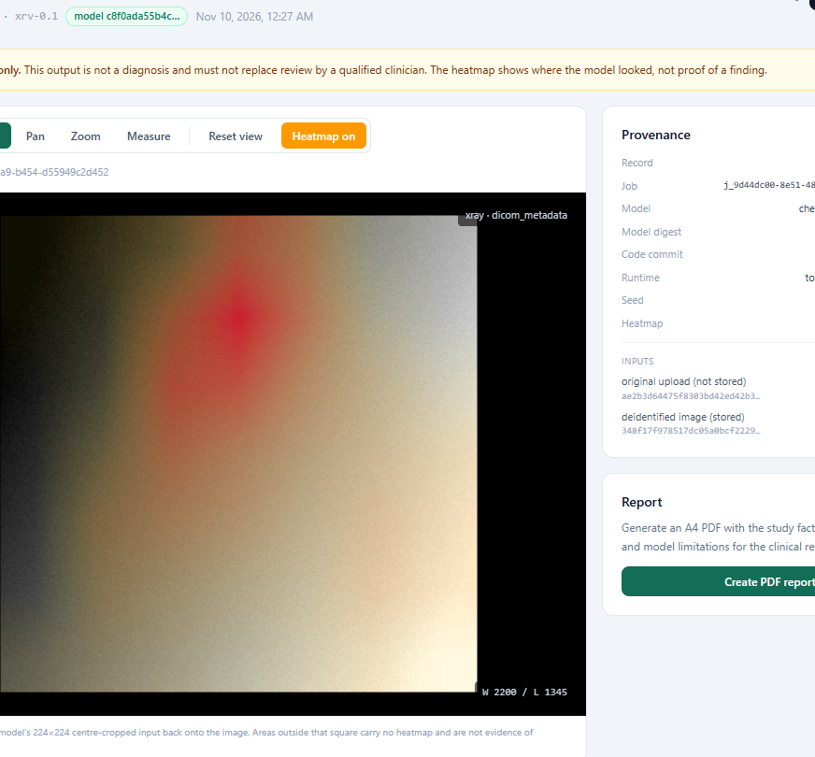

MBARARA UNIVERSITY OF SCIENCE AND TECHNOLOGY
MIAP
Multimodal Image Analysis Pipeline
De-identified images in. Traceable decision support out.
chest X-ray · mammography · limb X-ray
offline · CPU-only · no GPU
Decision support only — not a diagnosis, never a TB or cancer screen
Software demonstration · November 2026 · FastAPI + React prototype for low-resource clinical settings
Live result view: Grad-CAM heatmap with provenance panel (screenshot from the running app)
MIAP · Medical Image AI Pipeline · 1 / 15

Slide 2
THE PROBLEM
Radiology AI that runs where the radiologists aren't
0 GPUs
0 internet
665 ms
CPU-only PyTorch. One in-process worker runs inference so a sub-second model never blocks the API.
The demo runs fully offline. Weights are fetched once, then re-verified by SHA-256 per host.
Mean chest inference on CPU (DenseNet-121, 224×224); p95 689 ms, peak RSS 852 MB — M0 gate, 2026-11-09.
MIAP is built for low-resource hospitals: one commodity machine, three roles (clinician, researcher, administrator), and one explicit promise — every output says decision support, not a diagnosis. Scores are qualitative and uncalibrated; the TB notice travels with every chest result.
No GPU · no Docker · no network at runtime · SQLite on a single node
MIAP · Medical Image AI Pipeline · 2 / 15

Slide 3
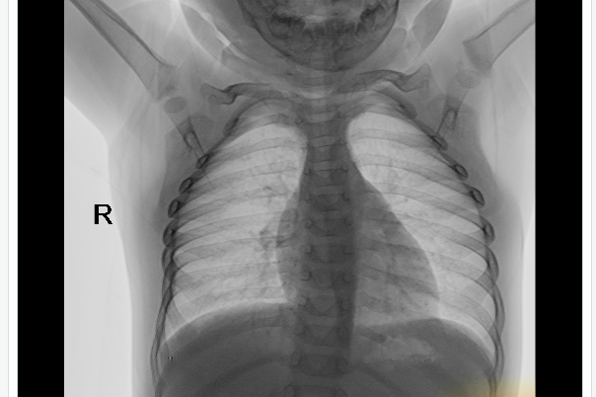
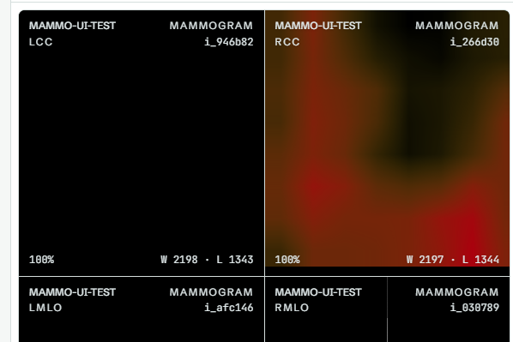
CAPABILITIES
Three image paths, one pipeline
siglip_bone 0.1
weights: google/siglip2-base-patch16-224
task: zero-shot normal vs abnormal
cam: last ViT block · 224×224
hip/pelvis: degraded (experimental)
Chest X-ray
Mammography
Limb X-ray
8-finding classification — lung opacity, effusion, pneumonia, consolidation, mass — with a Grad-CAM overlay showing where the model looked.
Model: chest_densenet121 · TorchXRayVision · Apache-2.0
Four-view review (CC + MLO per breast) with linked zoom/pan, and BI-RADS-style density A–D — one job per view, highest category per breast.
Model: monai_density · MONAI Model Zoo · Apache-2.0
Zero-shot bone review for limb radiographs — no fine-tuned fracture model needed. Hip and pelvis studies are flagged degraded and labelled experimental.
Model: siglip_bone · SigLIP 2 (Google) · Apache-2.0
MIAP · Medical Image AI Pipeline · 3 / 15

Slide 4
SYSTEM OVERVIEW
One process, three sinks
Browser — React 19 + Cornerstone3D viewer
one shared WebGL rendering engine, custom miap: image loader
FastAPI modular monolith — /api/v1/*
auth
patients
cases
ingestion
de-id (PS3.15)
routing
inference + worker
results (immutable)
reviews
reporting (PDF)
audit (hash chain)
models + approvals
In-process CPU worker
asyncio queue → ThreadPoolExecutor(1); interrupted jobs re-queued on startup
SQLite (WAL)
users, patients, cases, jobs, results, reviews, audit chain
Content-addressed blobs
SHA-256 of stored bytes + derived heatmaps (.npy/.png)
A4 PDF reports
clinician · researcher · governance audiences
No GPU · no Docker · no internet at runtime — one process serves the API and runs inference
MIAP · Medical Image AI Pipeline · 4 / 15

Slide 5
END-TO-END WORKFLOW
Anatomy of a study — seven steps
Create case
Upload + de-id
View
Submit analysis
Worker inference
Review findings
PDF report
Pseudonym + consent basis (clinical / research); an audit event is appended.
Size limit, type sniffing, PS3.15 de-identification, SHA-256 blob store; original digest recorded, bytes discarded.
Server decodes DICOM pixels; JPEG / JPEG-2000 transfers work because the browser never decodes.
Idempotency-Key required; routing maps capability bucket → approved model; HTTP 202.
Registry preprocessing profile → predict → Grad-CAM → immutable result document + provenance.
Confirm or dismiss each finding; notes are encrypted and readable only by their owner.
Audience-aware A4 PDF rendered from the stored, canonical JSON result.
Mammograms queue one job per view — never a mosaic — and the exam summary takes the highest density per breast. If no approved model covers a capability, the UI disables the button and the API answers 409 analysis_not_supported — the failure is explained, not silent.
Every stored result names its model version, input digest, preprocessing profile and CAM layer — reproducibility is a data field, not a promise
MIAP · Medical Image AI Pipeline · 5 / 15

Slide 6
INGESTION & PRIVACY
De-identified before anything is stored
1 · Upload — size limit + type sniffing
the server checks the real bytes, never the file extension
What that guarantees
No image→person path: the UID remapping key is deliberately not retained.
De-identification happens before storage — always, by construction, not by policy.
Blobs are immutable; a swapped weights or image file fails the digest check at load.
Every upload records a de-identification receipt in the hash-chained audit log.
Administrators are refused image bytes on every endpoint — 403, verified live 2026-11-10.
2 · De-identify — DICOM PS3.15 basic profile
patient tags removed or replaced, UIDs remapped, raster EXIF stripped
3 · Validate pixels
decode check before storage; failures return 422, never a partial store
4 · Store — content-addressed blob
SHA-256 of the stored (de-identified) bytes; written atomically; immutable
5 · Receipt — original digest recorded, bytes discarded
the original upload's digest is kept for comparison; the original bytes are never retained
MIAP · Medical Image AI Pipeline · 6 / 15

Slide 7
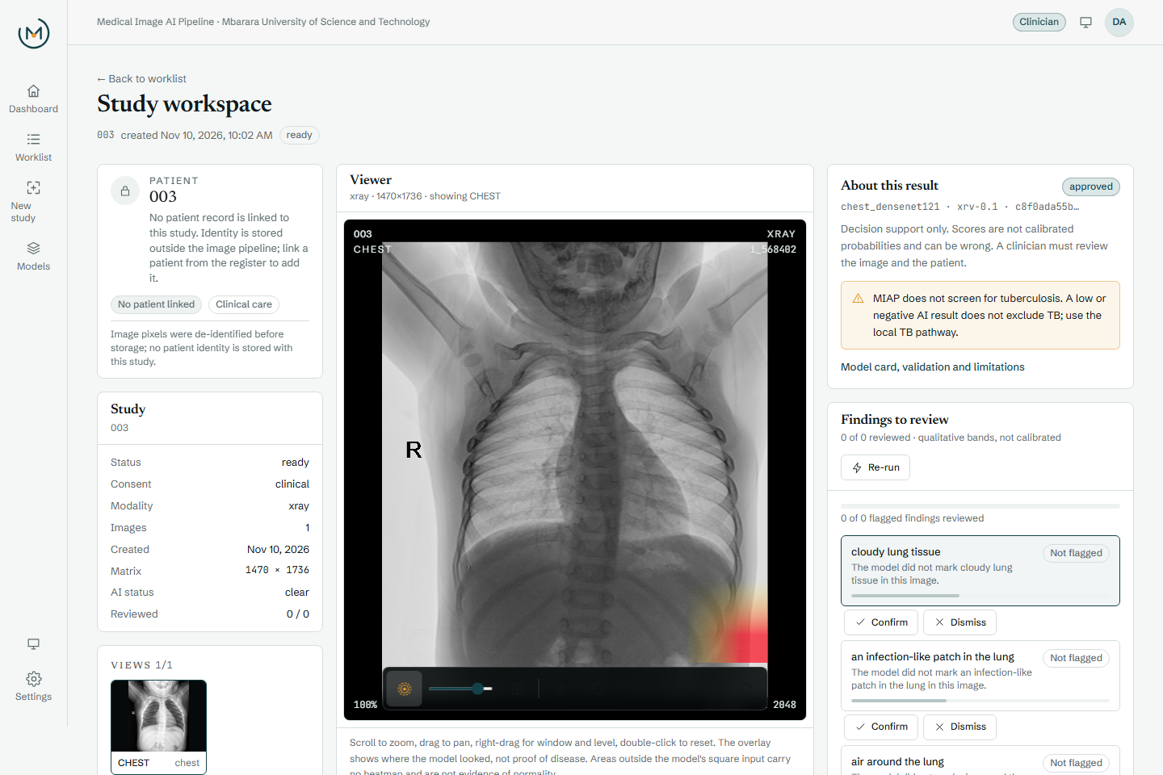
THE INTERFACE
The study workspace
One screen per study: everything a clinician needs to decide — nothing they don't.
Patient banner — the pseudonym is up front; identity sits in a separate encrypted record, visible only to the case owner.
Viewer — wheel zoom, drag pan, right-drag window/level; M-mode measurement; before/after split; H toggles the overlay.
Findings — plain-language bands (worth reviewing / not flagged) with confirm or dismiss and an encrypted note.
Trust strip — uncalibrated scores, the TB notice and the model state travel with every result.
Report — the PDF action comes last, after the findings have been reviewed.
Clinician workspace — chest study with Grad-CAM overlay (live app screenshot)
MIAP · Medical Image AI Pipeline · 7 / 15

Slide 8
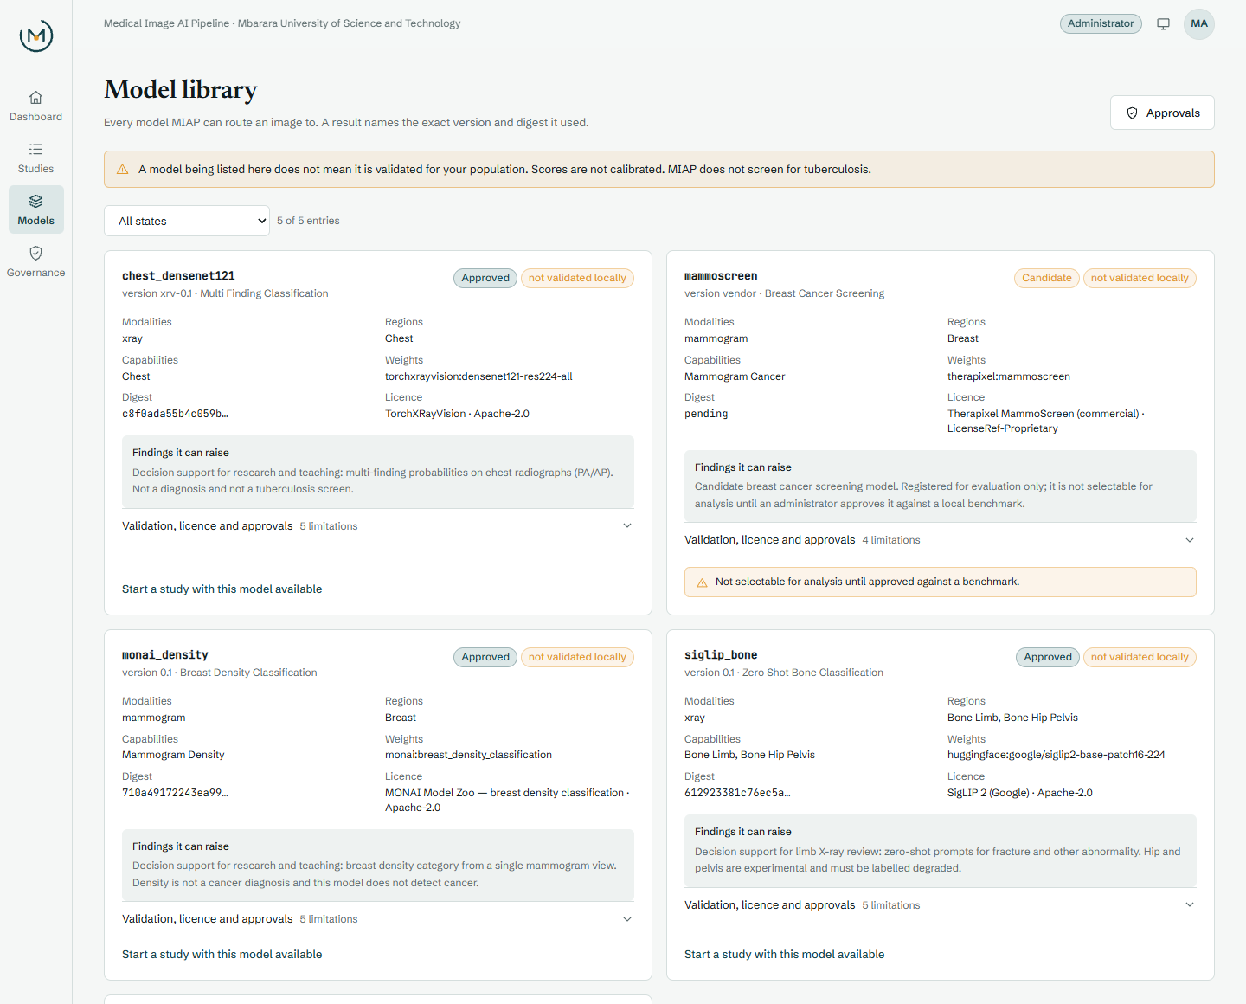
MODEL GOVERNANCE
A model library with teeth
Declarative registry — ml/registry.json carries digest, task, capabilities, SPDX licence with access date, source weights URL + SHA-256 and a benchmark path; prose model cards merge in at load.
Gated lifecycle — candidate → bench_model.py measures latency, peak RSS and CAM sanity through the real engine → an administrator approves against the benchmark digest; the decision survives re-seeding.
Load-time enforcement — the engine factory re-checks the digest; a swapped file fails with 409 model_digest_mismatch. Candidates stay visible but unselectable.
Live today — 5 entries: chest_densenet121, monai_density and siglip_bone approved; stub_classifier for demos; MammoScreen (Therapixel, proprietary) remains an unselectable candidate.
Model library — five entries with approval states, licences and digests (administrator view)
MIAP · Medical Image AI Pipeline · 8 / 15

Slide 9
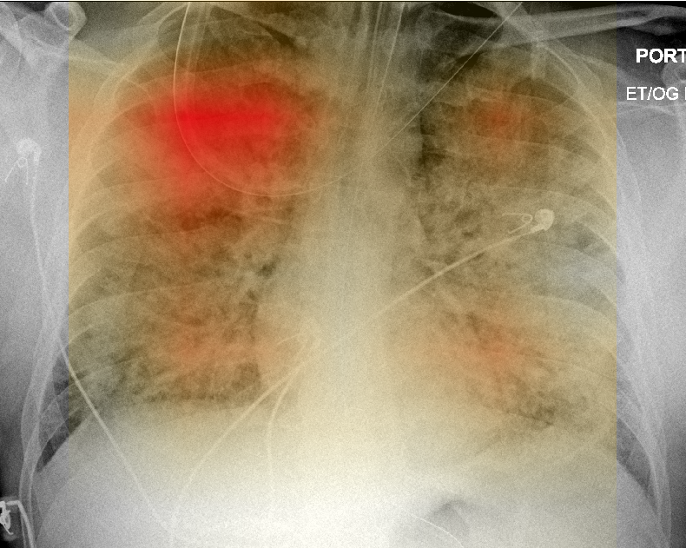
EXPLAINABILITY
Grad-CAM: where the model looked
How it works
Gradients of the predicted class flow back through the last convolutional layer into a 224×224 (chest, SigLIP) or 299×299 (density) map. The viewer maps the model's centre-crop square back through the image origin, direction and spacing, and draws it on a 2D canvas over the WebGL pane. Per-finding CAMs are computed lazily and cached.
Measured, not assumed
≈0.2%
rendered hotspot vs stored .npy argmax, as a fraction of image width
100→777%
zoom range across which the overlay stays pixel-registered with the image
Grad-CAM composited onto the de-identified chest image in the generated PDF report
−22.2%
Lung Opacity score when the CAM hotspot is masked: 0.869 → 0.677 (occlusion sanity)
MIAP · Medical Image AI Pipeline · 9 / 15

Slide 10
PERFORMANCE
Fast enough on a CPU
665 ms
689 ms
0.109 s
0.331 s
chest mean inference, CPU-only
DenseNet-121 · 224×224 · M0 hardware gate, 2026-11-09
chest p95 latency
12-image benchmark run · peak RSS 852 MB
MONAI density mean per view
2.652 s first result incl. CAM · peak RSS 465 MB
SigLIP bone mean per image
3.429 s first result incl. CAM · peak RSS 2.08 GB
Mean inference per model, seconds (bars proportional)
chest_densenet121
0.665
Measured by ml/benchmark/bench_model.py through the real engine, preprocessing profile and CAM gates.
Every gate passed; the benchmark digest is stored with the administrator's approval.
siglip_bone 0.1
0.331
monai_density 0.1
0.109
The benchmark proves speed, memory and CAM sanity only — no local clinical validation or accuracy estimate is claimed
MIAP · Medical Image AI Pipeline · 10 / 15

Slide 11
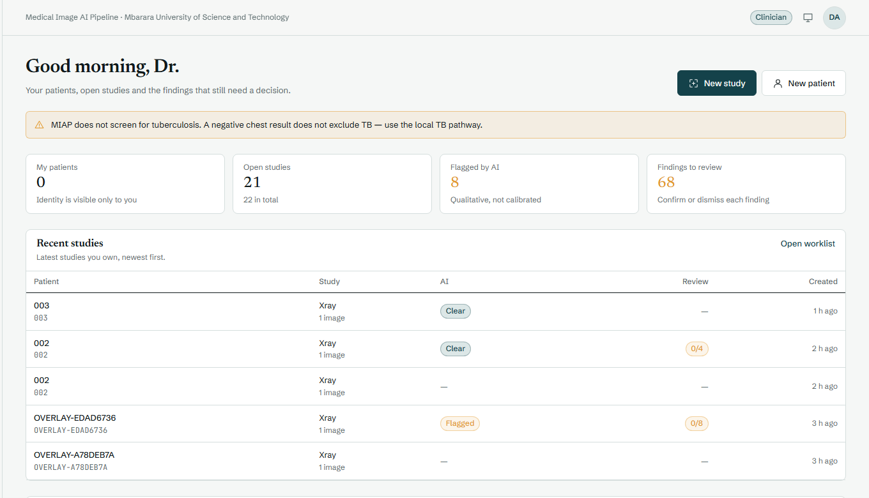
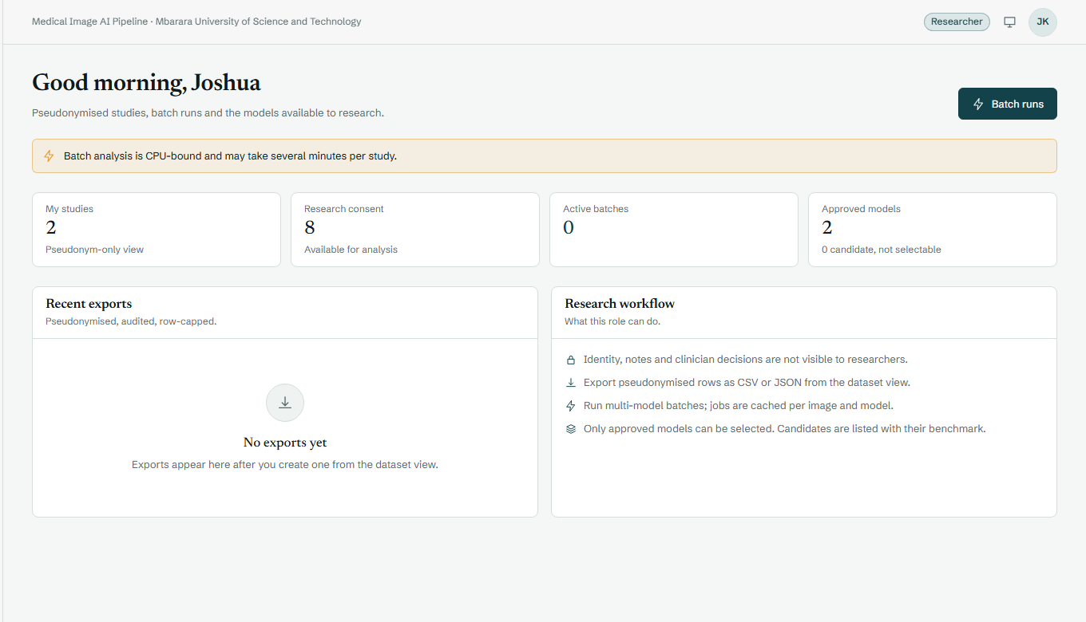
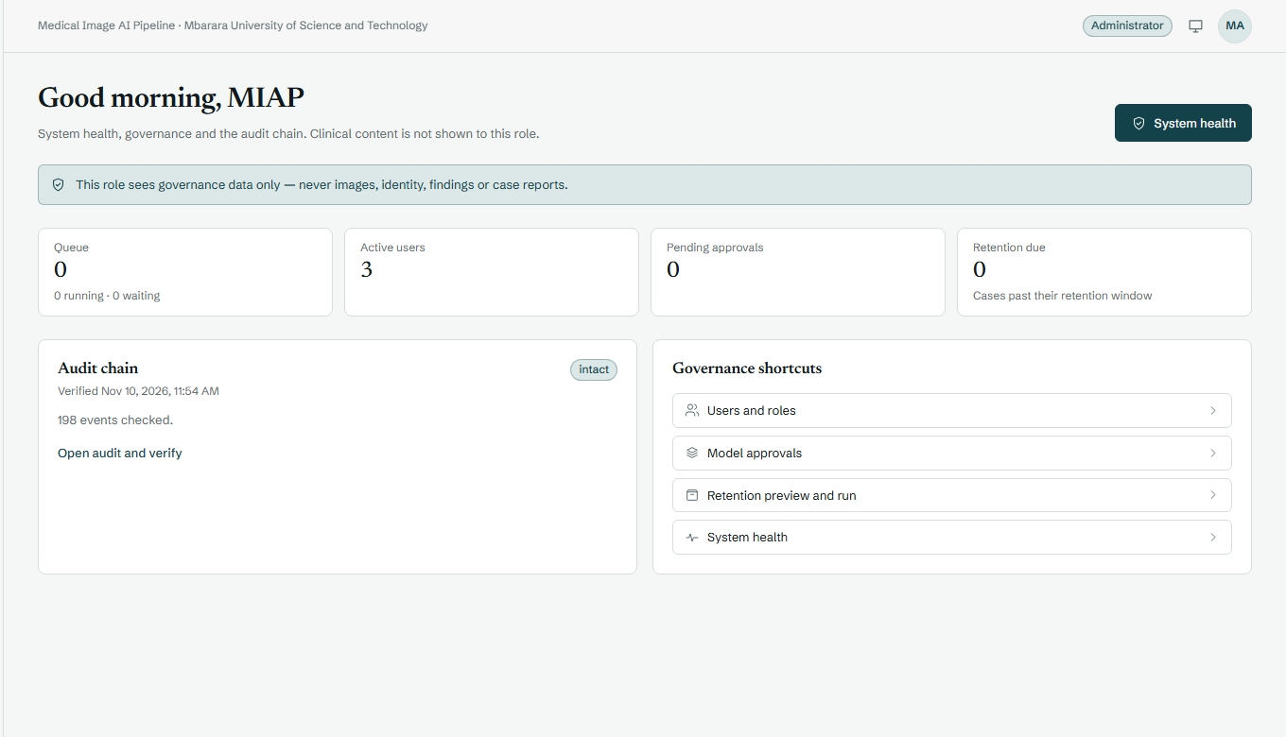
ROLES
One system, three roles
Clinician
Researcher
Administrator
Worklist with AI flags, own patients and the findings awaiting a decision — with the TB notice on every dashboard.
Datasets, batch analysis and model state — plus pseudonymised export with scores, thresholds and provenance.
Users, model approvals, retention and the audit chain — governance that never touches pixels or identity.
Server-enforced, not just UI-hidden: the interface renders only what the API allows. Administrators requesting image pixels get 403 images_forbidden, and identity reads fail closed — both verified against the running app on 2026-11-10.
MIAP · Medical Image AI Pipeline · 11 / 15

Slide 12
REPORTING
The right PDF for the reader
Clinician
Researcher
Governance
Patient identity
owner only
—
—
Plain-language bands
yes
yes
—
Raw scores + thresholds
yes
yes
—
Review decisions + notes
yes
counts only
—
Provenance + model / benchmark digests
yes
yes
yes
Audit chain + approvals
—
—
yes
included
partial / scoped
excluded
The stored JSON result stays canonical — each PDF is a rendering for its reader, and every download is itself an audited event.
MIAP · Medical Image AI Pipeline · 12 / 15

Slide 13
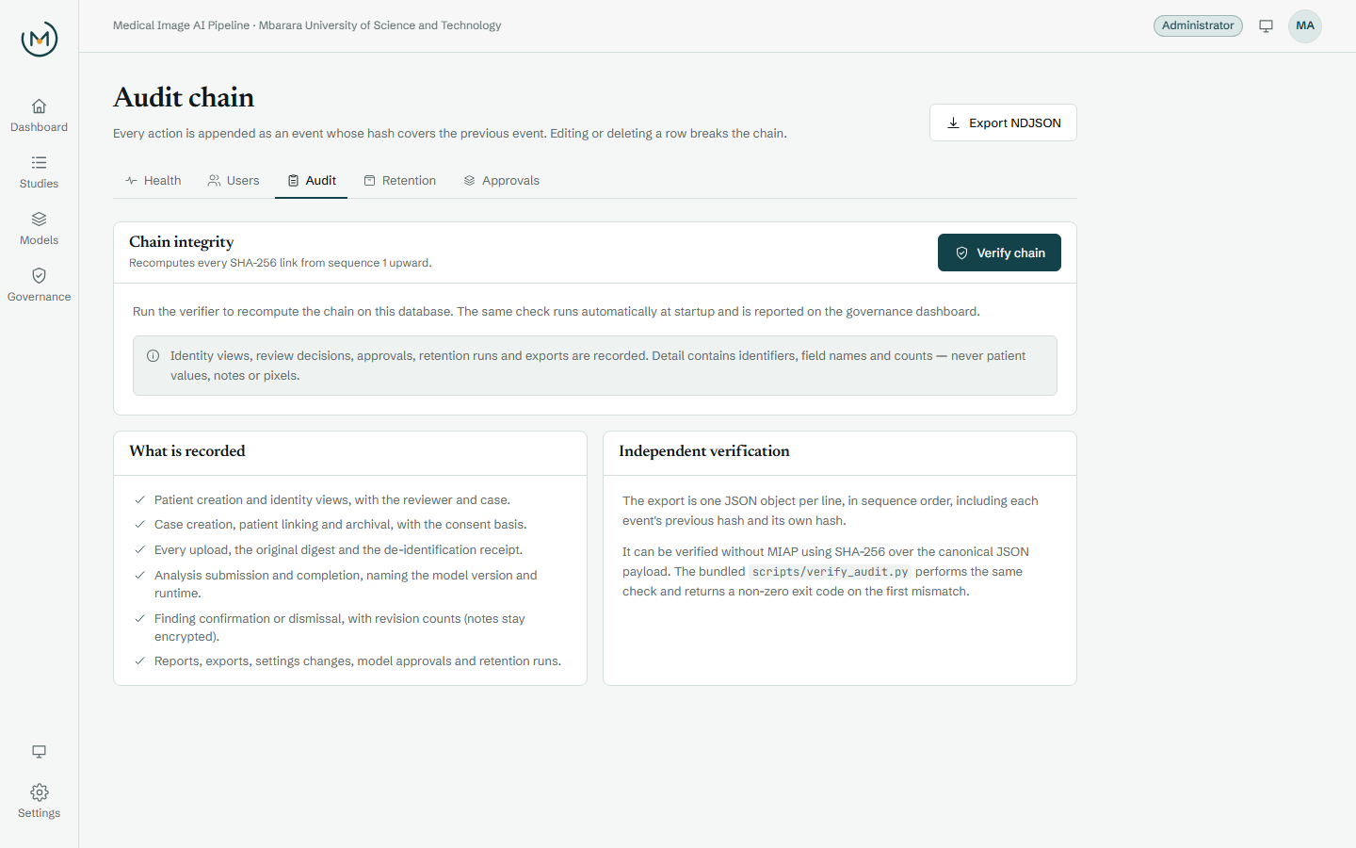
GOVERNANCE
Every action leaves a hash
Append-only, hash-chained — and verifiable without MIAP itself.
Chained by construction — every login, identity read, upload, analysis, review, report and approval appends an event that hashes the previous one; editing a row breaks the chain.
Fail-closed identity reads — the audit event commits before the payload returns; a failed write means a 503, not a silent read.
Verified live — 345 events, chain intact; export is one NDJSON (45,407 bytes in the final demo).
Independent check — verify_audit.py recomputes the export offline; a tampered copy was rejected at seq 3.
Honest limit — tamper-evident, not tamper-proof: DB-file write access could replace the chain.
Administrator audit page — chain integrity check and NDJSON export (live app screenshot)
MIAP · Medical Image AI Pipeline · 13 / 15

Slide 14
VERIFICATION
Evidence, not promises
267
0
backend tests passed
pytest suite in ~40 s on the final cycle — auth, RBAC, de-id, migrations, crypto, routing, engines, exam summary, batch idempotency.
console errors, clean build
Frontend typecheck clean, production build succeeds; headless checks at 1440 / 768 / 360 px with no computed font below 12 px.
2×
6 / 6
interrupted, still completed
Crash recovery: the server was killed mid-job; on restart the worker re-queued it and the job completed (states running → completed, attempts 2).
demo steps green, end to end
Browser demo: sign-in → upload + de-id → analysis → heatmap → 2-page PDF (37,047 bytes) → admin verifies the 87-event audit; admin pixels → 403.
Every claim traces to a command or artefact — see docs/MILESTONES.md and the dated evidence in docs/evidence/
MIAP · Medical Image AI Pipeline · 14 / 15

Slide 15
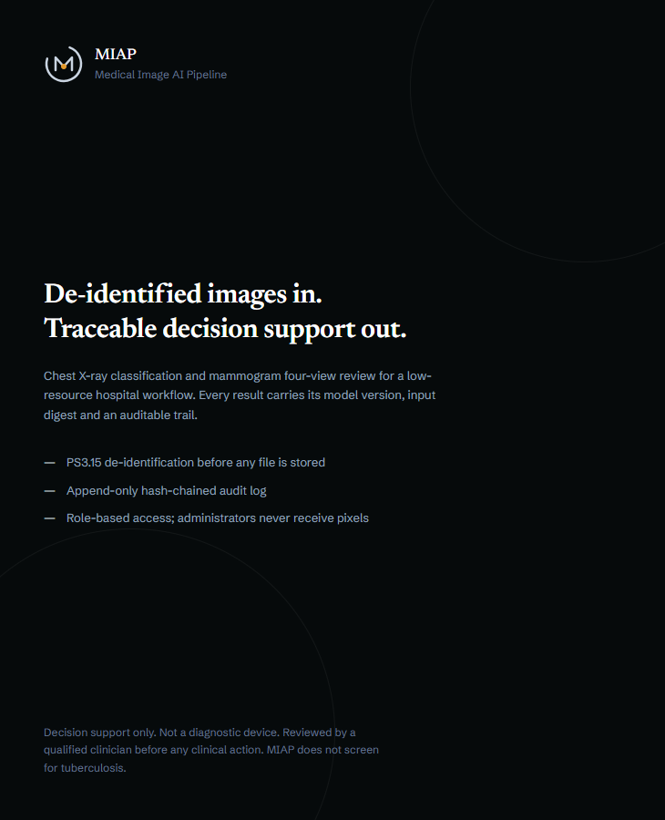
CLOSING
Decision support, done defensibly.
What MIAP is — de-identified ingestion, three image paths, explainable overlays, audience-aware reports and a verifiable audit trail, on one offline machine.
What it is not — a diagnostic device, a TB screen, a cancer screen or calibrated risk. Scores are qualitative and the models are not validated on Ugandan patients.
What comes next — local validation and calibration, then explicit governance decisions on models such as MammoScreen.
Mbarara University of Science and Technology · November 2026
Sign-in screen: the promise MIAP is built around
MIAP · Medical Image AI Pipeline · 15 / 15

