Slide 1

we burned 48 gpu hours training on 96 million tokens
alosh denny
superfloat · rootconf 2026
Notes:
Portrait slot is yours. 20 to 23 minutes of talking, 5 minutes of questions. The dry run was 18, so this version has room.

Slide 2
this is a talk about failure. mostly mine.

Slide 3
but it starts somewhere else entirely.

Slide 4
i build a number format, and a chip to run it on. before anyone commits silicon, somebody has to answer one question.

Slide 5
how few bits does a model actually need?
Notes:
This is the origin. The whole devops disaster happens downstream of trying to answer this. Leading here was the reviewers' main structural ask.

Slide 6

quantisation
compressing a model so it uses less memory, less power, and generates tokens faster.

Slide 7
it is rounding. every number in the model, written with fewer digits. the model gets smaller and cheaper. the question is what it forgets.
Notes:
The layman's analogy prakhar asked for. Rounding is the right one because it is literally true, not a metaphor.

Slide 8
and four people have to agree to do it.

Slide 9




cost. which gpu tier you are willing to pay for.
platform. runpod, modal, or the cloud you already have.
quality. how far you compress before it stops being smart.
hardware. nvidia, or the faster new silicon with no community yet.
Notes:
Your four decisions, in your words from the dry run. Groq and AMD are the 'faster, newer, nobody to ask when it breaks' option.

Slide 10
in most organisations you can settle two of those. maybe three. never four.

Slide 11
8 bits
the floor. compress past it and the model stops being intelligent
Notes:
From roughly 800 archived runs.

Slide 12
at six bits, a 4b model drops to 63. at eight it is level with sixteen.

Slide 13
to find that out, you train a lot of models.

Slide 14
878 runs. four platforms in a year. none of them on hardware i own.

Slide 15
laptop
→
control plane
→
gpu box
+
volume
where i type
schedules the work
exists for one job
outlives the job
four things. three of them are somebody else's.
Notes:
Front-loaded architecture diagram, which Rolland asked for. Two of today's failures come from getting the laptop wrong and the volume wrong.

Slide 16



modal. a python function that runs on an h100. pay by the second. the container dies at 24 hours, always.
runpod. a machine you rent by the hour. yours until you stop paying. keeps nothing unless you attach a disk.
before those, a gpu under my desk and a shared lab machine.
Notes:
Bharadwaj and Sohham both asked for this: introduce the platforms before the story that depends on them.

Slide 17
llama 3.2, 1b parameters, from scratch. a decoder-only language model, and none of what follows is about language.

Slide 18
shards
loader
1b
ckpt
→
→
→
the corpus, in pieces
reads what it can see
quantisation-aware
back onto the volume
one loop. the first box is the one that matters today.

Slide 19
the corpus does not arrive all at once. it arrives in boxes. ten percent, twenty, thirty.
Notes:
Plant this. It is the entire bug, two minutes before the bug.

Slide 20
2048
16
1 × h100
~6 days
sequence length
batch × accumulation
one gpu, rented by the second
if nothing goes wrong
the run, in four numbers
Notes:
Entity breakup rather than a list. The last box is the one that collides with the 24 hour ceiling on the next slide.

Slide 21



pytorch 2.8. cuda 12.8.
modal. h100 container, shared volume, a secret for the gated tokenizer.
huggingface. datasets and the tokenizer.
one script. checkpoints on sigterm, resumes from latest.
Notes:
The stack. That last line is the only reason any of the later failures were survivable.

Slide 22
leg 1
→
ckpt
→
leg 2
→
…
runs 23 hours
saved on sigterm
resumes, spawns leg 3
until the budget is spent
six days does not fit in a 24 hour container. so it runs in legs.
Notes:
The chain is the thing that makes a six day run possible on a platform that kills every container at 24 hours.

Slide 23
so here's the run that cost the most.

Slide 24
hour 1
hour 2
hour 6
hour 24
prepare starts unpacking the corpus
training starts. no errors anywhere
the loss is climbing. normal, early on. i leave it
it still has not come down. not normal
one day, and the only thing that went wrong never raised anything
Notes:
Progress over time, as a timeline rather than three sentences. Hour 6 is where I had the chance and missed it; hour 24 is the filled dot.

Slide 25
0.95
5.6
vs.
train loss
validation loss
Notes:
Let it sit. Ask the room what that gap means before you say it.

Slide 26
so i started guessing. in order.

Slide 27
guess one
the eval split is noisy
noise does not climb in a straight line for eighteen hours
guess two
it is overfitting
a 1b model does not overfit a corpus this size in a day
guess three
count the tokens it actually saw
took thirty seconds. should have been first
two hypotheses, then arithmetic
Notes:
The elimination ladder replaces four text slides. Walk the two dead rungs quickly; the third is the point and it leads straight into the next slide. The honest line is that guess three cost nothing and should have come first.

Slide 28


read the container logs by hand
pasted them into a chat window and argued with it
no dashboard, no trace, no alert. nothing was watching for this
Notes:
Rolland asked how much of the debugging was automated. The honest answer is none of it. Say that plainly; it is the most relatable slide in the deck.

Slide 29
and then i did the arithmetic.

Slide 30
steps
2048
16
96m
×
×
=
from the log
sequence
batch × accum
tokens. that is all it saw
four numbers already in the log. i had never multiplied them.
Notes:
The pivot. Everything before was hypothesis. This was arithmetic and it took thirty seconds.

Slide 31
10%
90%
vs.
of the corpus it trained on
it never saw at all

Slide 32
the first shard, thirty times over. that is not pretraining, that is memorisation.

Slide 33
which is why it looked brilliant on training data and useless on anything real.

Slide 34
so why did it only ever see the first box?

Slide 35
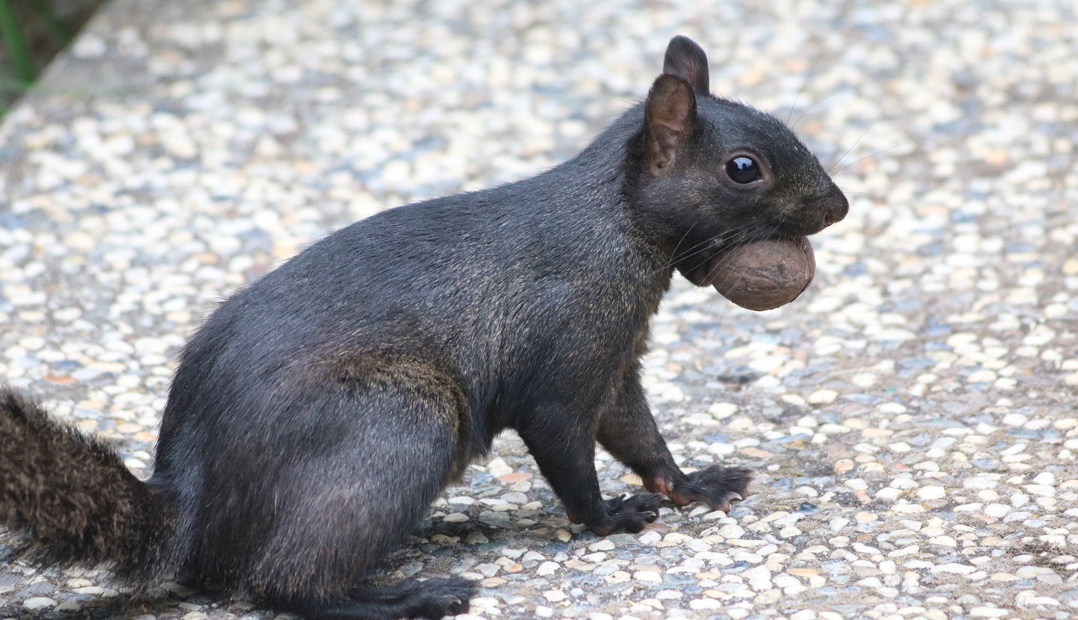
a cache. nobody called it one.
Notes:
Photo credit: Grendelkhan, Wikimedia Commons, CC BY-SA 3.0. Share-alike applies if this deck is published.

Slide 36
prepare
volume
train ×2
→
→
still unpacking boxes
one box visible, so far
looked once, never again
and both trainers were fighting over the same box

Slide 37
a container only sees what another container wrote after it asks again.

Slide 38
i had never told the trainer the data had finished loading.

Slide 39
reload
assert
chain
+
+
ask the volume again
refuse to start on a partial corpus
survive the 24h ceiling
the whole fix is three lines and a guard clause

Slide 40
48
h100 hours. two containers, one full day each.

Slide 41
and none of this is special to me.

Slide 42

the foreground launch. my laptop's dns killed four remote jobs.
Notes:
Photo credit: Shixart1985, Wikimedia Commons, CC BY 2.0. The platform's default mode ties the remote job's lifetime to the local client.

Slide 43
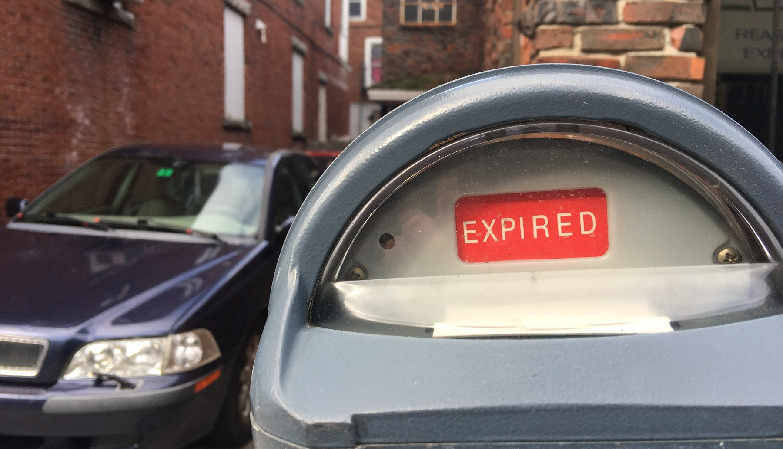
a twenty four hour cap. the run needed six days.
Notes:
Photo: MarkBuckawicki, Wikimedia Commons, CC0.

Slide 44
that cap is also the only reason this cost 48 hours and not a fortnight of credits.
Notes:
Your line from the dry run, and it lands. The constraint that annoyed you is the one that stopped the bleeding.

Slide 45
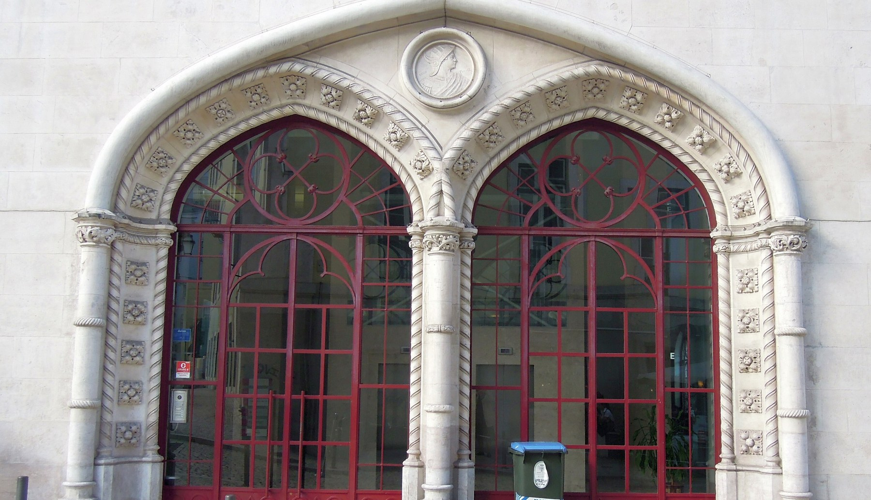
two volumes, one name. ten very bad minutes.
Notes:
Photo credit: Guldem Ustun, Wikimedia Commons, CC BY 2.0.

Slide 46
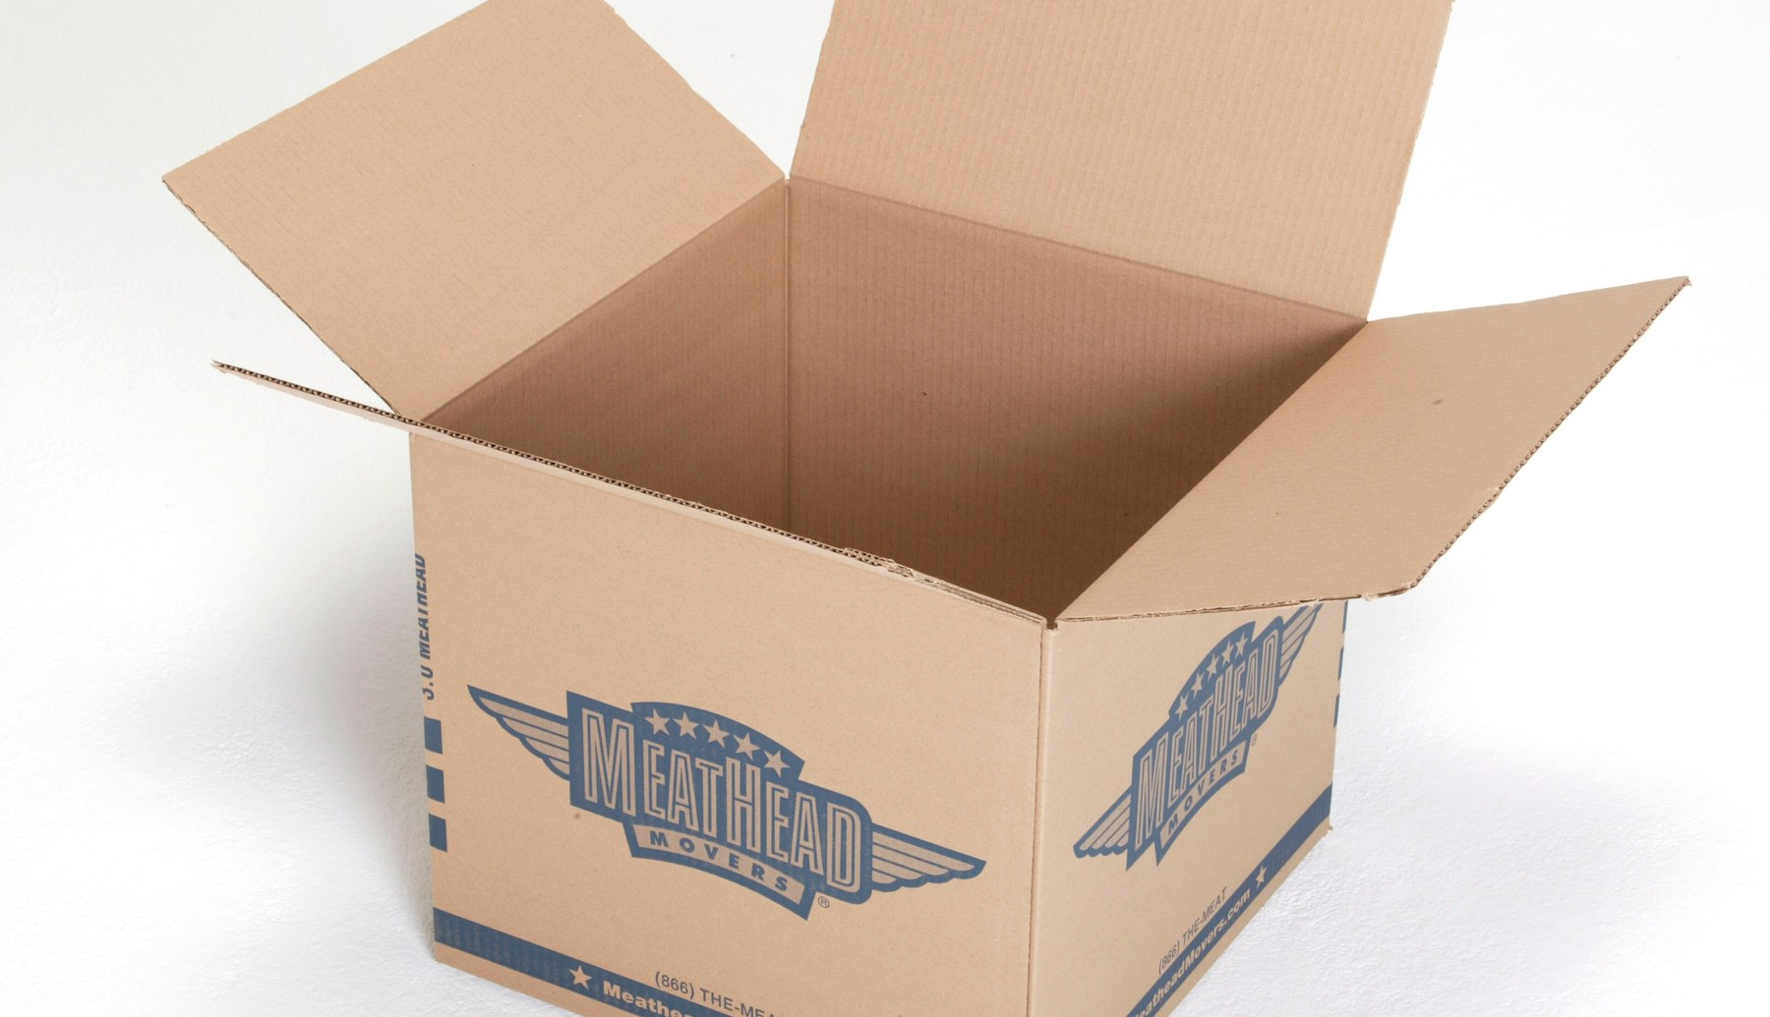
a zero sized volume. the models expired like they never existed.
Notes:
Photo credit: Meathead Movers, Wikimedia Commons, CC BY-SA 2.0. This one was runpod. No checkpoint, no disk, nothing at the end of it.

Slide 47
every one of these is somebody's postmortem this quarter. they are not exotic. they are the default.
Notes:
Sohham's note: frame these as common industry failures, not as rookie mistakes you happened to make.

Slide 48



shared state. who guarantees the input is complete before a consumer reads it?
lifetime. what keeps the remote work alive, and for how long?
ownership. whose job was it to notice?
Notes:
Three shapes. Every failure in the talk is one of them. Scale this up: a month-long run at a frontier lab fails the same way, with four more zeros on it.

Slide 49
hence, four checks. every run, no exceptions.

Slide 50



smoke test. one tiny pass end to end, on a cpu, before anything paid starts.
hash the data. if the hash matches, all of it loaded. if it does not, do not start.
checkpoint. every couple of hours, and push a copy to the hub.
list the tiers. take the cheaper gpu. the same mistake on it is a cheaper mistake.
Notes:
Your four, in your order. Note that the fourth is about choosing the tier, not about the results archive.

Slide 51
2 minutes
6 days
vs.
what the smoke test costs
what it is deciding the shape of
Notes:
Deliberately no rupee or dollar figures anywhere in this deck. Prakhar's note: cloud pricing moves, ratios do not.

Slide 52
the consumer asserts. it does not trust.

Slide 53
now. back to the question i started with.

Slide 54
91.3
90.2
→
bf16, untouched
eight bit, no retraining, no calibration set
Notes:
Qwen3 8B on the Berkeley Function Calling Leaderboard, scored by AST match.

Slide 55
eight bits is free. six bits, at the small end, is not a model any more.

Slide 56
but how would you even know?

Slide 57
langfuse
→
missed it
⇒
promptfoo
+
log metrics
one llm judging the logs
never flagged a missing tool call
three models, different families
counted, not judged
a judge grades the text it was given. silence reads as a perfectly reasonable answer.
Notes:
What I tried first was langfuse and langgraph with an llm as a judge over the logs. What I run now is an open ensemble through openrouter and promptfoo, three cheap models from different families so they do not share a blind spot, plus explicit metrics pulled out of the logs. Name the models out loud; check the versions before you put them on a slide.

Slide 58

three judges gave it a ten. it had stopped answering.
Notes:
Photo: Jan Kahanek via Unsplash, Wikimedia Commons, CC0. One benchmark category scores a model on correctly declining to call a tool, so a dead model passes every case for free.

Slide 59
1.2%
of prompts it still answered, while scoring a perfect 100 on one category

Slide 60
every capability metric needs a liveness metric.

Slide 61
who signs off when the model changes numerically but not by version?
what evidence does your team require?
has anyone ever rejected a change on it?
Notes:
Leave real time here. Five minutes of questions after this.

Slide 62
so who signs it off at your place?

