Slide 1
break a model, then fix it
portrait photo goes here
alosh denny
workshop plan · rootconf 2026
Notes:
For the editorial review. Say in the first ten seconds that this deck is the delivery plan, not the workshop content.

Slide 2
three hours. everyone leaves having broken a model on purpose.

Slide 3
this is not the workshop. this is how the room spends the time.

Slide 4




they build it. forty lines, one test that has to go green.
they break it. three ways, each a one line change.
they diagnose it. from the weights, not from the output.
they measure it. an eval that catches what accuracy misses.
Notes:
The order matters. They break things before they learn to diagnose. Diagnosis is boring until you have a corpse.

Slide 5
0:00
0:15
0:40
1:10
1:50
2:20
every setup prints PASS
they write the quantiser
they quantise a real model
they break it, three ways
they diagnose it from the weights
they build the evaluation
three hours. the last forty minutes are the overflow, if i lose time earlier i demo the eval instead of building it
Notes:
The whole run sheet on one slide. 0:00 is non-negotiable: it is the difference between starting at 0:00 and starting at 0:25. Ten minute break at 1:00.

Slide 6
the three breaks are all bugs i shipped.

Slide 7
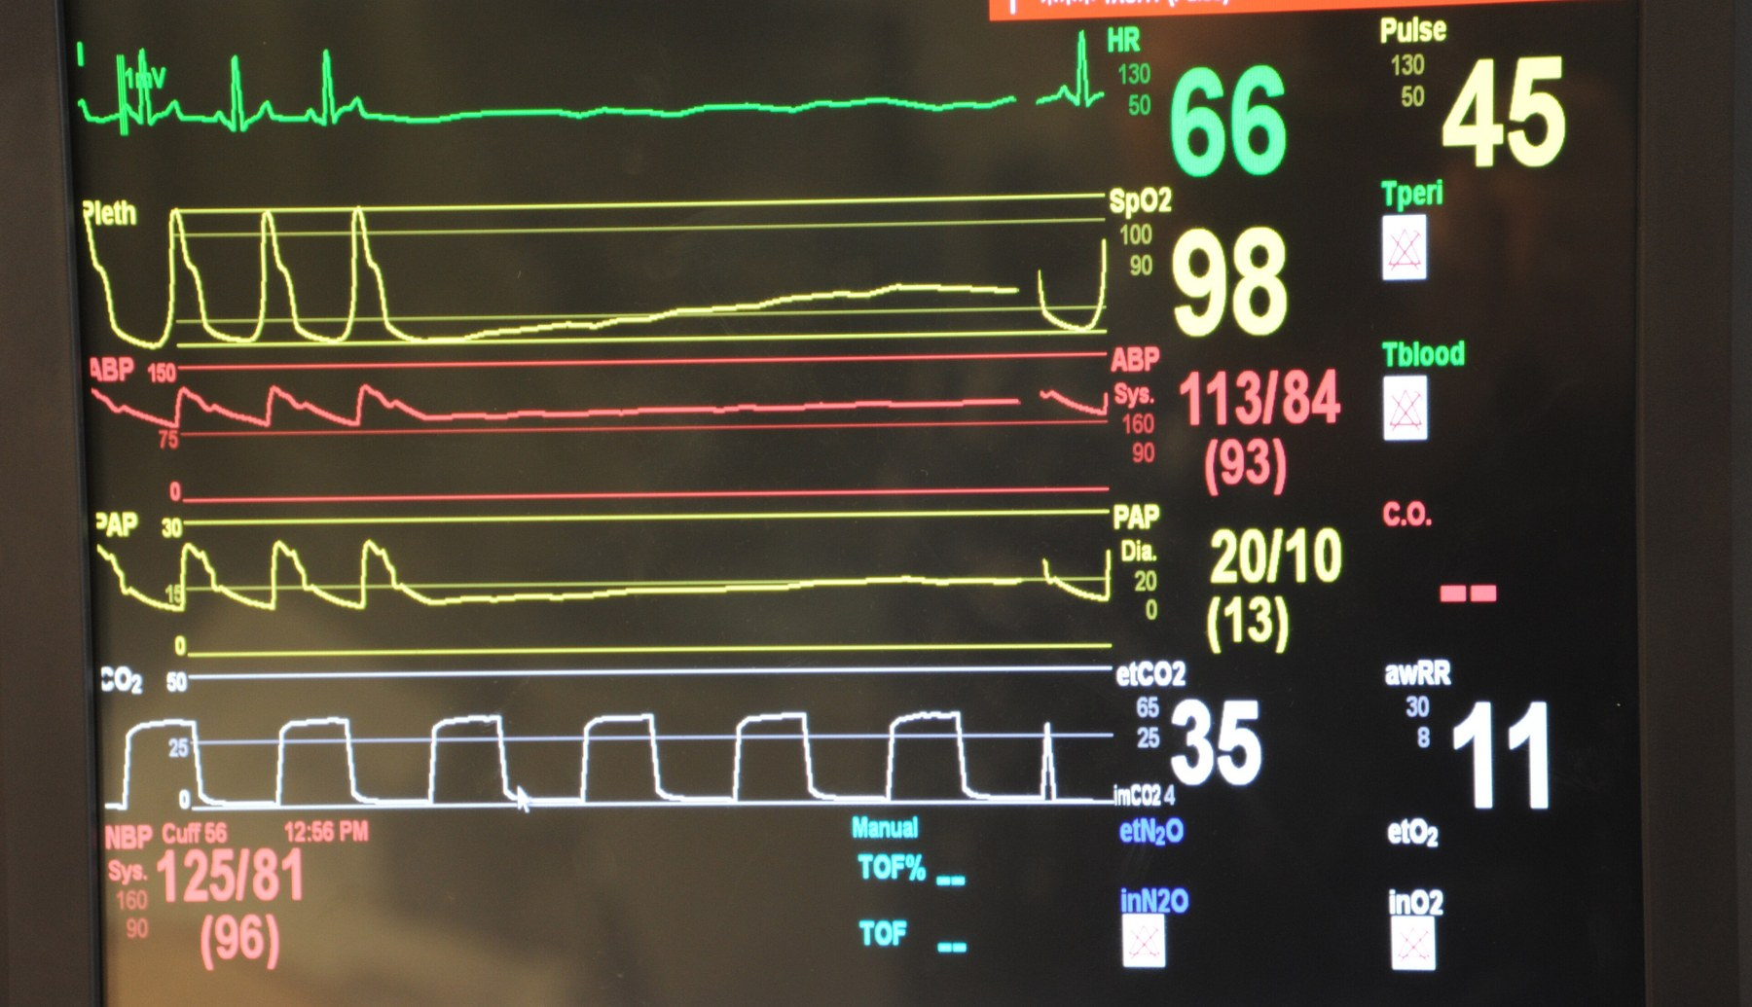
the dead layer. every weight rounds to zero.
Notes:
Quantise a freshly initialised wide layer at three bits. The network becomes an exactly zero function and no gradient can revive it. Looks like a precision limit, is actually scale placement. Photo: US Navy, Petty Officer 1st Class James Stenberg. Public domain.

Slide 8
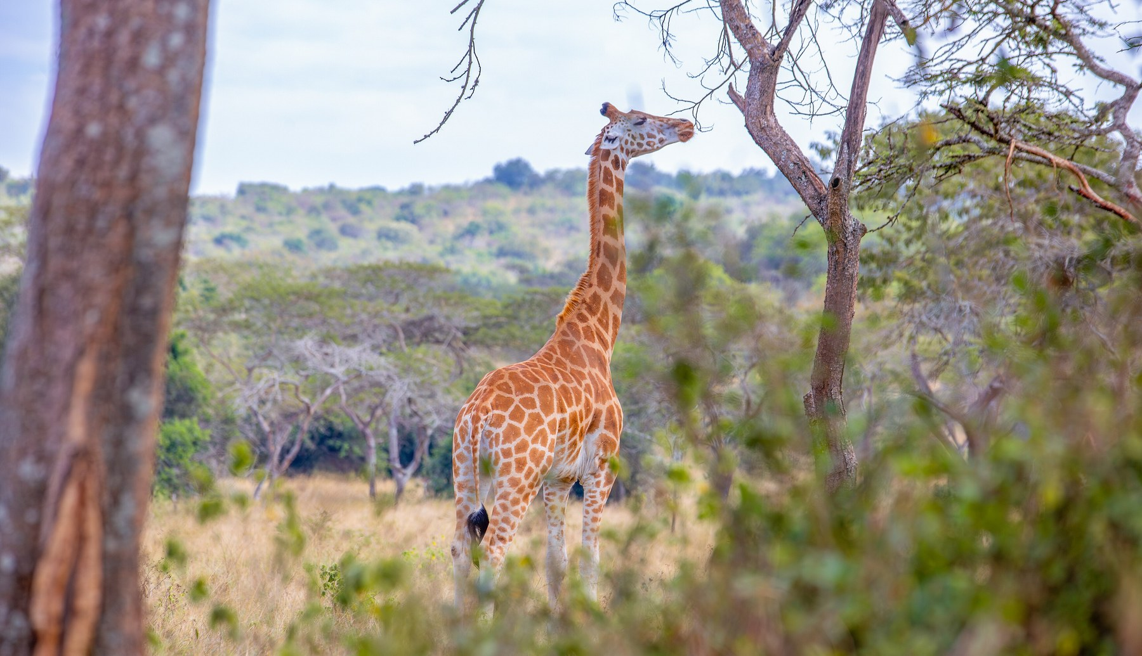
the outlier clip. one weight in ten thousand did not fit.
Notes:
Quantise the two projection matrices that no normalisation feeds, with no scale. Validation loss 2.53 to 7.73, at sixteen bits, where the grid step is three in a hundred thousand. Photo credit: Chrisruvy, Wikimedia Commons, CC BY-SA 4.0. Share-alike applies if published.

Slide 9
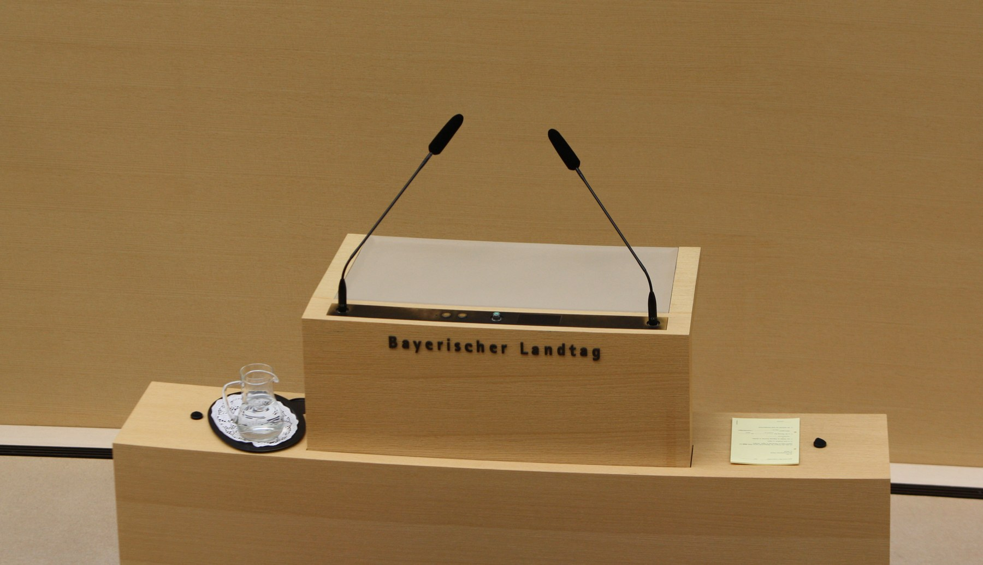
the silent one. it stopped answering and the score went up.
Notes:
Quantise too far, then score it the obvious way. One category rewards declining to answer, so a dead model scores a perfect 100 there. Photo credit: Michael Lucan, Wikimedia Commons, CC BY-SA 3.0 DE. Share-alike applies if published.

Slide 10
100%
7.47
1.2%
of weights in a wide layer round to zero at three bits
the largest weight in a checkpoint everyone assumes is bounded by one
of prompts a broken model still answered, while scoring 100
Notes:
Three numbers, three diagnoses. Each one is the signal for one of the three breaks.

Slide 11
every diagnosis is a histogram or a counter.

Slide 12
nobody has to read generated text. that's the part that goes wrong in a room.
Notes:
The pedagogical argument. Reading sample output is subjective and slow. Reading a weight histogram is neither, and it transfers to their own checkpoint on Monday.

Slide 13




runs on a laptop. python, pytorch, numpy, matplotlib.
no gpu. no cloud account. no dataset download.
under ten minutes of actual compute, all of it on cpu.
an identical colab notebook, cell for cell, as the fallback.
Notes:
This removes the single biggest reason hands-on ML workshops fall apart: half the room waiting on a download or a driver.

Slide 14
a branch per stage. nobody gets stranded.
Notes:
The repo carries the finished state of each stage. Anyone who falls behind checks out the next one and rejoins with working code they can read.

Slide 15
each stage ends on a test. green means move on. that replaces me asking thirty people whether they're done.

Slide 16
if i lose time early, the last hour is the thing that gives. i demo the eval instead of building it.

Slide 17
a quantiser
three checks
an eval pattern
forty lines they wrote and understand
runnable against any checkpoint they have on monday
capability paired with liveness, useful well past quantisation
what they walk out with
Notes:
The third generalises to anything that can fail by going quiet.

Slide 18
three hours, thirty people, one helper past that
the setup script in the joining email, a week ahead
january, not november — but november if you need it
Notes:
The asks. November sits between four other commitments, and Q1 puts the workshop after the silicon tapes out. Say I will do November if the schedule needs it.

Slide 19
will my checkpoint survive this, and how would i know if it hadn't?
Notes:
The test of the three hours is whether they can answer that about their own model without running the quantiser.

