Slide 1
One subscription, every visit
Revenue Cloud + Field Service: the residential pest control lifecycle, with Rentokil as the example
Core demo storyboard · Updated Oct 27, 2026
Notes:
Rentokil residential pest control. The sale happens in the field: the rep inspects and quotes in the Field Service mobile app at Michael's door (316 Ridgewood Dr, Bloomingdale, IL 60108), then Revenue Cloud and Field Service run the lifecycle. Secondary story to the QuantumBit high-tech base story.
Built in the rlm-base-dev repo (pest feature). Setup, data and scene details: docs/guides/pest-control-demo.md.

Slide 2
Meet Michael
Ants in the kitchen, mice in the garage, and a wooded lot
THE CAST
M
Michael
S
Sales Rep
Inspects, quotes, and signs at the door
Field Service Mobile + Revenue Cloud
316 Ridgewood Dr
Bloomingdale, IL 60108
O
Operations
Watches the plan build itself
Revenue Cloud orchestration
Single-family home · about 2,400 sq ft · basement and attached garage · wooded lot
D
Dispatcher
Routes visits by territory
Field Service
WHAT HE ENDS UP WITH
Home Protection plan
Monthly general pest and rodent service
Scene 3
T
Technician
Treats, adds services, changes plans
Field Service Mobile
Initial Service
One-time cleanout and exclusion, added by rule
Scene 2
C
Customer Care & Billing
Guarantees, pauses, renewals
Revenue Cloud Billing
Seasonal mosquito
April to October, pauses every winter
Scenes 3, 9
M
Michael
Signs and approves on the technician's device
Customer experience
Termite plan
Added on a visit, approved on the spot
Scene 8
Notes:
Michael is the customer for the whole story. He starts with a simple pest problem and, over a year, becomes a multi-service household. The plan names and prices are illustrative.
Demo with a freshly seeded customer (setup_rtk_inspection_visit). The Michael Reyes account in the demo org has been used for testing and is already on Home Protection Plus.

Slide 3
The lifecycle at a glance
Four phases, nine scenes, one household · about 17 minutes
Sell
The inspection is the sales call
Hand off
One order, two kinds of work
Serve
Every visit tied to what was sold
Grow & retain
The technician is the best salesperson
1
Plan the day
Sales Rep · Partly live ✧ Einstein
4
The plan builds itself
Operations · Live ✦ package
5
First treatment starts billing
Technician · Live ✦ package ✧ Einstein
8
Upsell & upgrade on the visit
Technician → Michael · Live ✧ Einstein
2
Inspect & quote on the tablet
Sales Rep · Live ✧ Einstein
ONE ORDER CREATES
6
Recurring visits run themselves
Dispatcher · Partly live ✦ package
9
Pause, resume & renew
Billing + Michael · Vision ✧ Einstein
Initial Treatment Work Order and appointment
An asset for every plan
Monthly billing for each plan
Billing that waits for the first treatment
3
Sign & pay at the door
Sales Rep + Michael · Live ✧ Einstein
7
Re-service with a guarantee check
Customer Care + Technician · Live ✦ package
↺ Renewal and next season's service start the loop again
✦ package FSL managed package
✧ Einstein AI suggests, people decide
ALL SCENES: CORE DEMO
Notes:
Use this as the map. Sell happens at Michael's door. Hand off is invisible automation. Serve is every visit after that. Grow and retain is where the technician and the subscription keep and expand the household.
Live, Partly live and Vision show what runs in the demo org today. Scenes 4–7 are where the Field Service managed package adds the most: automatic booking, live arrival updates, route optimization, and appointment booking.
✧ Einstein marks the six scenes with an AI moment. Each one suggests and a person decides; prices never come from the model.

Slide 4
Field Service Core vs the managed package
Core runs the lifecycle; the package makes residential routes pay
FIELD SERVICE CORE
MANAGED PACKAGE ADDS
WHERE IT SHOWS UP
Included with Field Service licenses
Field Service app from AppExchange (FSL)
Scenes that change with the package
Work Orders, Service Appointments, and Assets
Maintenance Plans that generate recurring visits
Skills, territories, operating hours, Work Types
Entitlements for guarantee checks
Field Service mobile app for technicians
Scheduling is manual: set the time, add the technician
Dispatcher Console: Gantt, map, drag and drop
Automatic booking and ranked technician candidates
Rules that enforce skills, territory, hours, and travel
Route optimization across the whole territory
Appointment booking with real arrival windows
Appointment Assistant: live "on my way" updates
Scene 4: Initial Service booked within 48 hours, automatically
Scene 5: Michael tracks the technician's arrival live
Scene 6: monthly visits optimized into dense routes
Scene 7: re-service booked into a real open window
Scenes 1–3, 8–9: unchanged; the Revenue Cloud story is all Core
For residential pest control, the package is close to essential: route density is the margin story (Scene 6), and Core can't show it. Without it, the demo books the first treatment from open times in the app (Scene 3).
Notes:
Be clear about what's Core and what's the package. Revenue Cloud plus Core Field Service runs the whole lifecycle. The managed package is what makes dispatch, routing, and arrival updates look the way a pest control operations leader expects. If the package isn't installed in the demo org, present Scenes 4–7 with the callouts as what the package adds.

Slide 5
Einstein at every step
Seven AI moments. Einstein suggests; the rep, the technician or Michael decides.
SCENE 1
Visit brief
Why Michael called, his plans and history, and what to look for, before the door opens.
SCENE 2
Findings from photos
Einstein reads each photo and suggests the pest, evidence and severity.
SCENE 2
Notes into findings
Dictate what you see; Einstein fills in the finding for the rep to check.
SCENE 3
Why this plan
Two plain sentences tying the plan to the findings, on screen and in the proposal.
SCENES 5, 8
Ask Einstein
Extra add-ons and plan changes the notes support, each with its reason.
SCENE 5
Visit summary
What was treated and approved, emailed to Michael when the visit is completed.
SCENES 8, 9
Billing agent
“Why is my bill $366?” answered line by line from the posted invoice.
✧ Prices stay rule- and zone-based · Nothing is saved or sold until a person accepts it · Falls back to the records when AI is off
Notes:
Every AI moment is a suggestion with a person in the loop. Einstein never sets a price: plans and prices still come from the inspection rules and Michael's service zone.
Each feature calls a Prompt Builder template from Apex (GPT-4o mini). With Einstein off, or if a call fails, the same cards are built from the records and the demo still runs.
The billing agent's action does the math from the posted invoice lines; the agent only puts it in plain language.

Slide 6
The inspection is the sales call
PHASE 1 · SELL
Inspect, price, sign, and book the first treatment in one visit
Notes:
Inspect, price, sign, and book the first treatment in one visit

Slide 7
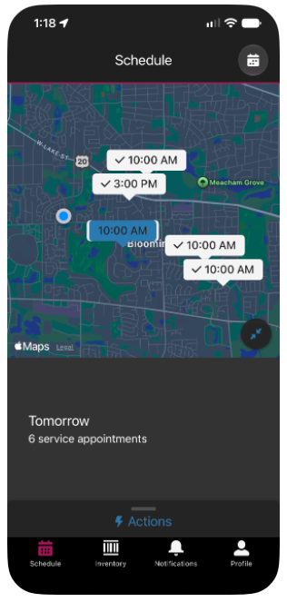
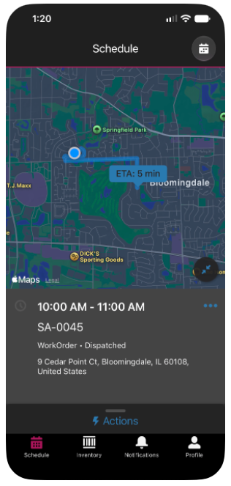
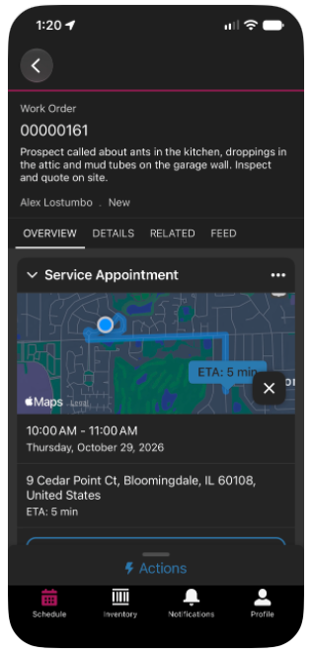
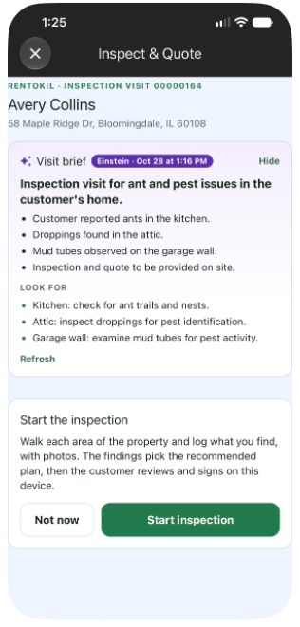
Plan the day
SCENE 1 · SELL
✧ EINSTEIN
Sales Rep · Field Service mobile schedule
WHAT THE AUDIENCE SEES
The rep's day in the Field Service app: inspection appointments across Bloomingdale
Michael's request from last night (ants in the kitchen, mice in the garage) is the first stop
His address, appointment window, and notes are on the appointment
Einstein briefs the rep before the door opens: why Michael called, his history, and what to look for
✧ WITH EINSTEIN
A visit brief tops Inspect & Quote: the reason for the visit, plans, last visit, open balance and what to look for. Built from the records when Einstein is off.
HOW IT FLOWS
1
Open today's schedule in the Field Service app
THE MOMENT
2
Michael's free pest inspection is first
Last night's web form is this morning's first stop.
3
Open the appointment → Einstein visit brief
4
Start Inspect & Quote on arrival
Notes:
Open on the rep's phone or tablet in the Field Service app. Michael asked for an inspection last night: ants in the kitchen, mice in the garage. This morning he's the first stop.
Everything the rep needs is on the appointment: what Michael reported, his window, and his address.
[LIVE] The inspection appointment on the rep's schedule (seed it with setup_rtk_inspection_visit).
[VISION] Web form to lead to booked inspection, and the route map (field sales visit planning; check licensing).
[EINSTEIN] Live: the visit brief at the top of Inspect & Quote and Treatment, written by a prompt template from the work order, past visits, plans, open invoices and pending plan changes. Refresh regenerates it. Without Einstein the same card is built from the records and labelled From the records.

Slide 8
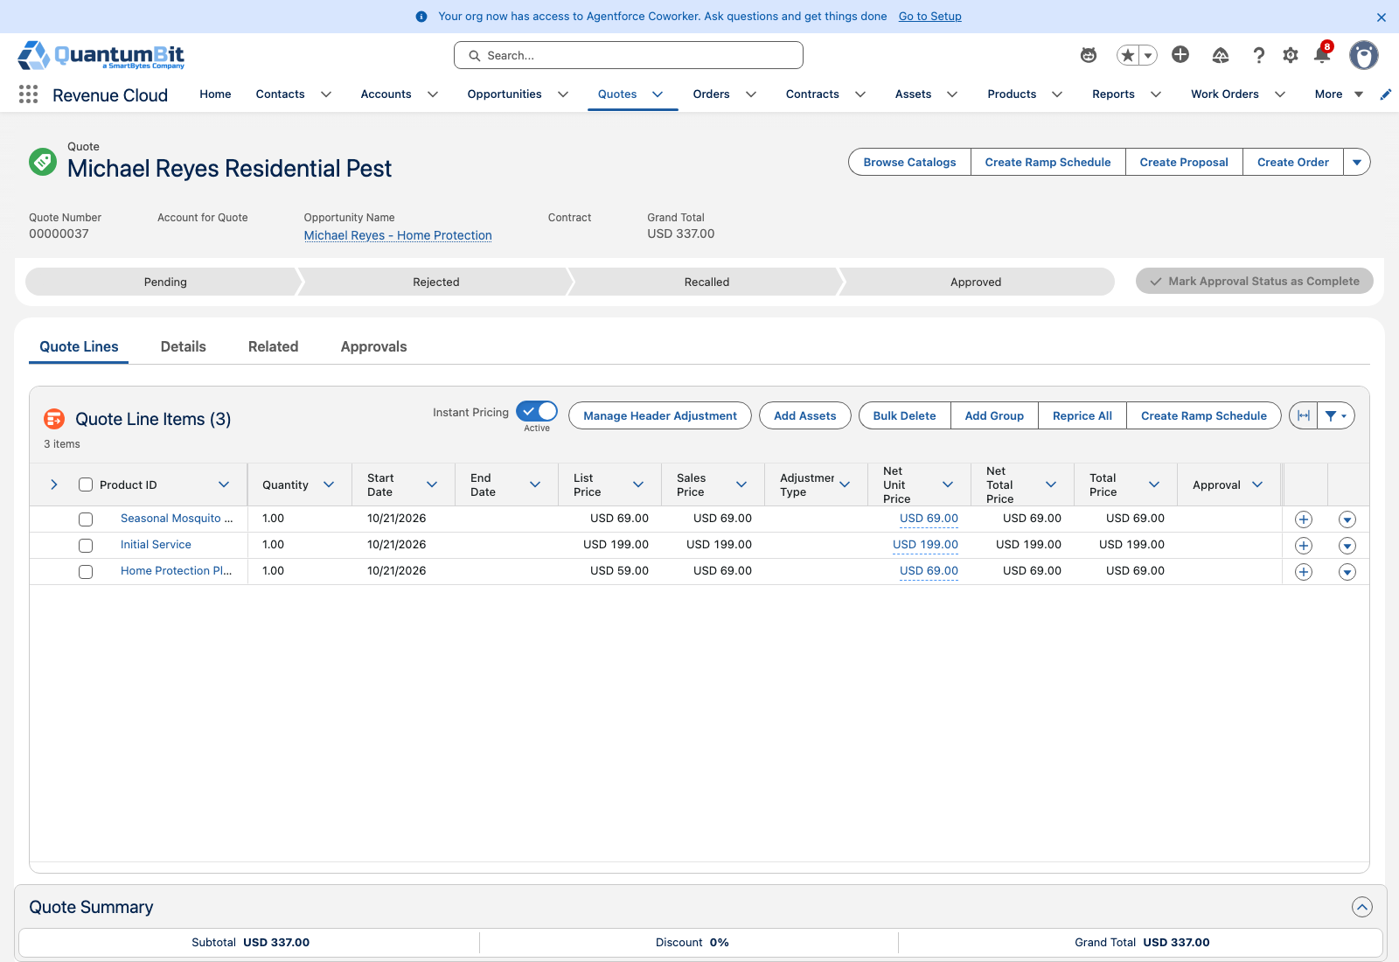
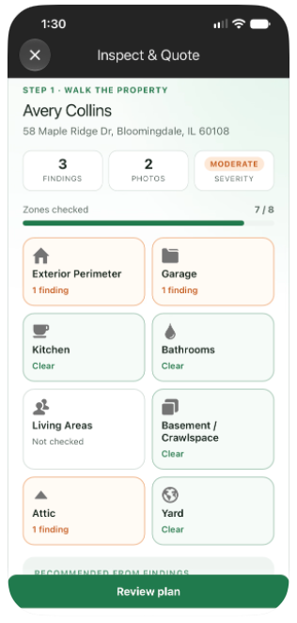
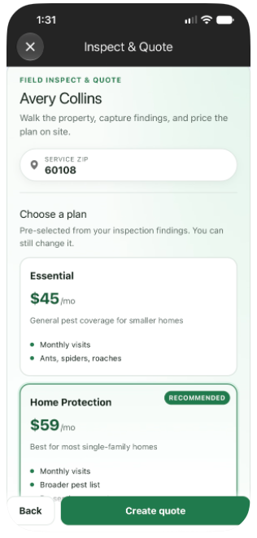
Inspect & quote on the tablet
SCENE 2 · SELL
LIVE
✧ EINSTEIN
Sales Rep · Field Service Mobile + Revenue Cloud quote
WHAT THE AUDIENCE SEES
The rep walks the property area by area, logging findings and photos: ant trails, rodent entry points
Findings recommend a plan; home size and severity adjust the price
Michael's ZIP sets his service-zone price
A rule adds the Initial Service to every plan automatically
Einstein reads each photo and the rep's dictated notes and suggests the pest, evidence and severity; the rep accepts or edits
HOW IT FLOWS
1
Walk the property: Einstein fills findings from photos
THE MOMENT
2
Enter home size and property details
The price reflects Michael's home, not a rate card.
3
Review the recommended plan and price
4
Create the quote and the Rentokil proposal
Notes:
Run Inspect & Quote from the inspection appointment in the Field Service app. Walk the property: each finding is an area, a pest and the evidence, with photos.
Findings drive the recommendation (rodents point to Home Protection). Square footage and severity are pricing attributes, and the ZIP sets the service zone: Bloomingdale 60108 is suburb x1.00; 60140 is rural x1.20.
Create quote places a priced Revenue Cloud quote and generates the Rentokil proposal PDF with the findings and photos.
[EINSTEIN] Live: after a photo upload, an Einstein sees card suggests the pest, evidence and severity; Review & apply pre-fills the finding. In the editor, dictate with the keyboard mic and tap Fill from notes. Nothing saves until the rep does, and the plan and price still come from the rules and Michael's zone.

Slide 9
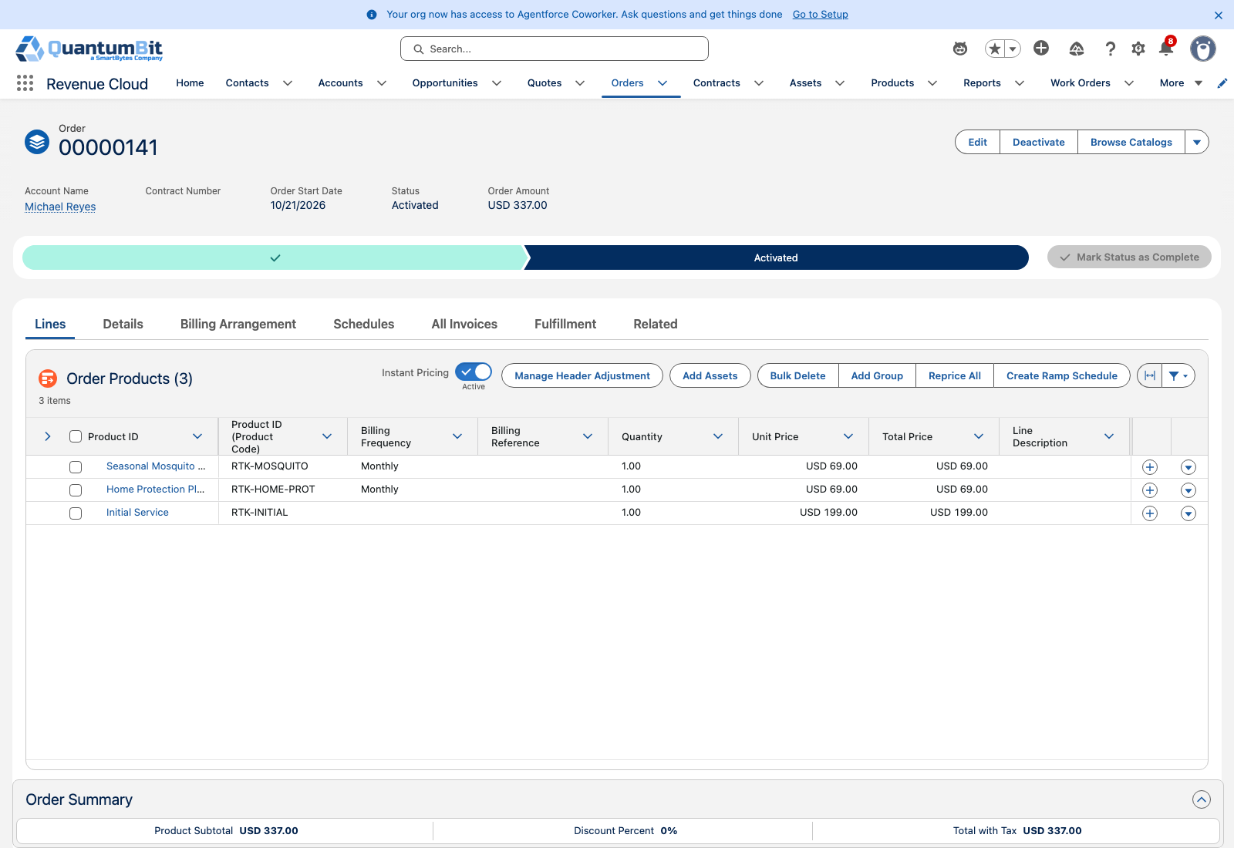
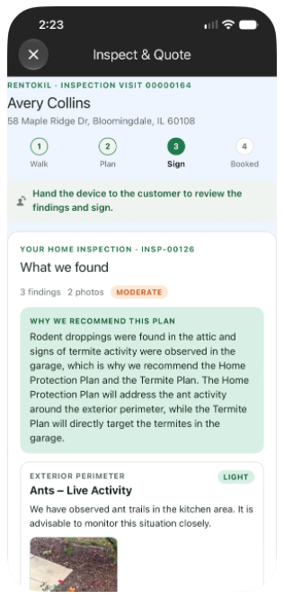
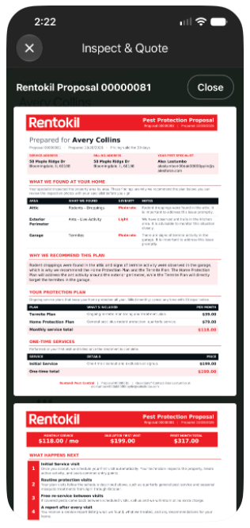
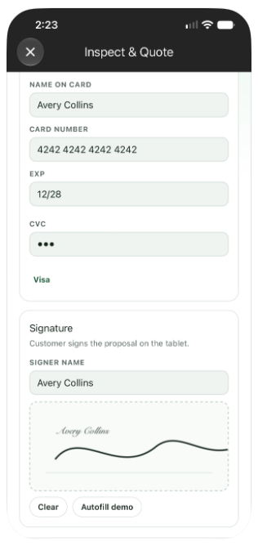
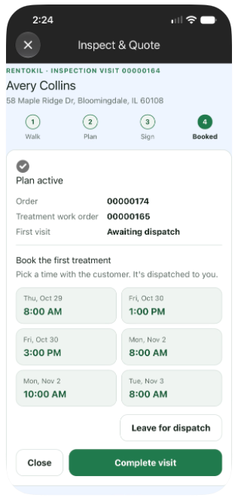
Sign & pay at the door
SCENE 3 · SELL
LIVE
✧ EINSTEIN
Sales Rep + Michael · Revenue Cloud quote, order, and payment
WHAT THE AUDIENCE SEES
Michael reviews the Rentokil proposal with his findings and photos
He picks Home Protection, adds seasonal mosquito, signs, and saves a card
The order activates on the spot
The rep books his first treatment from open times before leaving
Einstein explains why this plan in two plain sentences, on screen and in the proposal
HOW IT FLOWS
1
Show the proposal: why we recommend this plan
THE MOMENT
2
Sign & Pay: signature and card on file
Knock to signed in one visit, with the first treatment already on the schedule.
3
Activate the order
4
Pick a treatment time → dispatched
Notes:
Michael reviews the proposal on the device: his findings, photos and price. He signs and saves a card (the card is a mock in the demo org).
Booking activates the order and marks the inspection accepted. The last screen offers six open times for the first treatment; picking one schedules it and dispatches it to the technician.
This is the end of the sales cycle and the start of the service relationship, in one visit.
[VISION] A confirmation text to Michael.
[EINSTEIN] Live: Why this plan on Review the plan, in What we found at Sign & Pay, and in the proposal PDF's Why We Recommend This Plan box. Two sentences tied to the findings, with no prices or promises. It's saved on the inspection and the quote and only regenerates when the recommendation changes.

Slide 10
One order, two kinds of work
PHASE 2 · HAND OFF
The signed plan builds the first visit and every visit after it
Notes:
The signed plan builds the first visit and every visit after it

Slide 11
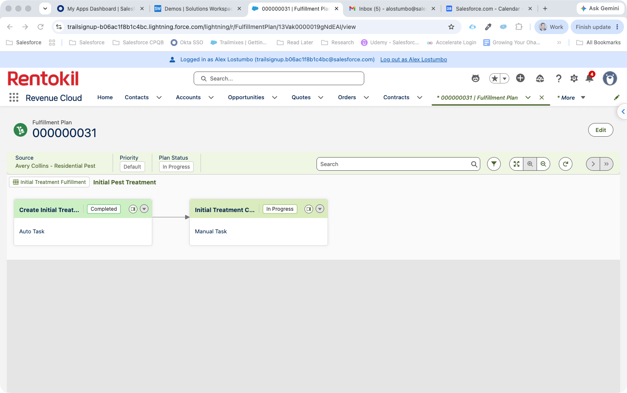
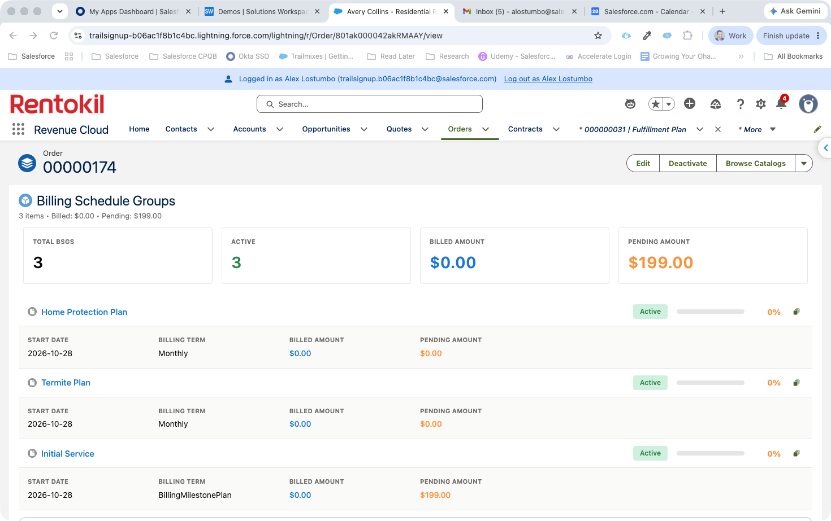
The plan builds itself
SCENE 4 · HAND OFF
LIVE
MANAGED PACKAGE
Operations · Dynamic Revenue Orchestration
WHAT THE AUDIENCE SEES
The order decomposes into a fulfillment plan automatically
The Initial Treatment Work Order and appointment are created
Each plan becomes an asset with its own monthly billing
Initial Service billing waits for the treatment to be completed
WITH THE MANAGED PACKAGE
The Initial Service is booked automatically into the best open slot within 48 hours, and Michael gets his arrival window by text. Nothing waits in a scheduling queue.
HOW IT FLOWS
1
Open Michael's order → fulfillment plan
THE MOMENT
2
Show the Initial Treatment Work Order
The rep never calls the office. The service plan builds itself.
3
Show Michael's plan assets
4
Point at Initial Service billing waiting
Notes:
Switch to operations. Nobody re-typed the order. Orchestration split it into the first treatment and the plans.
The Initial Treatment Work Order and appointment exist, already booked at the time the rep picked. Each plan is an asset that bills monthly.
Initial Service billing waits on the Initial Treatment Complete milestone.
[MANAGED PACKAGE] The Initial Service is booked automatically into the best open slot within 48 hours, and Michael gets his arrival window by text.

Slide 12
Every visit tied to what was sold
PHASE 3 · SERVE
Billing starts with service, and the guarantee enforces itself
Notes:
Billing starts with service, and the guarantee enforces itself

Slide 13
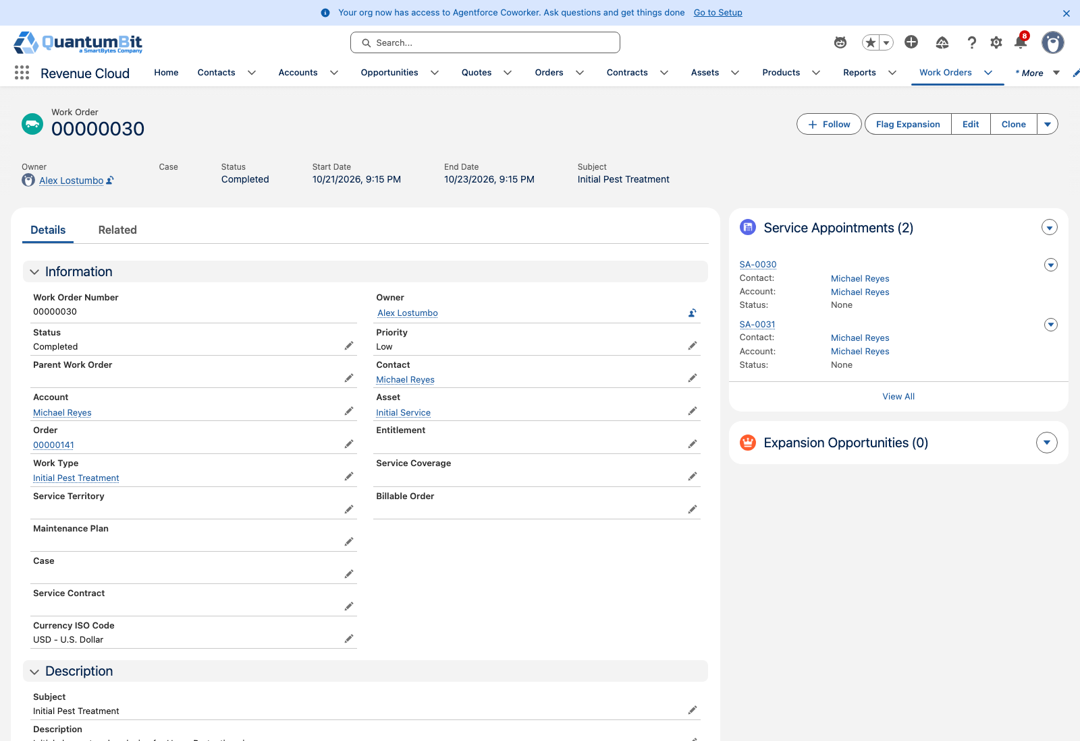
First treatment starts billing
SCENE 5 · SERVE
LIVE
MANAGED PACKAGE
✧ EINSTEIN
Technician · Field Service Mobile
WHAT THE AUDIENCE SEES
The technician opens Treatment: the rep's findings and photos are the checklist
A new finding, a wasp nest, becomes a one-time add-on Michael approves on the device
Completing the visit posts the invoices: Initial Service, the first month, and the add-on
Einstein suggests add-ons the notes support, and completing the visit emails Michael a summary
WITH THE MANAGED PACKAGE
Appointment Assistant texts Michael when the technician is on the way, with live location and ETA. No more waiting at home all afternoon.
HOW IT FLOWS
1
Open Treatment on the work order
THE MOMENT
2
Work the checklist from the findings
Michael pays when service starts, not when he signs.
3
Find & Add: log a finding → approved add-on
4
Complete → invoices posted, summary emailed
Notes:
The technician arrives already knowing the house: the rep's findings and photos are the treatment checklist.
Find & Add: they find a wasp nest, log it, and add nest removal at Michael's zone price. Michael approves on the device.
Completing the treatment accomplishes the billing milestone and posts the invoice: Initial Service plus the first month of each plan. Approved add-ons are billed on their own order and invoice.
[MANAGED PACKAGE] Appointment Assistant texts Michael when the technician is on the way, with live location and ETA.
[EINSTEIN] Live: Ask Einstein in Find & Add returns up to three extra add-ons with a reason, only from the catalog and only when the reason names a pest the product treats. Michael still approves each one. On Complete, Einstein writes a short visit summary (what was treated, what he approved, the next visit), saves it on the work order and emails it to him once.

Slide 14
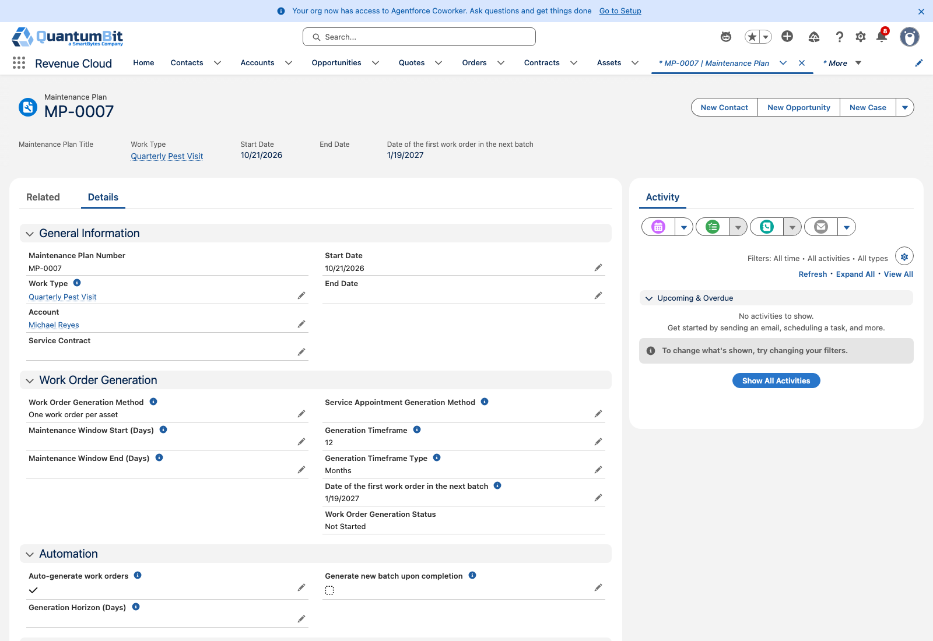
Recurring visits run themselves
SCENE 6 · SERVE
PARTLY LIVE
MANAGED PACKAGE
Dispatcher · Field Service scheduling
WHAT THE AUDIENCE SEES
Monthly visits are generated from the maintenance plan without anyone booking them
Each visit is routed into the Bloomingdale territory alongside neighboring customers
Michael gets a reminder text with an arrival window two days before
WITH THE MANAGED PACKAGE
Optimization packs every monthly visit into dense Bloomingdale routes and cuts drive time. This is where residential margin comes from, and Core alone can't show it.
HOW IT FLOWS
1
Open the maintenance plan → upcoming visits
THE MOMENT
2
Show the generated monthly Work Order
Recurring revenue and recurring routes come from the same record.
3
Show it on the Bloomingdale route
4
Show the reminder text to Michael
Notes:
Every quarter, the maintenance plan generates Michael's visit on its own. Dispatch sees it in the Bloomingdale route next to his neighbors.
That density is where residential pest control makes money. Michael just gets a reminder text.
[MANAGED PACKAGE] Optimization packs every quarterly visit into dense Bloomingdale routes and cuts drive time.
[LIVE] Michael's quarterly maintenance plan and generated visits (seed with setup_rtk_grow).
[VISION] Territory routing and reminder texts.

Slide 15
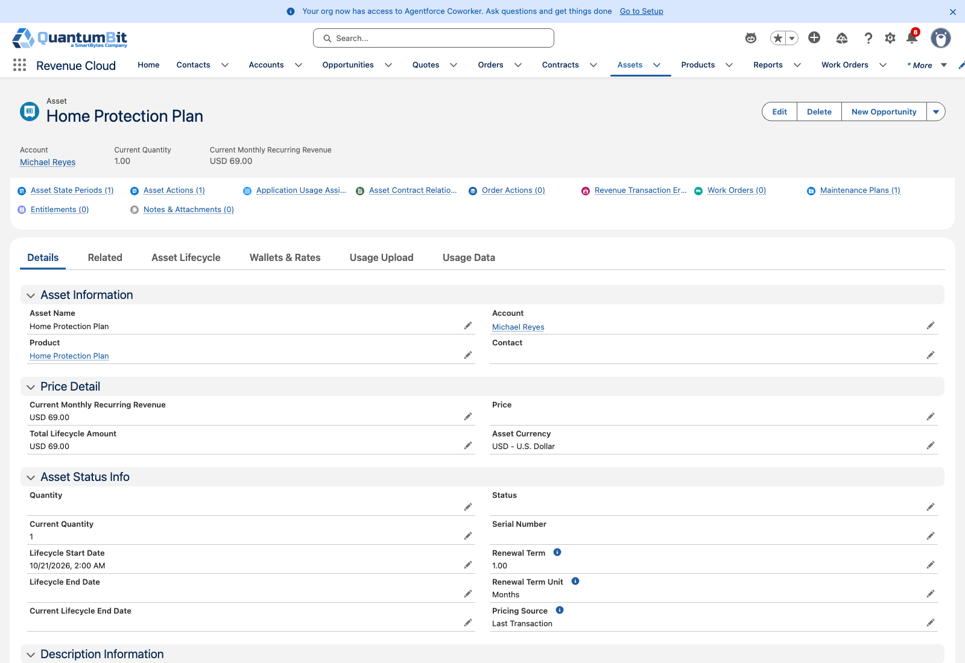
Re-service with a guarantee check
SCENE 7 · SERVE
LIVE
MANAGED PACKAGE
Customer Care + Technician · Field Service + Revenue Cloud Billing
WHAT THE AUDIENCE SEES
Three weeks later, Michael reports ants are back in the kitchen
A guarantee check finds his active Home Protection plan: re-service at no charge
A neighbor without a plan gets a priced, one-time treatment that is invoiced automatically
WITH THE MANAGED PACKAGE
Appointment booking offers Michael real open windows while he's still on the phone, and slots the re-service into a technician route already nearby.
HOW IT FLOWS
1
Log Michael's re-service request
THE MOMENT
2
Show the Covered result and $0 Work Order
The guarantee is enforced by the subscription, not by memory.
3
Repeat for the neighbor without a plan
4
Show the one-time order and invoice
Notes:
Ants come back three weeks later. That's normal, and it's what the guarantee is for.
The check looks at Michael's active plan and creates a no-charge re-service. A neighbor without a plan gets a priced one-time Re-service visit, billed as its own order and invoice.
Same process, the right outcome for each customer, decided by what they bought.
[MANAGED PACKAGE] Appointment booking offers Michael real open windows while he's still on the phone.

Slide 16
The technician is the best salesperson
PHASE 4 · GROW & RETAIN
Grow the household plan and keep it through every season
Notes:
Expand the household plan and keep it through every season

Slide 17
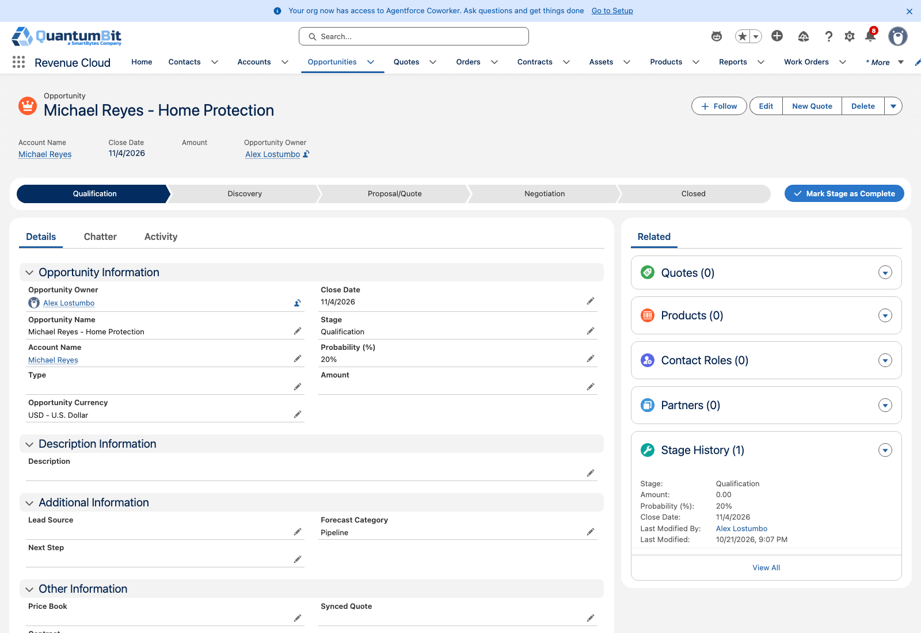
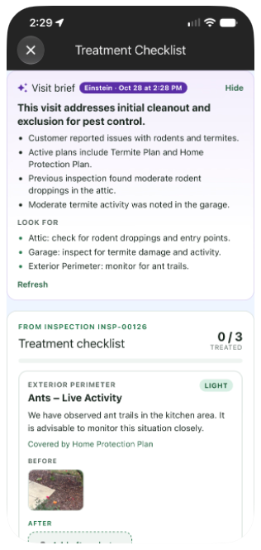
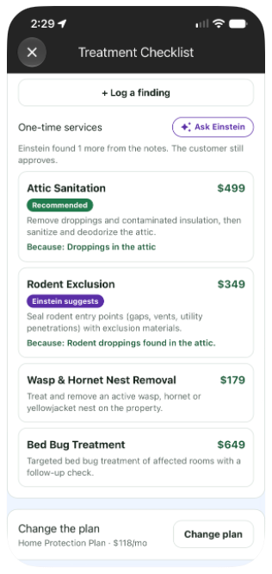
Upsell & upgrade on the visit
SCENE 8 · GROW & RETAIN
LIVE
✧ EINSTEIN
Technician → Michael · Field Service Mobile + Revenue Cloud amendment
WHAT THE AUDIENCE SEES
On a monthly visit, the technician logs mud tubes on the foundation: termite activity
Change the plan recommends the Termite plan, or an upgrade when a finding calls for one
Michael approves on the technician's device
Revenue Cloud amends his plan from tomorrow and bills the difference
Einstein surfaces plan changes the notes support, each with its reason; Michael still approves
HOW IT FLOWS
1
Log the finding in Find & Add
THE MOMENT
2
Change the plan → rules and Einstein picks
The person at the house is the best salesperson the company has.
3
Michael approves on the device
4
Amendment → upgrade on his assets + invoice
Notes:
On a routine visit the technician finds mud tubes, logs the finding, and Change the plan recommends Termite. A wasp finding would recommend upgrading to Home Protection Plus.
Michael approves on the device. Revenue Cloud amends his existing plan from tomorrow: upgrades and downgrades are recorded as such on his assets, and the invoice credits the old plan (prorated) and charges the new one.
Know before you demo: changes start the next day, one change at a time per customer, and a new plan bills on its own day of the month (it doesn't co-term).
[VISION] Approval by text from Michael's phone, and adding the termite inspection to his next visit.
[EINSTEIN] Live: Ask Einstein in Change the plan suggests tiers or add-on plans the findings support, badged Einstein suggests with the reason. The rules' recommendation stays first, and prices come from the rules and zone. When the prorated bill arrives, the Rentokil Pest Billing Agent explains the credit and the new charge.

Slide 18
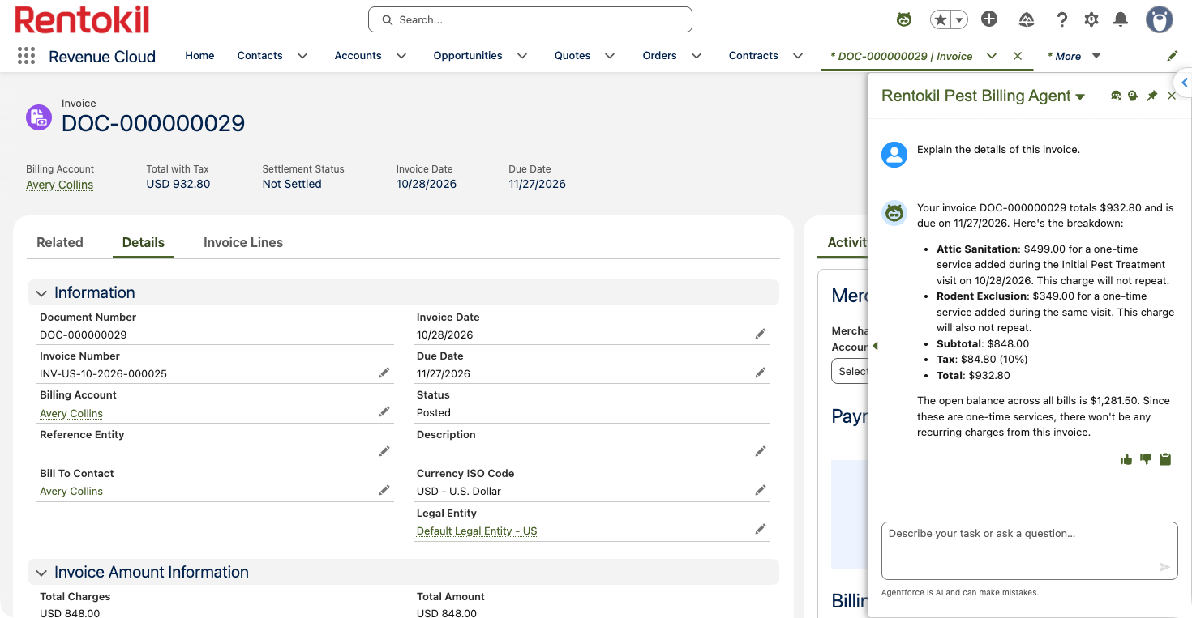
Pause, resume & renew
SCENE 9 · GROW & RETAIN
VISION
✧ EINSTEIN LIVE
Billing + Michael · Revenue Cloud subscription lifecycle
WHAT THE AUDIENCE SEES
Mosquito service pauses in November; visits and billing stop together
It resumes automatically in April with no call and no re-sign
At the one-year mark, the plan renews with the annual price adjustment
One subscription view shows every visit, invoice, and change
Einstein answers “why is my bill $366?” line by line: plans, initial service, add-ons and tax
HOW IT FLOWS
1
Open Michael's subscription timeline
THE MOMENT
2
Show the mosquito pause and resume
Seasonal service without seasonal churn.
3
Show the termite amendment
4
Show the renewal quote and price adjustment
Notes:
Close on the subscription. Mosquito service pauses for the winter and comes back in April without a call.
At one year, the whole plan renews with the annual adjustment. Everything we showed, from the inspection to the termite add-on, lives on this one record.
[VISION] Not built yet: seasonal ramp or suspend/resume, renewal with price uplift, subscription timeline view. Today the technician can remove the Mosquito plan by hand in Change the plan.
[EINSTEIN] Live: the Rentokil Pest Billing Agent (Agentforce employee agent). Ask: Why is Sam Patel's bill $366? Its action reads the posted invoice lines and returns the breakdown ($199 initial service at the treatment milestone + $65 and $69 for the first month of two plans + 10% tax = $366.30); the agent only rephrases it. It also explains plan-change credits and proration. Test it in the Agentforce panel.

Slide 19
What the audience should walk away with
Three outcomes, one for each stage of the household relationship
1
2
3
Close on the first visit
Every visit is accountable
Grow and keep every household
Inspect, price, sign, pay, and book the first treatment before leaving the driveway.
Billing starts with service, visits generate themselves, and the guarantee is enforced by the plan.
Technicians add services and upgrade plans with evidence, and seasonal plans pause instead of churning.
Shown in Scenes 1–3
Shown in Scenes 4–7
Shown in Scenes 8–9
Notes:
Land the three outcomes in the customer's language: close faster, run every visit profitably, and keep households longer.

Slide 20
Run of show and status
Who drives each scene, timing, and what's live in the demo org today
# | Scene | Persona | Min | Package · AI | Status today
1 | Plan the day | Sales Rep | 1 | ✧ Einstein | Partly live: inspection appointment on the schedule. Vision: web lead, route map · Einstein: visit brief
2 | Inspect & quote on the tablet | Sales Rep | 2.5 | ✧ Einstein | Live: property walk, findings and photos, recommended plan, zone and attribute pricing · Einstein: findings from photos and notes
3 | Sign & pay at the door | Sales Rep + Michael | 2 | ✧ Einstein | Live: proposal PDF, Sign & Pay, order activation, first-treatment booking · Einstein: why this plan
4 | The plan builds itself | Operations | 1.5 | ✦ Enhances | Live: orchestration creates the treatment work order; milestone billing
5 | First treatment starts billing | Technician | 2.5 | ✦ Enhances ✧ Einstein | Live: treatment checklist, Find & Add, completion posts invoices · Einstein: add-on picks, visit summary
6 | Recurring visits run themselves | Dispatcher | 1 | ✦ Enhances | Partly live: maintenance plan generates monthly visits. Vision: routing, reminders
7 | Re-service with a guarantee check | Customer Care + Technician | 2 | ✦ Enhances | Live: coverage check; free or priced re-service with invoice
8 | Upsell & upgrade on the visit | Technician → Michael | 2.5 | ✧ Einstein | Live: Change the plan; upgrade, downgrade or add on an amendment · Einstein: plan picks
9 | Pause, resume & renew | Billing + Michael | 1.5 | ✧ Einstein | Vision: seasonal pause and resume, renewal with uplift, timeline · Einstein: billing agent (live)
 | Total |  | 16.5 | Scenes 4–7 ✧ 1–3, 5, 8, 9 | Live: Scenes 2–5, 7, 8 · Partly live: 1, 6 · Vision: 9
Notes:
Status as of Oct 27, 2026 in the demo org. Setup: seed a fresh customer with setup_rtk_inspection_visit (and setup_rtk_grow for Scene 6). Demo guide: docs/guides/pest-control-demo.md in the rlm-base-dev repo.
Einstein needs einstein: true (prompt templates, prepare_pest steps 1.6–1.7); the billing agent needs agents: true (steps 15–18). Without them every AI card falls back to the rules.

