Slide 1
One contract, every site
Revenue Cloud + Field Service: commercial HVAC planned maintenance, with Brightline Commercial and Lakeshore Property Group as the example
Core demo storyboard · Updated Nov 5, 2026
Notes:
Commercial heating and cooling. Brightline Home Comfort's commercial division sells one planned-maintenance contract to Lakeshore Property Group: six sites (three offices, two restaurants and a small data room) with 42 rooftop units. Revenue Cloud prices and bills it; Field Service runs the visits, the emergency calls and the refrigerant rules.
Same org, brand and territory as the residential HVAC demo; this is its commercial counterpart. Sell (Scenes 1–3), Hand off (4), Serve (5–7) and Grow and retain (8–9) all run live in the demo org.
Built in the rlm-base-dev repo (hvac_commercial feature). Setup, data and scene details: docs/guides/hvac-commercial-demo.md.

Slide 2
Meet Lakeshore Property Group
Six buildings, 42 rooftop units, and one facilities director
THE CAST
L
Lakeshore Property Group
A
Account Manager
Surveys, quotes, adds sites, renews
Revenue Cloud
1 Lakeshore Plaza | Naperville, IL 60563
O
Operations
Watches site plans and projects build
Revenue Cloud orchestration
Three offices, two restaurants and a data room · six R-22 units from 2007–2009 at Office Park A · Renee Castillo, Director of Facilities, signs
D
Dispatcher
Routes site visits and emergency calls
Field Service
WHAT THEY END UP WITH
Planned maintenance
Quarterly visits for every unit at six sites, $3,715.20 a month
Scenes 2–4
T
Technician
Maintains units, logs refrigerant
Field Service Mobile
Response by site
4 hours, 24/7 at restaurants and the data room; next business day at offices
Scene 5
C
Customer Care & Billing
Emergency calls and the HQ invoice
Revenue Cloud Billing
One invoice
Monthly to HQ with a subtotal per site
Scene 7
R
Renee Castillo
Signs the contract and the project
Customer experience
RTU replacement
Six old units replaced for $103,400, billed by milestone
Scene 9
Notes:
Lakeshore Property Group is the customer for the whole story. Headquarters is the bill-to account; six site accounts sit under it, each with its own location, rooftop units and response needs. Renee Castillo, Director of Facilities, signs; Accounts Payable at HQ gets the invoice. The prices are illustrative.
The contract: each unit priced monthly by tonnage band ($38 up to 5 tons, $55 for 6–12, $85 for 13–25, $130 over 25), 4-hour response at $175 a site for the restaurants and the data room, next business day at $45 a site for the offices, and a $9-a-unit filter program. Six sites at a 5% discount: $3,715.20 a month, $44,582.40 a year. One year, renewed yearly at +3%, Net 30, billed monthly to HQ.
The capital project: Office Park A's six oldest units (R-22, 2007–2009) replaced at $16,800 each plus a $2,600 crane day, $103,400 billed 40 / 40 / 20.
Before each run: cci flow run reset_hvac_commercial_demo (skill: hvac-demo-seed-visits, Commercial section). The contract has to be booked once first (Scenes 2–3).

Slide 3
The lifecycle at a glance
Four phases, nine scenes, one portfolio · about 18 minutes
Sell
The contract is priced from the roof
Hand off
One order, every site
Serve
Every site on its own clock
Grow & retain
The account grows by the building
1
Site survey
Account Manager · Partly live
4
Site plans build themselves
Operations · Live ✦ package
5
Emergency call by site priority
Customer Care + Technician · Live ✦ package
8
Add a site and renew
Account Manager · Live
2
Contract quote
Account Manager · Live
ONE ORDER CREATES
6
Refrigerant compliance
Technician · Live
9
Capital project
Account Manager + Operations · Live
27 contract assets, each at its site
Response coverage for every site
A maintenance plan per site
One monthly invoice to HQ
3
Sign and order
Account Manager + Renee · Live
7
One invoice for every site
Billing · Live ✧ Einstein
↺ Renewals at +3% and new buildings start the loop again
✦ package FSL managed package
✧ Einstein AI suggests, people decide
ALL SCENES: CORE DEMO
Notes:
Use this as the map. Sell is the survey, the contract quote and the signature. Hand off is invisible automation: one order builds every site's coverage and visits. Serve is the emergency call, the refrigerant rules and the monthly invoice. Grow and retain is a new building mid-term, the renewal and a capital project.
Live and Partly live show what runs in the demo org today. Scenes 4–5 are where the Field Service managed package adds the most: automatic booking of each site's visits, and slotting a 4-hour call ahead of planned work.
✧ Einstein marks the billing agent in Scene 7. It explains the invoice; the numbers come from the posted invoice lines.

Slide 4
Field Service Core vs the managed package
Core runs the contract; the package keeps every site on time
FIELD SERVICE CORE
MANAGED PACKAGE ADDS
WHERE IT SHOWS UP
Included with Field Service licenses
Field Service app from AppExchange (FSL)
Scenes that change with the package
Work Orders, Service Appointments, and an Asset per rooftop unit
Maintenance Plans that generate each site's quarterly visit
Skills, territories, operating hours, Work Types
Entitlements and milestones for each site's response time
Field Service mobile app for technicians
Scheduling is manual: set the time, add the technician
Dispatcher Console: Gantt, map, drag and drop
Automatic booking and ranked technician candidates
Rules that enforce skills, territory, hours, and travel
Route optimization across the whole territory
Appointment booking with real arrival windows
Appointment Assistant: live "on my way" updates
Scene 4: each site's quarterly visit booked automatically
Scene 5: the 4-hour call slotted to the nearest technician
Scenes 1–3, 6–9: unchanged; the Revenue Cloud story is all Core
For commercial HVAC, the package earns its keep on response times: a 4-hour restaurant call competes with 42 units of planned work (Scenes 4–5). Without it, the demo dispatches the seeded visits to the presenter (Scene 5).
Notes:
Be clear about what's Core and what's the package. Revenue Cloud plus Core Field Service runs the whole contract, including each site's response time and the refrigerant rules. The managed package is what makes dispatch look the way a commercial service manager expects: quarterly visits booked into dense routes, and a restaurant's no-cool call placed ahead of planned maintenance. If the package isn't installed in the demo org, present Scenes 4–5 with the callouts as what the package adds.

Slide 5
What's different from residential
Same org, brand and territory. The customer is a portfolio of buildings.
CUSTOMER
A hierarchy of sites
HQ is billed; each site has its own account, location and units.
EQUIPMENT
Rooftop units
42 units with tag, tonnage, install year, refrigerant and charge.
PRICING
Per unit, by tonnage
$38 to $130 a unit a month, plus a response tier per site.
QUOTE
A line group per site
One quote and one order build coverage and a plan for every site.
VISITS
One visit per site
A quarterly work order per site, with a line per unit.
COMPLIANCE
Refrigerant leak rate
Units holding 50 lb or more are tracked against the EPA limit.
BILLING
One invoice, by site
Monthly to HQ on a PO, Net 30, with a subtotal per site.
✧ The billing agent explains the invoice by site · One-year term, renewed at +3% · Capital projects billed by milestone
Notes:
For an audience that has seen the residential demo: same org, brand and territory, but the customer is a portfolio. Residential prices a household by its systems' age and its ZIP; commercial prices every rooftop unit by tonnage and every site by the response time it needs.
One quote with a line group per site becomes one order. The order builds each site's coverage and maintenance plan, and HQ gets one invoice with site subtotals.
New for commercial: EPA refrigerant leak-rate tracking (Scene 6), adding a building mid-term (Scene 8) and a capital project billed by milestone (Scene 9).

Slide 6
The contract is priced from the roof
PHASE 1 · SELL
Survey the sites, price every unit, and sign one contract for the portfolio
Notes:
Survey the sites, price every unit, and sign one contract for the portfolio

Slide 7
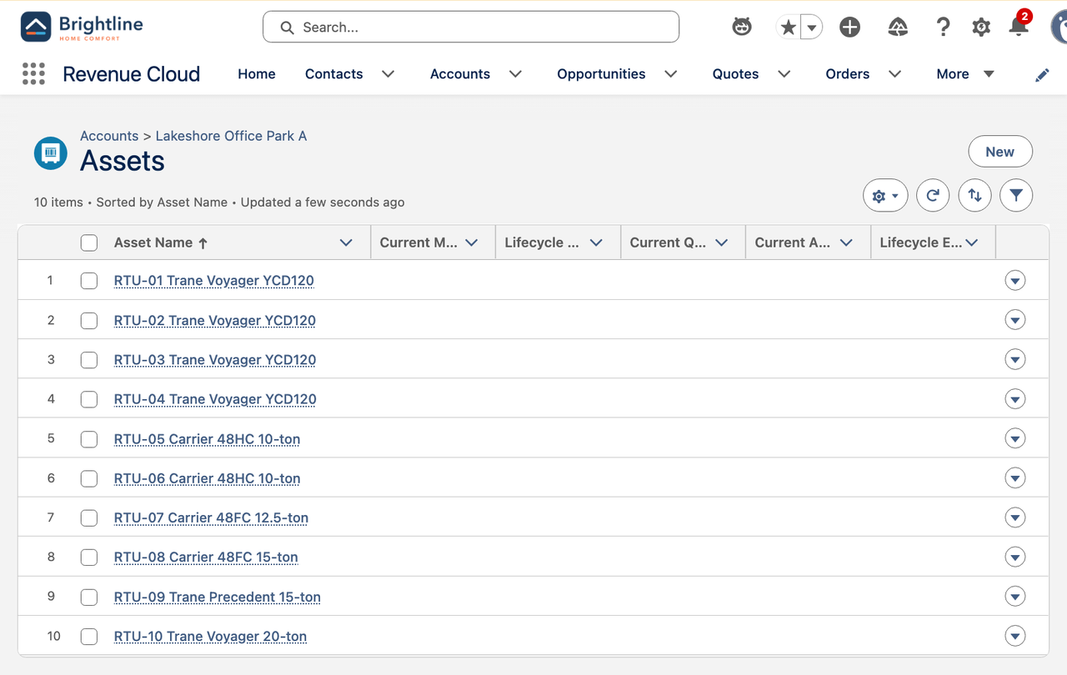
Site survey
SCENE 1 · SELL
PARTLY LIVE
Account Manager · Account hierarchy, locations and assets
WHAT THE AUDIENCE SEES
Lakeshore HQ is the bill-to account, with six site accounts under it
Each site has a Field Service Location, its address and its response needs
42 rooftop units are Assets with unit tag, tonnage, install year, refrigerant and charge
Units holding 50 lb or more are flagged for leak-rate tracking
Office Park A's six R-22 units from 2007–2009 are the capital project waiting to happen
HOW IT FLOWS
1
Open Lakeshore HQ → the site hierarchy
THE MOMENT
2
Open a site → its location and units
The survey is the price list: every unit on the roof is a line on the contract.
3
Show a unit: tonnage, refrigerant, charge
4
Point at the R-22 units at Office Park A
Notes:
Open on Lakeshore Property Group, the headquarters account. Its six sites are child accounts, each with a Field Service Location and its rooftop units as Assets.
Every unit carries what the contract needs: unit tag, make and model, tonnage, install year, refrigerant type and charge. Tonnage sets the unit's price band; charge decides leak-rate tracking (50 lb or more).
Office Park A has ten units; six of them are 2007–2009 units on R-22, which sets up the capital project in Scene 9.
[PARTLY LIVE] The hierarchy and the units are seeded with seed_hvac_commercial_sites (the reset flow restores them). There's no on-roof survey capture screen yet.
Screenshot: Office Park A's ten rooftop units.

Slide 8
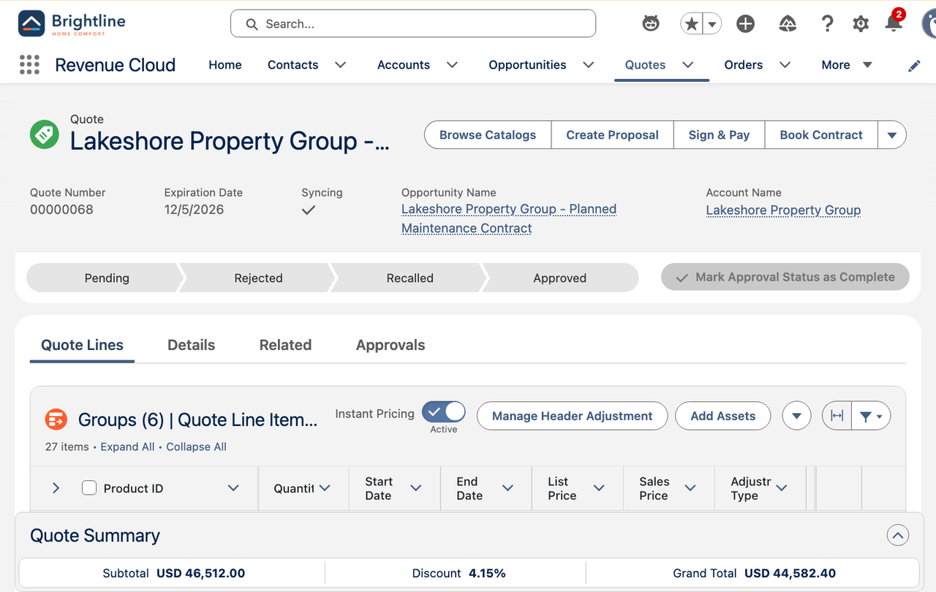
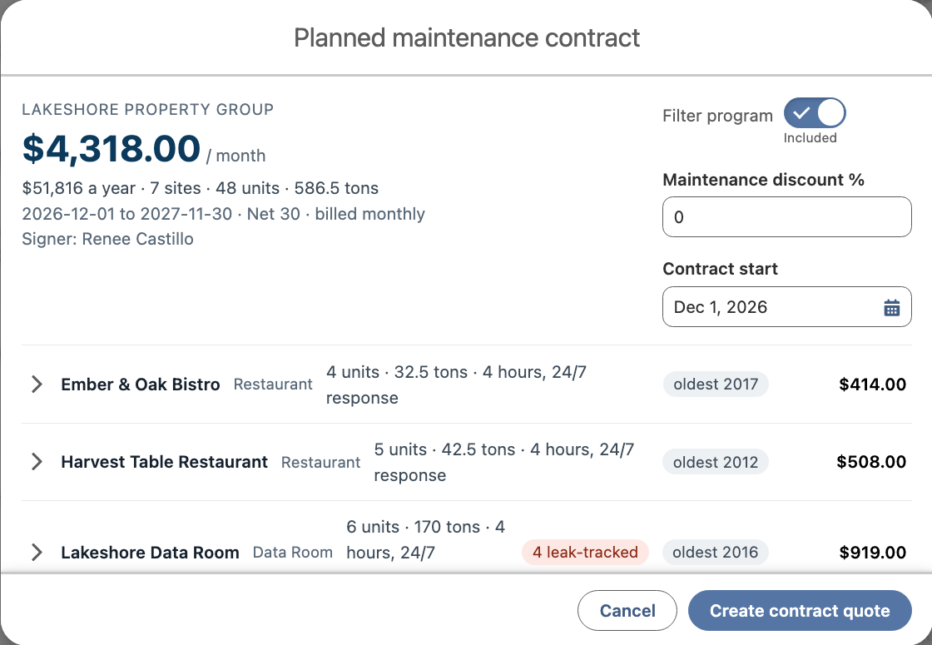
Contract quote
SCENE 2 · SELL
LIVE
Account Manager · Revenue Cloud quote by site
WHAT THE AUDIENCE SEES
Contract Quote on HQ previews every site: units, tonnage, response tier and oldest unit
Each unit is priced by tonnage band: $38, $55, $85 or $130 a month
Restaurants and the data room get 4-hour, 24/7 response; offices get next business day
A filter program and a maintenance discount apply across the portfolio; 15% or more goes to approval
Six sites come to $3,715.20 a month, $44,582.40 a year at 5% off
Create contract quote builds one quote with a line group per site
HOW IT FLOWS
1
Open Lakeshore HQ → Contract Quote
THE MOMENT
2
Review each site's units and response tier
One quote for six buildings, priced unit by unit.
3
Set the filter program and the discount
4
Create the quote: a line group per site
Notes:
From Lakeshore HQ, Contract Quote reads the site hierarchy and the units, and previews the contract site by site: units, tonnage, response tier and the oldest unit.
Pricing: planned maintenance per unit by tonnage band (up to 5 tons $38, 6–12 $55, 13–25 $85, over 25 $130 a month), response per site ($175 for 4-hour 24/7 at restaurants and the data room, $45 for next business day at offices), and the $9-a-unit filter program. A maintenance discount of 15% or more routes the quote to approval.
Lakeshore's six sites: $3,715.20 a month, $44,582.40 a year at a 5% discount. Create contract quote builds one quote with a line group per site (quote 00000068, 27 lines). The term is one year from the first of next month.
Screenshots: the Contract Quote preview and quote 00000068.

Slide 9
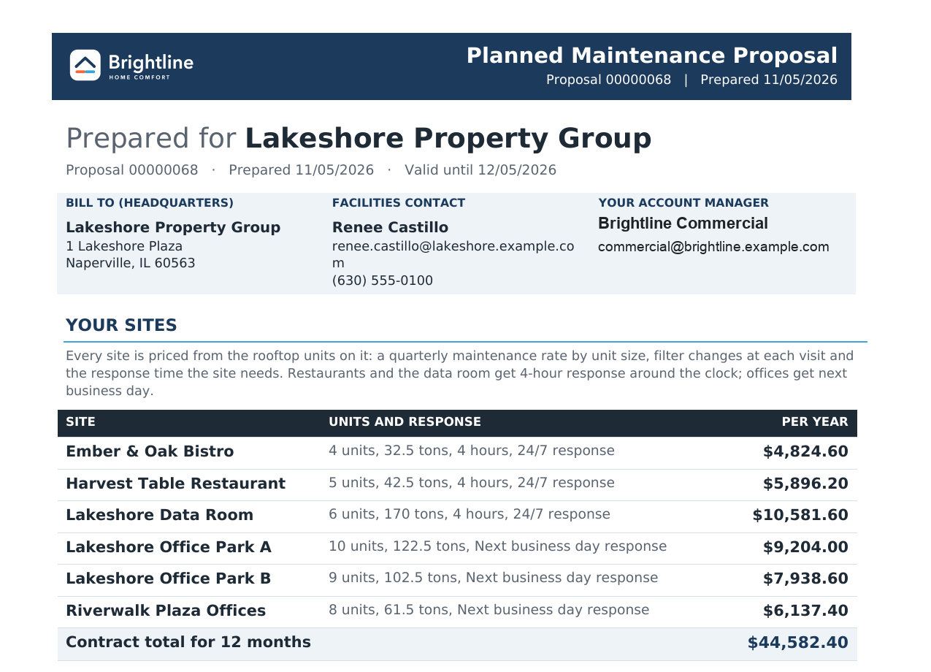
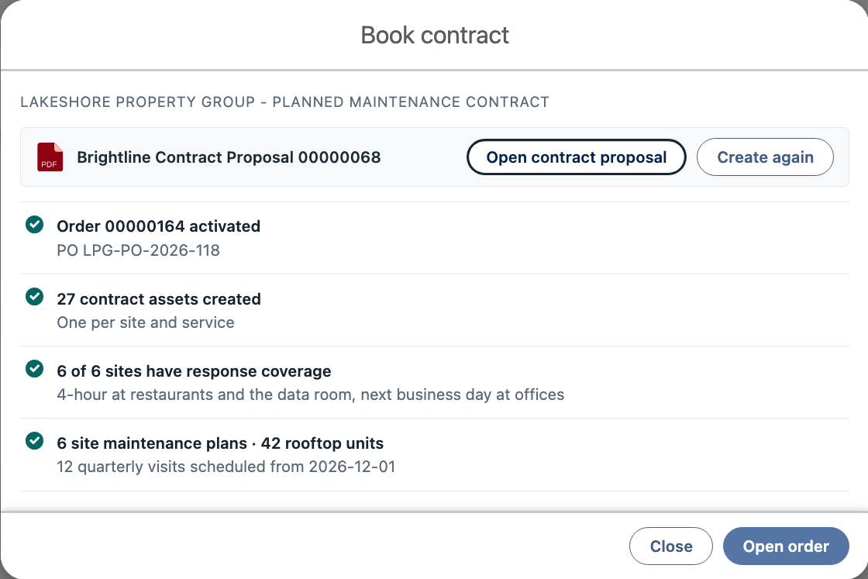
Sign and order
SCENE 3 · SELL
LIVE
Account Manager + Renee · Revenue Cloud order and documents
WHAT THE AUDIENCE SEES
Book Contract creates the Brightline Contract Proposal: a site table and each site's services
Renee signs, and the PO (LPG-PO-2026-118) goes on the order
The order activates: 27 contract assets, one per site and service
Response coverage for all six sites and six site maintenance plans come with it
HOW IT FLOWS
1
Book Contract → the contract proposal
THE MOMENT
2
Enter the PO and place the order
Signed once, live at every site.
3
The order activates
4
Assets, coverage and site plans are ready
Notes:
On the quote, Book Contract generates the Brightline Contract Proposal: the site table with units and response, the contract term, the monthly invoice and the contract total, then each site's services and the units they cover.
Renee signs; the account manager enters Lakeshore's PO (LPG-PO-2026-118), and booking places and activates the order.
The result panel shows the order activated, 27 contract assets (one per site and service), response coverage for all six sites and six site maintenance plans.
The proposal lists the quote creator as the account manager. Book the demo contract as a demo user before showing the PDF to an audience; the screenshot shows the team instead.
Screenshots: the contract proposal (quote 00000068) and the Book Contract result.

Slide 10
One order, every site
PHASE 2 · HAND OFF
The signed contract builds every site's coverage and visits
Notes:
The signed contract builds every site's coverage and visits

Slide 11
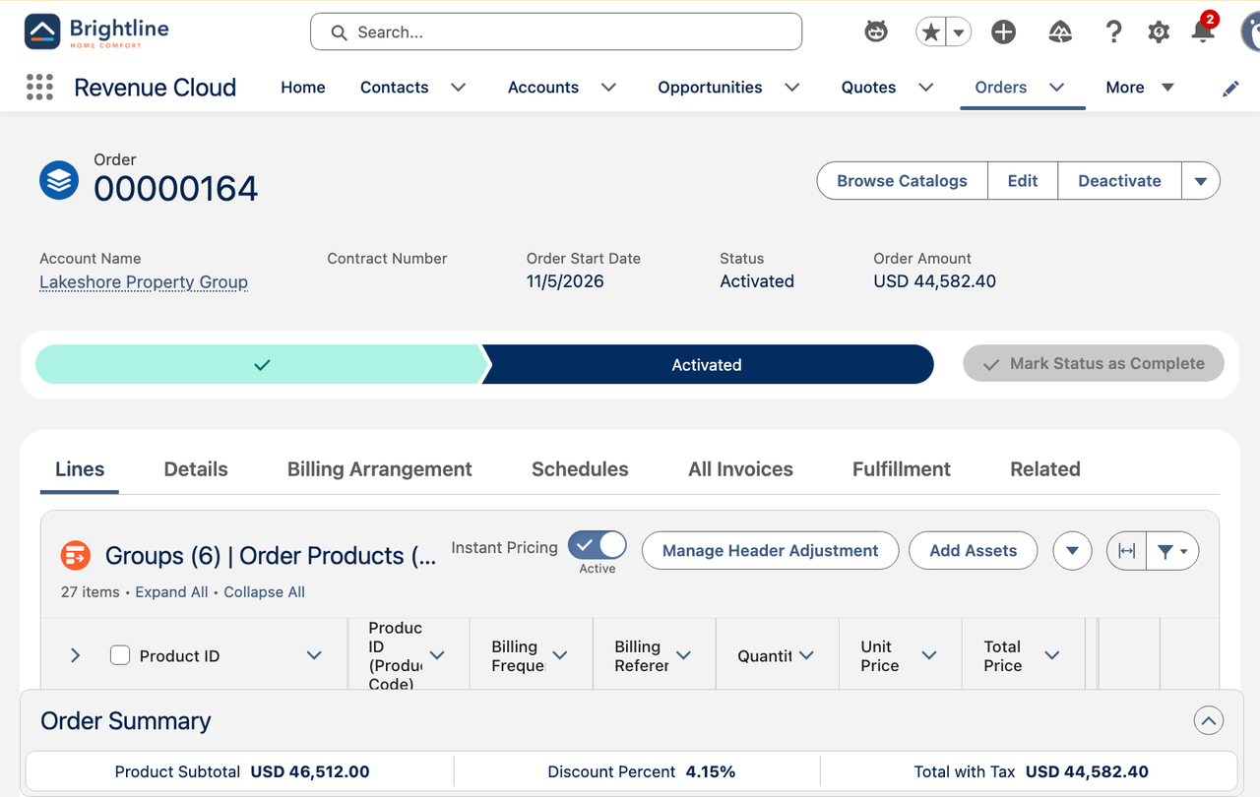
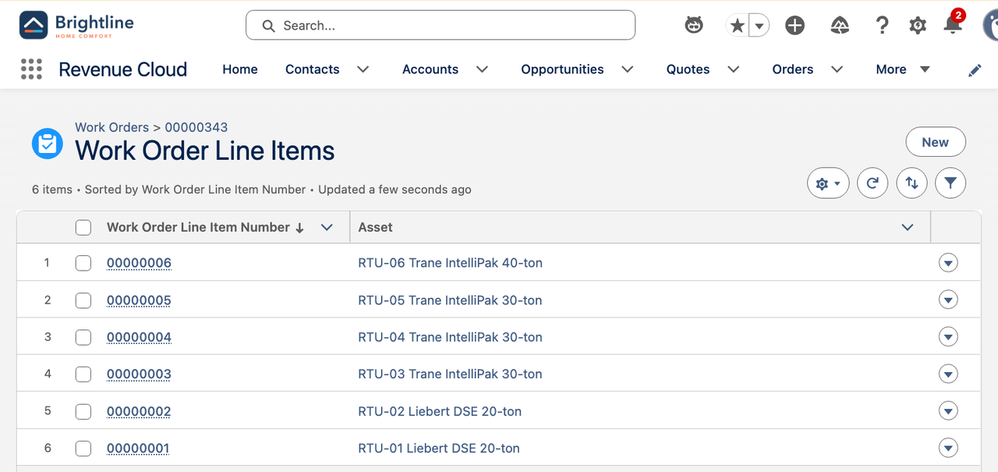
Site plans build themselves
SCENE 4 · HAND OFF
LIVE
MANAGED PACKAGE
Operations · Dynamic Revenue Orchestration + Field Service
WHAT THE AUDIENCE SEES
Activating the order turns each line into an asset at the site it came from
Each site gets an entitlement on its response coverage
Each site gets a maintenance plan at its location, with a quarterly rule per rooftop unit
Each quarter's visit is one work order per site, with a line per unit
WITH THE MANAGED PACKAGE
Each site's quarterly visit is booked automatically into the best slot in the territory, and the site contact gets the arrival window.
HOW IT FLOWS
1
Open the order → six groups, 27 lines
THE MOMENT
2
Open a site's entitlement and response tier
Nobody builds six service plans by hand. The order does it.
3
Open the site's maintenance plan
4
Show the quarterly visit, a line per unit
Notes:
Switch to operations. Nobody re-typed the order. Activating it assetized each line, and each asset took its site from the order line it came from.
Each site has an entitlement on its response coverage (4-hour 24/7 or next business day) and a maintenance plan at its location, with a quarterly rule per rooftop unit.
Each quarter's visit is one work order per site with a line per unit: the data room's visit (work order 00000343) has six lines.
[MANAGED PACKAGE] Each site's visit is booked automatically into the best slot, and the site contact gets the arrival window.
Screenshots: contract order 00000164 and the data room's visit lines (work order 00000343).

Slide 12
Every site on its own clock
PHASE 3 · SERVE
Response times by site, refrigerant rules by unit, one invoice for all of it
Notes:
Response times by site, refrigerant rules by unit, one invoice for all of it

Slide 13
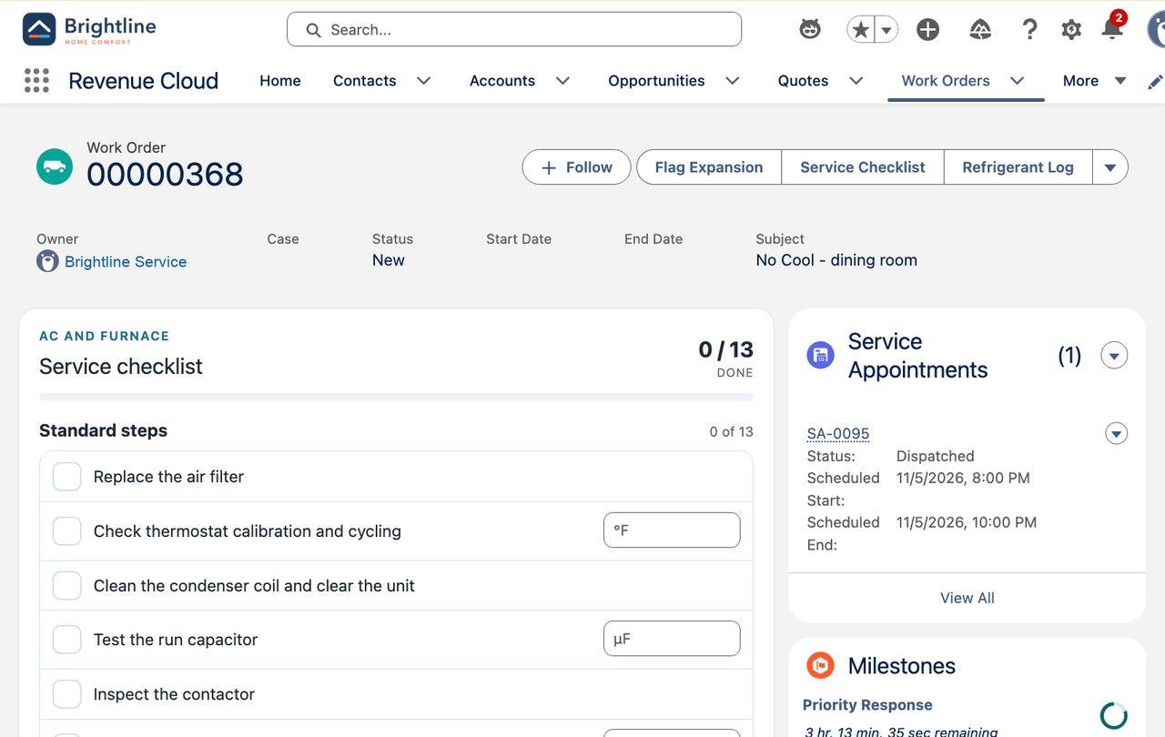
Emergency call by site priority
SCENE 5 · SERVE
LIVE
MANAGED PACKAGE
Customer Care + Technician · Entitlements and milestones
WHAT THE AUDIENCE SEES
Harvest Table reports No Cool in the middle of the lunch rush
The site's 4-hour, 24/7 entitlement covers it: Critical priority and a Priority Response countdown
The same call at an office is next business day; the site sets the clock, not the caller
The technician sees the countdown; arriving meets the milestone
WITH THE MANAGED PACKAGE
The call is slotted into the nearest qualified technician's route inside the 4-hour window, ahead of planned maintenance.
HOW IT FLOWS
1
Log the call at Harvest Table: No Cool
THE MOMENT
2
Covered: Critical, 4-hour milestone
The response time comes from the site on the contract, not from who answers the phone.
3
Dispatch → the technician's countdown
4
Arrival meets the milestone
Notes:
A restaurant without cooling at lunch is the call the contract is for.
Log it as a No-Cool call at Harvest Table Restaurant. The coverage check finds the site's 4-hour, 24/7 entitlement: Covered, Critical priority, and the Priority Response milestone starts a 4-hour countdown around the clock. The same call at an office gets next business day.
The technician sees the countdown in Service Checklist; Start visit meets the milestone. The call uses the shared No-Cool work type, so it shows the AC checklist (filter, thermostat, coil, capacitor, contactor).
[LIVE] The reset flow books the call for the next hour (seed_hvac_commercial_service_call). Contract quotes start on the first of next month, so the seed moves not-yet-started site entitlements to today.
[MANAGED PACKAGE] The call is slotted into the nearest qualified technician's route, ahead of planned maintenance.
Screenshot: the Harvest Table call, Covered and Critical with its 4-hour milestone.

Slide 14
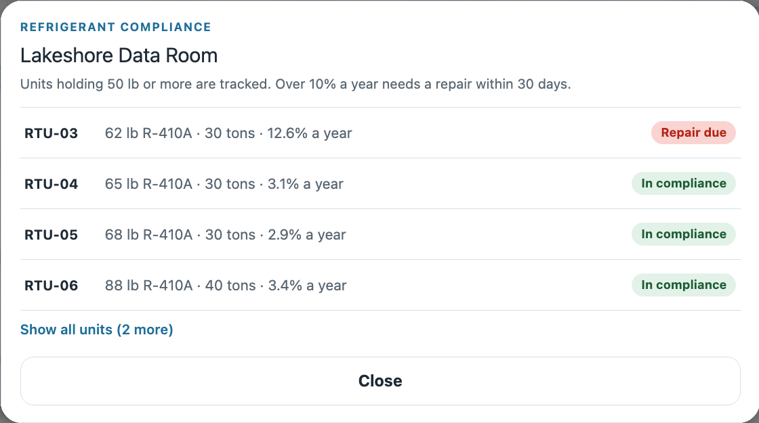
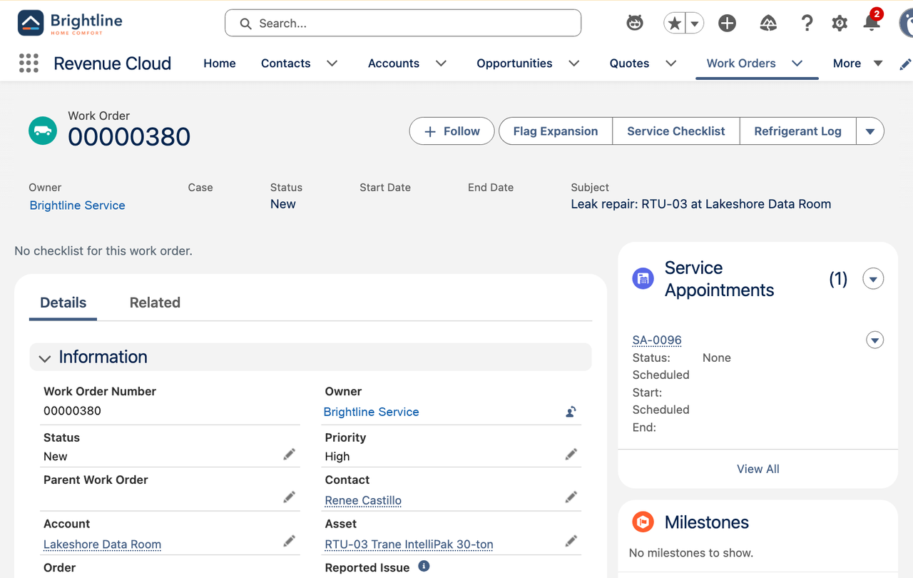
Refrigerant compliance
SCENE 6 · SERVE
LIVE
Technician · Field Service Mobile + refrigerant log
WHAT THE AUDIENCE SEES
On the data room's maintenance visit, Refrigerant Log lists each tracked unit's charge and leak rate
RTU-03 (62 lb R-410A) is at 7.9% after an add 140 days ago
The technician logs 3 lb: 3 / 62 × 365 / 140 = 12.6%, over the 10% limit
The unit turns Repair due with a 30-day deadline, and a leak repair work order opens at the site
Completing the repair puts the unit back In Compliance
HOW IT FLOWS
1
Open the data room visit → Refrigerant Log
THE MOMENT
2
Log 3 lb added to RTU-03
The EPA math is done on the roof, and the repair is booked before the technician leaves.
3
Leak rate 12.6%: Repair due in 30 days
4
Show the leak repair work order
Notes:
On the data room's quarterly visit, the technician opens Refrigerant Log (a work order action that also runs in the Field Service mobile app). It lists the site's tracked units with their charge, the last add and the annualized leak rate.
RTU-03 holds 62 lb of R-410A and is at 7.9% after an add 140 days ago. The technician logs 3 lb: 3 / 62 × 365 / 140 = 12.6%, over the 10% limit for comfort cooling.
The unit turns Repair due with a 30-day deadline, and a Commercial Leak Repair work order opens at the site for RTU-03. Completing the repair puts the unit back In Compliance.
[LIVE] The reset flow reseeds the history and dispatches the visit tomorrow at 9 Central (seed_hvac_refrigerant_leak). Logging 2.5 lb or more crosses the limit.
The demo tracks units holding 50 lb or more, the long-standing EPA Section 608 threshold. The AIM Act rule lowers it to 15 lb for newer refrigerants; say so if the audience knows the rule.
Screenshots: the Refrigerant Log after the 3 lb entry, and the leak repair work order.

Slide 15
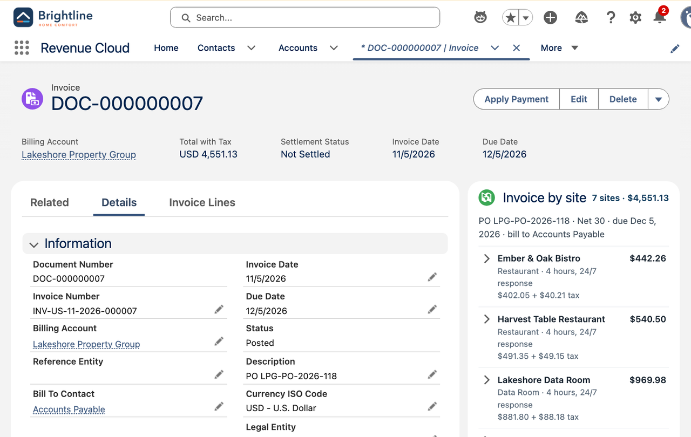
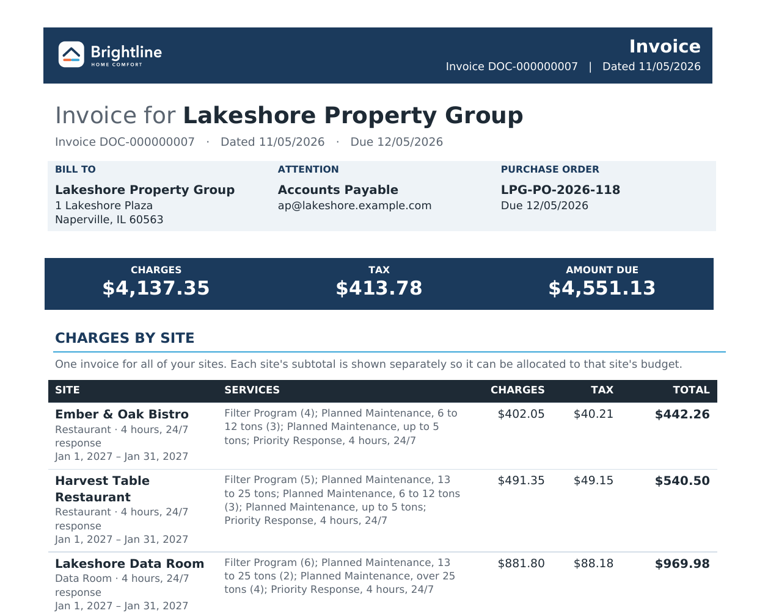
One invoice for every site
SCENE 7 · SERVE
LIVE
✧ EINSTEIN LIVE
Billing · Revenue Cloud Billing + Agentforce
WHAT THE AUDIENCE SEES
The month's invoice goes to HQ: PO, Net 30, bill to Accounts Payable
Invoice by site shows a subtotal per site: $4,137.35 + $413.78 tax = $4,551.13 across seven sites
The consolidated invoice PDF shows the same site table
Einstein answers “Explain the latest Lakeshore invoice by site”: each site's lines, periods and share
HOW IT FLOWS
1
Open the month's invoice to HQ
THE MOMENT
2
Invoice by site: a subtotal per site
Seven buildings, one bill, and every line explained by site.
3
Open the consolidated invoice PDF
4
Ask the billing agent to explain it by site
Notes:
One invoice a month to Lakeshore HQ: the PO, Net 30, bill to Accounts Payable. The Invoice by site card on the invoice groups the lines by the site each asset belongs to.
DOC-000000007: $4,137.35 plus $413.78 tax, $4,551.13 across seven sites (Westfield joined mid-term in Scene 8). The consolidated invoice PDF shows the same site table.
[EINSTEIN] Live: in the Agentforce panel, ask the Brightline Billing Agent "Explain the latest Lakeshore invoice by site". Its action groups the posted lines by site and returns each site's lines, periods and share (Harvest Table is $540.50, 11.9%). For a project invoice it names the milestone. The agent only puts the math in words. Test it in the panel; sf agent preview can't start employee agents.
Screenshots: invoice DOC-000000007 with Invoice by site, and the consolidated invoice PDF.

Slide 16
The account grows by the building
PHASE 4 · GROW & RETAIN
Add buildings mid-term, renew every year, and replace the oldest units as a project
Notes:
Add buildings mid-term, renew every year, and replace the oldest units as a project

Slide 17
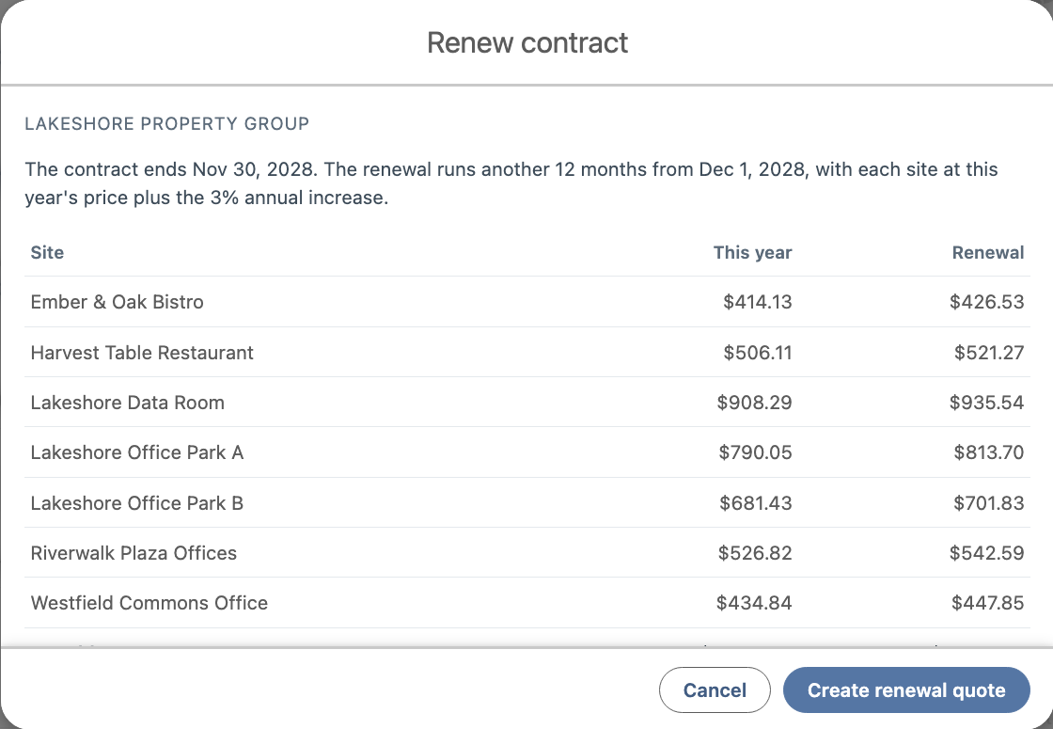
Add a site and renew
SCENE 8 · GROW & RETAIN
LIVE
Account Manager · Revenue Cloud amendment and renewal
WHAT THE AUDIENCE SEES
Lakeshore buys Westfield Commons Office: six more rooftop units
Add Site prices it at the contract's discount, on an amendment co-terminated with the contract
It's prorated from Jan 1, 2027: order 00000165, $4,643.65
Renew Contract previews each site at this year's price plus 3%
The renewal quote covers all seven sites: $51,140.04
HOW IT FLOWS
1
Westfield Commons joins the account
THE MOMENT
2
Add Site: priced at the contract's discount
A new building joins the contract in one step, and the renewal already knows about it.
3
Amendment order, prorated and co-terminated
4
Renew Contract: every site at +3%
Notes:
Lakeshore buys Westfield Commons Office (seed it with seed_hvac_commercial_new_site: a site account, a location and six units).
Add Site on the new site prices its units and response at the contract's discount and adds them on an amendment order co-terminated with the contract, prorated from Jan 1, 2027 (order 00000165, $4,643.65). Its coverage and maintenance plan build the same way as Scene 4. It can be shown once per contract.
Renew Contract previews each site at this year's price plus 3% and creates the renewal quote: 00000083, $51,140.04 for seven sites.
Screenshot: the Renew Contract preview.

Slide 18
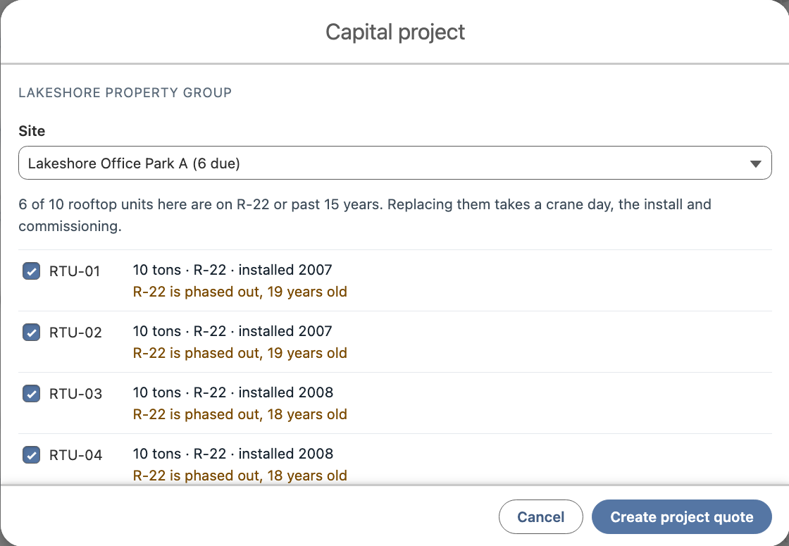
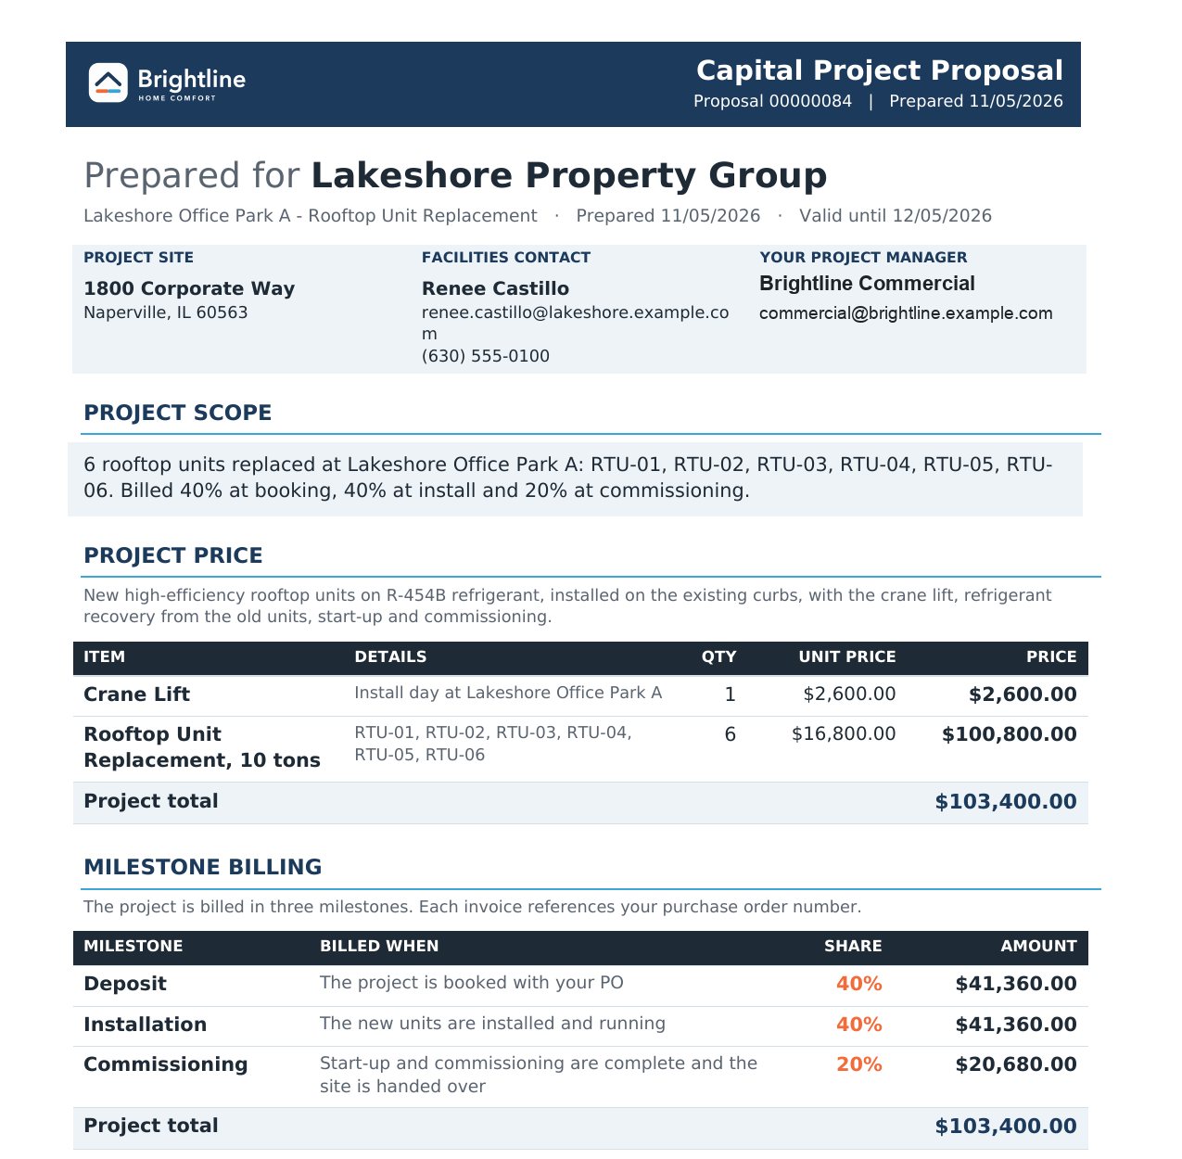
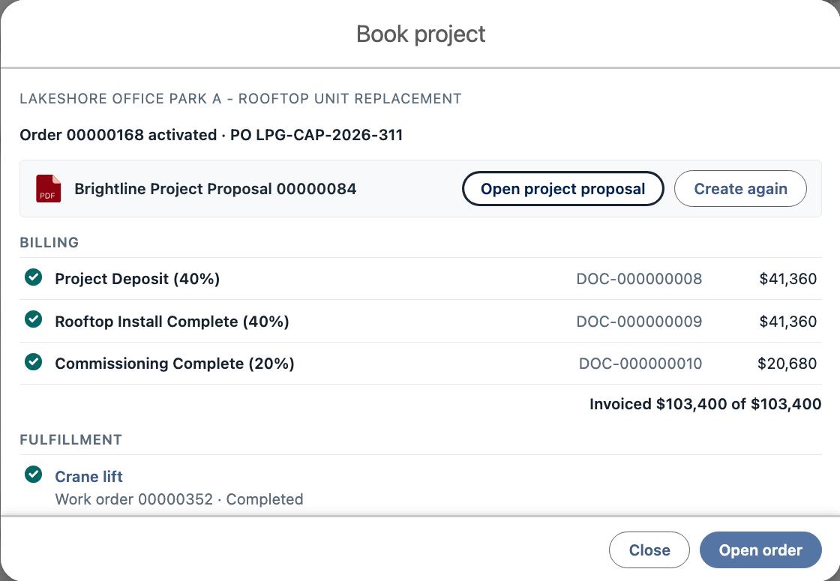
Capital project
SCENE 9 · GROW & RETAIN
LIVE
Account Manager + Operations · Milestone billing
WHAT THE AUDIENCE SEES
Capital Project on Office Park A recommends the six units on R-22 or past 15 years
Six replacements at $16,800 plus a $2,600 crane day: $103,400
Book Project creates the project proposal, takes the PO and bills the 40% deposit ($41,360)
Orchestration creates the crane lift, install and commissioning work orders in turn
The install bills the next 40% and records the new R-454B units; commissioning bills the last 20%
HOW IT FLOWS
1
Capital Project: the units to replace
THE MOMENT
2
Create the project quote
The oldest units become a $103,400 project, billed as the work gets done.
3
Book Project: proposal, PO, deposit
4
Crane, install, commissioning: billed by milestone
Notes:
On Office Park A, Capital Project recommends the units worth replacing: the six on R-22 or more than 15 years old.
Create project quote prices six Rooftop Unit Replacements at $16,800 and a $2,600 crane day: $103,400. Book Project generates the Brightline Project Proposal with the scope and the milestone schedule, takes PO LPG-CAP-2026-311 and bills the 40% deposit ($41,360).
Orchestration creates the crane lift, install and commissioning work orders one after another. Completing the install bills the second 40% and rewrites the six units as new R-454B units; commissioning bills the last 20% ($20,680).
[LIVE] reset_hvac_capital_project (in the reset flow) rejects open project quotes, cancels the project work orders and restores the old units.
Screenshots: the Capital Project preview, the project proposal and the Book Project result (quote 00000084).

Slide 19
What the audience should walk away with
Three outcomes, one for each stage of the portfolio relationship
1
2
3
One contract for the portfolio
Every site on its own clock
Grow with the portfolio
Every site and every unit priced, signed and ordered once.
Site plans build themselves, response times follow the site, refrigerant rules are kept, and HQ gets one invoice.
New buildings join mid-term, renewals price themselves, and old units become projects billed by milestone.
Shown in Scenes 1–3
Shown in Scenes 4–7
Shown in Scenes 8–9
Notes:
Land the three outcomes in the customer's language: one contract for every building, every site served on its own terms with one bill, and an account that grows as the portfolio does.

Slide 20
Run of show and status
Who drives each scene, timing, and what's live in the demo org today
# | Scene | Persona | Min | Package · AI | Status today
1 | Site survey | Account Manager | 1.5 | — | Partly live: seeded hierarchy and units. Vision: on-roof survey capture
2 | Contract quote | Account Manager | 2.5 | — | Live: preview by site, tonnage bands, response tiers, discount with approval, a line group per site
3 | Sign and order | Account Manager + Renee | 2 | — | Live: contract proposal PDF, PO, order activation, assets by site
4 | Site plans build themselves | Operations | 1.5 | ✦ Enhances | Live: coverage and a maintenance plan per site; one quarterly visit per site with a line per unit
5 | Emergency call by site priority | Customer Care + Technician | 1.5 | ✦ Enhances | Live (seeded call): Covered, Critical, 4-hour 24/7 milestone; offices next business day
6 | Refrigerant compliance | Technician | 2 | — | Live: refrigerant log, annualized leak rate, Repair due and a leak repair work order
7 | One invoice for every site | Billing | 2 | ✧ Einstein | Live: PO, Net 30, Invoice by site, consolidated PDF · Einstein: billing agent by site
8 | Add a site and renew | Account Manager | 2 | — | Live: co-terminated, prorated amendment (once per contract); renewal quote at +3%
9 | Capital project | Account Manager + Operations | 3 | — | Live: project quote, proposal, 40 / 40 / 20 milestone billing, crane, install and commissioning work orders
 | Total |  | 18 | Scenes 4–5 ✧ 7 | Live: Scenes 2–9 · Partly live: 1
Notes:
Status as of Nov 5, 2026 in the demo org. Book the contract once (Scenes 2–3), then run cci flow run reset_hvac_commercial_demo before each demo: it restores the sites and units, resets the capital project, reseeds the data room's refrigerant history and books the Harvest Table call. Skill: hvac-demo-seed-visits (Commercial section). Demo guide: docs/guides/hvac-commercial-demo.md.
The billing agent needs agents: true; the documents need docgen: true. The managed package isn't required; Scenes 4–5 show the callouts as what it adds.

