Slide 1
Sales Budget And Planning Process Overview
Phase 1 UAT training deck for planners, merchandisers, and business reviewers

Slide 2
Training Objectives
Understand the planning workspaces and when to use each one
Execute the end-to-end budget and planning cycle in the recommended sequence
Use bottom-up edits, top-down splash, locks, and undo/redo correctly
Import and export the supported workbook formats safely
Understand the core planning rules and current UAT limitations

Slide 3
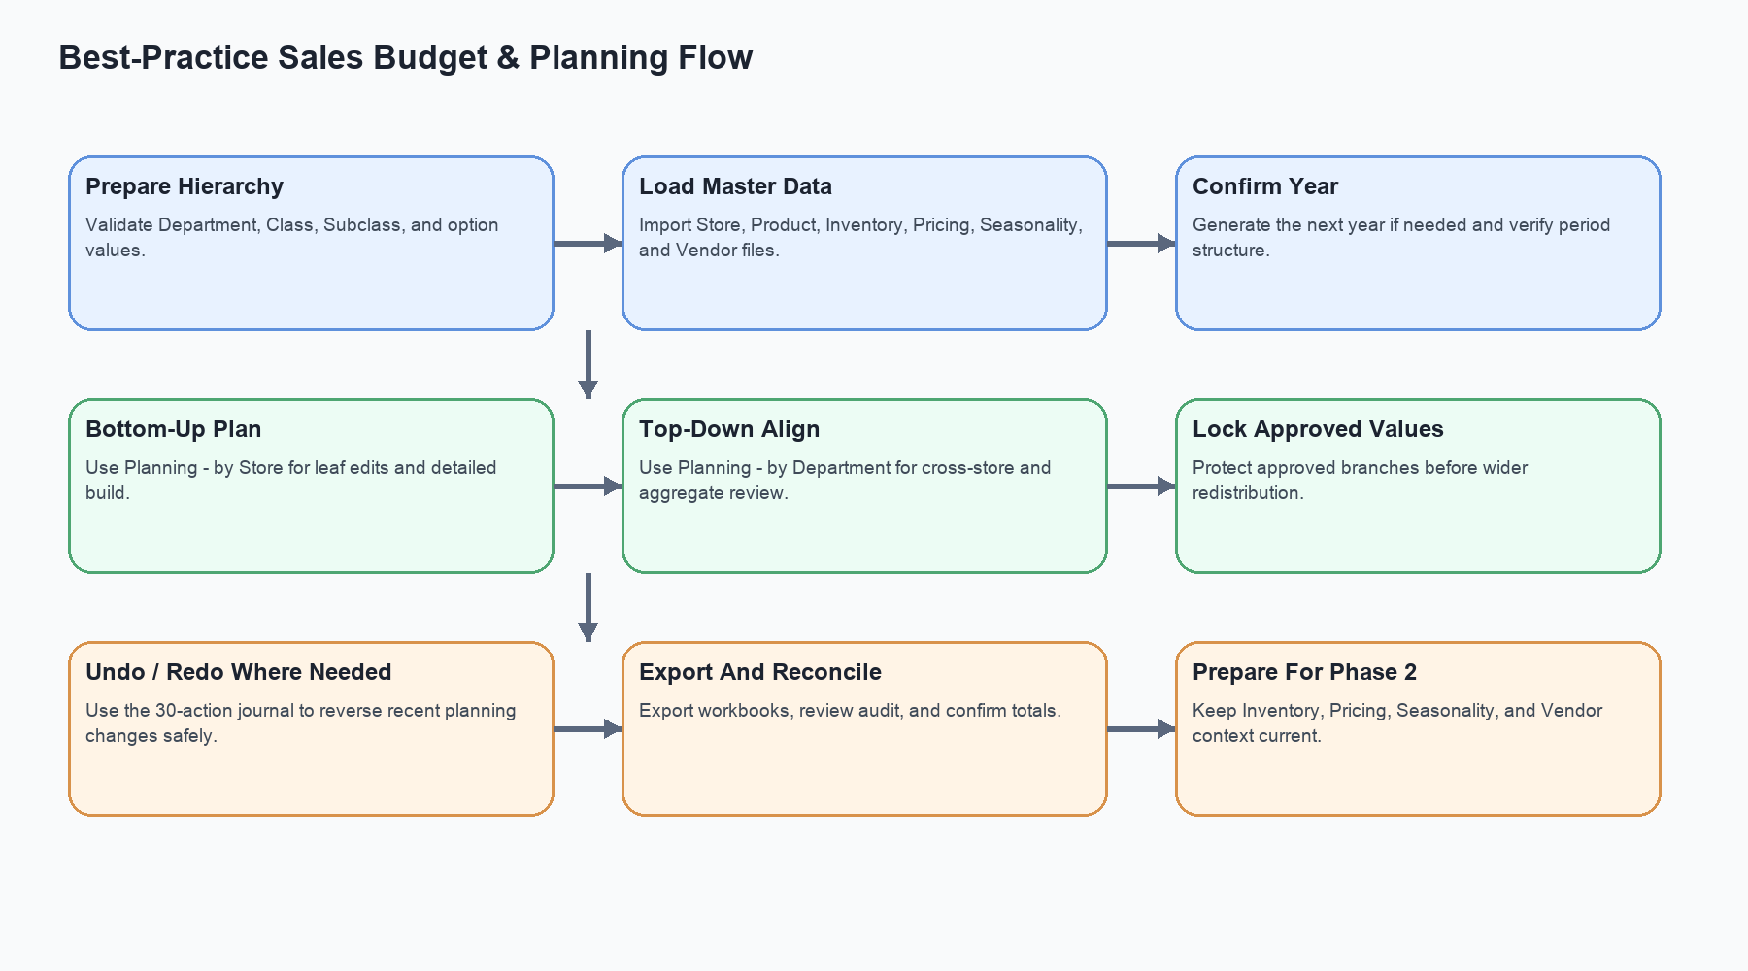
Best-Practice Planning Flow
Recommended end-to-end sequence from hierarchy setup through export and reconciliation.

Slide 4
Application Workspaces
Planning - by Store for detailed bottom-up planning
Planning - by Department for top-down and cross-store review
Hierarchy Maintenance for Department / Class / Subclass control
Store, Product, Inventory, Pricing, Seasonality, and Vendor maintenance workspaces
Compact menu-based toolbar preserves maximum grid space

Slide 5
Bottom-Up And Top-Down Rules
Leaf edits should be performed at the lowest relevant level
Parent totals must always equal the sum of children after recalculation
Splash reallocates aggregate targets to unlocked descendants only
Same-year recalculation applies throughout Phase 1
Undo and redo preserve the planning invariants for up to 30 actions

Slide 6
Supported Workbook Imports And Exports
Branch Profile.xlsx
Product Profile.xlsx
Inventory Profile.xlsx
Pricing Policy.xlsx
Seasonality & Events.xlsx
Vendor Supply Profile.xlsx
Planning workbook import and export

Slide 7
Grid And UI Guidance
Use the workspace selector to switch functions quickly
Keep hierarchies collapsed and expand only the branches being reviewed
Use store view first for detail and department view second for alignment
Use locks before major top-down changes
Export and review after each major planning cycle

Slide 8
Phase 2-Ready Data Foundations
Pricing policy, inventory, seasonality, and vendor data are already in Phase 1 scope
These data foundations will support future price, markdown, and forecasting recommendations
Phase 2 will reuse the current transactional planning model rather than replace it

Slide 9
Current UAT Considerations
Imports and exports are still synchronous in Phase 1
Some performance hardening remains for production
CloudFront-to-ALB HTTPS is pending Route 53 and ACM
Always use the exported templates when preparing workbook imports

