Slide 1
Sales Planning UAT AWS Stack And Transaction Flow
Phase 1 deployed runtime, endpoints, security decisions, and operational considerations

Slide 2
Current Live UAT Stack
CloudFront + WAF for the public web entry point
Static React build on S3
.NET 8 interactive API on ECS Fargate
RDS PostgreSQL in true private subnets
Microsoft Entra sign-in and backend API authorization
Origin-protected ALB behind CloudFront

Slide 3
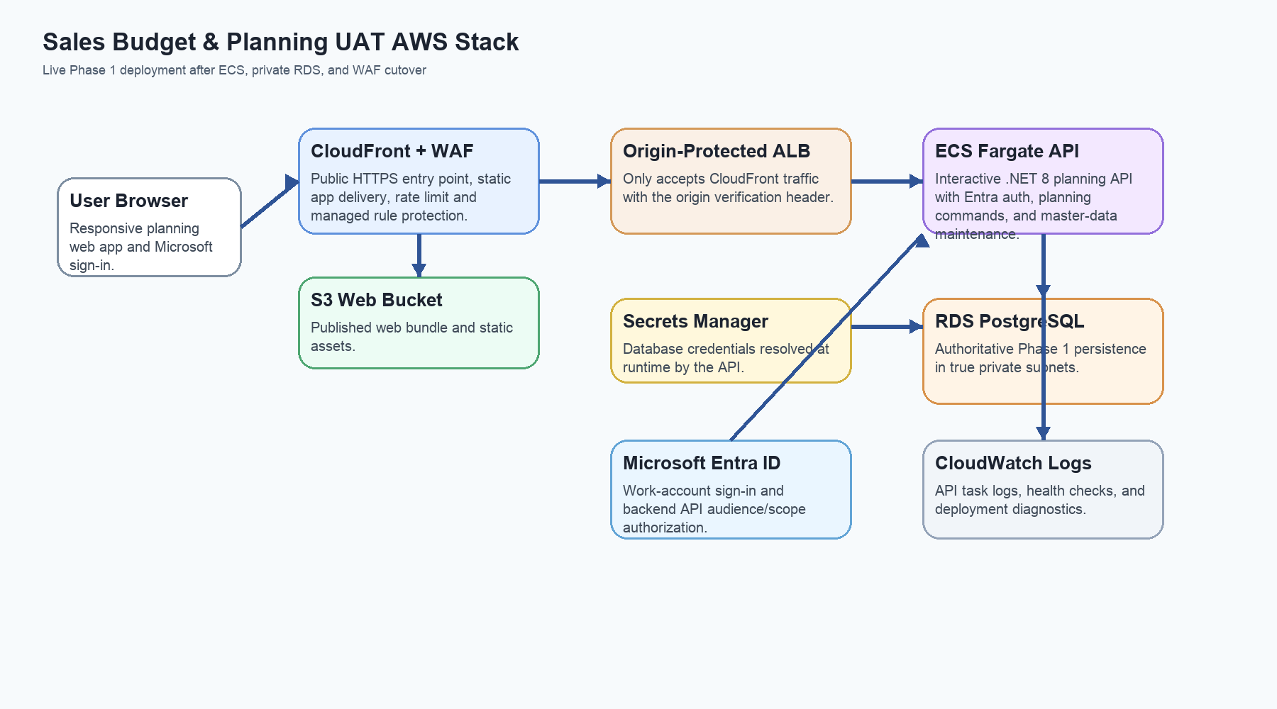
Graphical AWS Stack
Live Phase 1 UAT runtime after the ECS, private RDS, and WAF cutover.

Slide 4
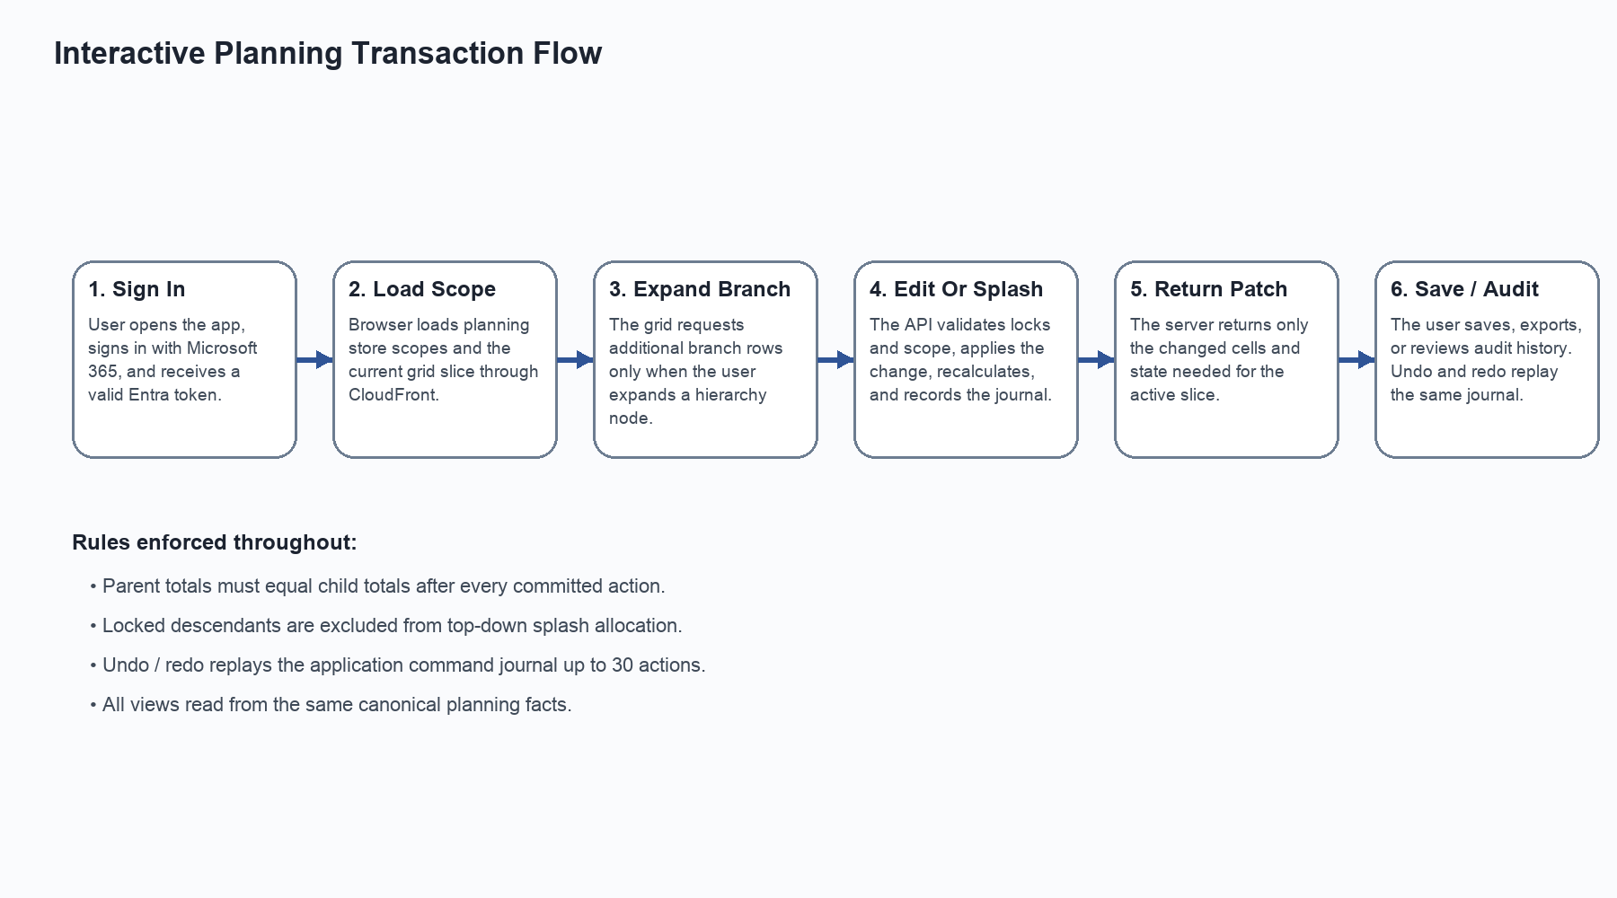
Transaction Flow
Startup, lazy branch loading, command processing, patch return, save, and audit flow.

Slide 5
Key Endpoints
Area | Endpoint / Name | Purpose
Public App | https://d22xc0mfhkv9bk.cloudfront.net | User access entry point
Health | https://d22xc0mfhkv9bk.cloudfront.net/health | Operational smoke check
Public API | /api/v1 | Protected business API path through CloudFront
ECS Service | sales-planning-demo-api | Interactive API workload
ECS Cluster | sales-planning-demo-cluster | Fargate cluster
Active DB | sales-planning-demo-pg-private | Private PostgreSQL instance

Slide 6
Security And Design Decisions
WAF attached at CloudFront with managed rule groups and rate limiting
ALB accepts traffic only from CloudFront and only when the secret origin header is present
Database is not publicly accessible and runs in the dedicated private DB subnet group
ECS uses Secrets Manager for DB credentials
CloudFront-to-ALB HTTPS is deferred until Route 53 and ACM are available

Slide 7
Current Limitations And Recommendations
Grid still uses the client-side row model rather than AG Grid SSRM
Workbook import and export are still synchronous
CloudFront-to-ALB origin traffic is still HTTP
Rollback DB should be deleted after UAT acceptance
Next priority: delta recalculation, SSRM, async jobs, and ALB HTTPS

